Slide 1


Audio-Text Cross Modal Generation
Wenwu Wang
Centre for Vision, Speech and Signal Processing (CVSSP)
& Institute for People Centred Artificial Intelligence
University of Surrey
United Kingdom
Email: w.wang@surrey.ac.uk
Web: http://personal.ee.surrey.ac.uk/Personal/W.Wang/
Perspective Talk on ICASSP 2023, 6 June, Rhodes, Greece

Slide 2



Many thanks to…
Xinhao Mei
Haohe Liu
Xubo Liu
Zehua Chen
Qiuqiang Kong
Mark Plumbley
Danilo Mandic
Yi Yuan
Jianyuan Sun
Jian Guan
Feiyang Xiao
Yong Xu
Yin Cao
Turab Iqbal
Yuxuan Wang
Volkan Kilic
Qiaoxi Zhu
Philip Jackson
Qiang Huang
David Frohlich
Emily Corrigan-Kavanagh
Marc Green
Andres Fernandes
Christian Kroos
Arshdeep Singh
Funding from:
UK Engineering and Physical Sciences Research Council (EPSRC) & British Council Newton Institutional Links Award

Slide 3
Outline
Audio-to-Text
Problem description and existing methods
Several open problems & our methods
Text-to-Audio
Problem description and existing methods
Our method AudioLDM & sound demos
Perspectives on Audio-Language Learning
Conclusion & Future Work
Sound Recognition

Slide 4
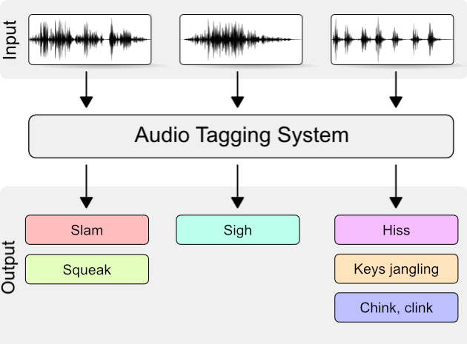
Sound Recognition
Scene Classification Audio Tagging Sound Event Detection
Applications:
Security (glass break, smoke alarms) Assisted living (human activity)
Medical sounds (heart, lung) Environmental (birds, insects, noise)
Traffic (autonomous driving) Multimedia (video+sound search)

Slide 5
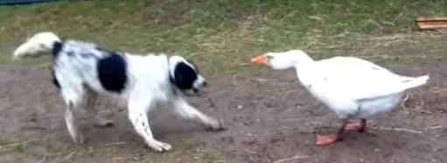
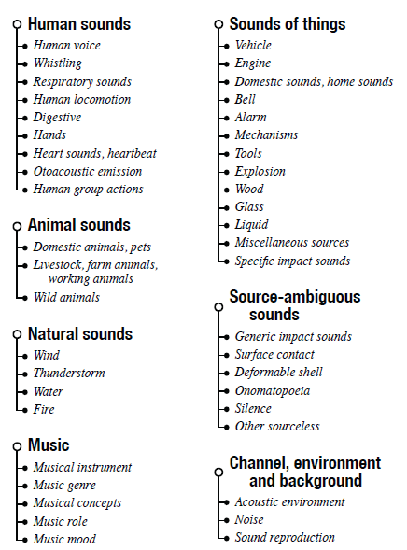

AudioSet (Google) (2017)
Top-level Categories
[Gemmeke, et al. ICASSP2017]
From Google YouTube videos:
2.1 million x 10-sec segments
Labelled from 632 audio event categories (hierarchical tags)
Multiple labels (average 2.7 per clip)
Maximum depth: 6
Example:
Sound of things -> Vehicle
-> Motor vehicle -> Emergency vehicle
-> Siren -> Ambulance siren

Slide 6

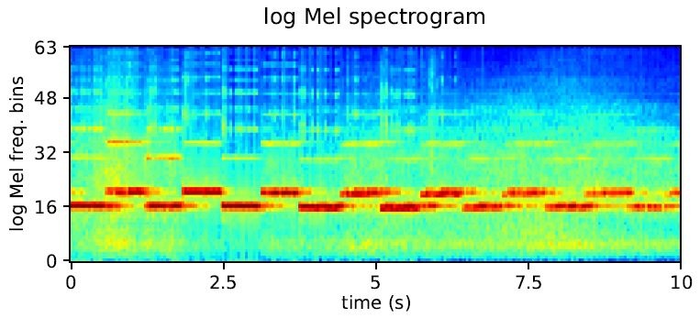
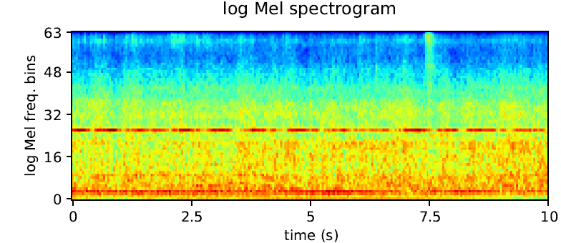
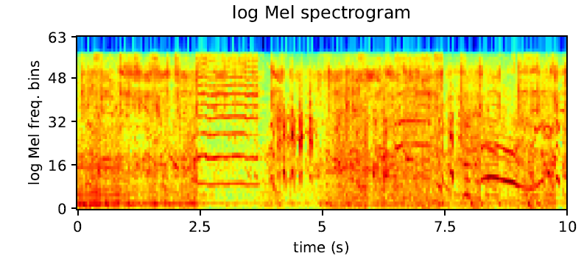
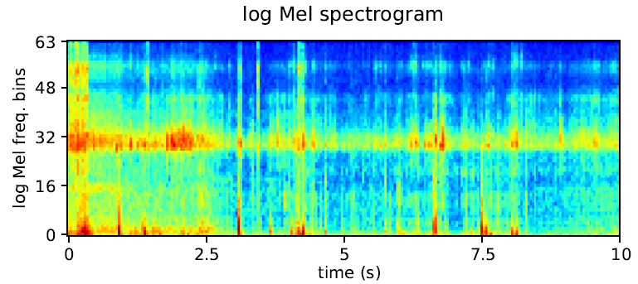
Audio Tagging with Weakly Labelled Data
Ambulance (siren)
Reverse beep
Air horn, truck horn
Bicycle
Frequency
Time
Notes:
Air horn, truck horn: Y-8baTnilyjs_30.000_40.000.wav
Reverse beep: Y-6qSMlbJJ58_30.000_40.000.wav
Ambulance (siren): Y-4F1TX-T6T4_30.000_40.000.wav
Bicycle: Y-oAw5iTeT1g_40.000_50.000.wav

Slide 7
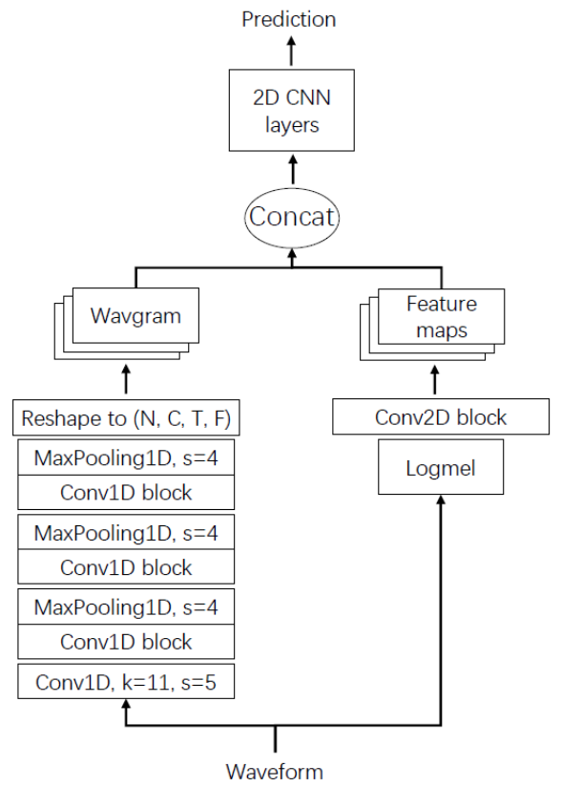
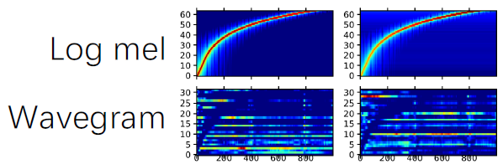
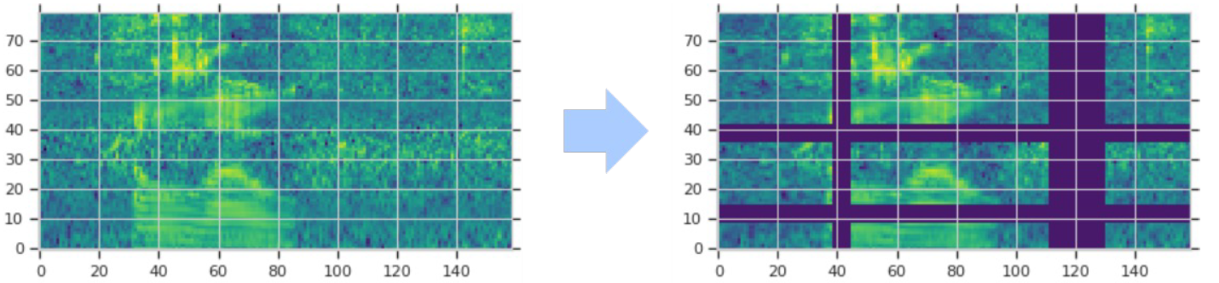
PANNs: Large-Scale Pre-trained Audio Neural Networks
Wavegram-Logmel-CNN for AudioSet tagging
Time-domain (“Wavegram”), plus
Log mel spectrogram
Data augmentation, e.g. use SpecAugment:
randomly mask time and frequency stripes of log mel spectrogram
Q. Kong, Y. Cao, T. Iqbal, Y. Wang, W. Wang, and M. D. Plumbley, "PANNs: large-scale pretrained audio neural networks for audio pattern recognition", IEEE/ACM Transactions on Audio Speech and Language Processing, 2020.

Slide 8
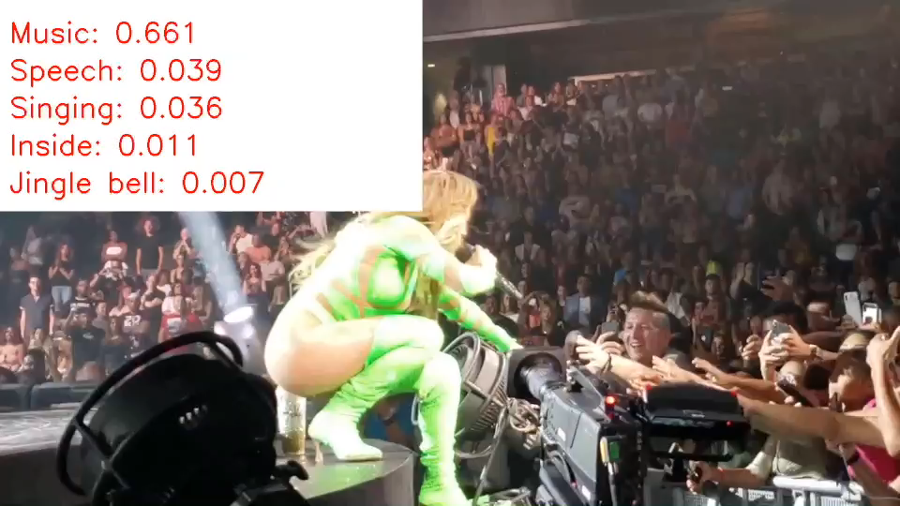
PANNs: Demo

Slide 9
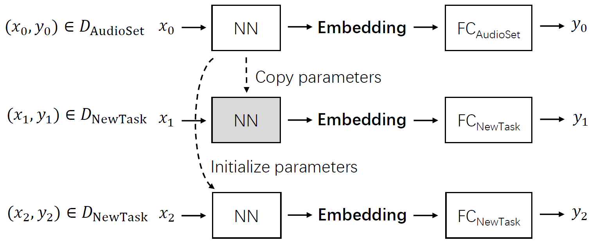
Impact of PANNs
Transfer to other datasets, e.g.:
ESC-50 (sound events),
GTZAN dataset (music)
RAVDESS (human speech emotion)
Impact of PANNs
Most cited article in IEEE/ACM Trans ASLP since 2020.
IEEE SPS Young Author Best Paper Award (Kong, Iqbal) 2022.
Baseline for e.g. HEAR challenge 2021, DCASE challenge 2021, 2022.
Backbone of winner in DCASE 2021 & 2022 audio caption task.

Slide 10
Recent Developments: General Purpose Audio Representation Learning
Audio2Vec (Tagliasacchi et al, 2020)
CLAR (Al-Tahan and Mohsenzadeh, 2021)
COLA (Saeed et al, 2021)
BOYL-A (Niizumi et al, 2021)
AST (Gong et al, 2021)
ATST (Li and Li, 2022)
MAE-AST (Baade et al, 2022)
SSAST (Gong et al, 2022)
Audio-MAE (Huang et al, 2022)
BEATs (Chen et al, 2022)
ASiT (Atito et al, 2023)
mean Average Precision (mAP): 31.4 (2017) -> 50.6 (2022)

Slide 11

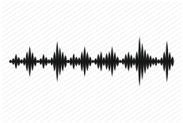
Audio to Text Generation
Automated audio captioning (AAC) is a cross-modal translation task which aims at generating a natural language description given an audio clip.
This task requires detecting the audio events and their spatial-temporal relationships and describing these information using natural language.
Applications
  Audio retrieval
  Assist hearing-impared to understand environmental sounds
  Subtitle for sounds in TV programs
AAC started in 2017, and has received increasing attention in recent three years with freely available datasets released and being held as a task in DCASE Challenges 2020-2022.
AAC system
“a woman talks nearby as water pours”

Slide 12
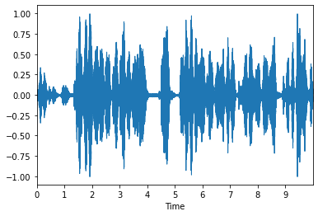
Existing Methods
Model Architecture
  All proposed methods are based on the encoder-decoder paradigm ultilizing deep learning techniques
    RNN-RNN (2017)
    CNN-RNN (2019)
    CRNN-RNN(2020)
    CNN-Transformer(2020)
    Transformer-Transformer(2021)
    Pre-trained models (2021)
    Large language models (2022 & 2023)
    Contrastive language-audio pretraining (2022 & 2023)
Training
  Cross-entropy training with maximum likelihood estimation
  Reinforcement learning
Auxiliary Information
  Keywords or tag information
  Sentence information
  Pre-trained models
  Data augmentations
Audio Signal
Encoder
Audio Features
Decoder
“a woman talks near by as water pours”
Generated Caption
X. Mei, X. Liu, M.D. Plumbley, and W. Wang, “Automated audio captioning: an overview of recent progress and new challenges," EURASIP Journal on Audio Speech and Music Processing, 2022.

Slide 13
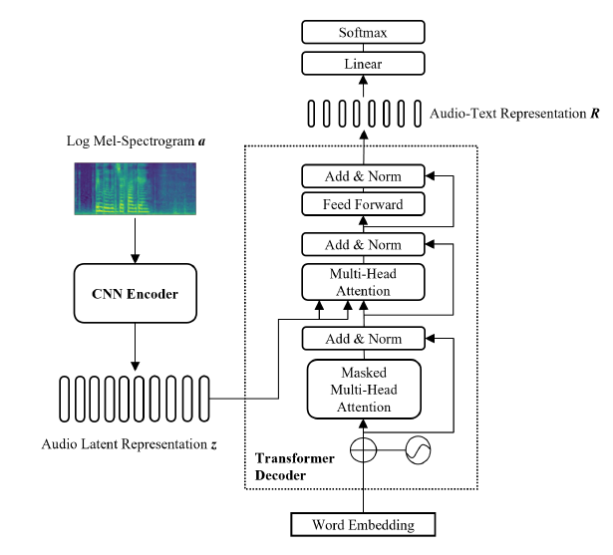
An Example: CNN-Transformer Encoder-Decoder

Slide 14
Datasets
  Clotho: an audio captioning dataset whose audio clips are all collected from the Freesound archive, each audio clip has 5 reference captions and is between 15-30 seconds long. There are in total 3839, 1045 and 1045 audio clips in training, validation and evaluation sets. Clotho is used as the official ranking dataset in DCASE challenge.
  AudioCaps: the largest audio captioning dataset which contains more than 50k 10-second audio clips sourced from AudioSet. Training set contains 49274 audio clips with one reference caption, validation and test sets contain 494 and 957 audio clips respectively with 5 reference captions.
  MACS: consists audio clips from the development set of TAU UrbanAcoustic Scenes 2019 dataset. The audio clips are all 10-second long recorded from three acoustic scenes (airport, public square and park) and are annotated by students. MACS contains 3930 audio clips without being split into subsets. The number of captions per audio clip varies in the dataset.
  AudioCaption: a domain-specific Mandarin-annotated audio captioning dataset. Two scene-specific sets has been published: one for hospital scene and another for in-car scene.

Slide 15
Performance Metrics
Metrics
  As a text generation problem, most metrics are directly borrowed from NLP tasks such as Machine Translation, Summarization. These metrics are all based on n-gram or sub-sequence matches.
    BLEU: calculated as a weighted geometric mean of modified precision of n-grams.
    METEOR: measures a harmonic mean of precision and recall based on word level matches between the candidate sentence and references
    ROUGE: calculated as F-measures based on the longest common subsequence.
  Metrics borrowed from Image Captioning
    CIDEr: applies term frequency inverse document frequency (TF-IDF) weights to n-grams and calculates the cosine similarity between them.
    SPICE: transforms captions into scene graphs and calculates F-score based on tuples in them.
    SPIDEr: a linear combination of CIDEr and SPICE, where SPICE score ensures captions are semantically faithful to the audio clip, while CIDEr score ensures captions are syntactically fluent.
  Other metrics
    BERTScore, sentenceBERT, and FENSE, mBLEU, div-n, etc.
X. Mei, Q. Huang, X. Liu, G. Chen, J. Wu, Y. Wu, J. Zhao, S. Li, T. Ko, H.L. Tang, X. Shao, M.D. Plumbley, and W. Wang, "An encoder-decoder based audio captioning system with transfer and reinforcement learning", in Proceedings of the Detection and Classification of Acoustic Scenes and Events 2021 Workshop (DCASE 2021).
X. Mei, X. Liu, M.D. Plumbley, and W. Wang, “Automated audio captioning: an overview of recent progress and new challenges", EURASIP Journal on Audio Speech and Music Processing, 2022.

Slide 16
Several Open Problems
Data scarcity
Representations of audio, text and joint audio-text
Diversity of captions
Large language models + audio models
Interactions with other modalities (e.g. vision)
….

Slide 17
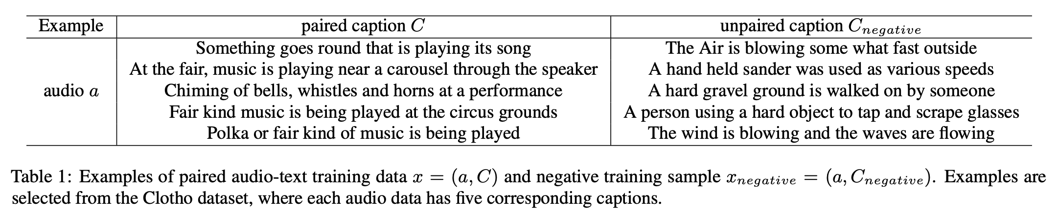
CL4AC - Contrastive Learning for Audio Captioning
Contrastive Loss (CL) objective is designed to maximize the difference between the representation of the matched audio-caption pair and those from the negative pairs

Slide 18


CL4AC: System Architecture
Baseline system – CNN (PANNs) encoder and Transformer decoder
Use the last vector in the audio-text representation to predict whether the input audio and caption are paired (y=0) or not (y=1)
Training objective: Loss_{training} = (1 - y) Loss_{CE} + Loss_{CL}
X. Liu, Q. Huang, X. Mei, T. Ko, H. Tang, M.D. Plumbley, and W. Wang, "CL4AC: A Contrastive Loss for Audio Captioning", in Proceedings of the Detection and Classification of Acoustic Scenes and Events 2021 Workshop (DCASE 2021).

Slide 19
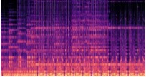
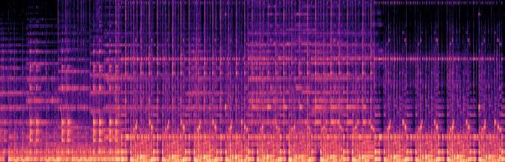


Audio Captioning Transformer
Motivation
  CNN encoders can be limited at modeling temporal information for time series signals (audio)
  RNN encoders can be limited at modeling long-range dependencies between time frames
  Transformer shows powerful ability at modeling sequence data in NLP tasks
We propose Audio Captioning Transformer (ACT), a full Transformer network to overcome the problems in existing methods.
ACT encoder has a better ability to model the global information within an audio signal as well as capture temporal relationships between audio events.
ACT encoder follows the settings in ViT containing 12 encoder blocks and 12 heads with an embedding dimension of 768.
We perform experiments with 3 different decoder settings (# of layers, heads).
Audio Features
a woman talks nearby as water pours <eos>
Feed Forward
Linear & Softmax
Layer Norm
Layer Norm
$$N_{e}×$$
Multi-Head Attention
Feed Forward
Layer Norm
Layer Norm
$$N_{d}×$$
Multi-Head Attention
: CLS Token
Positional embedding
*
*
Layer Norm
Linear projection of flatten patches
…
Masked
Multi-Head Attention
Non-overlapping Mel-Spectrogram patches
Positional embedding
Log Mel-Spectrogram
Word Embedding Layer
<sos> a woman talks nearby as water pours

Slide 20
Diverse Audio Captioning
Motivation
  Existing models tend to generate deterministic (i.e. generating a fixed caption for a given audio clip), generic (i.e. generating same captions for similar audio clips), and simple (i.e. using simple and common words) captions.
  Different people may describe an audio clip from different aspects using distinct words, phrases and grammars.
  We argue that an audio captioning system should have the ability to generate diverse captions for a fixed audio clip and across similar audio clips.
Each audio clip in Clotho dataset has five diverse reference human-annotated captions.
Models trained on Clotho with MLE encourage the use of high frequent n-grams occurred in references, which leads to generic and simple captions.
Examples
 | Ground Truth | CNN-Transformer trained with MLE (Beam search with size 5)
Cap_1 | A drill starts and stops four times with brief stops in between. | a jackhammer is being used to start a stop
Cap_2 | A jackhammer digs into concrete, taking occasional short breaks. | a jackhammer is being used to get a stop
Cap_3 | A jackhammer is being operated on a concrete surface. | a jackhammer is being used to start up and down
Cap_4 | A small jackhammer rattles as it works at another hard object. | a jackhammer is being used to start up
Cap_5 | Outdoors manually operated jack hammer or a tool | a jackhammer is being used to start a halt

Slide 21
Diverse Audio Captioning
Methods
  We propose an adversarial training framework for audio captioning based on a conditional generative adversarial network (C-GAN).
  After training with MLE, the model is trained in an adversarial training manner to encourage diversity.
  This framework is agnostic to the architecture of the caption generator.
  We select CNN-Transformer as our generator.
Language
Evaluator
Generator
probability of human-annotated
0.9
probability of semantic relevant
a man is speaking <eos>
0.7
Sigmoid
Transformer
FC
CNN
Cosine Similarity
CNN
GRU
GRU
GRU
GRU
GRU
GRU
GRU
GRU
Random vector z
Naturalness
Discriminator
<sos> a man is speaking
Semantic
Evaluator
a
man
is
speaking
a
man
is
speaking
X. Mei, X. Liu, J. Sun, M. Plumbley, W. Wang, "Diverse audio captioning via adversarial training", in Proc. IEEE International Conference on Acoustics, Speech and Signal Processing (ICASSP 2022), Singapore, 22-27 May, 2022.
X. Mei, X. Liu, J. Sun, M. Plumbley, W. Wang, “Towards generating diverse audio captioning via adversarial training", arXiv:2212.02033, 2023.

Slide 22
Diverse Audio Captioning
Naturalness discriminator
  ND takes a caption as input and outputs a probability that indicates whether the given caption is human-annotated or machine-generated.
  Generator and ND make up a conditional generative adversarial network (C-GAN) and are trained alternatively to compete with each other.
  The aim of ND is to improve the naturalness of the generated captions.
Semantic evaluator
  SE is pre-trained using ground-truth captions and audio clips and frozen during the adversarial training stage.
  Its aim is to ensure the semantic relevance of the generated caption with the given audio clip.
Language evaluator
  Evaluate CIDEr metrics of generated captions.
  Its aim is to ensure the captions achieve high scores under the objective evaluation metrics.
Final reward:
  The final reward is a combination of these three scores
  r(w) = λ (n + s) + (1 − λ) · c
probability of human-annotated
0.9
Sigmoid
FC
GRU
GRU
GRU
GRU
Naturalness
Discriminator
a
man
is
speaking
probability of semantic relevance
0.7
CNN
Cosine Similarity
GRU
GRU
GRU
GRU
Semantic
Evaluator
a
man
is
speaking

Slide 23
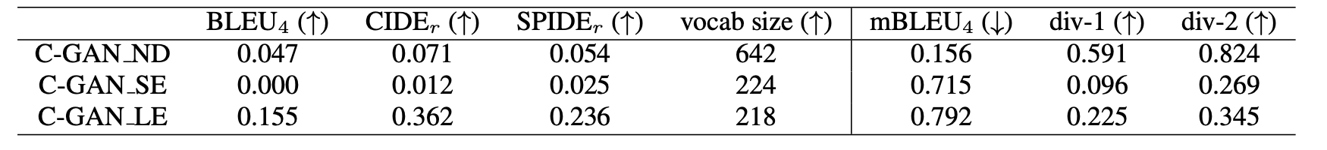
Diverse Audio Captioning
Ablation Study
When only using the naturalness discriminator, the model would generate random captions which are irrelevant to the given audio clip, thus these captions would be diverse but were not semantically faithful to the audio clip.
When only using the semantic evaluator, the system cannot even generate reasonable sentences, but instead some disordered and repetitive words.
When only optimizing CIDEr, the n-gram based evaluation metrics drops slightly, compared to the MLE model, as a random vector is appended to encourage the diversity of generated captions.
Example
 | C-GAN | CNN-Transformer trained with MLE (Beam search with size 5)
Cap_1 | a loud buzzing occurs and then starts again | a jackhammer is being used to start a stop
Cap_2 | a jackhammer is being started and then slows down | a jackhammer is being used to get a stop
Cap_3 | a loud drilling occurs and then slows down | a jackhammer is being used to start up and down
Cap_4 | an old engine is running and then loud squealing | a jackhammer is being used to start up
Cap_5 | a loud drilling occurs and then starts again | a jackhammer is being used to start a halt

Slide 24

Audio Captioning Demos

Slide 25
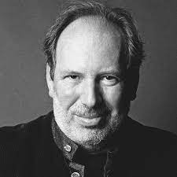
Text to Audio Generation
Computational “foley artist”: (e.g., https://www.thefoleybarn.com )
  Game developer: e.g., A ghost is haunting a house.
  Audio producer: e.g., high heels hitting metal ground.
  Movie producer: e.g., the laser sound from a laser gun.
  …
Automatic content creation (> 60 startups¹)
  Endless music
  Audiobook with ambient noises
  White noise for meditation
  …
Data Augmentations
Sound is often the unsung hero of the movie world
- Hans Zimmer
¹https://github.com/csteinmetz1/ai-audio-startups

Slide 26
Related Works
Label-to-Audio Generation
  Acoustic Scene (Kong et al., 2019), Sound event (Liu et al., 2019), FootStep (Comunit et al. 2019), …
Text-to-Audio Generation
  DiffSound (Yang et al., 2022), AudioGen (Kreuk et al., 2022), Make-an-Audio (Huang et al., 2023)
Text-to-Music Generation
  MusicLM (Andrea et al., 2023)
  Moûsai (Flavio et al., 2023)
  Noise2Music (Huang et al., 2023)
Others
  JukeBox (Dhariwal et al., 2020), AudioLM (Borsos et al., 2022), SingSong (Donahue et al., 2023),…

Slide 27
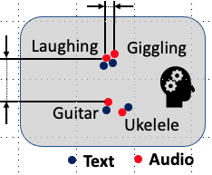
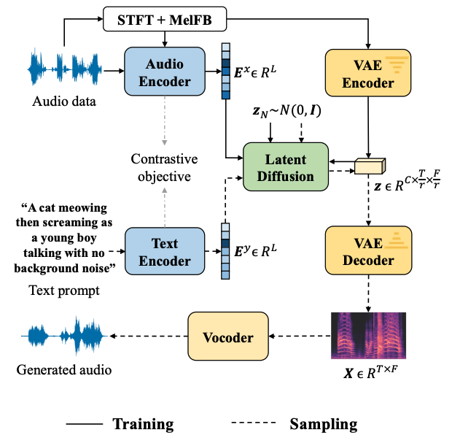

AudioLDM
Self-supervised training
Contrastive Language-Audio Learning (CLAP) Encoders
  Align audio and text in one space.
Latent Diffusion Models
  Learn to generate VAE latent conditioned on CLAP embedding
Mel-spectrogram Autoencoder
  Learn latent representations.
Mel-to-Waveform Vocoder
  Reverse Mel back to waveform
H. Liu, Z. Chen, Y. Yuan, X. Mei, X. Liu, D. Mandic, W. Wang, M. D. Plumbley, "AudioLDM: text-to-audio generation with latent diffusion models," in Proc. IEEE International Conference on Machine Learning (ICML 2023), Hawaii, USA, 23-29 July, 2023.

Slide 28
Overall Advantages
Less computation cost
  Latent Diffusion Models
Less dependency on audio-text pairs
  Train LDMs by self supervision
Continueous latent space
  Zero-shot audio style transfer
  Zero-shot audio super-resolution
  Zero-shot audio inpainting
  …

Slide 29
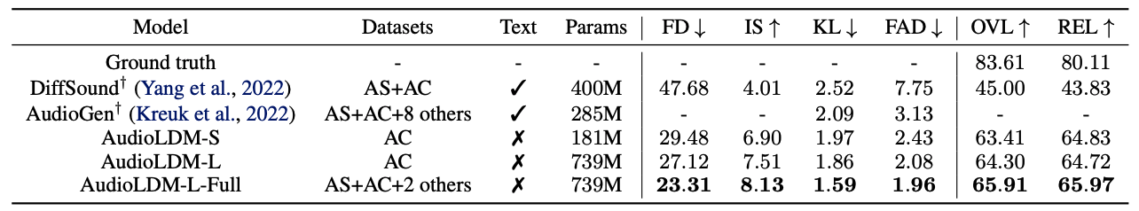
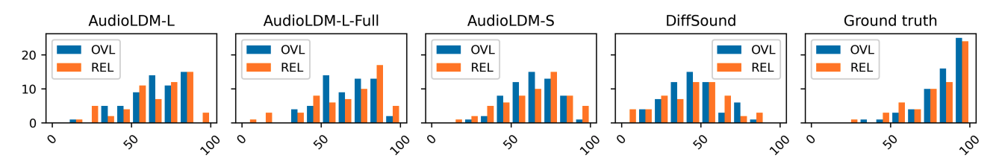
Result – SOTA Comparison
Trained on a single 3090 or A100 GPU!

Slide 30
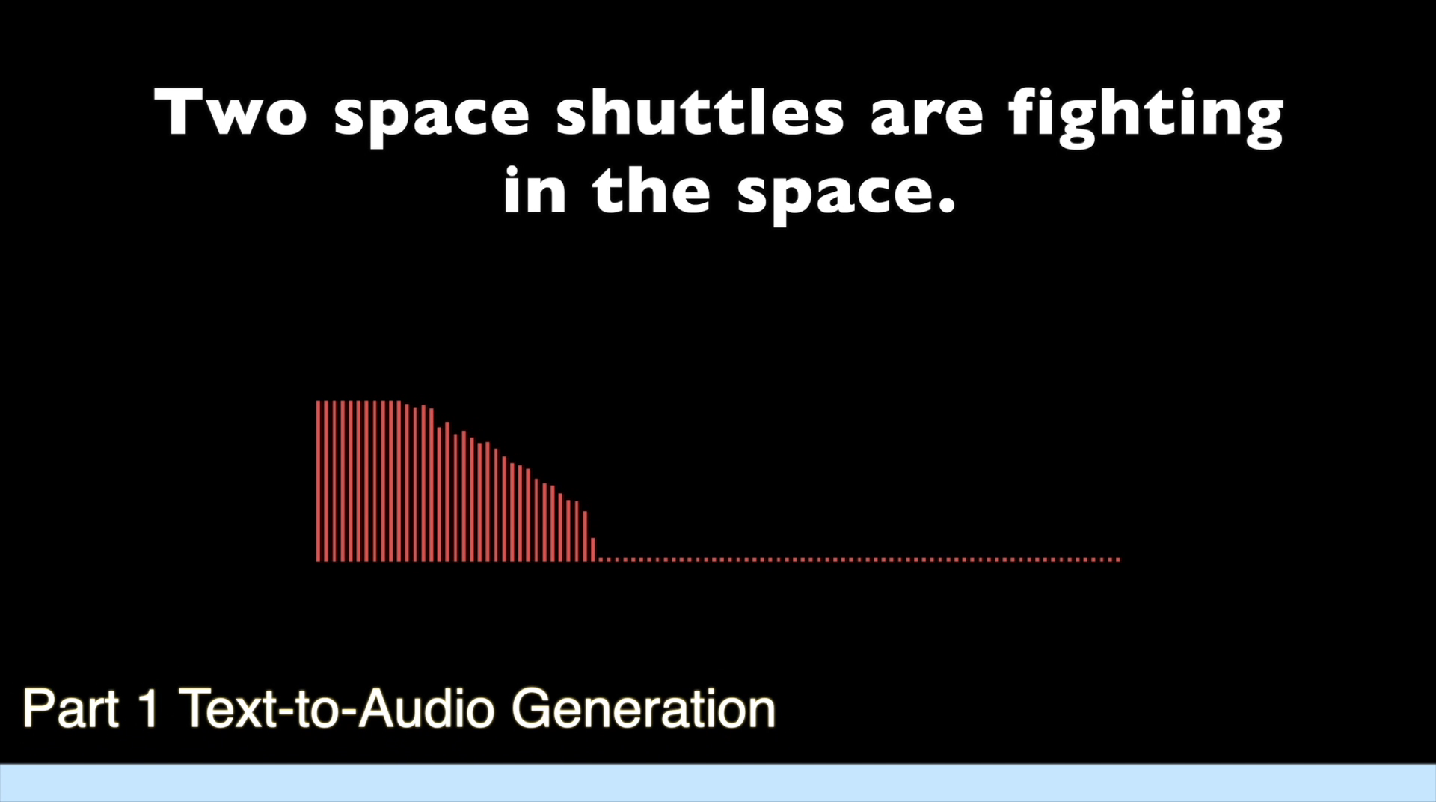
AudioLDM: Demos

Slide 31
Impact of AudioLDM
Accepted by the top machine learning conference ICML 2023
One of the 25 most-liked machine learning apps on Hugging Face Spaces among 25000+ apps
Received more than 1400 stars on Haohe’s Github page.
Widely used by people for creating albums, games, 3D animations
Widely reported and shared on social media & official news channels (Youtube, Twitter, LinkedIn, Note, MarkTechPost, MachineHeart, Reddit, Zenodo, Replicate, University Press release, and many more)
Search “AudioLDM” will pop out more than 10 pages of entries

Slide 32
Perspectives on Audio-Text Learning
Audio models (perception/classification) + language models (reasoning)
  LTU (Gong et al., 2023): AST+LLaMA
Unified models for open-ended and closed ended tasks
  Pingi (Deshmukh et al, 2023): a unified model for audio classification + captioning+ question answering
General representation models towards unlimited modalities
  ONE-PEACE (Wang et al, 2023): vision, audio and language modalities
Other applications: e.g. language-queried audio source separation, retrieval, etc.
  Separate What You Describe (Liu et al, 2022 & 2023), CAPTURE (Okamoto, et al, 2023)

Slide 33
Perspectives on Audio-Text Learning (cont.)
Interactions with large language models (LLMs)
  Interacting with LLMs, e.g. GPT-3, ChatGPT, GPT-4, LaMDA, LLaMa, PaLM, Galactica, using techniques, e.g. LoRA (Hu et al 2021), Frozen (Tsimpoukelli et al, 2021)
  Instruction tuning, e.g. Vicuna (Chiang et al, 2023)
Creating new datasets for audio-language multimodal learning:
  WavCaps (Mei et al, 2023), OpenAQA-5M (Gong et al, 2023)
  Repurposing existing datasets, e.g. AudioSet, Freesound, ESC-50, FSD50K, VGGSound, LAION-Audio-630K, AudioCaps, Clotho, BBC Sound Effects, Sound Bible, ClothoAQA, WavText5K, SoundDescs, FindSound, MACS, CochlScene MOSEI, MELD, Nsynth, FMA, etc.
Other audio/speech/music, & image/video related work:
  CLAP (Elizalde et al, 2022); SpeechLM (Zhang et al, 2022); AudioGPT (Huang et al, 2023), SpeechGPT (Zhang et al, 2023); PandaGPT (Su et al, 2023); Audioclip (Guzhov et al, 2022)
  ImageBind (Girdhar et al, 2023): one embedding space to bind images, text, audio, depth, thermal, and IMU data
  Vision-language models: VisualBERT (Li et al, 2019); SimVLM (Wang et al, 2021); Flamingo (Alayrac et al, 2022)

Slide 34
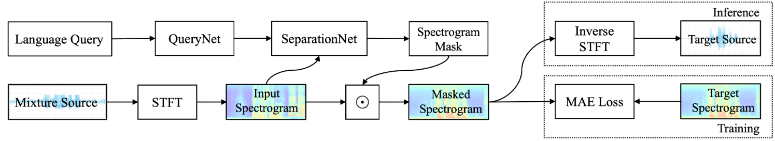
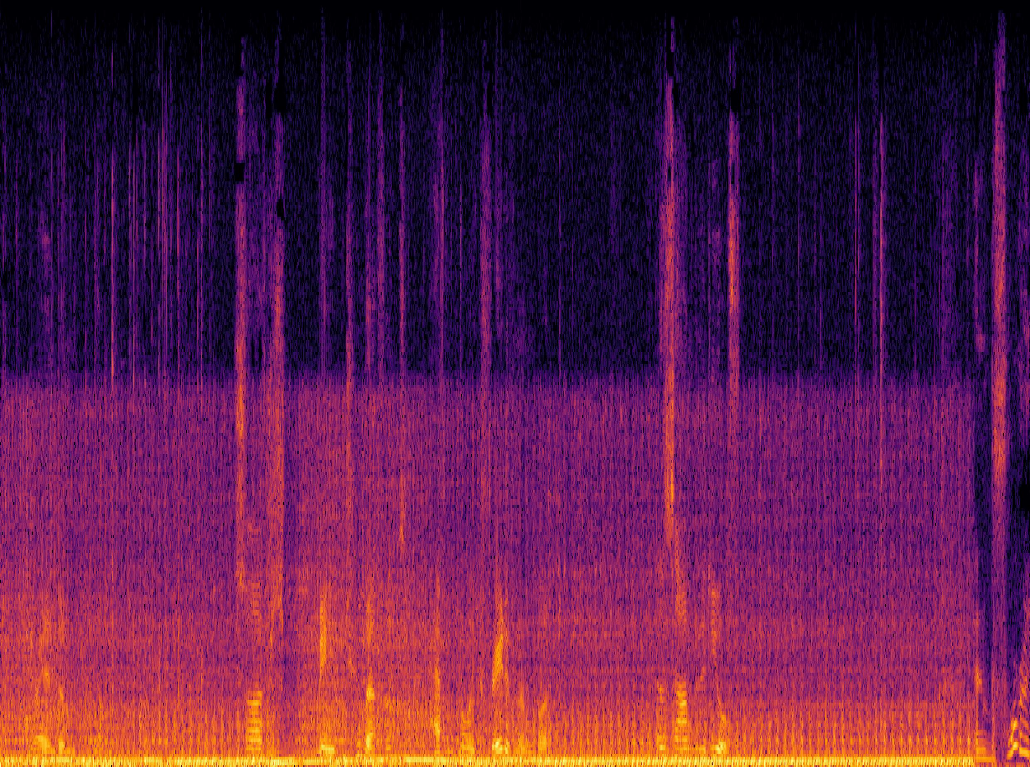
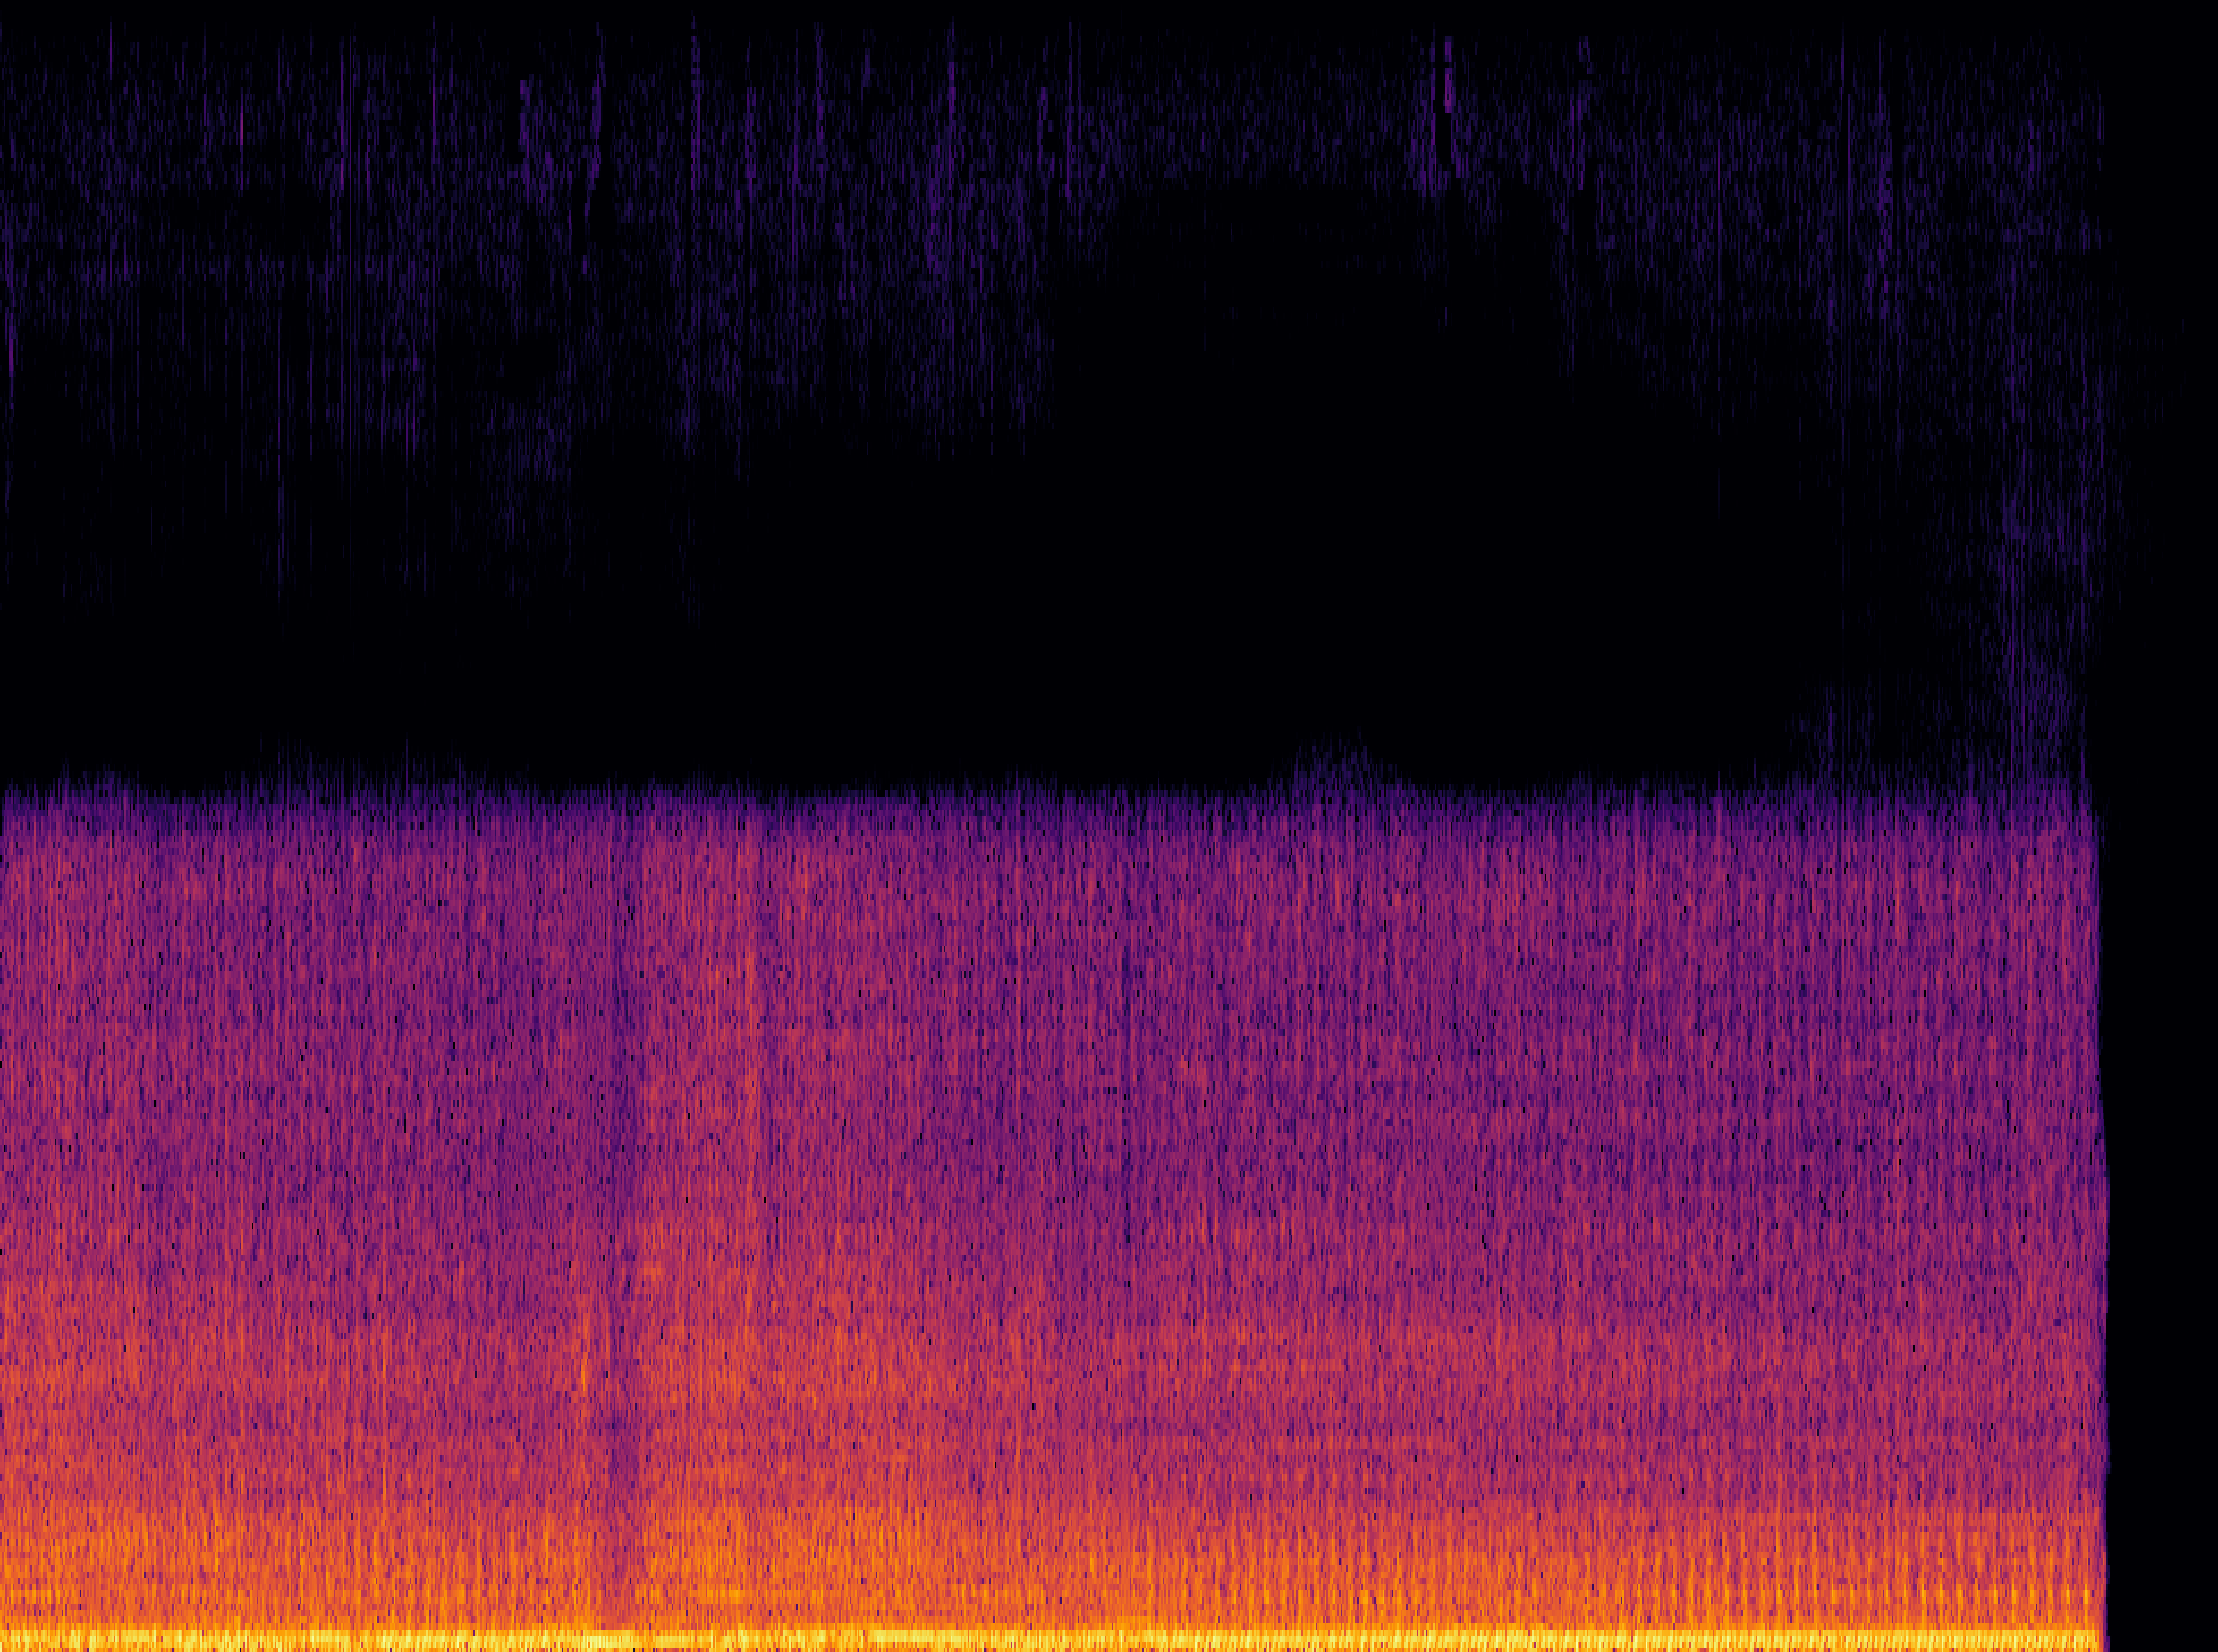
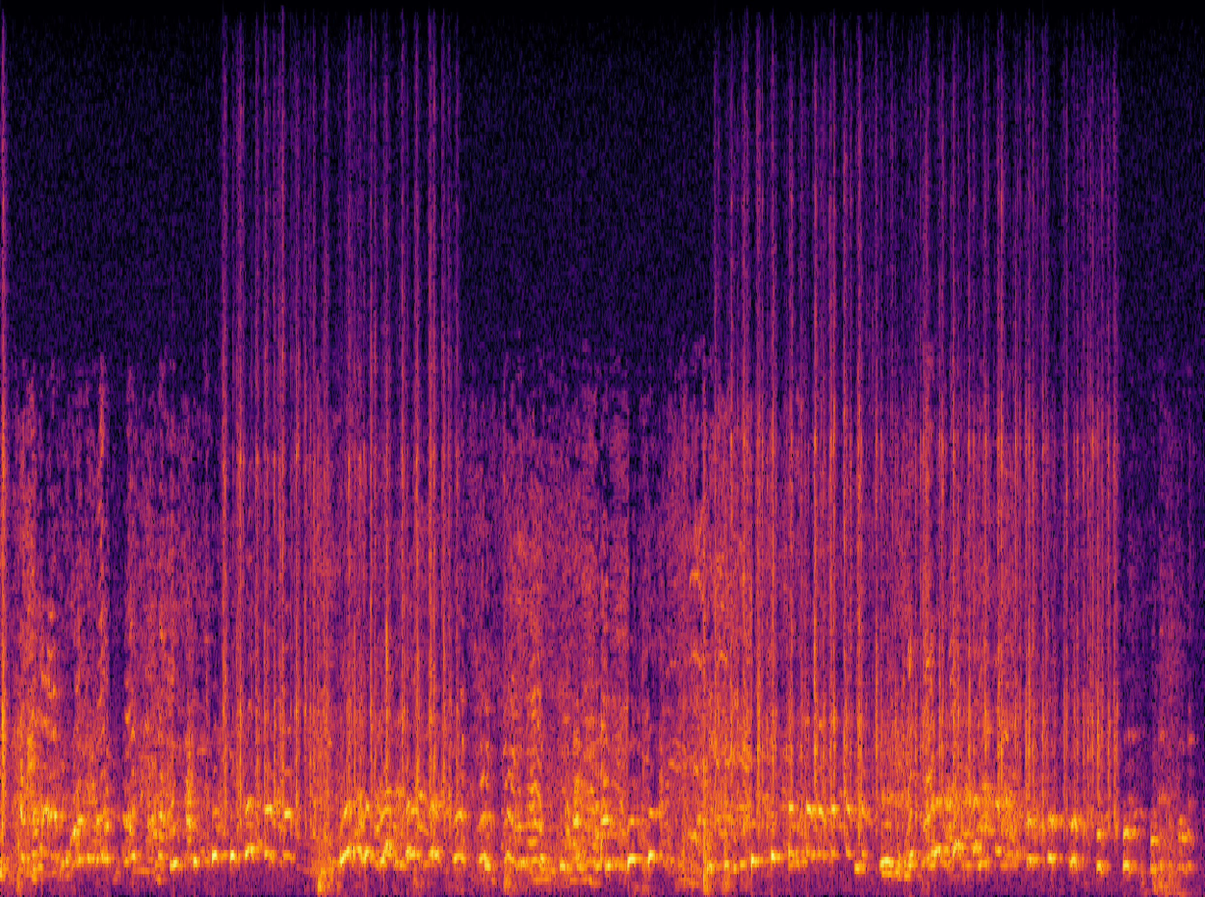
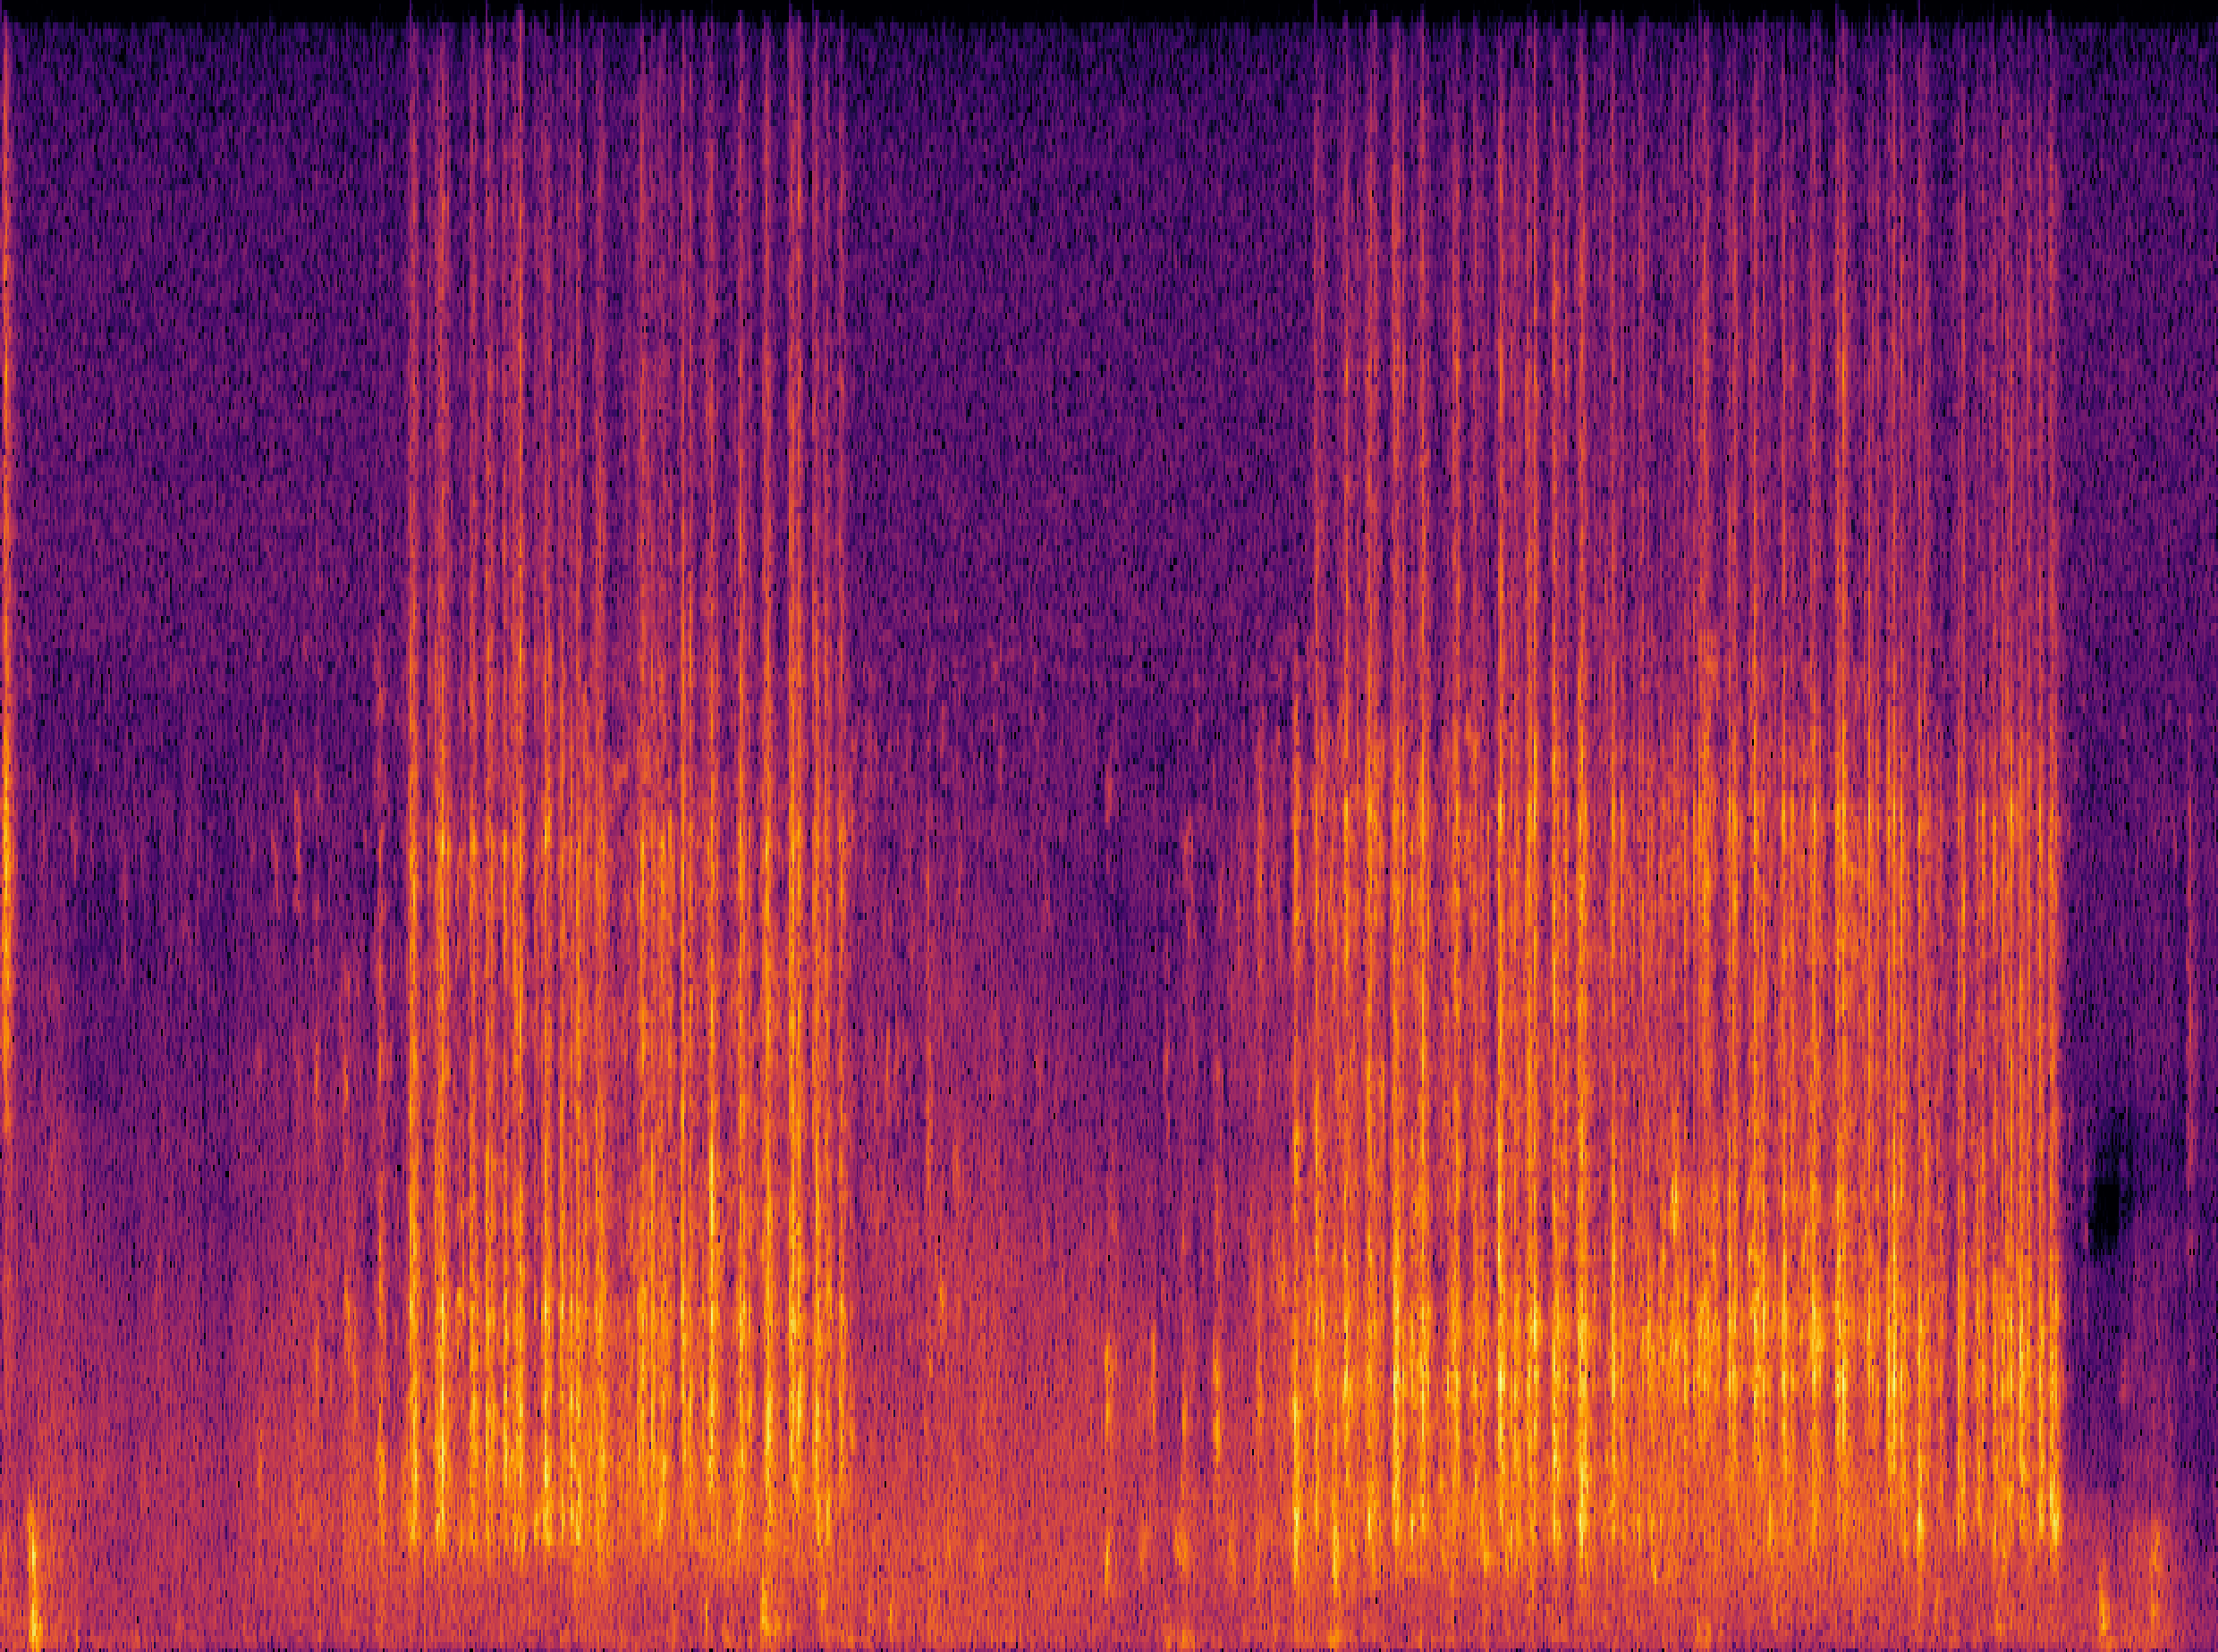
An Example: Language-Queried Audio Source Separation
Use language query to extract target source
BERT-mini
(Transformer-based)
ResUNet-based
separation net
Same shape as
input spectrogram
Mean absolute error for training
Human query: “The engine sound of a vehicle”
Human query: “The sound of hitting the keyboard”
Mix
Separated
Mix
Separated
X. Liu, H. Liu, Q. Kong, X. Mei, J. Zhao, Q. Huang, M.D. Plumbley, and W. Wang,"Separate What You Describe: Language-Queried Audio Source Separation," in Proc. 23rd Interspeech Conference (INTERSPEECH 2022), 18-22 September, 2022, Incheon, Korea.

Slide 35
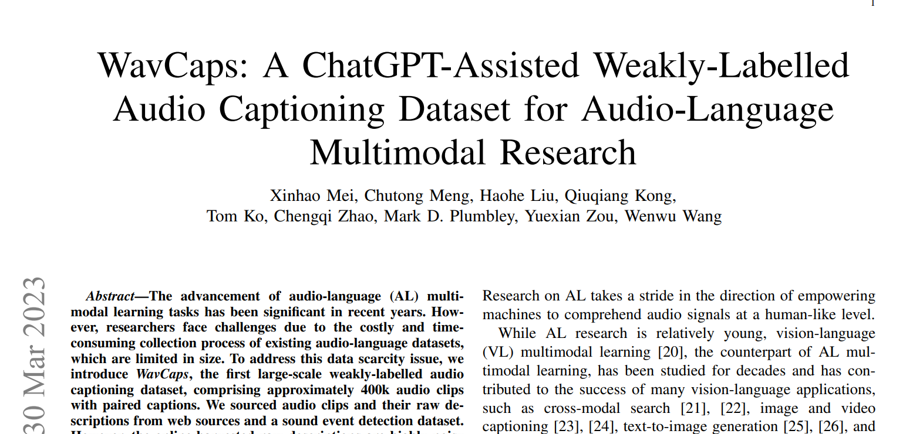
WavCaps
Paper:
https://arxiv.org/abs/2303.17395
Code:
https://github.com/xinhaomei/wavcaps

Slide 36
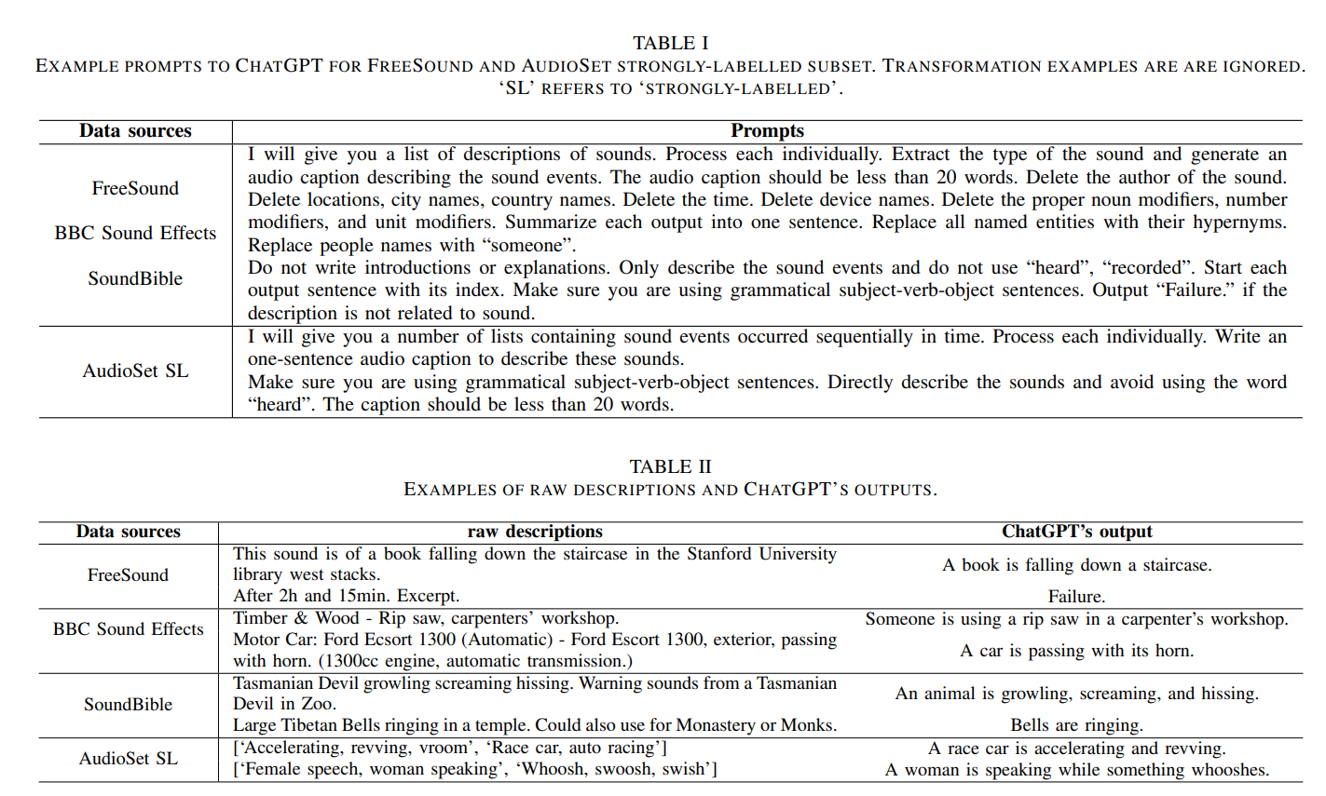
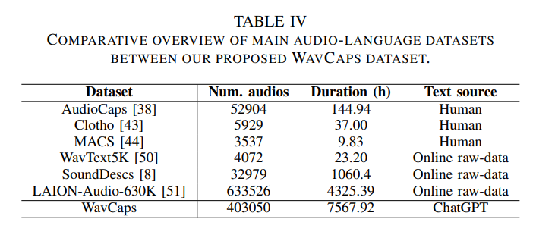
WavCaps

Slide 37
Conclusion & Future Works
Summary
  We have discussed some recent works on audio to text (e.g. diverse audio captioning) and text to audio generation (e.g. AudioLDM)
  Using the proposed adversarial training methods, we can improve the diversity while maintaining the quality of the generated captions
  AudioLDM offers state of the art performance in text-to-audio generation
  We also discussed several perspectives about audio-language learning and some trending works
Future Works
  Further improving captioning performance, e.g. using pre-trained language models
  Improving contrastive language-audio pre-training models
  Improving the diversity and quality of the generated captions
  Link to other applications such as audio retrieval and source separation with language query
  Leveraging concept learning/reasoning with large language models & recognition/perception ability of audio models
  Towards controllable & fine-grained sound generation
  Physics based model + data driven model
  Unified models for audio to text & audio to text generation

Slide 38
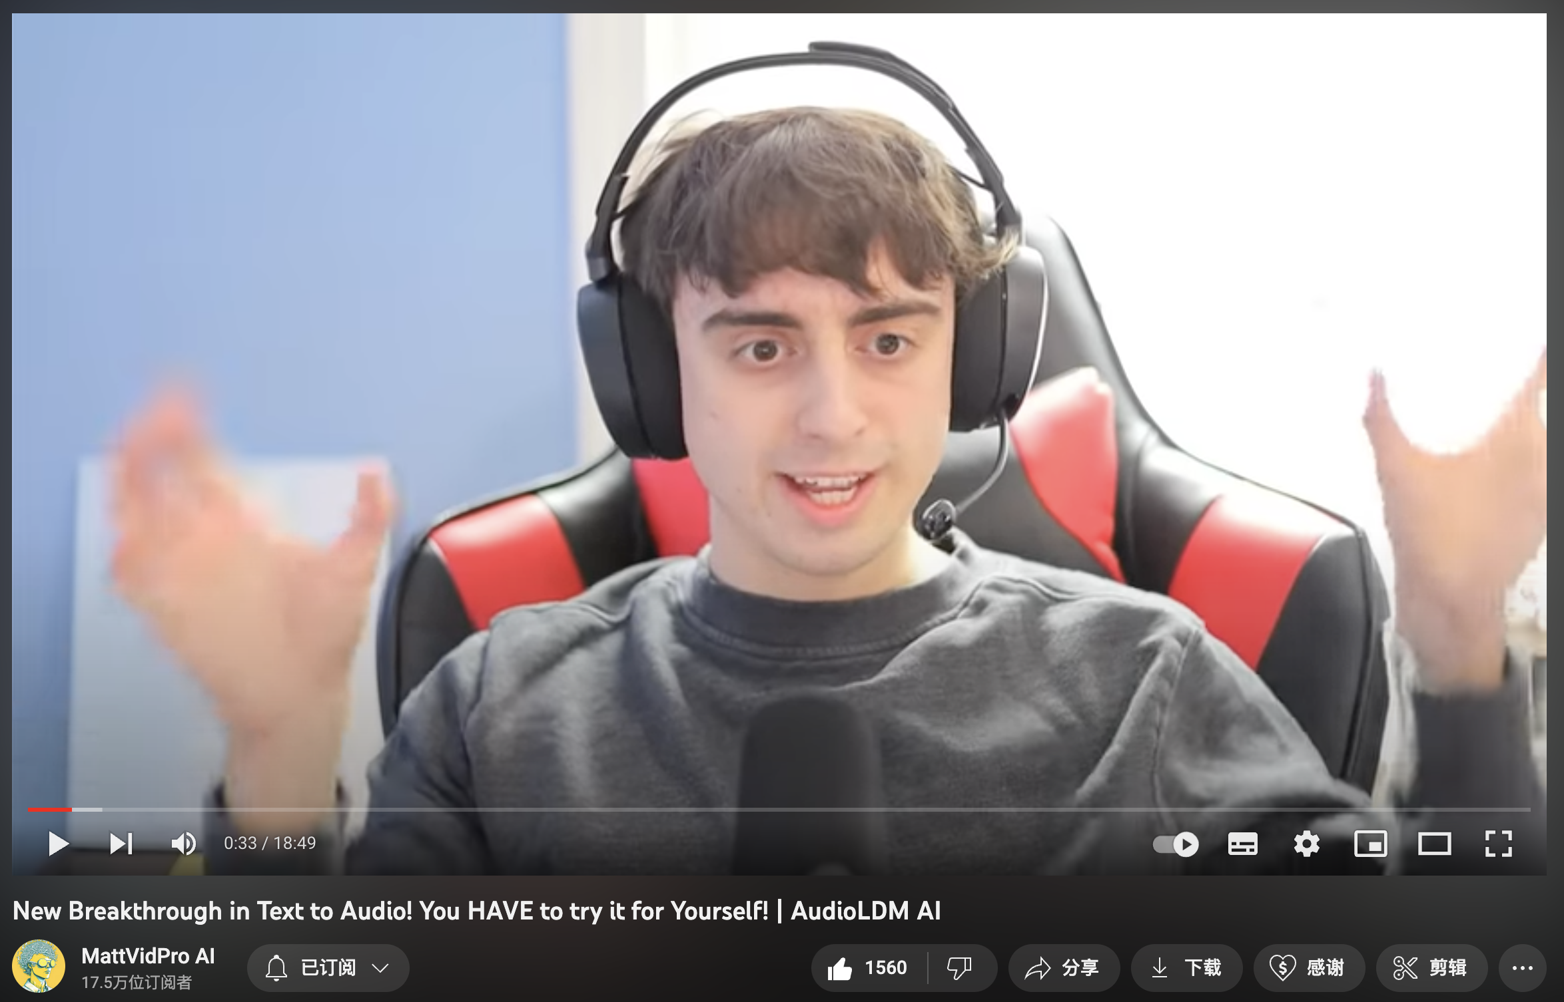
Paper, Codes, Demos, and More, …
Code avaliable at:
https://github.com/XinhaoMei/DCASE2021_task6_v2
https://github.com/XinhaoMei/ACT
https://github.com/liuxubo717/cl4ac
https://haoheliu.github.io/
Paper (https://arxiv.org/abs/2301.12503):
  AudioLDM: Text-to-Audio Generation with Latent Diffusion Models
Hugging Face Space:
  https://huggingface.co/spaces/haoheliu/audioldm-text-to-audio-generation
Project Page: https://audioldm.github.io/
Github:
  Pretrained model: https://github.com/haoheliu/AudioLDM
  Evaluation tools: https://github.com/haoheliu/audioldm_eval
YouTube: https://www.youtube.com/watch?v=_0VTltNYhao
WavCaps:
https://arxiv.org/abs/2303.17395
Code:
https://github.com/xinhaomei/wavcaps

Slide 39


Thank you for listening!
This work was sponsored by a Newton Institutional Links Award from the British Council, titled “Automated Captioning of Image and Audio for Visually and Hearing Impaired” & EPSRC projects titled “Making Sense of Sounds” and “AI for Sounds”.

