Slide 1
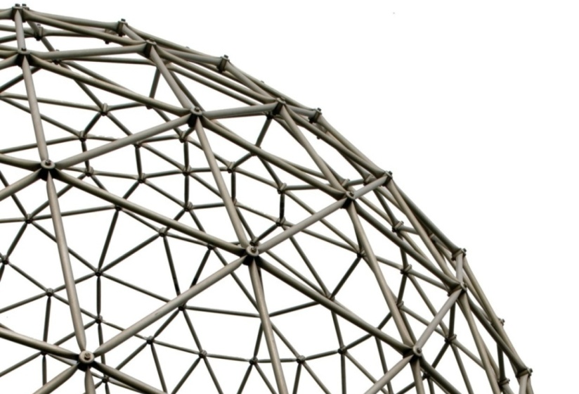
Language Queried Audio Source Separation
Wenwu Wang
Centre for Vision, Speech and Signal Processing (CVSSP)
& Surrey Institute for People Centred Artificial Intelligence
University of Surrey
United Kingdom
Email: w.wang@surrey.ac.uk
Web: https://personalpages.surrey.ac.uk/w.wang/
Keynote talk on IWAENC 2026, Cremona, Italy
10/09/2026

Slide 2



Acknowledgement
Xubo Liu
Yi Yuan
Haohe Liu
Xinhao Mei
Yiming Zhang
Liting Gao
Yun Chen
Junqi Zhao
Qingju Liu
Qiuqiang Kong
Atiyeh Alinaghi
Jian Guan
Feiyang Xiao
Yong Xu
Yin Cao
Qiaoxi Zhu
Jonathon Chambers
Philip Jackson
Mark Barnard
Swati Chandna
Jing Dong
Alfredo Zermini
Yang Yu
Tariq Jan
Tao Xu
Josef Kittler
Mark Plumbley
Saeid Sanei
DeLiang Wang
… …
Funding from:
UK Engineering and Physical Sciences Research Council (EPSRC) & University Defence Research Collaboration (UDRC), British Council, Research England, industry including BBC, Samsung, Huawei, etc.

Slide 3
Outline
A brief history about audio source separation
    Cocktail party problem & speech source separation
    Example problems and methods
    Recent developments
A brief history about (large) audio-language models
    Large audio models
    Large language models
    Large audio-language models (examples, datasets, applications)
Language queried audio source separation
  Early models
  AudioSep
  FlowSep & FlowSep2
  A related problem: language guided audio editing
Conclusions and future works

Slide 4
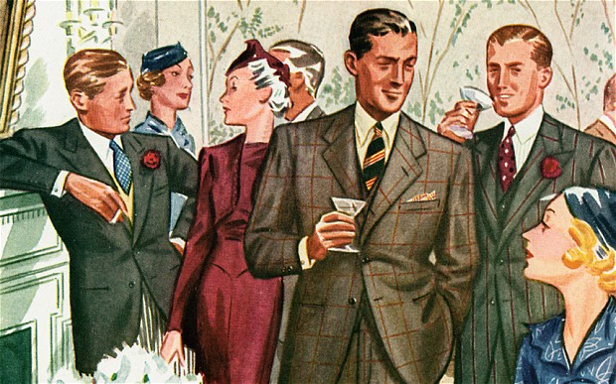
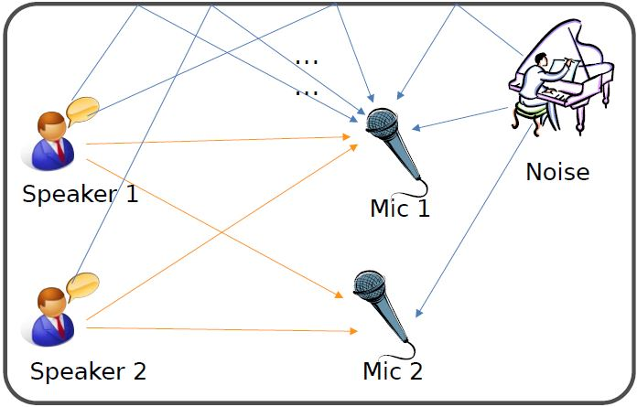
Cocktail Party Problem
Cocktail party problem may involve a few tasks:
How many speakers?
(Source counting)
Where are they?
(Localization and tracking)
Who speaks and when?
(Diarization)
What are the individual speech sources?
(Speech source separation)
What has been said?
(Automatic speech recognition)
What kind of environment?
(Acoustic scene recognition, event detection, room acoustics)
Cocktail-party problem (Cherry 1953) or ball-room problem (Helmholtz, 1863)
4
“No machine has yet been constructed to do just that [solving the cocktail party problem].” (Cherry, 1957)
Notes:
In this section, I will show you, what is audio-visual multi-speaker tracking, what is its application, which challenges are often met, and I will show you some popular multi-tracking methods and their drawbacks.

Slide 5
Speech Source Separation
Various methods explored for the speech source separation problem
  Beamforming
  Adaptive filtering
  Blind source separation and independent component analysis
  Sparse representation and dictionary learning
  Matrix/tensor factorization techniques
  Time-frequency masking
  Learning based techniques
  Computational auditory scene analysis
  Exploiting additional modalities or conditions (e.g. visual signals)
  …
5
Notes:
In this section, I will show you, what is audio-visual multi-speaker tracking, what is its application, which challenges are often met, and I will show you some popular multi-tracking methods and their drawbacks.

Slide 6
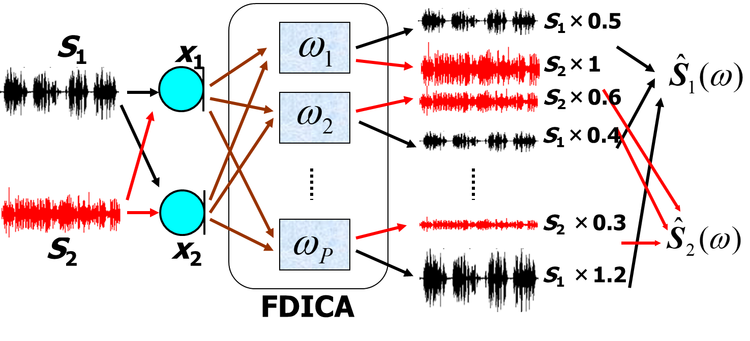

Frequency Domain ICA: Demo
Sources
Mixtures
Parra & Spences
Wang et al.
P. Smaragdis, “Blind separation of convolved mixtures in the frequency domain,” Neurocomput., vol. 22, pp. 21–34, 1998.
L. Parra and C. Spence, “Convolutive blind source separation of nonstationary sources,” IEEE Trans. Speech Audio Process., vol. 8, no. 3, pp. 320–327, May 2000.
H. Sawada, R. Mukai, S. Araki, S. Makino, “A robust and precise method for solving the permutation problem of frequency-domain blind source separation,” IEEE Trans. on Speech and Audio Processing, vol. 12, no. 5, pp. 530-538, 2004.
W. Wang, S. Sanei, and J. A. Chambers, “Penalty function based joint diagonalization approach for convolutive blind separation of nonstationary sources,” IEEE Trans. Signal Processing, vol. 53, no. 5, pp. 1654-1669, May 2005.
H. Buchner, R. Aichner, W. Kellermann, “A generalization of blind source separation algorithms for convolutive mixtures based on second-order statistics,” IEEE Trans. on Speech and Audio Processing, vol. 13, no. 1, pp. 120-134, 2005.

Slide 7
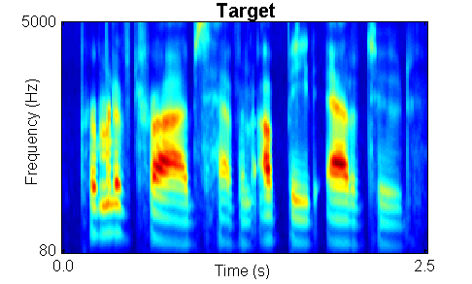
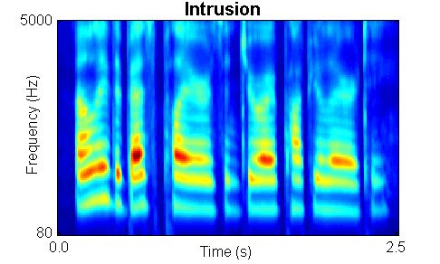

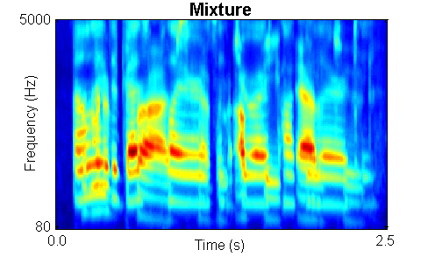
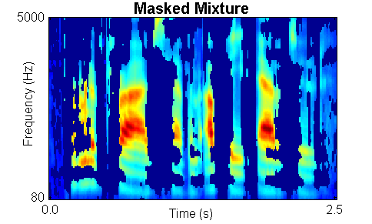
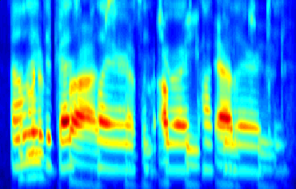
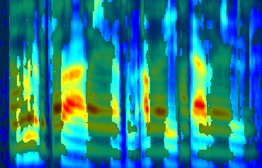
Time-Frequency Masking (TFM)
Psychophysical tests show that the ideal binary mask results in dramatic speech intelligibility improvements (Brungart et al., 2006; Li & Loizou, 2008). Acknowledgement to Prof DeLiang Wang for this demo.

Slide 8
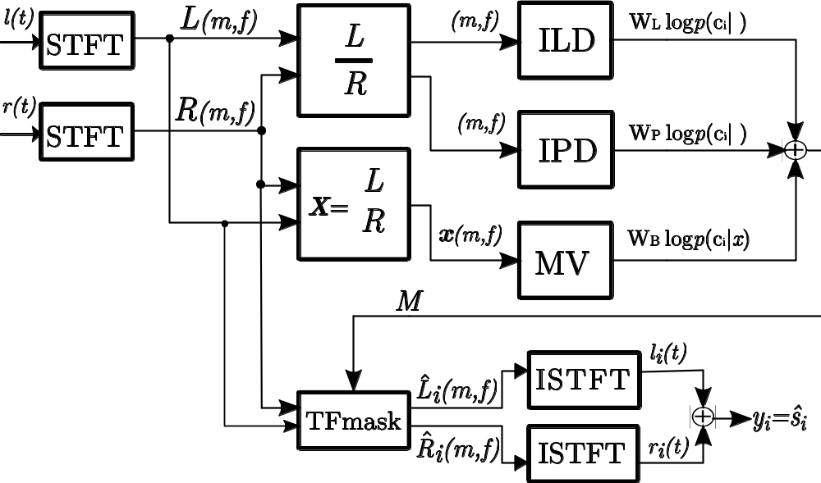

TFM: An Example
left
Source 1
right
Source 2
Sawada et al.
Mandel et al.
Alinaghi et al.
es1
es2
O. Ylmaz and S. Rickard, “Blind separation of speech mixtures via time-frequency masking,” IEEE Trans. Signal Process., vol. 52, no. 7, pp. 1830–1847, Jul. 2003.
M. I. Mandel, R. J. Weiss, and D. P. W. Ellis, “Model-based expectation-maximization source separation and localization,” IEEE Trans. Audio, Speech, Lang. Process., vol. 18, no. 2, pp. 382–394, Feb. 2010
H. Sawada, S. Araki, and S. Makino, “Underdetermined convolutive blind source separation via frequency bin-wise clustering and permutation alignment,” IEEE Trans. Audio, Speech, Lang. Process., vol. 19, no. 3, pp. 516–527, Mar. 2011.
A. Alinaghi, P. Jackson, Q. Liu, and W. Wang, "Joint mixing vector and binaural model based stereo source separation", IEEE Transactions on Audio Speech and Language Processing, vol. 22, no. 9, pp. 1434-1448, 2014.

Slide 9
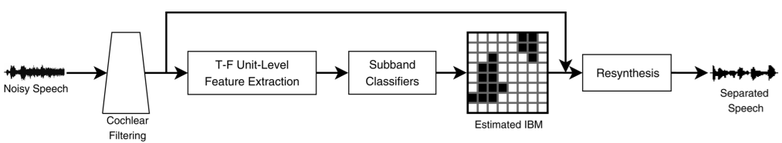
More Recent Developments
Neural T-F masking
Formulate separation problem as T-F unit classification problem:
Y. Wang and D. L. Wang, “Towards scaling up classification-based speech separation,” IEEE Transactions on Audio, Speech, and Language Processing, 2013.
Y. Wang, A. Narayanan, and D. L. Wang, “On training targets for supervised speech separation,” IEEE/ACM TASLP, 22(10):1849–1858, 2014.
Embedding based separation
Deep Clustering: learns the structure of T-F mask:
J. R. Hershey, Z. Chen, J. Le Roux, and S. Watanabe, “Deep clustering: discriminative embeddings for segmentation and separation,” ICASSP 2016, pp. 31–35.
Deep Attractor Network: learns an embedding space in which each speaker is represented by an attractor point:
Z. Chen, Y. Luo, and N. Mesgarani, “Deep attractor network for single-microphone speaker separation,” ICASSP 2017, pp. 246–250.

Slide 10




More Recent Developments
Permutation free end to end separation
Permutation Invariant Training (PIT):
D. Yu, M. Kolbæk, Z.-H. Tan, and J. H. Jensen, “Permutation invariant training of deep models for speaker-independent multi-talker speech separation,” ICASSP 2017, pp. 241–245.
Conv-TasNet: learn the representation of mixture and masks in the time domain
Y. Luo and N. Mesgarani, “TasNet: surpassing ideal time-frequency masking for speech separation,” arXiv:1805.12347, 2018.
Y. Luo and N. Mesgarani, “Conv-TasNet: surpassing ideal time-frequency magnitude masking for speech separation,” IEEE/ACM TASLP, 2019.

Slide 11
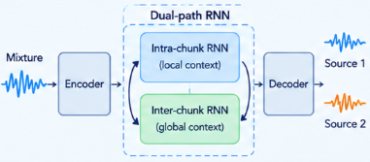
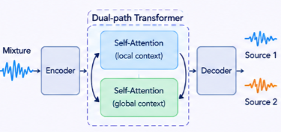
More Recent Developments
Long context modelling & transformer architecture:
DPRNN:
Y. Luo, Z. Chen, and T. Yoshioka, “Dual-Path RNN: efficient long sequence modeling for time-domain single-channel speech separation,” ICASSP, 2020.
DPTNet:
J. Chen et al., “Dual-Path transformer network: direct context-aware modeling for end-to-end monaural speech separation,” ICASSP, 2020.
SepFormer:
C. Subakan, M. Ravanelli, S. Cornell, M. Bronzi, and J. Zhong, “Attention is all you need in speech separation,” ICASSP, 2021.

Slide 12








More Recent Developments
Generative models based separation systems:
WaveNet/GAN/Diffusion model:
Q. Liu, P. Jackson, and W. Wang, "A speech synthesis approach for high quality speech separation and generation", IEEE Signal Processing Letters, vol. 26, no. 12, pp. 1872-1876, December 2019.
L. Chen, M. Yu, Y. Qian, D. Su, and D. Yu, “Permutation invariant training of generative adversarial network for monaural speech separation,” INTERSPEECH 2018.
R. Scheibler, Y. Ji, S.-W. Chung, J. Byun, S. Choe, and M.-S. Choi, “Diffusion-based generative speech source separation,” ICASSP 2023.
C. Zhao, G. Sun, K. Deng, C. Li, and P. C. Woodland, “STR-DIFFSEP: Streamable diffusion model for speech separation,” ICASSP 2026.
$$p(s|x)$$
$${\hat{s}=p}_{θ}(s|x)$$
$$x$$
  Separator
(Mask/Unmixing Matrix/Filter)
$$\hat{s}=Mx$$
$$M$$
$$x$$
Generator
(WaveNet/GAN/Diffusion)
$${\hat{s}=G}_{θ}(x,z)$$
$$G_{θ}(x,z)$$

Slide 13
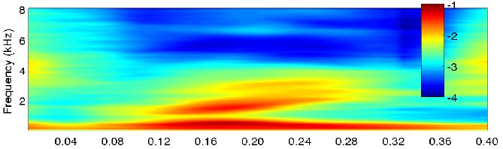

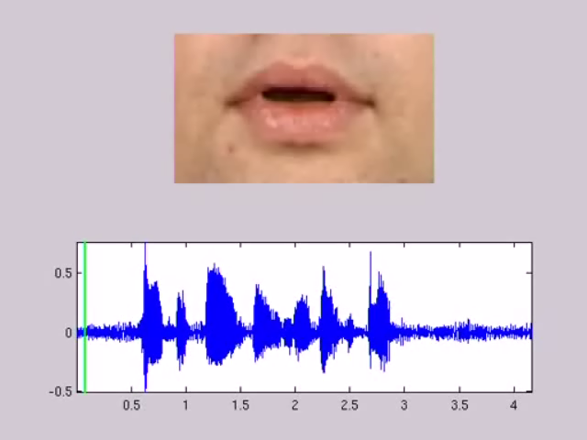
AV Speech or General Sound Separation
 | Mixture | Ideal | Mandel | AV-LIU | AVDL-BSS | Rivet | AVMP-BSS
A
B
C
D
AV speech separation
D. Sodoyer, J.L. Schwartz, L. Girin, J. Klinkisch, and C. Jutten, "Separation of audio-visual speech sources," EURASIP Journal on Applied Signal Processing, pp. 1165-1173, Nov., 2002.
W. Wang, D. Cosker, Y. Hicks, S. Sanei, and J. A. Chambers, "Video assisted speech source separation," Proc. ICASSP, vol. V, pp.425-428, Philadelphia, USA, March 18-23, 2005.
Q. Liu, W. Wang, et al., “Source separation of convolutive and noisy mixtures using audio-visual dictionary learning and probabilistic time-frequency masking", IEEE Transactions on Signal Processing, vol. 61, no. 22, pp. 5520-5535, 2013.
A. Ephrat et al., “Looking to listen at the cocktail party: a speaker-independent audio-visual model for speech separation,” ACM TOG, 2018.
J. Wu et al., “Time domain audio visual speech separation,” IEEE ASRU, 2019.
R. Gao and K. Grauman, “VisualVoice: audio-visual speech separation with cross-modal consistency,” Proc. CVPR, 2021.
Nagrani, et al., “Seeing voices and hearing faces: cross-modal biometric matching,” in Proc. CVPR, 2018.
K. Li et al., “An audio-visual speech separation model inspired by Cortico-Thalamo-Cortical Circuits,” IEEE TPAMI, 2024.
Notes:
In this section, I will show you, what is audio-visual multi-speaker tracking, what is its application, which challenges are often met, and I will show you some popular multi-tracking methods and their drawbacks.

Slide 14
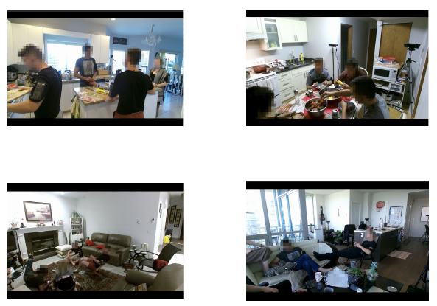
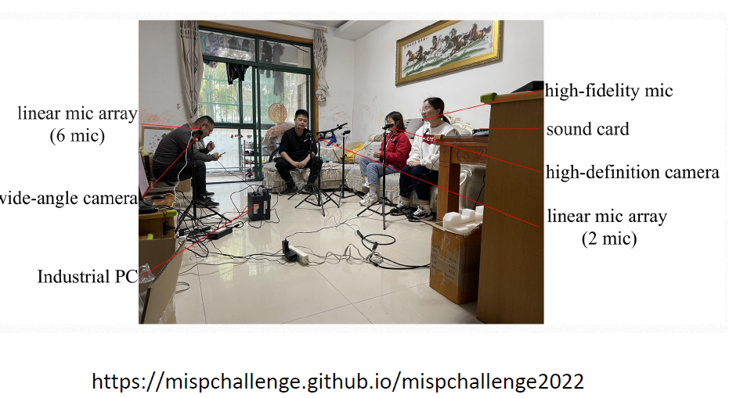

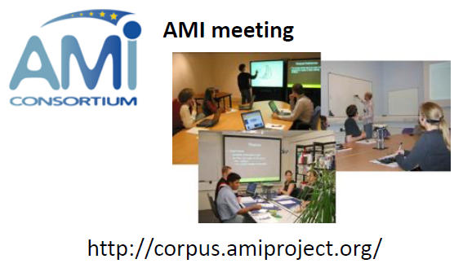
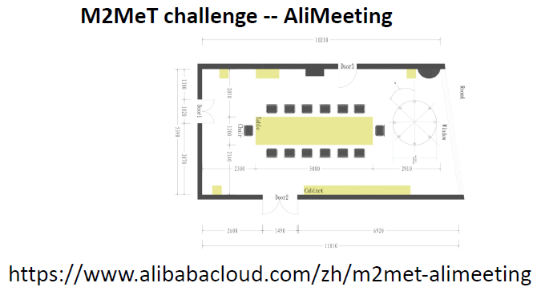
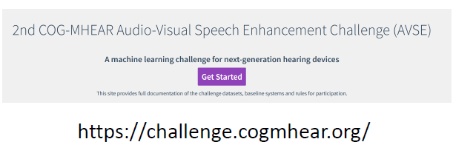
Data Challenges in (AV) Speech Separation
MMCSG (Multi-Modal Conversations in Smart Glasses) dataset
https://ai.meta.com/datasets/mmcsg-dataset/
Notes:
In this section, I will show you, what is audio-visual multi-speaker tracking, what is its application, which challenges are often met, and I will show you some popular multi-tracking methods and their drawbacks.

Slide 15
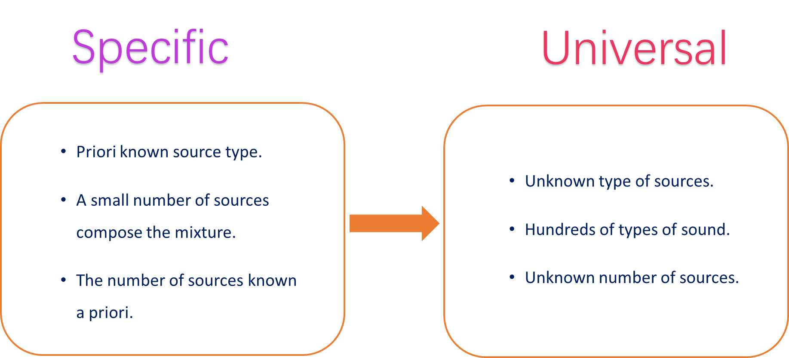
Universal Audio Source Separation
I. Kavalerov, et al, “Universal sound separation,” WASPAA 2019.
E. Tzinis, et al, “Improving universal sound separation using sound classification”, ICASSP 2020.
S. Wisdom, et al, “What’s all the fuss about free universal sound separation data?,” ICASSP 2021.
Q. Kong, et al, “Universal Source Separation with Weakly Labelled Data,” arXiv 2023.
Notes:
In this section, I will show you, what is audio-visual multi-speaker tracking, what is its application, which challenges are often met, and I will show you some popular multi-tracking methods and their drawbacks.

Slide 16
Outline
A brief history about audio source separation
    Cocktail party problem & speech source separation
    Example problems and methods
    Recent developments
A brief history about (large) audio-language models
    Large audio models
    Large language models
    Large audio-language models (examples, datasets, applications)
Language queried audio source separation
  Early models
  AudioSep
  FlowSep & FlowSep2
  A related problem: language guided audio editing
Conclusions and future works

Slide 17
(Large) Audio Models
Learning general/universal audio representations from large scale audio data shows promising performance in downstream tasks (classification, separation, retrieval, etc):
PANNs (Kong, et al, 2020): large scale CNN-based audio model
Audio2Vec (Tagliasacchi et al, 2020): sequence to sequence unsupervised model
CLAR (Al-Tahan and Mohsenzadeh, 2021): self-supervised model
COLA (Saeed et al, 2021): self supervised model
BOYL-A (Niizumi et al, 2021): self supervised model
AST (Gong et al, 2021): large scale transformer-based audio model
ATST (Li and Li, 2022): transformer-based model
MAE-AST (Baade et al, 2022): self-supervised model
SSAST (Gong et al, 2022): self-supervised AST model
Audio-MAE (Huang et al, 2022): self-supervised model
BEATs (Chen et al, 2023): audio pre-training with acoustic tokenizers
ASiT (Atito et al, 2024): self-supervised models for general audio representation
SSLAM (Alex et al, 2025): self-supervised learning from audio mixtures
mean Average Precision (mAP) on AudioSet: 31.4 (2017) -> 55.8 (2025)

Slide 18
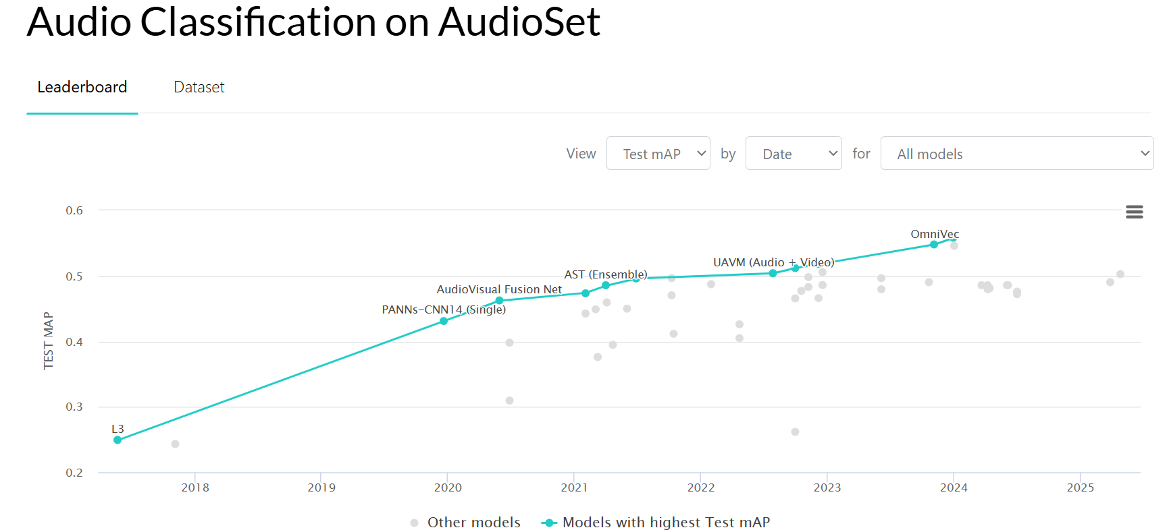
(Large) Audio Models
Leaderboard:
https://paperswithcode.com/sota/audio-classification-on-audioset
https://www.codesota.com/audio/classification

Slide 19
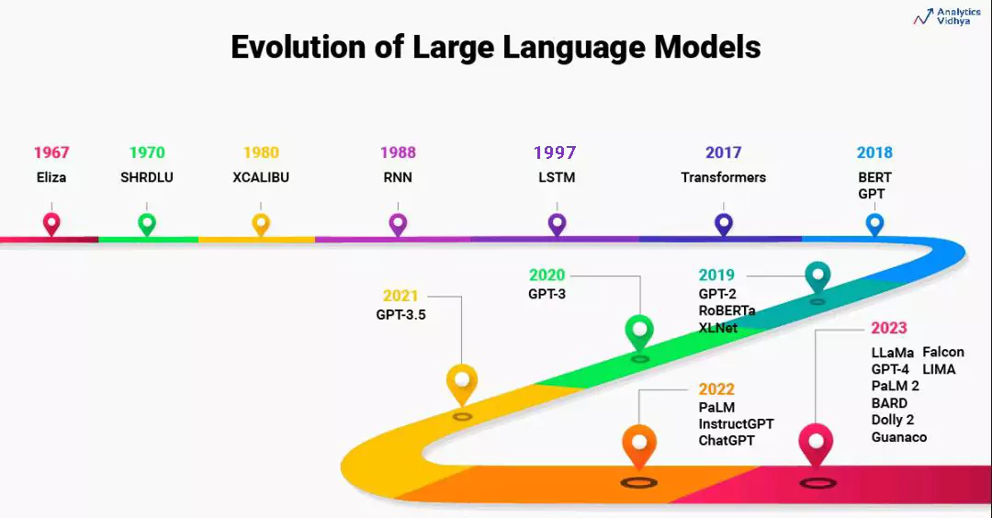
Large Language Models (LLMs)
Courtesy to Aravind Pai: https://www.analyticsvidhya.com/blog/2023/07/beginners-guide-to-build-large-language-models-from-scratch/

Slide 20
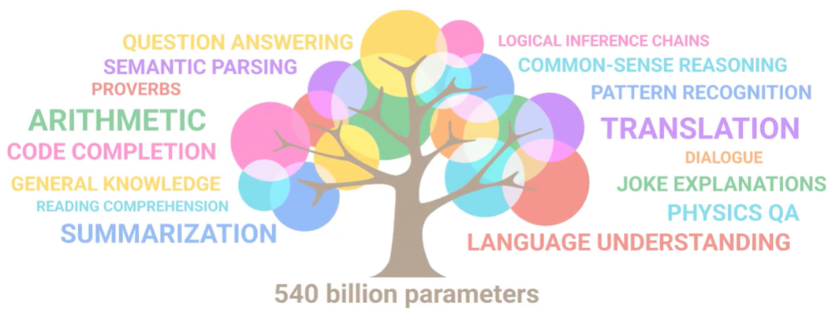
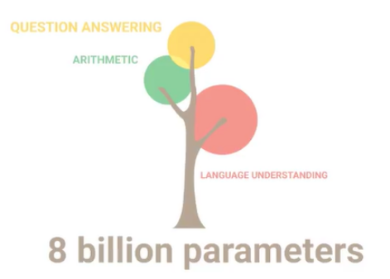
Large Language Models (LLMs)
Figures from Ryan O'Connor: https://www.assemblyai.com/blog/emergent-abilities-of-large-language-models/
Wei et al, “Emergent abilities of large language models,” Transactions on Machine Learning Research, 2022.

Slide 21
Large Audio-Language Models: Why?
Leverage knowledge within LLMs to address the limitations of audio models
  Zero-shot or few-shot classification
Explore homogeneity across tasks with LLMs
  Use LLMs as an agent to solve multi-task problems
Extend the capabilities of audio models for new tasks
  Extending from audio classification to audio captioning/question answering & reasoning
  Extending from audio generation to storytelling & controllable editing
  Extending from audio source separation to language queried audio source separation

Slide 22
Large Audio Language Models - Examples
Whisper: automatic speech recognition (ASR)
Wav2Vec 2.0: speech to text (STT)
DeepSpeech: open-source ASR
Coqui AI: speech synthesis and TTS
Jasper and QuartzNet: ASR
GPT-3 with Whisper: ASR + LLMs
Sonix.ai: speech transcription and analysis
SpeechBrain: platform for speech models
OpenSTT: ASR
Gemini: text/image/speech
WavLLM: speech LLMs
MuseNet: music instrumental composition & style transfer
MusicVAE: melody generation, remixing, and style interpolation
JukeBox: raw music with vocals and lyrics
Riffusion: text to music generation
MusicLM: text to music generation
REMI: symbolic music generation (e.g. MIDI)
DeepBach: classic music composition
AIVA: music generation assistant
Wav2CLIP: audio and language mapping
AudioCLIP: audio-text-image alignment
CLAP: audio-text alignment
CLAP-LAION: audio-text alignment
Pengi: audio classification & AQA
Qwen-Audio: speech, music, general audio
AudioLM: Speech/music generation
LTU: audio QA and reasoning
SALMONN: speech-audio-music LLMs
ImageBind: image, text, audio, depth
ONE-PEACE: audio-text-image
AudioGPT: Speech, Music, Talking Head
UniAudio: speech/sound/music/singing
AudioLDM/AudioLDM2/WavJourney/ DreamAudio: TTA generation
AudioSep/FlowSep/FlowSep2: language guided audio source separation
WavCraft/RFM-Editing/SFM-Adapter/RFM-Editing2: text prompted audio/speech editing
APT-LLM: LLM based AQA and reasoning
GCDance/TeMuDance: Language guided music to dance generation

Slide 23
Audio Language Datasets
AudioCaps (Kim et al, 2019)
Clotho (Drossos et al, 2020)
SoundDescs (Koepke et al, 2021)
LAION-Audio-630K (Wu et al, 2023)
Auto-ACD (Xu et al, 2024)
Audio-FLAN (Xue et al, 2025)
SeaBench-Audio (Liu et al, 2025)
MusicSem (Salganik et al, 2026)
WavCaps (Mei et al, 2023)
Sound-VECaps (Yuan et al, 2024)
AudioSetCaps (Bai et al, 2025)
CLEAR (Abdelnour et al, 2018)
DAQA (Fayek and Johnson, 2019)
Clotho-AQA (Lipping et al, 2022)
MUSIC-AVQA (Li et al, 2022)
mClothoAQA (Behera et al, 2023)
OpenAQA-5M (Gong et al, 2023)
AudioMCQ (He et al, 2025)
Audio Flamingo 3 (Goel et al, 2025)
Jamendo-MT-QA (Koh et al, 2026)

Slide 24
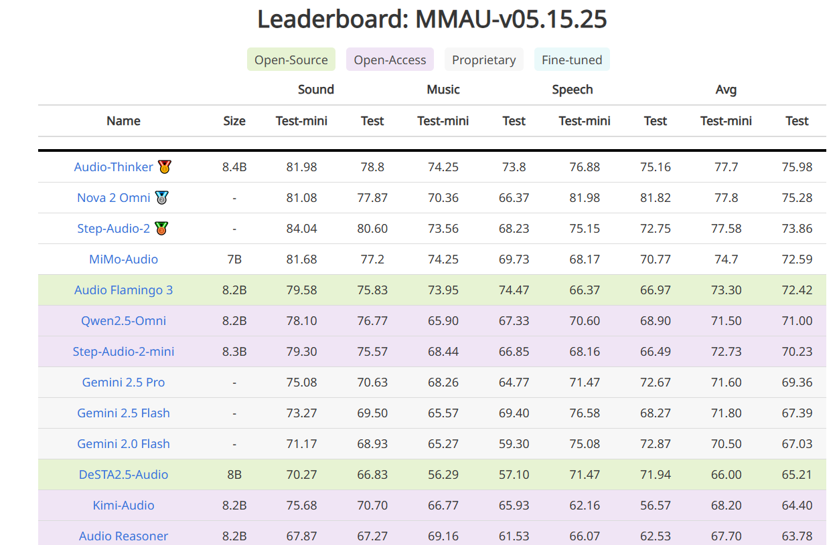
Large Audio-Language Models –
Recent Progress
https://sakshi113.github.io/mmau_homepage/#leaderboard-v15-parsed

Slide 25
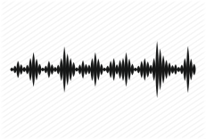
Application 1 - Audio to Text Generation
Automated audio captioning (AAC) is a cross-modal translation task which aims at generating a natural language description for a given audio clip.
This task requires understanding the audio content, such the spatial-temporal relationships between events and scenes, and describing such information using natural language.
Applications
  Audio retrieval
  Assist hearing-impared to understand environmental sounds
  Subtitle for sounds in TV programs
AAC System
“a woman talks nearby as water pours”

Slide 26
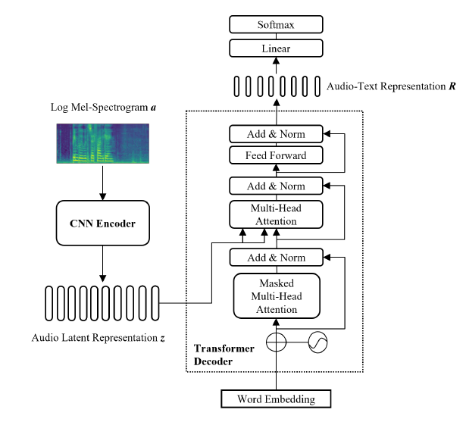
A Typical Model
Common challenges in automated audio captioning:
Data scarcity
Representations of audio, text and audio-text
Diversity of captions
Multi-lingual captioning
Interactions with other modalities (e.g. vision)
….
Y. Hou, Q. Ren, A. Mitchell, W. Wang, J. Kang, T. Belpaeme, and D. Botteldooren, "Soundscape captioning using sound affective quality network and large language model," IEEE Transactions on Multimedia, 2026.
Y. Zhu, Y. Zhang, L. Xiao, W. Wang, and A. Men, "Zero-shot diverse audio captioning with diffusion models", Knowledge Based Systems, 2026.
Y. Zhang, X. Xu, R. Du, H. Liu, Y. Dong, Z.-H. Tan, W. Wang, and Z. Ma, "Zero-shot audio captioning using soft and hard prompts," IEEE Transactions on Audio Speech and Language Processing, vol. 33, pp. 2045 - 2058, May 2025.
Y. Zhang, H. Yu, R. Du, Z.-H. Tan, W. Wang, Z. Ma, Y. Dong, "ACTUAL: audio captioning with caption feature space regularization," IEEE/ACM Transactions on Audio Speech and Language Processing, vol. 31, pp. 2643 - 2657, 2023.
X. Mei, X. Liu, M. Plumbley, and W. Wang, "Automated audio captioning: an overview of recent progress and new challenges", EURASIP Journal on Audio Speech and Music Processing, 2022.

Slide 27

Audio Captioning Demo

Slide 28
Application 2 - Text to Audio Generation
Potential Applications:
Related Works:
Computational “foley artist”
  Game developer: e.g., A ghost is haunting a house.
  Audio producer: e.g., high heels hitting metal ground.
  Movie producer: e.g., the laser sound from a laser gun.
  …
Automatic content creation
  Endless music
  Audiobook with ambient noises
  White noise for meditation
  …
Data Augmentations
Label-to-Audio Generation
  Acoustic Scene (Kong et al., 2019), Sound event (Liu et al., 2019), FootStep (Comunit et al. 2019), …
Text-to-Audio Generation
  DiffSound (Yang et al., 2022), AudioGen (Kreuk et al., 2022), Make-an-Audio (Huang et al., 2023)
Text-to-Music Generation
  MusicLM (Andrea et al., 2023), Moûsai (Flavio et al., 2023), Noise2Music (Huang et al., 2023)
Others
  JukeBox (Dhariwal et al., 2020), AudioLM (Borsos et al., 2022), SingSong (Donahue et al., 2023),…

Slide 29
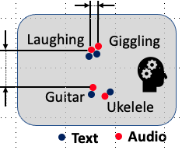
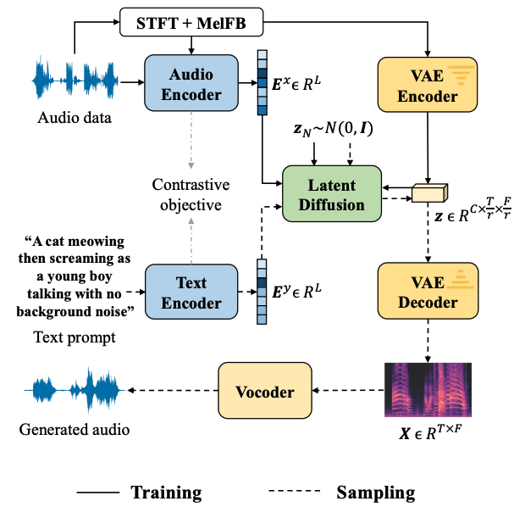
Text to Audio Generation: AudioLDM
Self-supervised training
Contrastive Language-Audio Learning (CLAP) Encoders
  Align audio and text in one space.
Latent Diffusion Models
  Learn to generate VAE latent conditioned on CLAP embedding
Mel-spectrogram Autoencoder
  Learn latent representations.
Mel-to-Waveform Vocoder
  Reverse Mel back to waveform
H. Liu, Z. Chen, Y. Yuan, X. Mei, X. Liu, D. Mandic, W. Wang, M. D. Plumbley, "AudioLDM: text-to-audio generation with latent diffusion models," in Proc. IEEE International Conference on Machine Learning (ICML 2023), Hawaii, USA, 23-29 July, 2023.

Slide 30
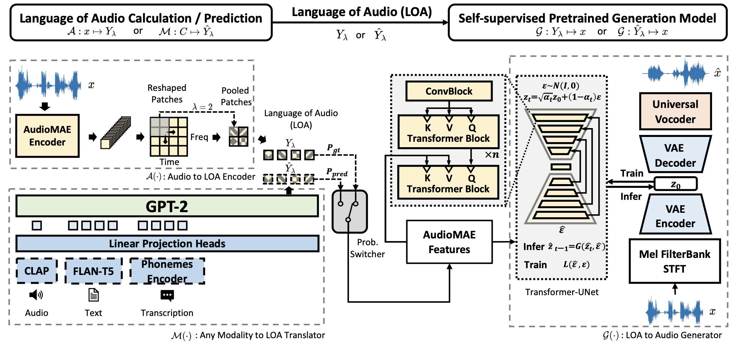
Text to Audio Generation: AudioLDM 2
H. Liu , Y. Yuan , X. Liu , X. Mei , Q. Kong , Q. Tian , Y. Wang , W. Wang, Y. Wang , M. D. Plumbley, "AudioLDM 2: Learning holistic audio generation with self-supervised pretraining," IEEE/ACM Transactions on Audio Speech and Language Processing, vol. 32, pp. 2871-2883, 2024. [PDF] [code]

Slide 31
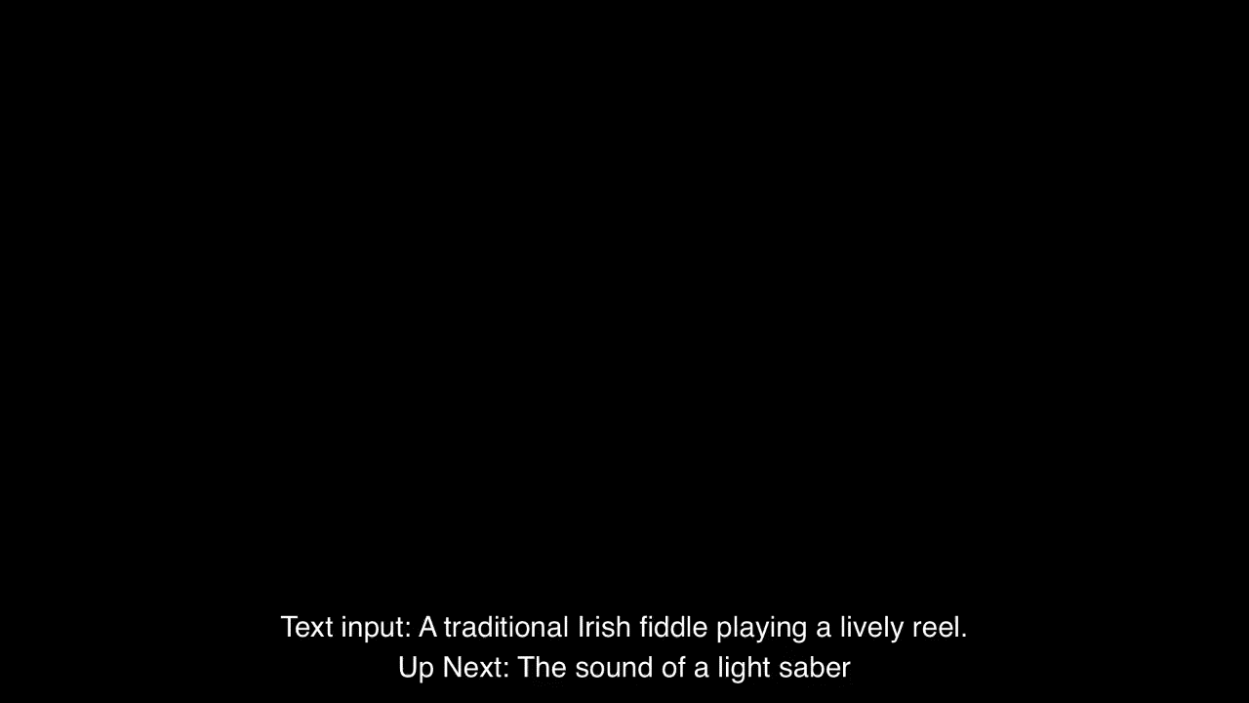
AudioLDM 2 - Demo
We generated a total of 350 audio files with prompts (generated by ChatGPT) without cherry-picking.
Codes and more demos: https://audioldm.github.io/audioldm2/

Slide 32
Outline
A brief history about audio source separation
    Cocktail party problem & speech source separation
    Example problems and methods
    Recent developments
A brief history about (large) audio-language models
    Large audio models
    Large language models
    Large audio-language models (examples, datasets, applications)
Language queried audio source separation
  Early models
  AudioSep
  FlowSep & FlowSep2
  A related problem: language guided audio editing
Conclusions and future works

Slide 33
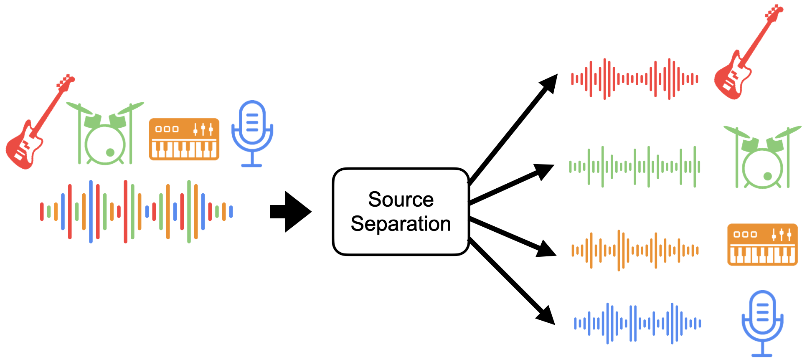
Query-based Audio Source Separation
  Query type: vision, audio, labels, …
  Not flexible and straightforward to separate desired sounds
Notes:
In this section, I will show you, what is audio-visual multi-speaker tracking, what is its application, which challenges are often met, and I will show you some popular multi-tracking methods and their drawbacks.

Slide 34
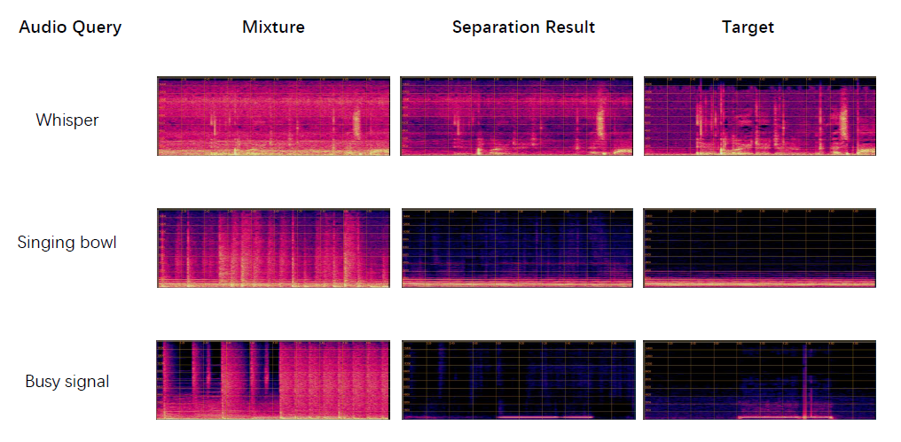
Universal Audio Source Separation with Query by Embeddings
Use the embedding from audio query to extract the sound of interest
J. Zhao, X. Liu, J. Zhao, Y. Yuan, Q. Kong, M. Plumbley, and W. Wang, "Universal sound separation with self-supervised audio masked autoencoder," in Proceedings of the 32nd European Signal Processing Conference (EUSIPCO 2024), Lyon, France, August 26-30, 2024.
Notes:
In this section, I will show you, what is audio-visual multi-speaker tracking, what is its application, which challenges are often met, and I will show you some popular multi-tracking methods and their drawbacks.

Slide 35
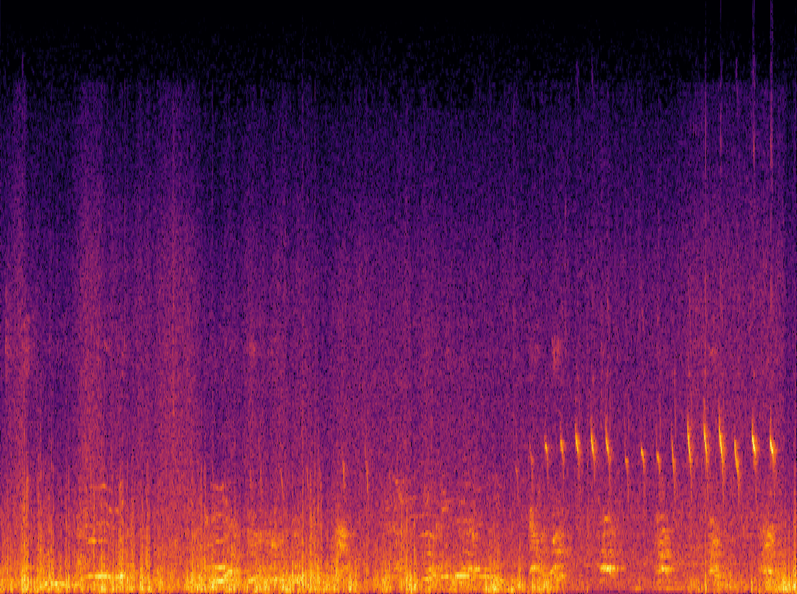
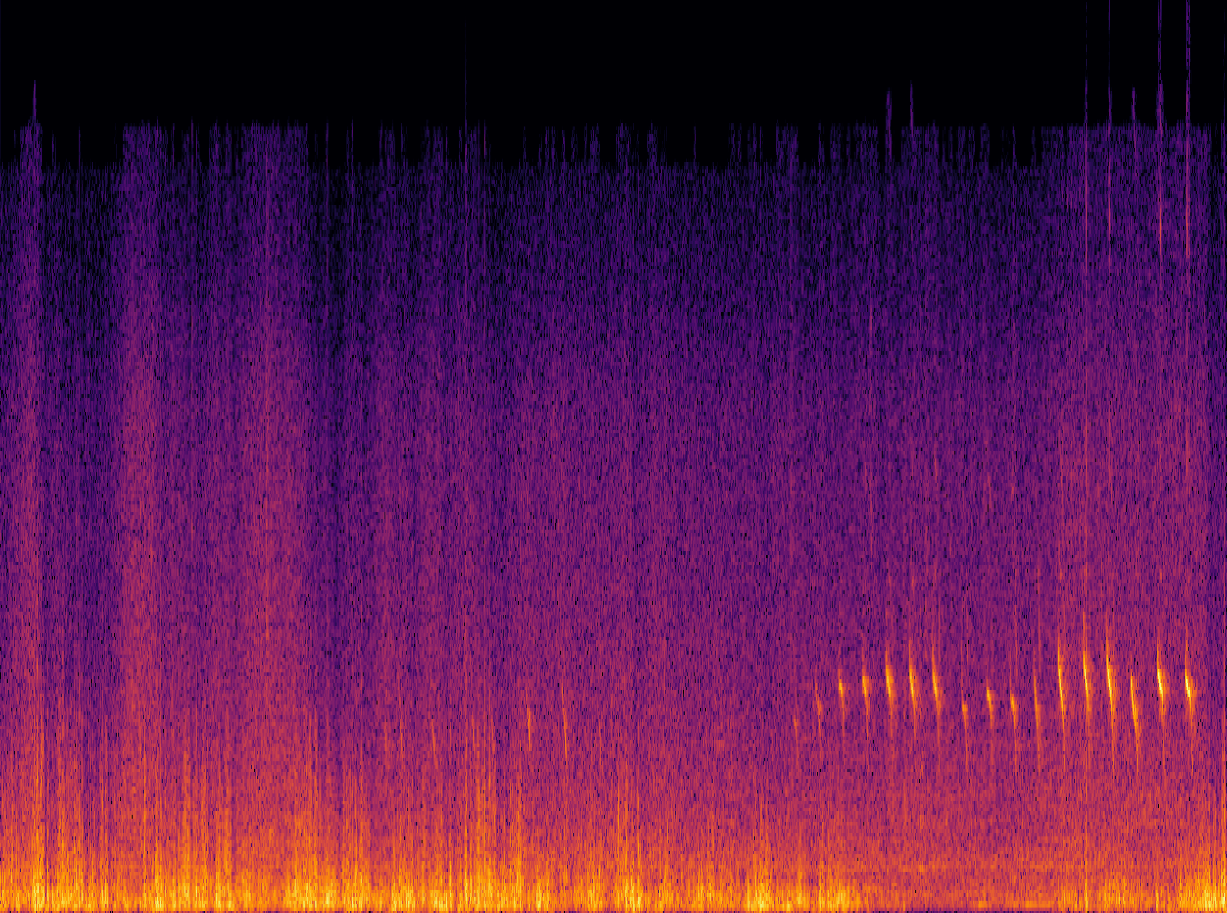
Language Queried Audio Source Separation
LASS – Separate a target source from an audio mixture based on the natural language descriptions of the target source
First attempt bridging audio source separation and natural language processing
Support input arbitrary text to separate desired sound sources
Language Query: “A bird is chirping under the thunder storm”
LASS
Notes:
In this section, I will show you, what is audio-visual multi-speaker tracking, what is its application, which challenges are often met, and I will show you some popular multi-tracking methods and their drawbacks.

Slide 36
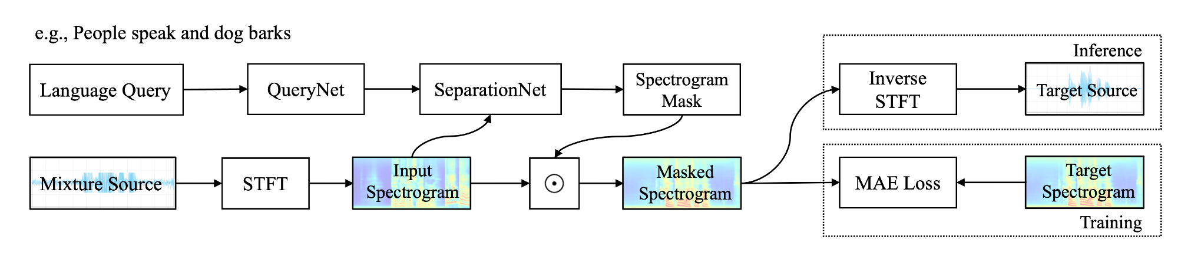
Challenges and Methods
How to construct training data?
  Training with synthetic mixtures generating from audio-text datasets
LASS-Net
  QueryNet (BERT) + SeparationNet (ResUNet) + FiLM fusion
  Trained with 17 hours of data from AudioCaps dataset
X. Liu, H. Liu, Q. Kong, X. Mei, J. Zhao, Q. Huang, M.D. Plumbley, and W. Wang,"Separate what you describe: language-queried audio source separation," in Proc. 23rd Interspeech Conference (INTERSPEECH 2022), 18-22 September, 2022, Incheon, Korea.
Notes:
In this section, I will show you, what is audio-visual multi-speaker tracking, what is its application, which challenges are often met, and I will show you some popular multi-tracking methods and their drawbacks.

Slide 37
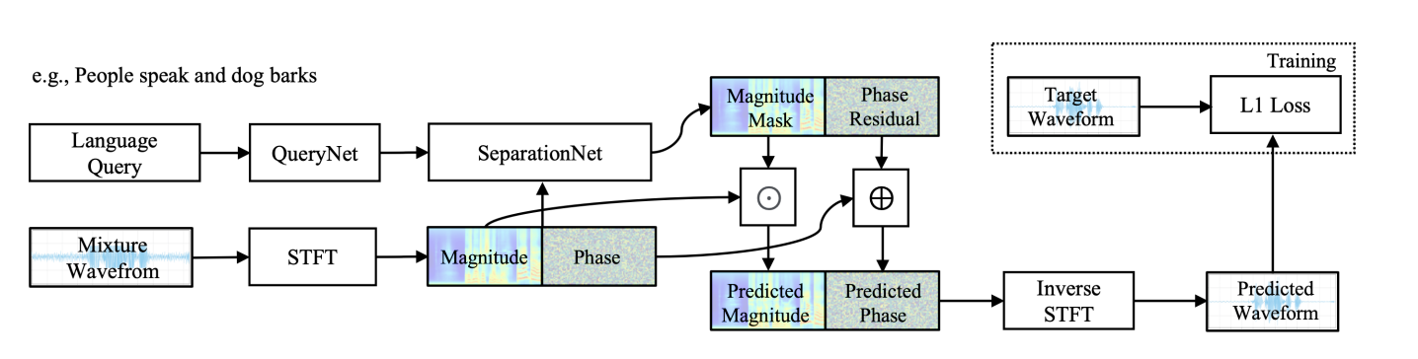
Method 1: AudioSep
CLAP/CLIP + ResUNet, trained with 14,000 hours of multimodal data
A foundation model for open-domain sound separation with texts
Impressive zero-shot performance in separating speech, music, sounds
X. Liu, Q. Kong, Y. Zhao, H. Liu, Y. Yuan, Y. Liu, R. Xia, Y. Wang, M.D. Plumbley, and W. Wang,“Separate Anything You Describe" in IEEE/ACM Transactions on Audio Speech and Language Processing, vol. 33, pp. 458-471, Dec 2024.
Notes:
In this section, I will show you, what is audio-visual multi-speaker tracking, what is its application, which challenges are often met, and I will show you some popular multi-tracking methods and their drawbacks.

Slide 38
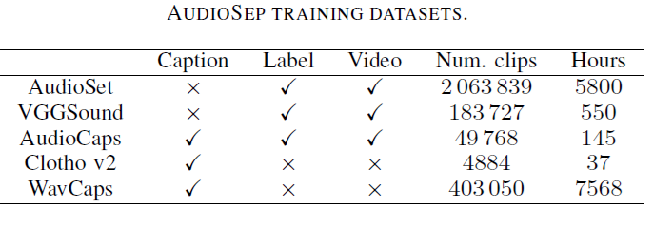
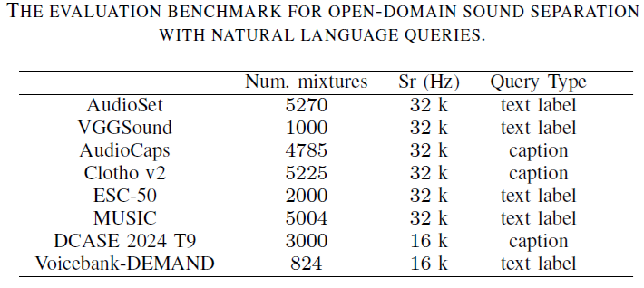
Training & Testing Data
Notes:
In this section, I will show you, what is audio-visual multi-speaker tracking, what is its application, which challenges are often met, and I will show you some popular multi-tracking methods and their drawbacks.

Slide 39
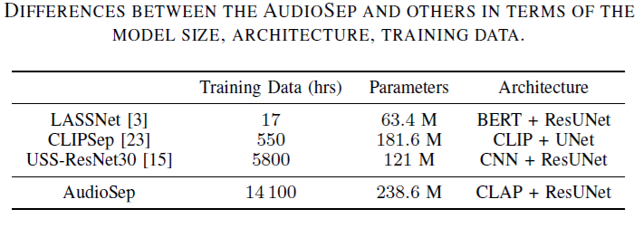
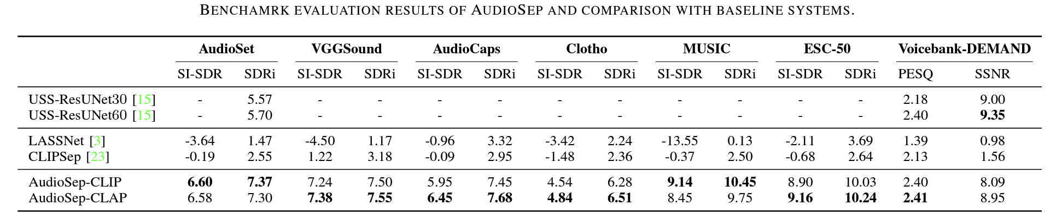
Experimental Results
AudioSep achieved excellent results on multiple datasets.
Impressive zero-shot separation performance on MUSIC and ESC-50.
Paper:
https://arxiv.org/pdf/2308.05037.pdf
Code:
https://github.com/Audio-AGI/AudioSep
Demo:
https://huggingface.co/spaces/Audio-AGI/AudioSep
Notes:
In this section, I will show you, what is audio-visual multi-speaker tracking, what is its application, which challenges are often met, and I will show you some popular multi-tracking methods and their drawbacks.

Slide 40
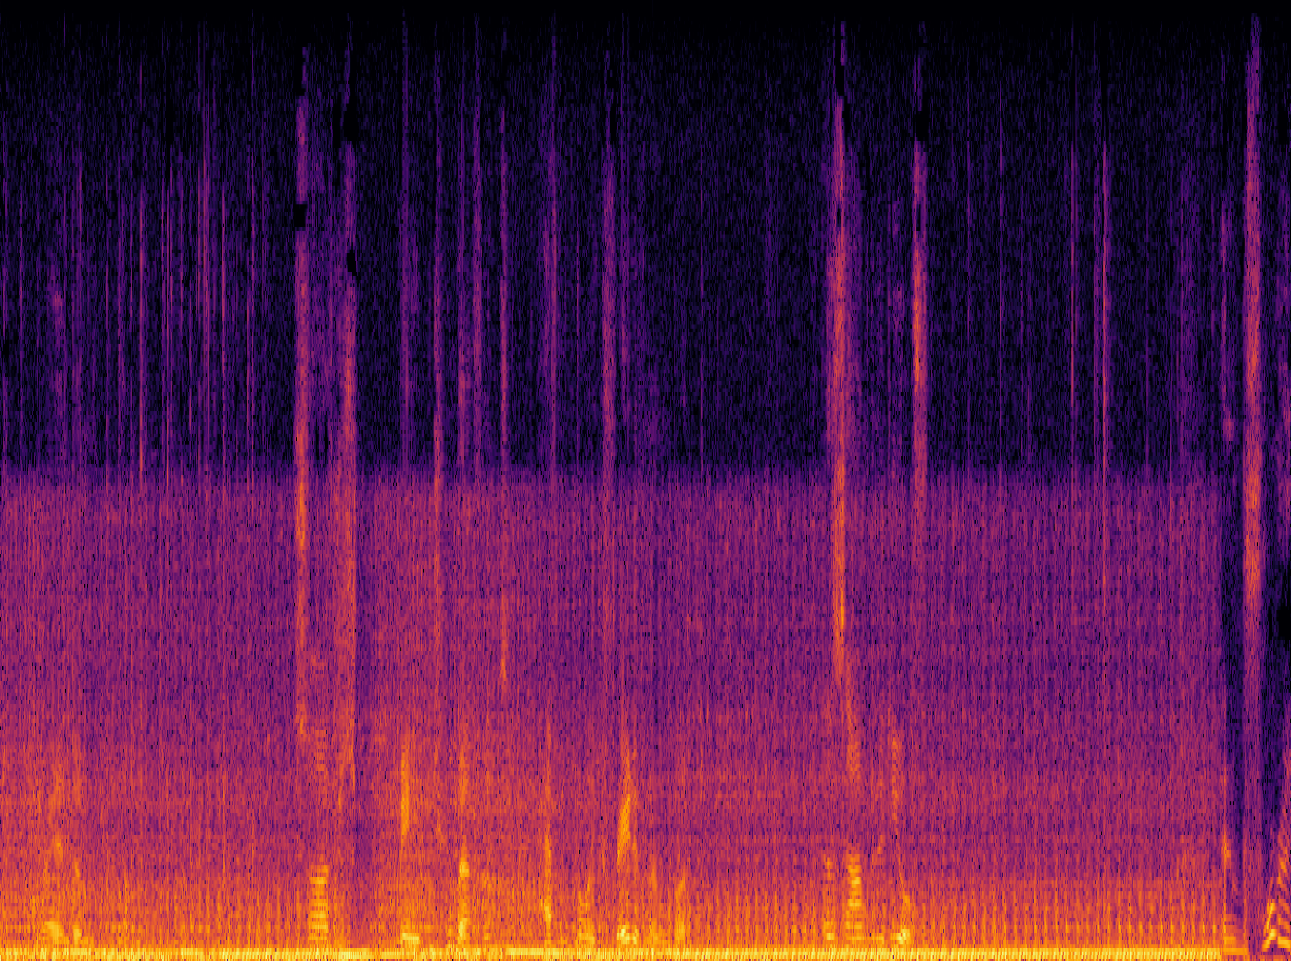
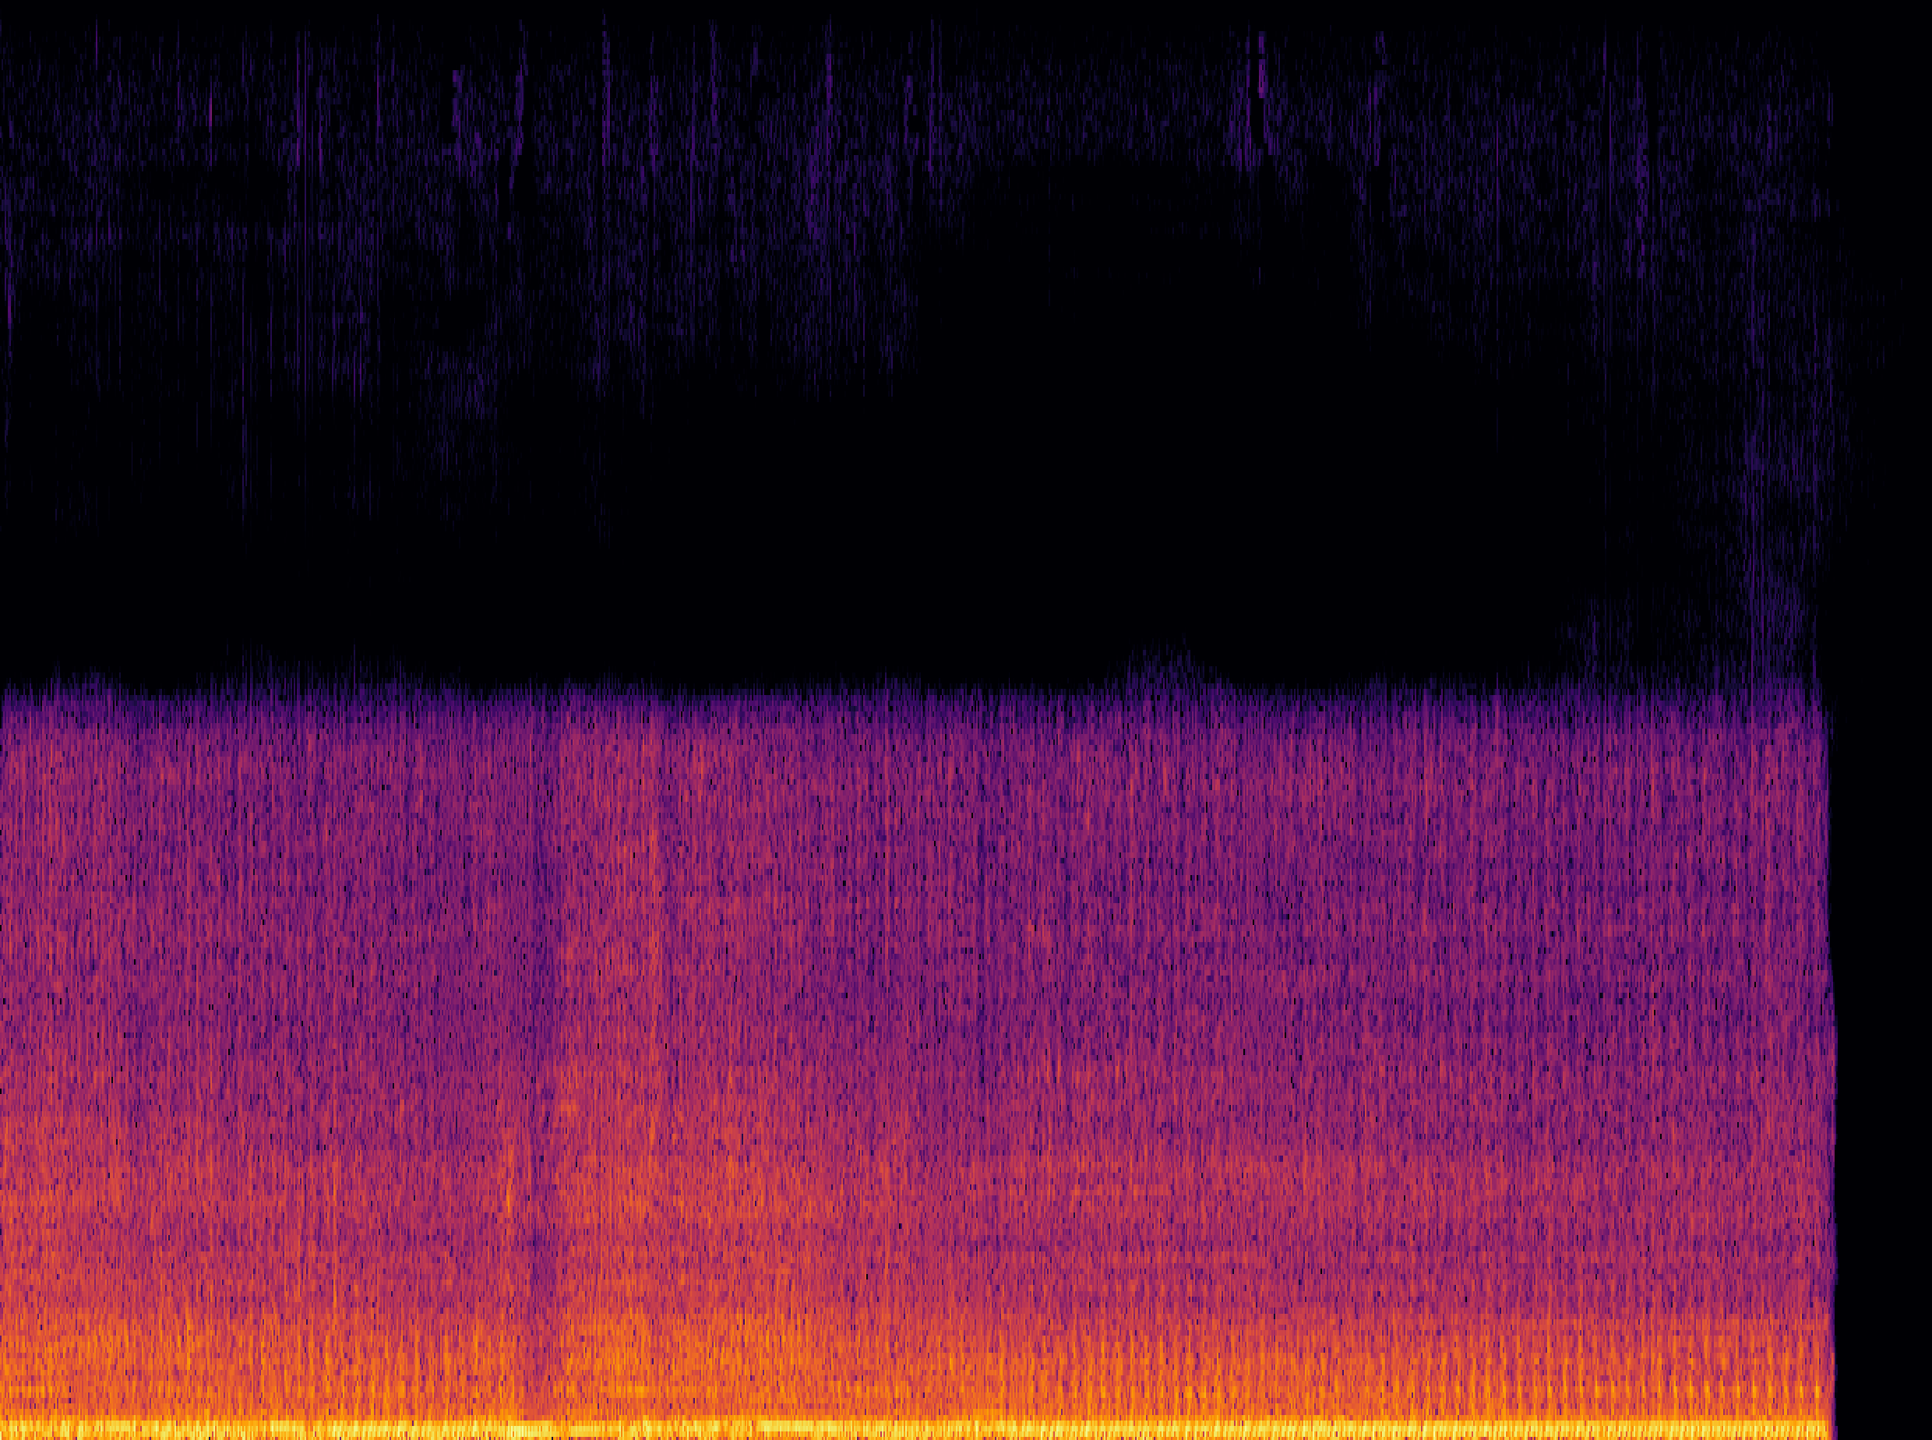
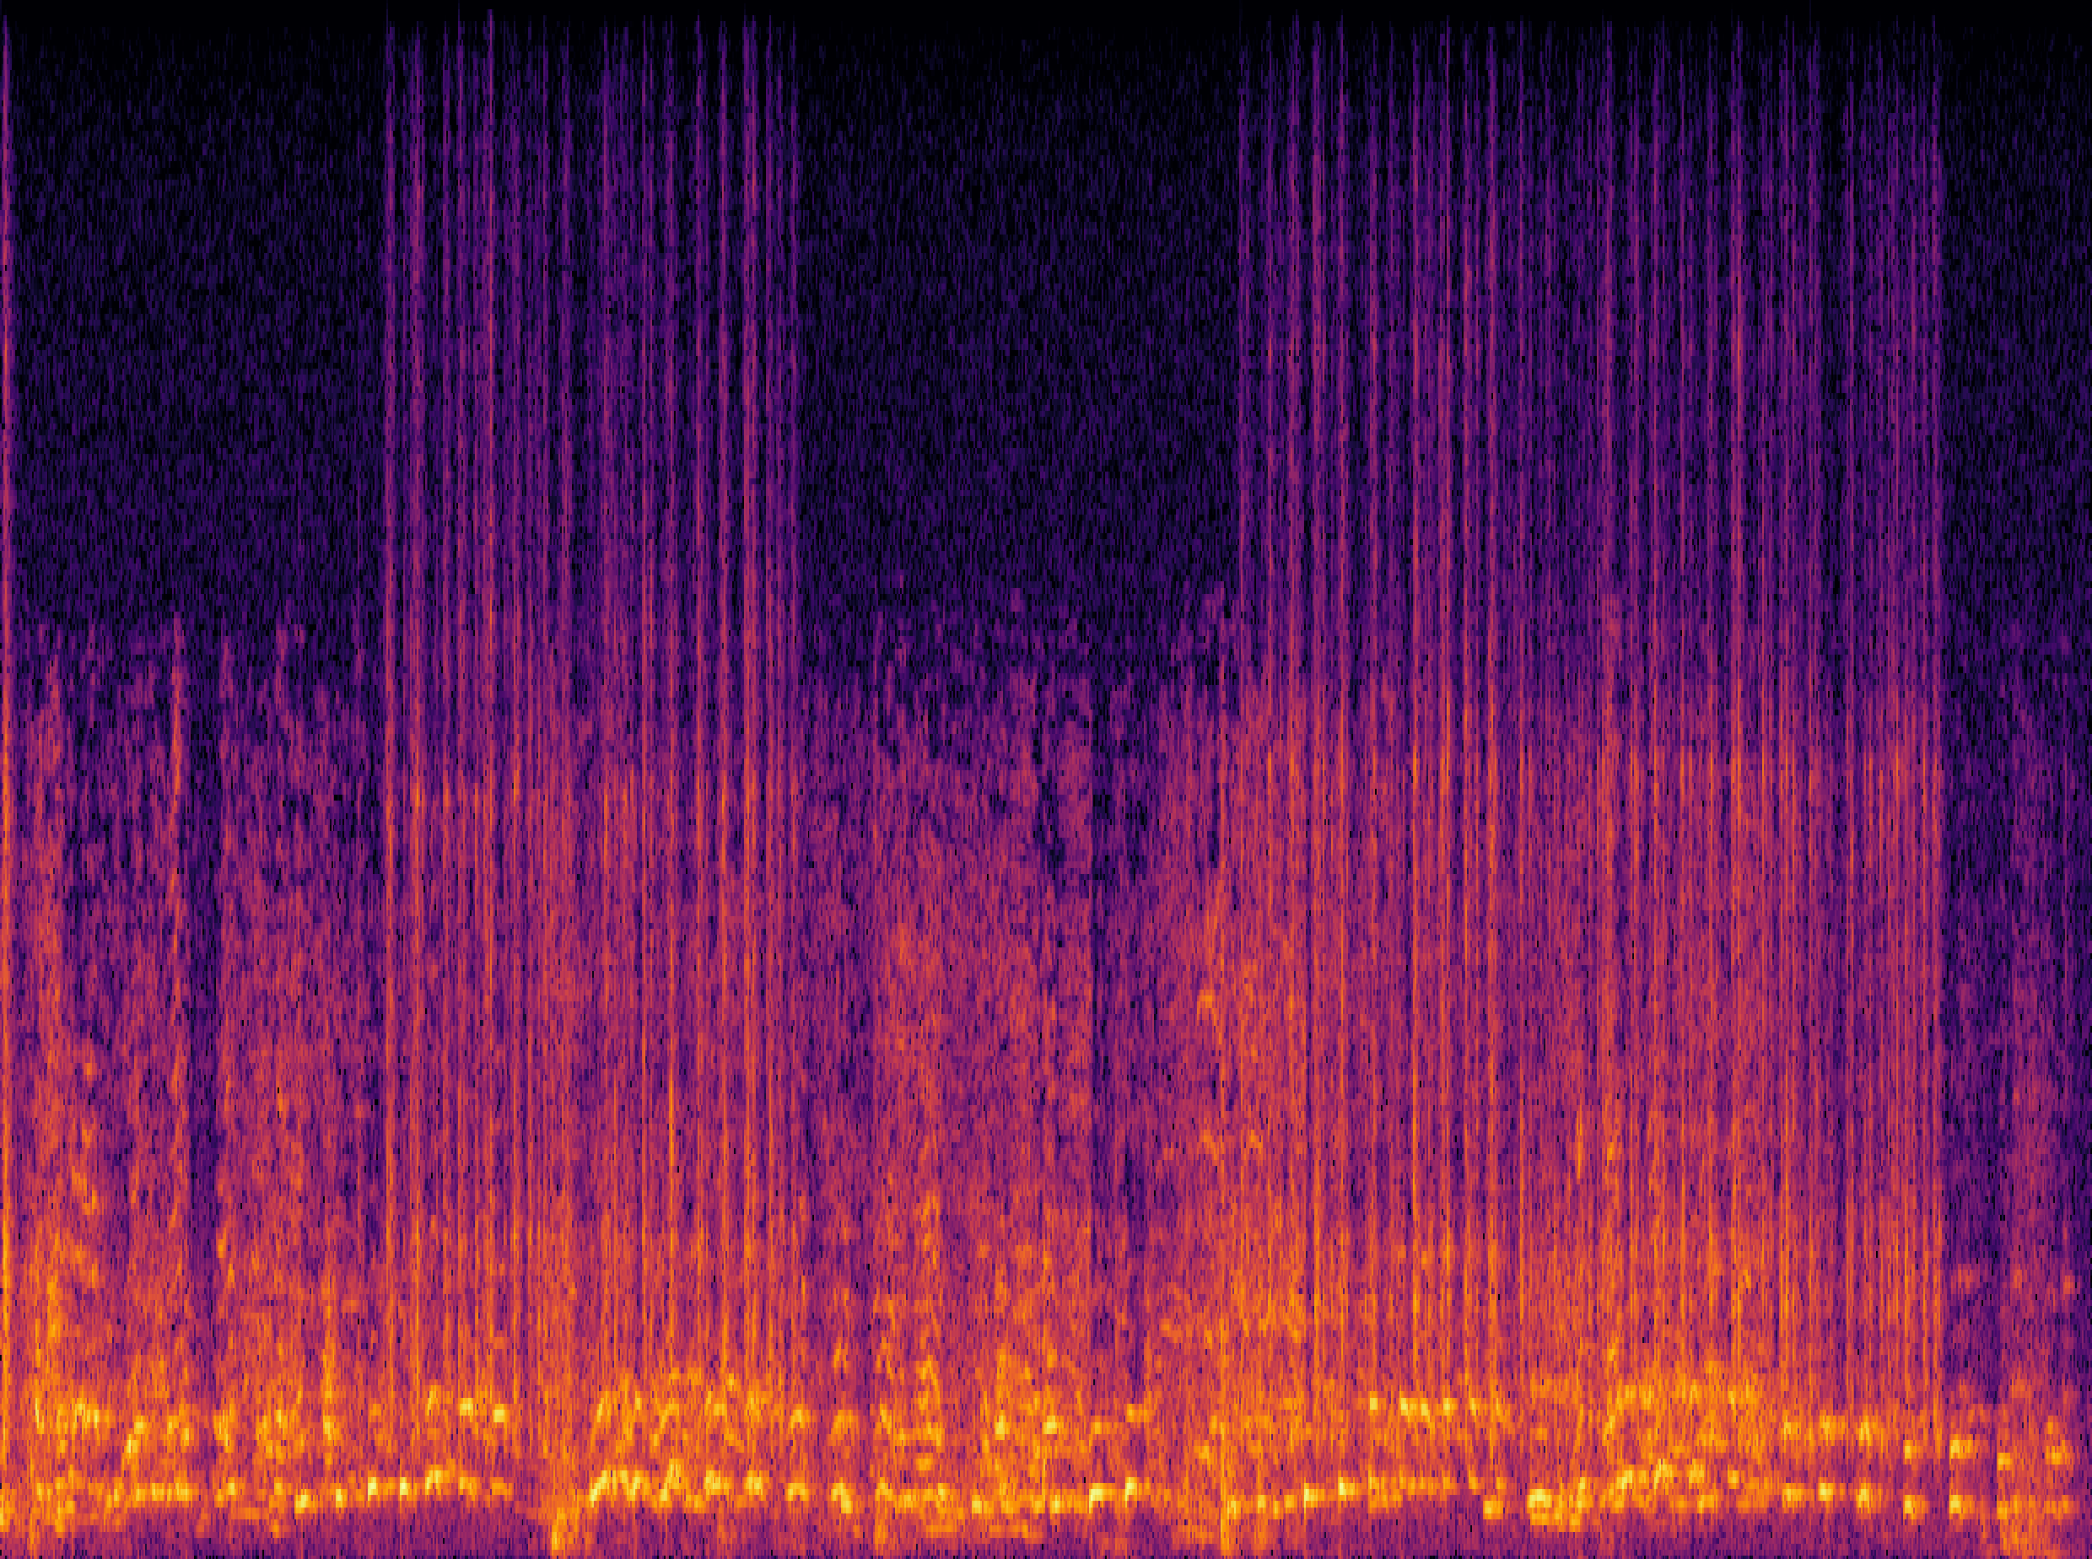
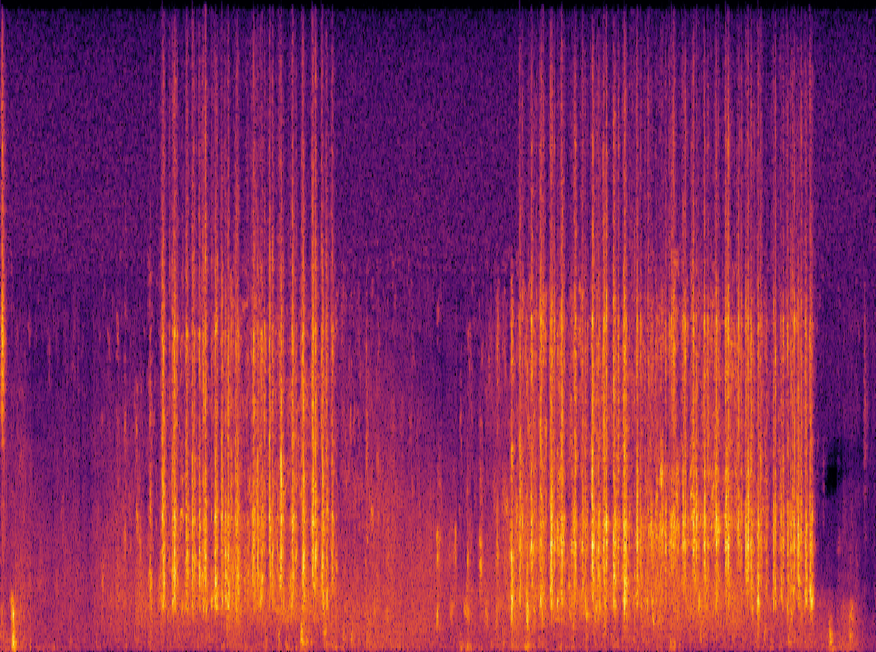
AudioSep: Sound Demos
Human query: “The engine sound of a vehicle”
Mix
Separated
Human query: “The sound of hitting the keyboard”
Mix
Separated
Notes:
In this section, I will show you, what is audio-visual multi-speaker tracking, what is its application, which challenges are often met, and I will show you some popular multi-tracking methods and their drawbacks.

Slide 41
Method 2: FlowSep
Existing Ideas:
A “New” Idea:
  Discriminative approaches.
  Time-frequency masking on spectrogram to remove the noise sound sources.
  Using the generative approaches.
  Diffusion-based generation framework with rectified flow matching.
  Separation system by generating new audio samples with the noise clips and text prompts as a condition.
Challenges:
  Challenging with overlapping sound events.
  Excessive and insufficient masking leads to artifacts, including spectral holes and incomplete separation.
Notes:
In this section, I will show you, what is audio-visual multi-speaker tracking, what is its application, which challenges are often met, and I will show you some popular multi-tracking methods and their drawbacks.

Slide 42
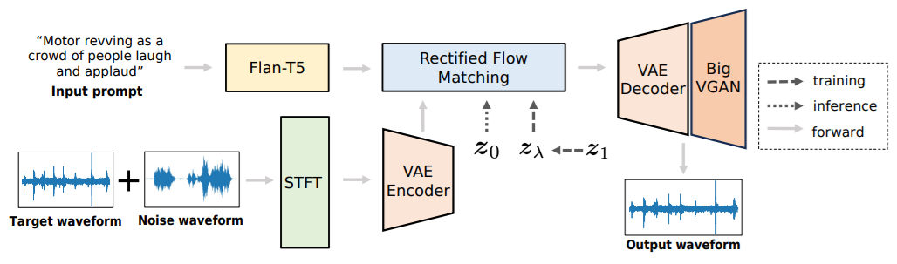

FlowSep: Architecture
  Text-to-audio generation model as the backbone, Rectified Flow Matching for feature generation.
  Extended VAE latent space to integrate the noise audio feature.
  Flan-T5 text encoder, VAE latent decoder and BigVGAN vocoder.
Y. Yuan, X. Liu, H. Liu, M.D. Plumbley, and W. Wang,“FlowSep: Language-queried sound separation with rectified flow matching" in ICASSP 2025.
Notes:
In this section, I will show you, what is audio-visual multi-speaker tracking, what is its application, which challenges are often met, and I will show you some popular multi-tracking methods and their drawbacks.

Slide 43
Training Data
  A total of 1,680 hours of audio from various datasets for training. When creating the mixture audio samples, every two audio clips are ensure not sharing any overlapping sound source classes. All the segments are padded or cropped to 10 seconds with 16kHz sampling rate, and we mixture two waveform with a random SNR between -15 and 15 dB.
  AudioCaps
    One of the largest publicly available audio captioning dataset, containing 49837 10-second audio clips with human annotated captions.
  VGGSound
    Audio dataset with 200,000 audio clips. Each sample has a duration of 10 seconds and annotated with labels.
  WavCaps
    Large-scale audio dataset with weakly-labelled captions generated with LLM. We only use the samples less than 10 seconds and collected a total of 400,000 clips.
Notes:
In this section, I will show you, what is audio-visual multi-speaker tracking, what is its application, which challenges are often met, and I will show you some popular multi-tracking methods and their drawbacks.

Slide 44
Evaluation Data
  VGGSound
    2000 mixtures generated from a group of 200 clean and distinct audio samples, mixed with random LUFS loudness between -35 and -25 dB.
  ESC-50
    2000 mixtures with a SNR at 0 dB.
  AudioCaps
    928 samples by mixing the audio from testing set under random SNR rate between -15 and 15 dB.
  DCASE2024 Task 8
    DCASE-Synth includes 3000 mixtures from 1000 selected audio clips under an SNR rate between -15 and 15 dB.
    DCASE-Real consists of 100 audio clips from read-world scenarios.
Notes:
In this section, I will show you, what is audio-visual multi-speaker tracking, what is its application, which challenges are often met, and I will show you some popular multi-tracking methods and their drawbacks.

Slide 45
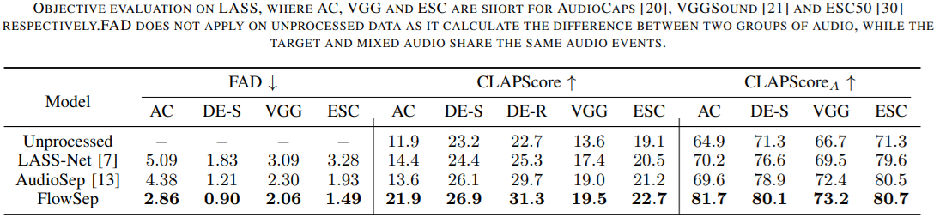
Experimental Results
  Unlike discriminative network that modify on the original audio clips, generated results do not strictly align with the target audio sample in the temporal dimension.
  Hence, traditional objective metrics are not suitable for generative based models.
  We apply FAD, CLAPScore and CLAPScoreA from generative tasks to evaluate the performance.
45
Notes:
In this section, I will show you, what is audio-visual multi-speaker tracking, what is its application, which challenges are often met, and I will show you some popular multi-tracking methods and their drawbacks.

Slide 46
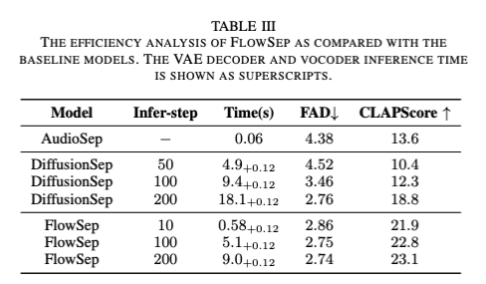

Experimental Results (Cont.)
  Results on subjective evaluations.
  Ablation studies between RFM and traditional diffusion-based models.
46
Notes:
In this section, I will show you, what is audio-visual multi-speaker tracking, what is its application, which challenges are often met, and I will show you some popular multi-tracking methods and their drawbacks.

Slide 47


FlowSep – Sound Demos
  Baseline models show incomplete separation with noticeable spectral gaps.
  FlowSep demonstrates promising capabilities in such situations.
  More demos please refer to https://audio-agi.github.io/FlowSep_demo/.
47
Y. Yuan, X. Liu, H. Liu, M.D. Plumbley, and W. Wang,“FlowSep: Language-queried sound separation with rectified flow matching" in ICASSP 2025.
Notes:
In this section, I will show you, what is audio-visual multi-speaker tracking, what is its application, which challenges are often met, and I will show you some popular multi-tracking methods and their drawbacks.

Slide 48

FlowSep 2
Y. Yuan, X. Liu, H. Liu, X. Kang, M. D. Plumbley, W. Wang, “FlowSep 2: Self-supervised flow matching for language-queried audio source separation", submitted to IEEE Transactions on Audio Speech and Language Processing, August 2026. https://arxiv.org/pdf/2608.22111
Notes:
In this section, I will show you, what is audio-visual multi-speaker tracking, what is its application, which challenges are often met, and I will show you some popular multi-tracking methods and their drawbacks.

Slide 49


FlowSep 2 – Training and Testing Datasets
Notes:
In this section, I will show you, what is audio-visual multi-speaker tracking, what is its application, which challenges are often met, and I will show you some popular multi-tracking methods and their drawbacks.

Slide 50


FlowSep 2 – Key Results
Notes:
In this section, I will show you, what is audio-visual multi-speaker tracking, what is its application, which challenges are often met, and I will show you some popular multi-tracking methods and their drawbacks.

Slide 51










FlowSep 2 - Demos
Prompt
"A couple of men speaking as metal clanks and a power tool operates"
"An aircraft engine is taking off"
Mixture
SAM Audio
FlowSep
FlowSep2
Ground Truth
https://audio-agi.github.io/Flowsep2-demo/
Notes:
In this section, I will show you, what is audio-visual multi-speaker tracking, what is its application, which challenges are often met, and I will show you some popular multi-tracking methods and their drawbacks.

Slide 52

DCASE Challenge –Task 10
52
https://dcase.community/challenge2024/task-language-queried-audio-source-separation
Notes:
In this section, I will show you, what is audio-visual multi-speaker tracking, what is its application, which challenges are often met, and I will show you some popular multi-tracking methods and their drawbacks.

Slide 53

Controllable Audio Editing:
RFM-EDITING & RFM-EDITING2
Demos here:
https://katelin-glt.github.io/RFM-Editing-Demo/
Remove continuous frying noises:
Original:
Edited:
Replace someone suddenly sneezes out loud with several pigeons cooing:
Original:
Edited:
L. Gao, Y. Yuan, Y. Chen, Y. Cheng, Z. Li, J. Wen, S. Zhang, and W. Wang, "RFM-EDITING: Rectified flow matching for text-guided audio editing," in Proc. IEEE International Conference on Acoustics, Speech and Signal Processing (ICASSP 2026), Barcelona, Spain, May 4-8, 2026. [PDF]
L. Gao, Y. Zhu, Y. Chen, D. Wang, S. Zhang, Z. Li, J.Y. Guillemaut, W. Wang, “RFM-Editing 2: Text-guided audio editing with rectified flow matching and coarse-to-fine diffusion transformers,” submitted to IEEE Trans. On Audio Speech and Language Processing, July 2026. https://arxiv.org/abs/2606.20101v3

Slide 54

Controllable Speech Editing: SFM-Adapter
The goal of Speech Style Edit: Change How Speech Sounds, Not What It Says !
Main framework: a reconstruction-based diffusion architecture that can incorporate external style conditions (e.g., natural language and audio).
Source
Audio Prompt
Target
Edited
Text Prompt
Speaking with intention, her unhappy voice held a high pitch and low energy.
A fatigued disconsolate male voice, characterized by a slow speaking speed and a deep, low pitch, emits a subtle energy, resulting in a soothing audio experience that exudes tranquility.
Y. Chen, H. Liu, Q. Chen, A. Singh, J. Zhao, W. Wang, P. J. B. Jackson, M. D. Plumbley, "SFM-Adapter: Style-aware feature manipulation adapter for speech style editing", IEEE Transactions on Audio Speech and Language Processing, 2026. [PDF] [code, data, & demo], vol. 34, pp. 3132-3145, 2026.

Slide 55
Summary & Future Directions
Summary:
Language queried audio source separation offers helpful and flexible tools for users to control what sound to be separated from the sound mixtures, using natural language-based queries.
FlowSep & FlowSep2 offers better separation results than AudioSep, meaning generative models perform better as compared with time-frequency masks-based models.
Rectified flow matching based loss works better than diffusion loss. Self-supervised flow representation further improves the results of flow matching.
Future directions:
Explore advanced reasoning capabilities of LALMs for LASS (e.g., separating complex queries like "the second sound" or "annoying sounds").
Further scale the datasets and improve diversities of datasets.
Improve generalisation to more and unseen sound classes.
Apply self-supervised techniques (e.g., MixIT) for pre-training to enhance separation performance.
Include additional modalities (e.g. visual, EEG).
55
Notes:
In this section, I will show you, what is audio-visual multi-speaker tracking, what is its application, which challenges are often met, and I will show you some popular multi-tracking methods and their drawbacks.

Slide 56

Take Away: Papers, Codes, Data, Demos
AudioLDM:
Paper: https://arxiv.org/abs/2301.12503
Project Page: https://audioldm.github.io/
Pretrained model: https://github.com/haoheliu/AudioLDM
Evaluation tools: https://github.com/haoheliu/audioldm_eval
YouTube: https://www.youtube.com/watch?v=_0VTltNYhao
AudioLDM2:
Project Page: https://audioldm.github.io/audioldm2/
APT:
Code: https://github.com/JinhuaLiang/APT
SemantiCodec:
Paper/code/demos at project page:
https://haoheliu.github.io/SemantiCodec/
WavCraft:
Code: https://github.com/JinhuaLiang/WavCraft
AudioSep & FlowSep & FlowSep2:
https://github.com/Audio-AGI/AudioSep
https://audio-agi.github.io/FlowSep_demo/
https://audio-agi.github.io/Flowsep2-demo/
RFM-EDITING & RFM-EDITING2:
https://katelin-glt.github.io/RFM-Editing-Demo/
WavJourney:
Paper: https://arxiv.org/abs/2307.14335
Code: https://github.com/Audio-AGI/WavJourney
Demo: https://huggingface.co/spaces/Audio-AGI/WavJourney
AudioSetCaps:
Data and code: https://github.com/JishengBai/AudioSetCaps
https://huggingface.co/datasets/baijs/AudioSetCaps
WavCaps:
Paper: https://arxiv.org/abs/2303.17395
Code: https://github.com/xinhaomei/wavcaps
SFM-Adapter: https://ychenn1.github.io/SFM-Adapter/
Sound-VECaps: paper, data & code:
https://yyua8222.github.io/Sound-VECaps-demo
GCDance: paper, data & code:
https://xinranliu7715.github.io/gcdance/
More code about other works avaliable at:
https://github.com/XinhaoMei/DCASE2021_task6_v2
https://github.com/XinhaoMei/ACT
https://github.com/liuxubo717/cl4ac

