Slide 1


Large Language-Audio Models and Applications
Wenwu Wang
Centre for Vision, Speech and Signal Processing (CVSSP)
& Surrey Institute for People Centred Artificial Intelligence
University of Surrey
United Kingdom
Email: w.wang@surrey.ac.uk
Web: https://personalpages.surrey.ac.uk/w.wang/

Slide 2



Many thanks to…
Xinhao Mei
Haohe Liu
Xubo Liu
Jinhua Liang
Yi Yuan
Yiming Zhang
Qiuqiang Kong
Yuelan Cheng
Zehua Chen
Xinran Liu
Mark Plumbley
Turab Iqbal
Jianyuan Sun
Jian Guan
Feiyang Xiao
Yong Xu
Yin Cao
Jinzheng Zhao
Yuxuan Wang
Qiaoxi Zhu
Volkan Kilic
Zehua Chen
Zhanyu Ma
Danilo Mandic
Philip Jackson
Qiang Huang
David Frohlich
Emily Corrigan-Kavanagh
Marc Green
Andres Fernandes
Christian Kroos
Trevor Cox
Arshdeep Singh
…
Funding from:
UK Engineering and Physical Sciences Research Council (EPSRC) & British Council Newton Institutional Links Award

Slide 3
Outline
Introduction
Large audio models & large language models
Large language-audio models
  Example models & datasets
  Typical methods for fusing/aligning audio and language
  Open challenges
  Integration of audio and language models
Applications of LLAMs to audio related tasks
  Audio captioning (e.g. audio to text generation)
  Audio question answering and reasoning
  Text to audio generation & composition & storytelling
  LLMs for controllable audio editing
Conclusions and future works

Slide 4
Audio Signal Processing
Tasks:
Audio source separation
Audio source localisation/tracking
Audio event detection/localisation
Audio scene classification
Audio tagging
Audio search and retrieval
Audio rendering
Audio recognition
…
Models:
Physics-based models
Perceptually motivated models
Data-driven models
Hybrid models
….
Data:
Audio-only
Multimodal (audio, visual, texts, EEG, etc)

Slide 5
(Large) Audio Models
Learning general/universal audio representations from large scale audio data shows promising performance in downstream tasks (classification, separation, retrieval, etc):
PANNs (Kong, et al, 2020): large scale CNN-based audio model
Audio2Vec (Tagliasacchi et al, 2020): sequence to sequence unsupervised model
CLAR (Al-Tahan and Mohsenzadeh, 2021): self-supervised model
COLA (Saeed et al, 2021): self supervised model
BOYL-A (Niizumi et al, 2021): self supervised model
AST (Gong et al, 2021): large scale transformer-based audio model
ATST (Li and Li, 2022): transformer-based model
MAE-AST (Baade et al, 2022): self-supervised model
SSAST (Gong et al, 2022): self-supervised AST model
Audio-MAE (Huang et al, 2022): self-supervised model
BEATs (Chen et al, 2023): Audio pre-training with acoustic tokenizers
ASiT (Atito et al, 2024): self-supervised models for general audio representation
mean Average Precision (mAP) on AudioSet: 31.4 (2017) -> 50.6 (2023)

Slide 6
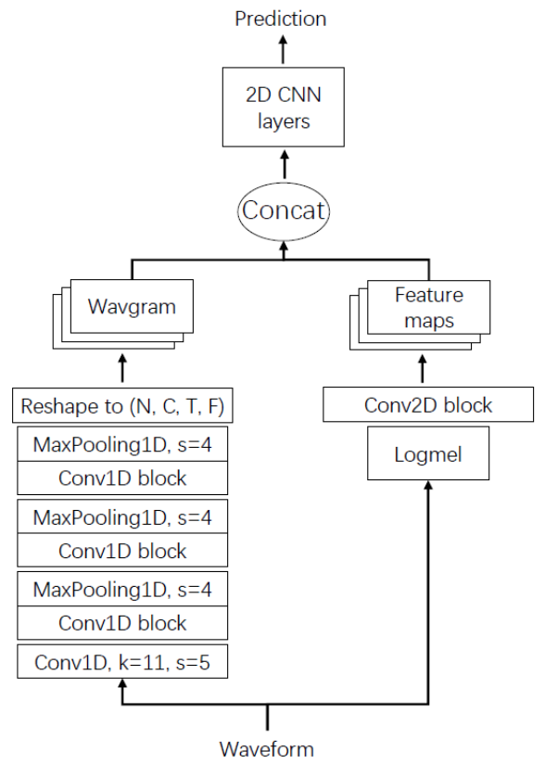
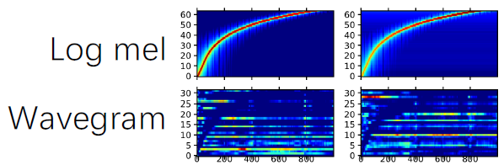
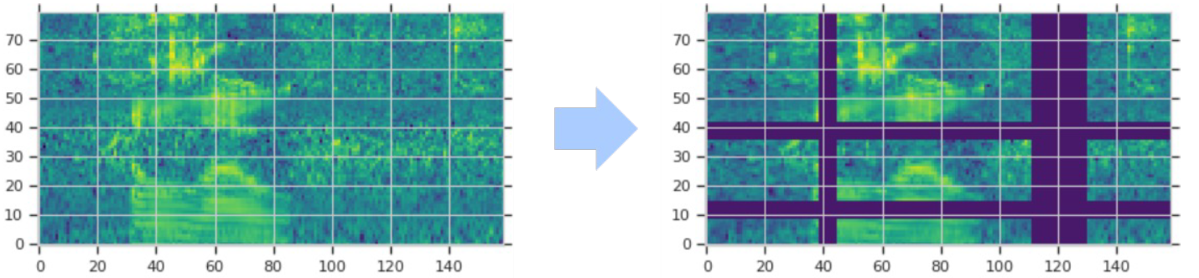
PANNs: Large-Scale Pre-trained Audio Neural Networks
Wavegram-Logmel-CNN for AudioSet tagging
Time-domain (“Wavegram”), plus
Log mel spectrogram
Data augmentation, e.g. use SpecAugment:
randomly mask time and frequency stripes of log mel spectrogram
Q. Kong, Y. Cao, T. Iqbal, Y. Wang, W. Wang, and M. D. Plumbley, "PANNs: large-scale pretrained audio neural networks for audio pattern recognition", IEEE/ACM Transactions on Audio Speech and Language Processing, 2020.

Slide 7
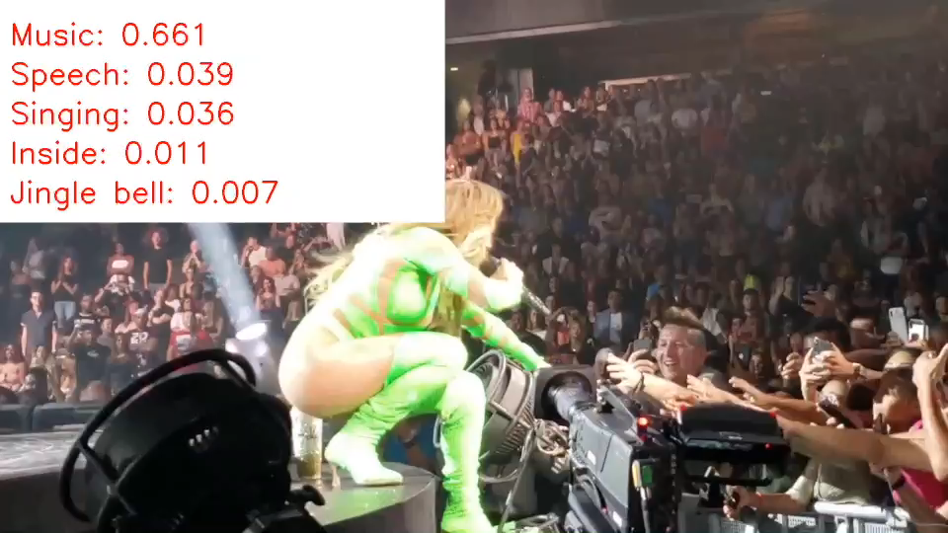
PANNs: Demo

Slide 8
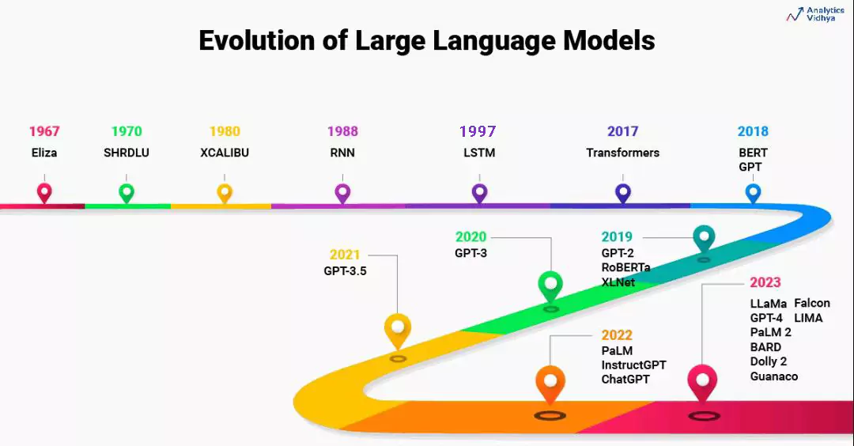
Large Language Models (LLMs)
Courtesy to Aravind Pai: https://www.analyticsvidhya.com/blog/2023/07/beginners-guide-to-build-large-language-models-from-scratch/

Slide 9
Large Language Models (LLMs)
Figures from Ryan O'Connor: https://www.assemblyai.com/blog/emergent-abilities-of-large-language-models/
Wei et al, “Emergent abilities of large language models,” Transactions on Machine Learning Research, 2022.

Slide 10
Large Language-Audio Models: Why?
Leverage knowledge within LLMs to address the limitations of audio models
  Zero-shot or few-shot classification
Explore homogeneity across tasks with LLMs
  Use LLMs as an agent to solve multi-task problems
Extend the capabilities of audio models for new tasks
  Extending from audio classification to audio captioning/question answering & reasoning
  Extending from audio generation to storytelling & controllable editing
  Extending from audio source separation to language queried audio source separation

Slide 11

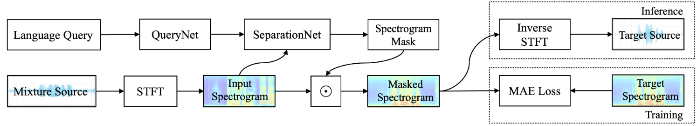

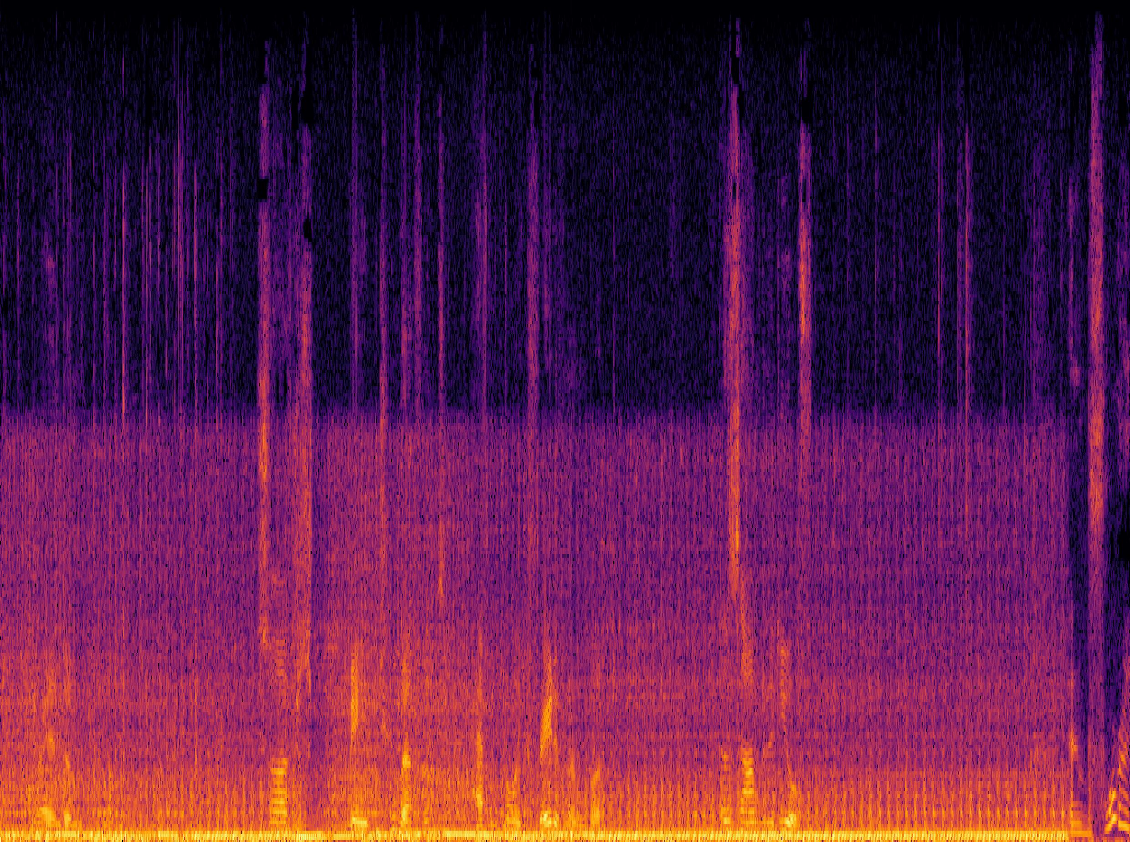
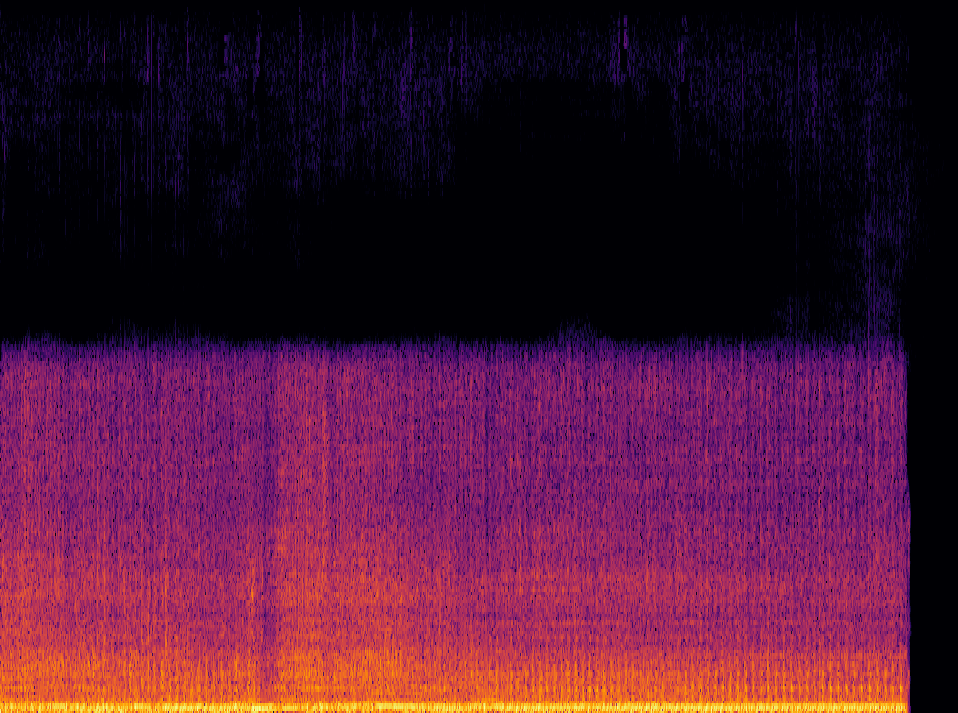
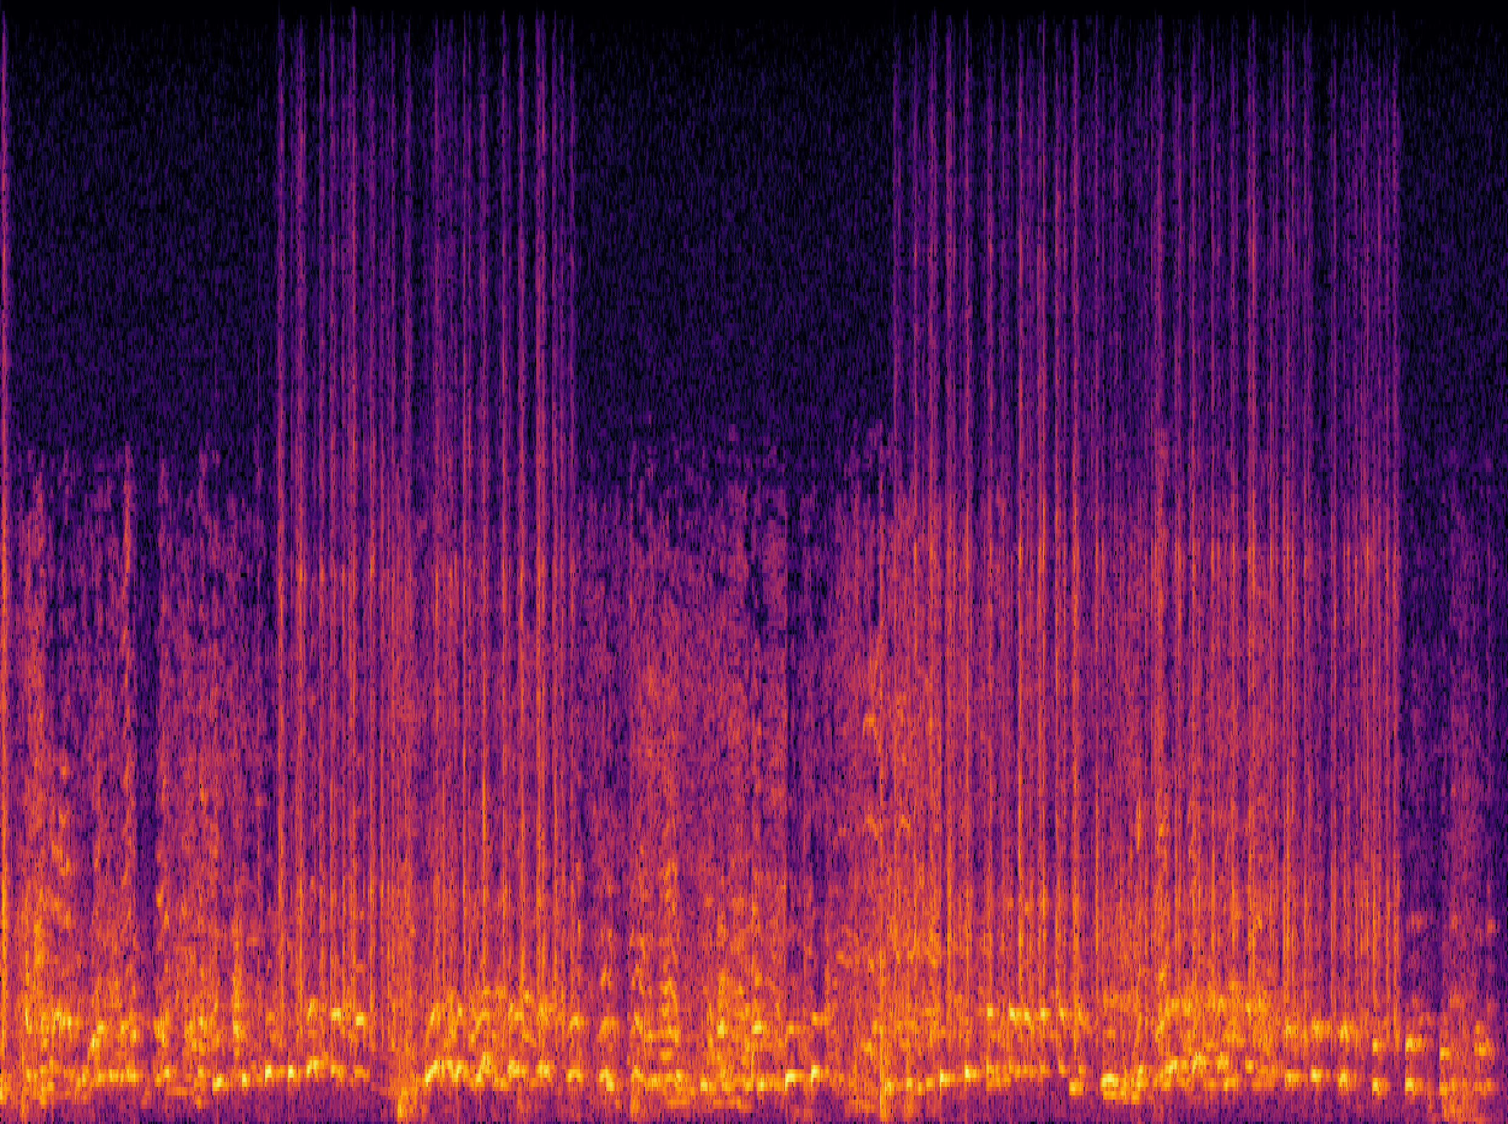
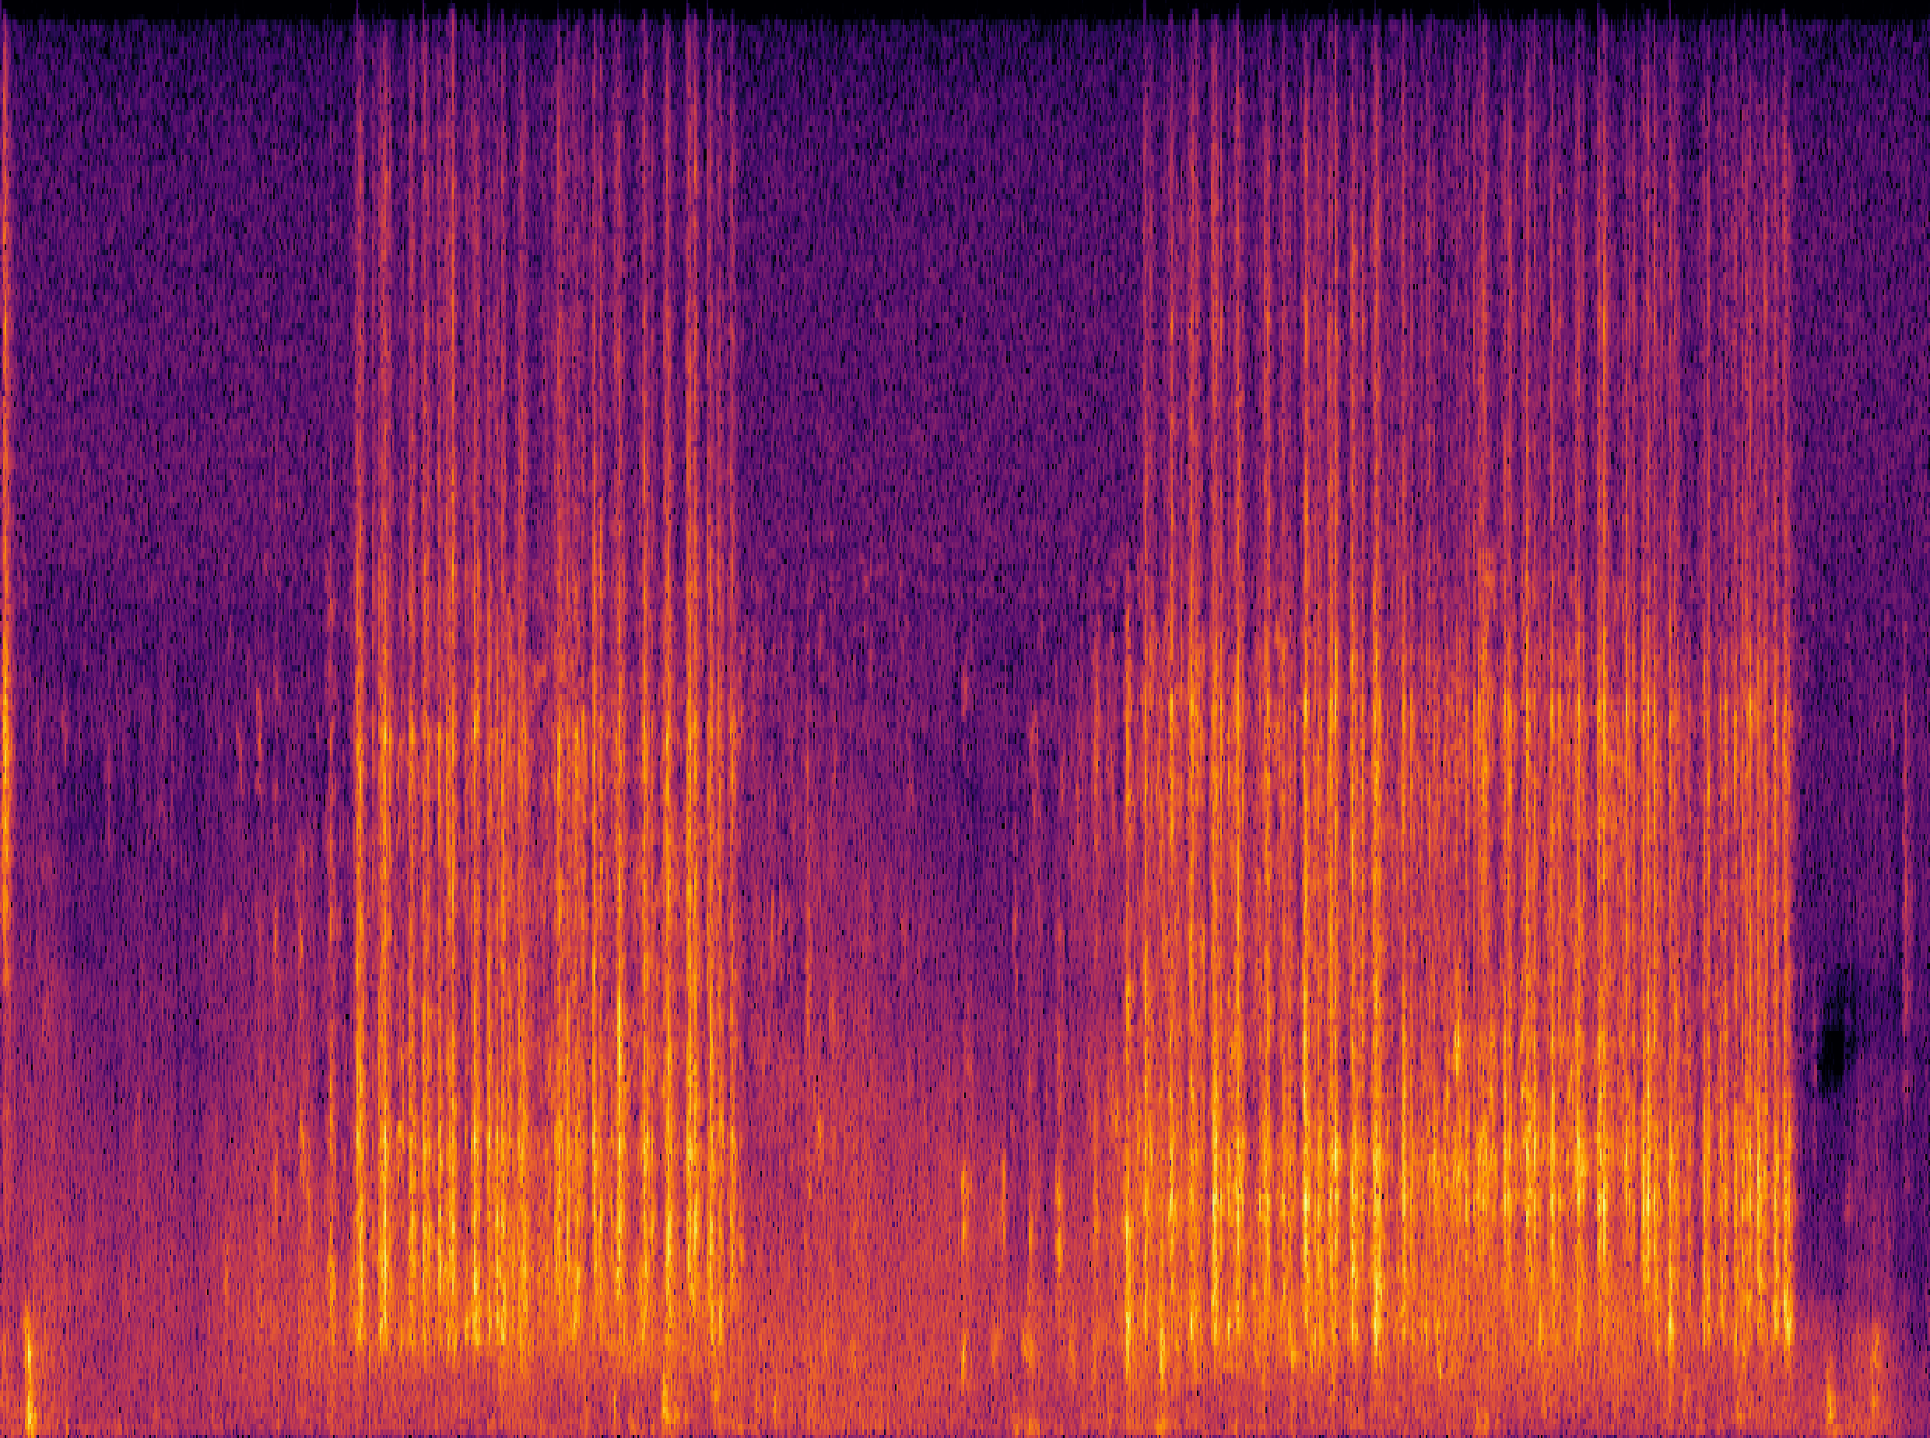
An Example: Language-Queried Audio Source Separation
Use language query to extract target source
BERT-mini
(Transformer-based)
ResUNet-based
separation net
Same shape as
input spectrogram
Mean absolute error for training
Human query: “The engine sound of a vehicle”
Human query: “The sound of hitting the keyboard”
Mix
Separated
Mix
Separated
X. Liu, H. Liu, Q. Kong, X. Mei, J. Zhao, Q. Huang, M.D. Plumbley, and W. Wang,"Separate What You Describe: Language-Queried Audio Source Separation," in Proc. 23rd Interspeech Conference (INTERSPEECH 2022), 18-22 September, 2022, Incheon, Korea.

Slide 12
Large Language Audio Models - Examples
Whisper: automatic speech recognition (ASR)
Wav2Vec 2.0: speech to text (STT)
DeepSpeech: open-source ASR
Coqui AI: speech synthesis and TTS
Jasper and QuartzNet: ASR
GPT-3 with Whisper: ASR + LLMs
Sonix.ai: speech transcription and analysis
SpeechBrain: platform for speech models
OpenSTT: ASR
Gemini: text/image/speech
WavLLM: speech LLMs
MuseNet: music instrumental composition & style transfer
MusicVAE: melody generation, remixing, and style interpolation
JukeBox: raw music with vocals and lyrics
Riffusion: text to music generation
MusicLM: text to music generation
REMI: symbolic music generation (e.g. MIDI)
DeepBach: classic music composition
AIVA: music generation assistant
Wav2CLIP (Wu et al, 2021): audio and language mapping
AudioCLIP (Guzhov et al, 2021): audio-text-image alignment
CLAP (Elizalde et al, 2022): audio-text alignment
CLAP-LAION (Wu et al, 2022): audio-text alignment
Pengi (Deshmukh et al. 2023): audio classification & AQA
Qwen-Audio (Chu et al, 2023): speech, music, general audio
AudioLM (Borsos et al 2022): Speech/music generation
LTU (Gong et al, 2023): audio QA and reasoning
SALMONN (Tang et al, 2023): speech-audio-music LLMs
ImageBind (Girdhar et al, 2023): image, text, audio, depth
ONE-PEACE (Wang et al, 2023): audio-text-image
AudioGPT (Huang et al, 2023): Speech, Music, Talking Head
UniAudio (Yang et al, 2024): speech/sound/music/singing
AudioLDM (Liu et al 2023): text to audio generation
AudioLDM 2 (Liu et al 2023): text to audio generation
Re-AudioLDM (Yuan et al 2024): text to audio generation
T-CLAP(Yuan et al 2024): audio-text alignment
WavCraft (Liang et al, 2024): text prompted audio editing
APT-LLM (Liang et al, 2024): LLM based AQA and reasoning

Slide 13
(Large) Language-Audio Multi-Modal Datasets
AudioCaps (Kim et al, 2019)
Clotho (Drossos et al, 2020)
SoundDescs (Koepke et al, 2021)
LAION-Audio-630K (Wu et al, 2023)
Auto-ACD (Xu et al. 2024)
WavCaps (Mei et al, 2023)
Sound-VECaps (Yuan et al, 2024)
AudioSetCaps (Bai et al, 2024)
CLEAR (Abdelnour et al, 2018)
DAQA (Fayek and Johnson, 2019)
Clotho-AQA (Lipping et al, 2022)
MUSIC-AVQA (Li et al, 2022)
mClothoAQA (Behera et al, 2023)
OpenAQA-5M (Gong et al, 2023)

Slide 14
Trends and Open Questions in LLAMs
Open challenges:
Fusion of audio and language models: aligning/fusing audio-text data
Applications to audio tasks: addressing existing challenges in audio tasks
Extending to multi-modality: text, audio, visual, or more modalities
Data scarcity: audio-language dataset shortage for building audio-language models
Extending to multi-tasks: exploring in new tasks & solving multi-task problems
Multi-lingual models and datasets: lacking multi-lingual models and datasets
Real-time streaming: demands for real-time processing for applications in live captioning, gaming, and customer service
Low-resource language support: growing interest in training models for underrepresented languages for inclusiveness
Safety issues: growing concerns about toxicity and privacy issues
Explaining models: explaining and interpreting different choices and decisions made by the model
Object hallucination: struggling in answering discriminative questions related to the identification of specific object sounds within an audio clip
Performance evaluations: lack of common evaluation protocols, tools and benchmarks
Applications:
Accessibility, voice assistants, content creation, and human-computer interaction

Slide 15
Typical Methods for Fusing Audio and Language
Aligning audio-texts with contrastive pretraining
  Examples: CLAP, CLAP-LAION, AudioCLIP, Wav2CLIP, T-CLAP, etc.
Tokenizing audio and texts, then followed by LLMs
  Examples: Moshi, VITA, LSLM, Voicebox, FunAudioLLM, LauraGPT, etc.
Fusing embeddings with cross-attention
  Examples: Q-former
Cascading acoustic models with LLMs
  Examples: naive ASR+LLM+TTS
Combination of the above schemes
  Examples: SPIRIT-LM, Spectron, etc.

Slide 16
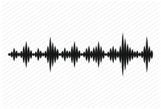
Task 1: Audio to Text Generation
Automated audio captioning (AAC) is a cross-modal translation task which aims at generating a natural language description given an audio clip.
This task requires detecting the audio events and their spatial-temporal relationships and describing these information using natural language.
Applications
  Audio retrieval
  Assist hearing-impared to understand environmental sounds
  Subtitle for sounds in TV programs
AAC started in 2017, and has received increasing attention in recent three years with freely available datasets released and being held as a task in DCASE Challenges 2020-2022.
AAC system
“a woman talks nearby as water pours”

Slide 17
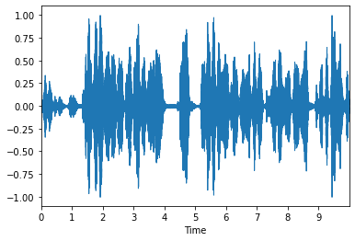
Existing Methods
Model Architecture
  All proposed methods are based on the encoder-decoder paradigm ultilizing deep learning techniques
    RNN-RNN (2017)
    CNN-RNN (2019)
    CRNN-RNN(2020)
    CNN-Transformer(2020)
    Transformer-Transformer(2021)
    Pre-trained models (2021)
    Large language models (2022, 2023, 2024)
    Contrastive language-audio pretraining (2022, 2023, 2024)
Training
  Cross-entropy training with maximum likelihood estimation
  Reinforcement learning
Auxiliary Information
  Keywords or tag information
  Sentence information
  Pre-trained models
  Data augmentations
Audio Signal
Encoder
Audio Features
Decoder
“a woman talks near by as water pours”
Generated Caption
X. Mei, X. Liu, M.D. Plumbley, and W. Wang, “Automated audio captioning: an overview of recent progress and new challenges," EURASIP Journal on Audio Speech and Music Processing, 2022.

Slide 18
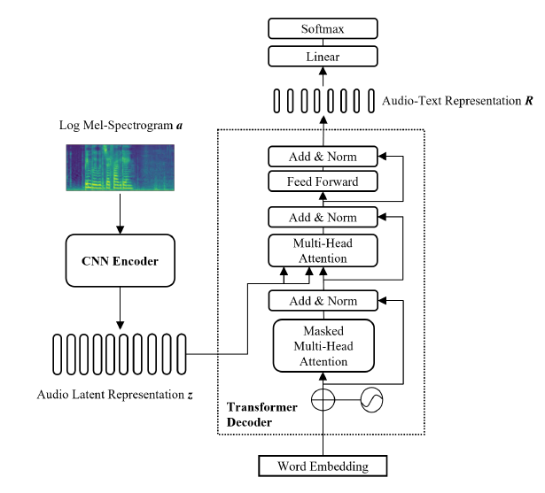
An Example: CNN-Transformer Encoder-Decoder
Common challenges in automated audio captioning:
Data scarcity
Representations of audio, text and audio-text
Diversity of captions
Multi-lingual captioning
Interactions with other modalities (e.g. vision)
….

Slide 19
Diverse Audio Captioning
Motivation
  Existing models tend to generate deterministic (i.e. generating a fixed caption for a given audio clip), generic (i.e. generating same captions for similar audio clips), and simple (i.e. using simple and common words) captions.
  Different people may describe an audio clip from different aspects using distinct words, phrases and grammars.
  We argue that an audio captioning system should have the ability to generate diverse captions for a fixed audio clip and across similar audio clips.
Each audio clip in Clotho dataset has five diverse reference human-annotated captions.
Models trained on Clotho with MLE encourage the use of high frequent n-grams occurred in references, which leads to generic and simple captions.
Examples
 | Ground Truth | CNN-Transformer trained with MLE (Beam search with size 5)
Cap_1 | A drill starts and stops four times with brief stops in between. | a jackhammer is being used to start a stop
Cap_2 | A jackhammer digs into concrete, taking occasional short breaks. | a jackhammer is being used to get a stop
Cap_3 | A jackhammer is being operated on a concrete surface. | a jackhammer is being used to start up and down
Cap_4 | A small jackhammer rattles as it works at another hard object. | a jackhammer is being used to start up
Cap_5 | Outdoors manually operated jack hammer or a tool | a jackhammer is being used to start a halt

Slide 20
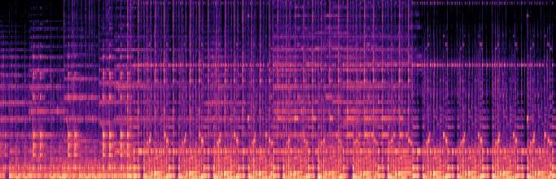
Diverse Audio Captioning
Methods
  We propose an adversarial training framework for audio captioning based on a conditional generative adversarial network (C-GAN).
  After training with MLE, the model is trained in an adversarial training manner to encourage diversity.
  This framework is agnostic to the architecture of the caption generator.
  We select CNN-Transformer as our generator.
Language
Evaluator
Generator
probability of human-annotated
0.9
probability of semantic relevant
a man is speaking <eos>
0.7
Sigmoid
Transformer
FC
CNN
Cosine Similarity
CNN
GRU
GRU
GRU
GRU
GRU
GRU
GRU
GRU
Random vector z
Naturalness
Discriminator
<sos> a man is speaking
Semantic
Evaluator
a
man
is
speaking
a
man
is
speaking
X. Mei, X. Liu, J. Sun, M. Plumbley, W. Wang, "Diverse audio captioning via adversarial training", in Proc. IEEE International Conference on Acoustics, Speech and Signal Processing (ICASSP 2022), Singapore, 22-27 May, 2022.
X. Mei, X. Liu, J. Sun, M. Plumbley, W. Wang, “Towards generating diverse audio captioning via adversarial training", arXiv:2212.02033, IEEE/ACM Transactions on Audio Speech and Language Processing, vol. 32, pp. 3311-3323, 2024.

Slide 21
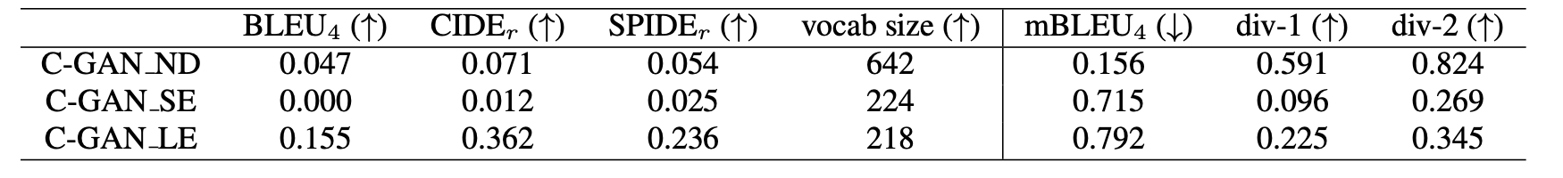
Diverse Audio Captioning
Ablation Study
When only using the naturalness discriminator, the model would generate random captions which are irrelevant to the given audio clip, thus these captions would be diverse but were not semantically faithful to the audio clip.
When only using the semantic evaluator, the system cannot even generate reasonable sentences, but instead some disordered and repetitive words.
When only optimizing CIDEr, the n-gram based evaluation metrics drops slightly, compared to the MLE model, as a random vector is appended to encourage the diversity of generated captions.
Example
 | C-GAN | CNN-Transformer trained with MLE (Beam search with size 5)
Cap_1 | a loud buzzing occurs and then starts again | a jackhammer is being used to start a stop
Cap_2 | a jackhammer is being started and then slows down | a jackhammer is being used to get a stop
Cap_3 | a loud drilling occurs and then slows down | a jackhammer is being used to start up and down
Cap_4 | an old engine is running and then loud squealing | a jackhammer is being used to start up
Cap_5 | a loud drilling occurs and then starts again | a jackhammer is being used to start a halt

Slide 22
ACTUAL: AC with Caption Feature Space Regularization
Problems/Motivations:
  Existing audio captioning models are often trained by one-to-many audio caption pairs, in which each audio clip is randomly paired with one of the relevant captions in each training iteration. This may lead to significant variations during the process for model optimization.
  Using all the captions of the same audio simultaneously could lead to compromise in input diversity and model performance (i.e. 7.5% degradation in SPIDEr).
Ideas: ACTUAL: caption feature space regularization:
  (i) In the first stage, a proxy caption feature space is learned by minimizing the distance between different captions belonging to the same audio clip and maximizing the distance between different captions of different audio clips.
  (ii) In the second stage, an audio captioning model is trained with the previously built proxy feature space as a regularization term, i.e., utilizing the proxy feature space as an additional objective to mitigate the training issue.
Y. Zhang, H. Yu, R. Du, Z.-H. Tan, W. Wang, Z. Ma, Y. Dong, "ACTUAL: audio captioning with caption feature space regularization," IEEE/ACM Transactions on Audio Speech and Language Processing, vol. 31, pp. 2643 – 2657, 2023. [PDF] [code]

Slide 23
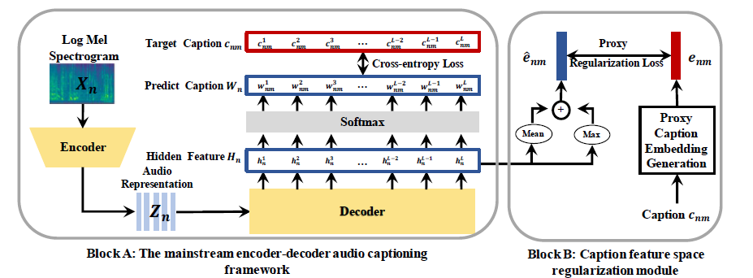
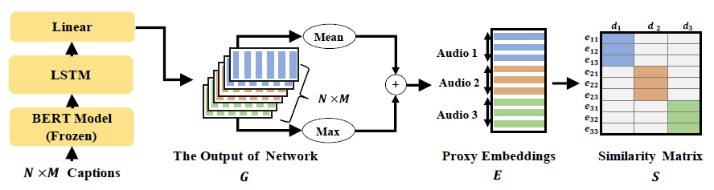
ACTUAL: How Does it Work?

Slide 24
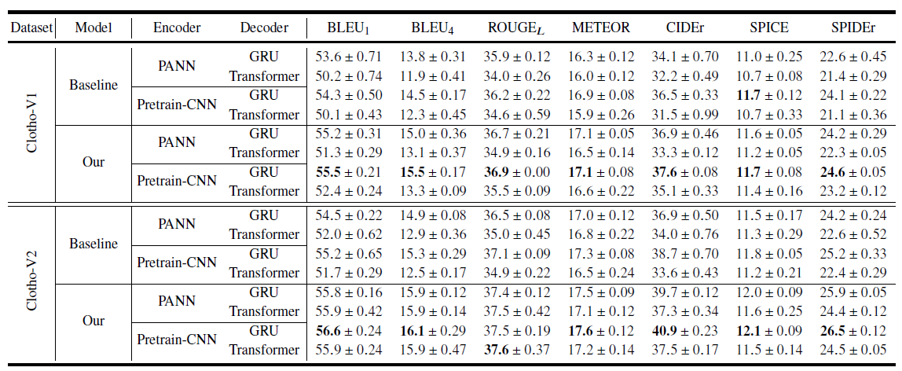
Results: Comparison with Baselines

Slide 25
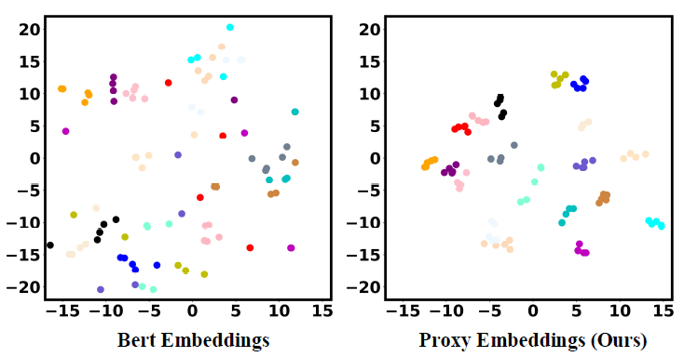
Results – Visualization of Features

Slide 26

Audio Captioning Demos

Slide 27
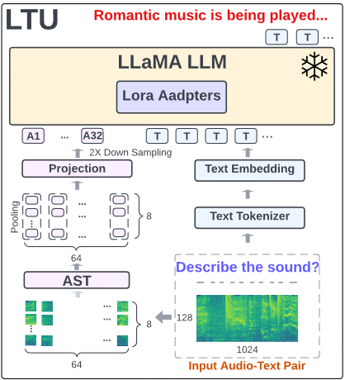
Task 2: Audio Question Answering & Reasoning
Acoustic Prompt Tuning (APT): an adapter extending LLMs/VLMs to the audio domain using an improved soft-prompting approach
Motivation:
Existing works on LLAMs used pretrained audio embeddings as soft prompt and adjust the LLM with Parameter-Efficient Fine-Tuning (PEFT).
However, they cannot generalize to multi-modal setting, e.g., audio-visual language models.
Can we extend the off-the-shelf language models to the audio domain rather than training a dedicated LLM (~7B to 70B)?
Fig. An example of an audio LLM structure (LTU (Gong et al, 2023)).
J. Liang, X. Liu, W. Wang, M. D. Plumbley, H. Phan, E. Benetos, “Acoustic Prompt Tuning: Empowering Large Language Models with Audition Capabilities”, IEEE/ACM Transactions on Audio Speech and Language Processing (in peer review), 2024. arXiv:2312.00249

Slide 28
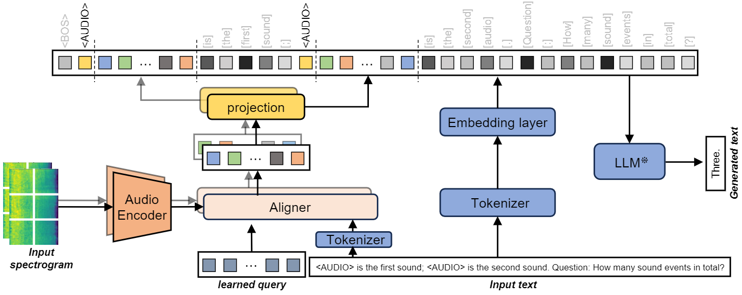
Task: Audio Reasoning – APT
Acoustic Prompt Tuning (APT): an adapter extending LLMs/VLMs to the audio domain using an improved soft-prompting approach
1. Interleaved acoustic and text embeddings
2. Instruction-aware architecture
3. Multi-task training

Slide 29
APT - Interleaved Acoustic and Text Embeddings
Existing approach
Proposed approach
Use acoustic tokens as prefix
Juxtapose acoustic with text embedding
<WAV> What sound events are heard?
<WAV> This is a dog. <WAV> This is a pig. <WAV> This is?
Suit: tagging, captioning, Q&A
Suit: tagging, captioning, Q&A, few-shot learning, audio comparison and summarization
No need extra information
Require audio identifier to differentiate audio from texts

Slide 30
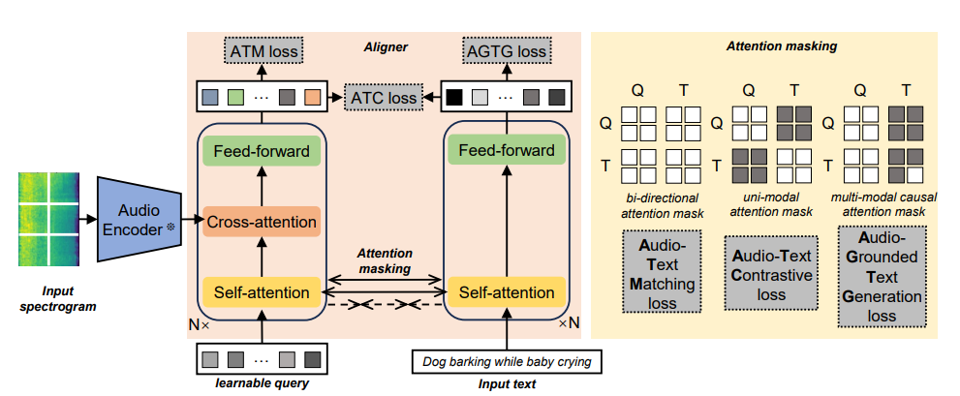
APT – Instruction Aware-Architecture
We adapt a 4-layer transformer and pretrain it with three loss, following BLIP-2.
ATM - learn to predict if the audio-text pair is from the same recording.
ATC - learn to match the matched audio-text pair out of a batch of negative (mismatched) pairs
AGTG – learn to predict the next textual token provided the acoustic and previous textual tokens

Slide 31
APT – Curriculum Learning
target sound event detection
Audio tagging
AudioSet-SL
Few-shot learning
AudioSet
Temporal event retrieval
AudioSet
AudioSet-SL
Audio captioning
WavCaps
Sound event counting
Complex reasoning
AudioCaps
AudioSet-SL
NLAR
Clotho
Audio Q&A
ClothoAQA
Stage 1
Stage 2
Stage 3

Slide 32
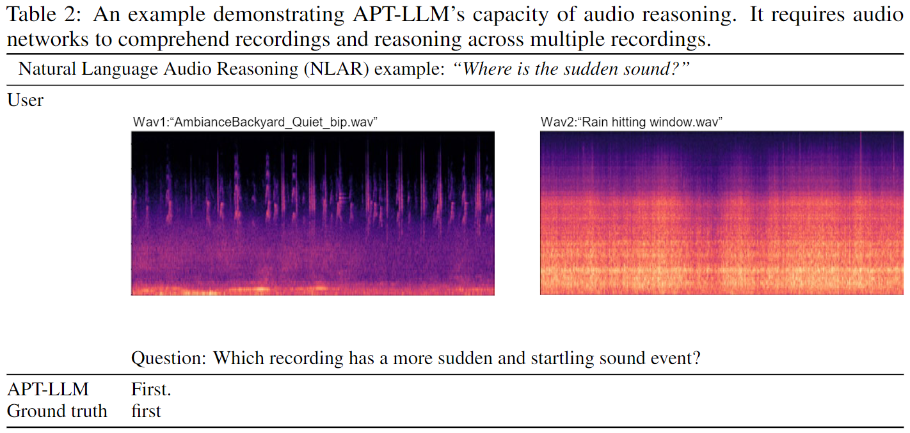
APT – Reasoning Example
The model developed is used to analyse audio clips by comparison and summarisation.
Data collection
Data cleaning
Event description
Q&A Generation
Rejected
Human Inspect
Accepted

Slide 33
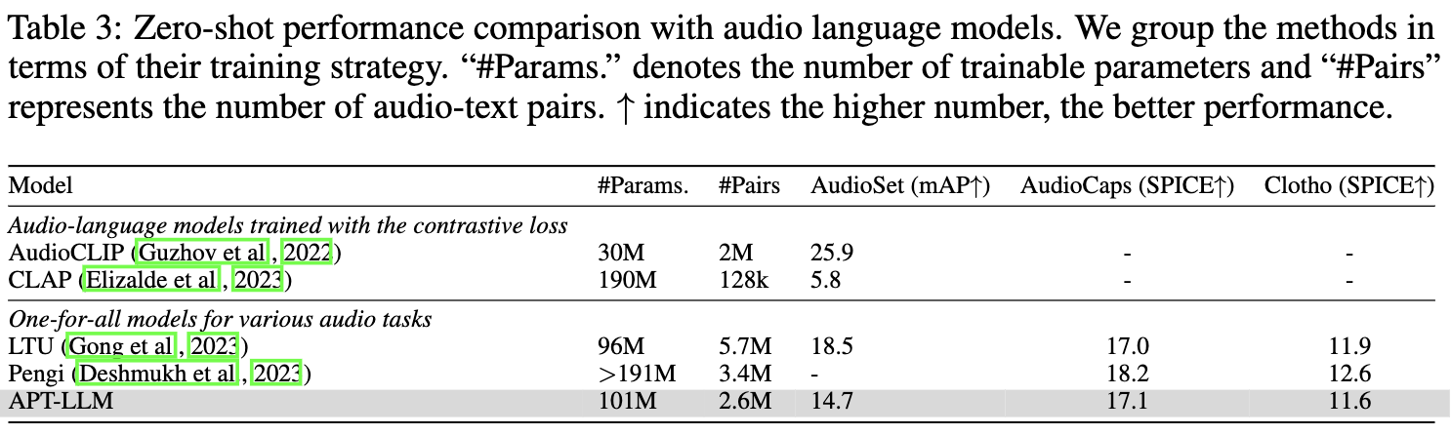
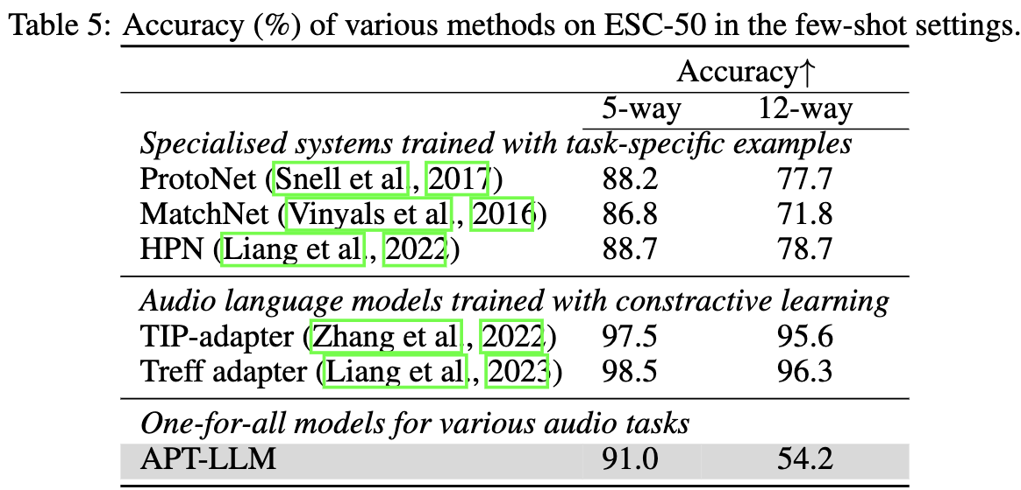
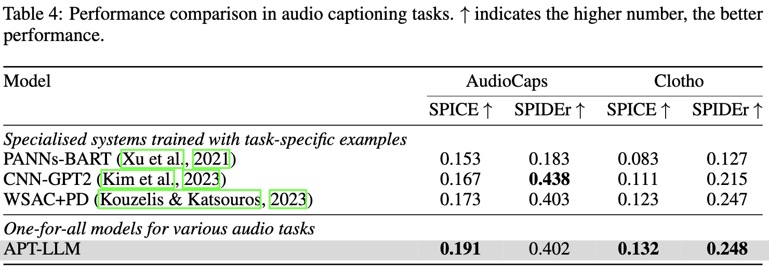
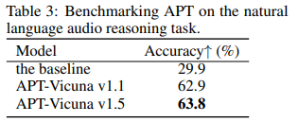
APT – Experimental Results
APT-LLM has a promising result on common audio tasks without fine-tuning on task-specific data. After fine-tuning for two epochs, APT-LLM achieves the best performance on downstream tasks.

Slide 34
APT – Demos
"first_recording": "Creaking pier.wav",
"second_recording": "Machetes sliding 2.wav",
"question": "In which recording are the sound events more evenly distributed?",
"answer": "second“
"first_recording": "Rain and Storm.wav",
"second_recording": "Car vs. Freight Train.wav",
"question": "Does the second recording have a calming effect like the first recording?",
"answer": "yes"
"first_recording": "Creaking pier.wav"
"second_recording": "Machetes sliding 2.wav"
"first_recording": "Rain and Storm.wav"
"second_recording": "Car vs. Freight Train.wav"
Code: https://github.com/JinhuaLiang/APT
Paper: https://arxiv.org/abs/2312.00249

Slide 35
Task 3: Text to Audio Generation
Potential Applications:
Related Works:
Computational “foley artist”:
  Game developer: e.g., A ghost is haunting a house.
  Audio producer: e.g., high heels hitting metal ground.
  Movie producer: e.g., the laser sound from a laser gun.
  …
Automatic content creation
  Endless music
  Audiobook with ambient noises
  White noise for meditation
  …
Data Augmentations
Label-to-Audio Generation
  Acoustic Scene (Kong et al., 2019), Sound event (Liu et al., 2019), FootStep (Comunit et al. 2019), …
Text-to-Audio Generation
  DiffSound (Yang et al., 2022), AudioGen (Kreuk et al., 2022), Make-an-Audio (Huang et al., 2023)
Text-to-Music Generation
  MusicLM (Andrea et al., 2023)
  Moûsai (Flavio et al., 2023)
  Noise2Music (Huang et al., 2023)
Others
  JukeBox (Dhariwal et al., 2020), AudioLM (Borsos et al., 2022), SingSong (Donahue et al., 2023),…

Slide 36
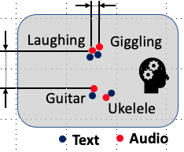
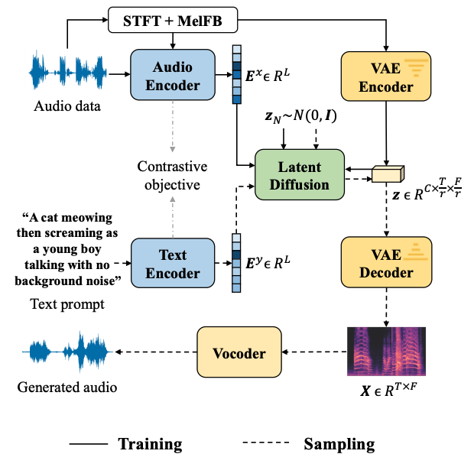

AudioLDM
Self-supervised training
Contrastive Language-Audio Learning (CLAP) Encoders
  Align audio and text in one space.
Latent Diffusion Models
  Learn to generate VAE latent conditioned on CLAP embedding
Mel-spectrogram Autoencoder
  Learn latent representations.
Mel-to-Waveform Vocoder
  Reverse Mel back to waveform
H. Liu, Z. Chen, Y. Yuan, X. Mei, X. Liu, D. Mandic, W. Wang, M. D. Plumbley, "AudioLDM: text-to-audio generation with latent diffusion models," in Proc. IEEE International Conference on Machine Learning (ICML 2023), Hawaii, USA, 23-29 July, 2023.

Slide 37
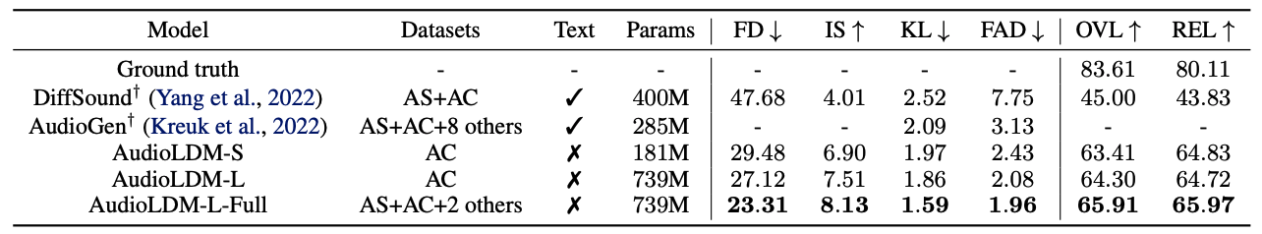
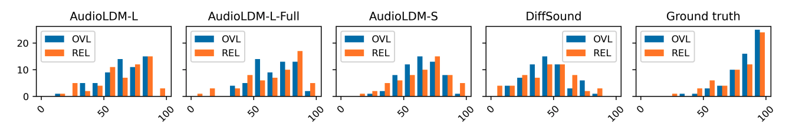
AudioLDM – Experimental Results
Trained on a single 3090 or A100 GPU!

Slide 38
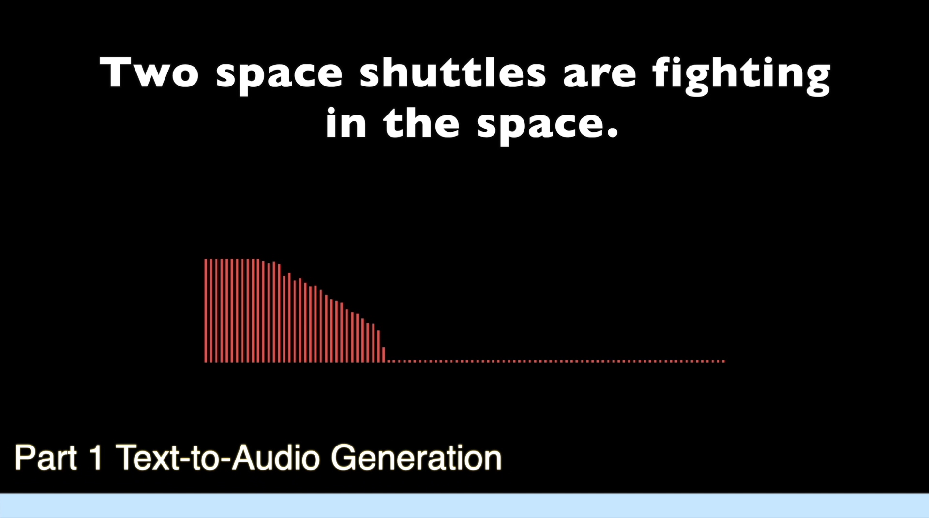
AudioLDM - Sound Demos

Slide 39
AudioLDM 2 – LLM+LDM
Waveform
Waveform Generation
Auto-regressive modeling:
  ✅ Explicit modeling of temporal dependencies.
  ✅ Enjoy the advance of recent LLM development.
  ✅ Good in-context learning performance.
  ❌ Long generation sequence/ lack of parallelism
  ❌ Long range dependencies
  ❌ Error propagation
Diffusion-based approach:
  ✅ Stable
  ✅ State-of-the-art generation quality
  ✅ Flexible formulation for manipulation, interpolation, etc.
  ❌ Do not explicitly model temporal dependencies
  ❌ Less flexible on duration
Can we utilize both advantages from LLM and Diffusion?
“Audio Translator”
Diffusion Model
Language of Audio
AR modeling
LLM
e.g., 16 vectors for 10 seconds
Training
Conditions (e.g., text)
Inference
Waveform Generation
Diffusion Model
Language of Audio
LLM
Conditions (e.g., text)
Code:
https://github.com/haoheliu/audioldm2

Slide 40
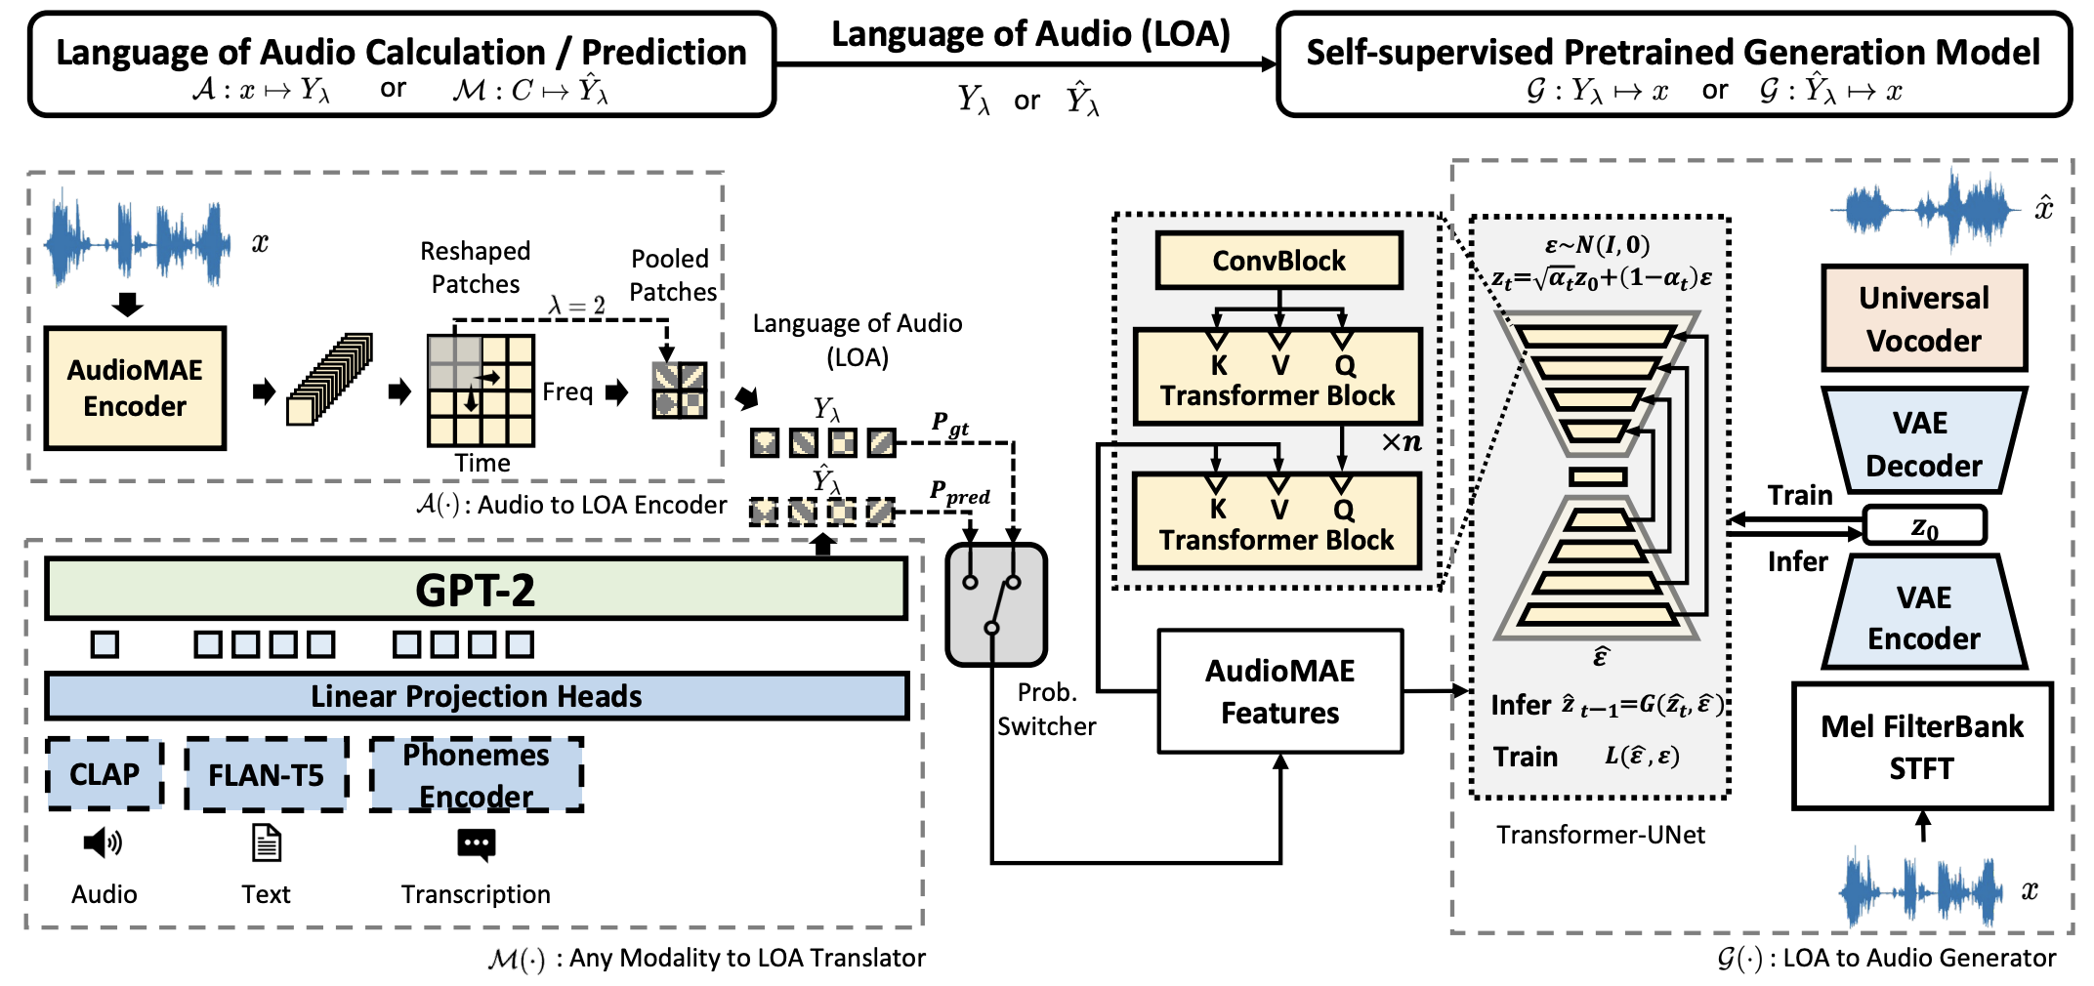
AudioLDM 2 - Architecture
H. Liu, et al. “AudioLDM 2: Learning holistic audio generation with self-supervised pretraining.” IEEE/ACM Transactions on Audio, Speech, and Language Processing, 2024.

Slide 41
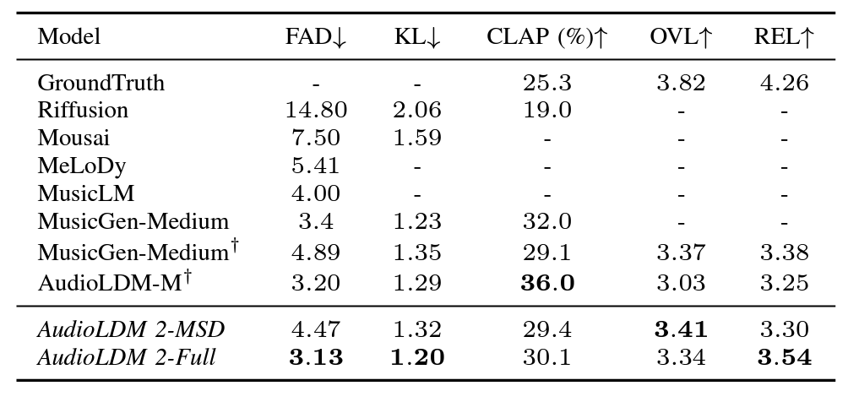
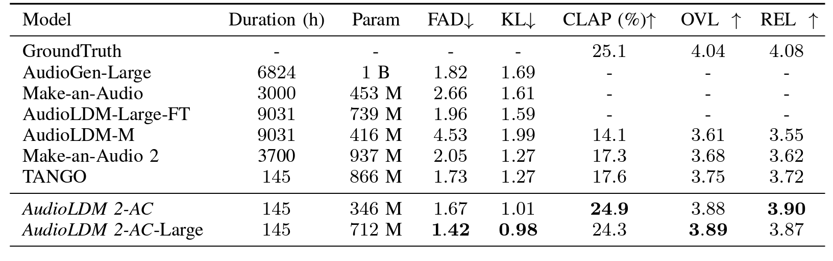
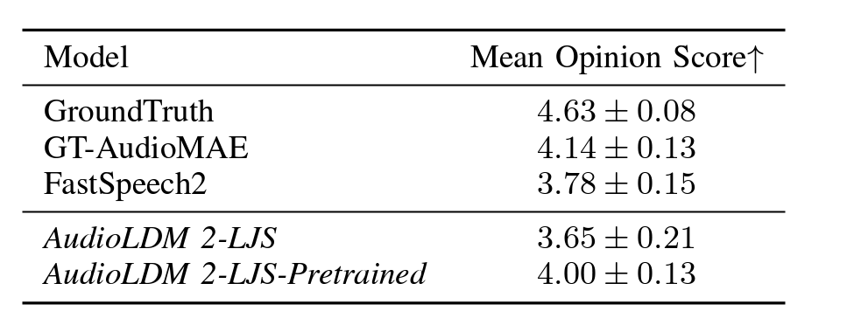
AudioLDM 2 - Performance
Text-to-Music Generation on MusicCaps
SoTA performance on Text-to-Audio/Music/Speech Generation Tasks
Text-to-Audio Generation on AudioCaps
Text-to-Speech Generation on LJSpeech

Slide 42
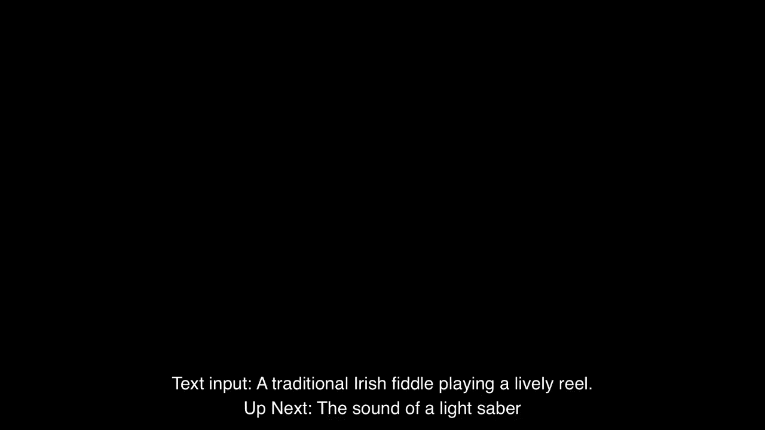
AudioLDM 2 - Demo
We generated a total of 350 audio files with prompts (generated by ChatGPT) without cherry-picking.
Codes and more demos: https://audioldm.github.io/audioldm2/

Slide 43
Audio Storytelling - WavJourney
WavJourney - Compositional Audio Creation with LLMs
Open Challenges:
Advantages offered by WavJourney:
Create audio storytelling with:
  Personalized speakers
  Lifelike speech
  Immersive music
  Impactful sound effects
  All simply from texts!
Contextual comprehension and design
  Understand text instructions
  Design storytelling with speech/music/SFX
Audio production and composition
  Dynamic spatial-temporal relationship
Interpretable and interactive creation
Paper:
https://arxiv.org/abs/2307.14335
Code:
https://github.com/Audio-AGI/WavJourney
Demo:
https://huggingface.co/spaces/Audio-AGI/WavJourney

Slide 44
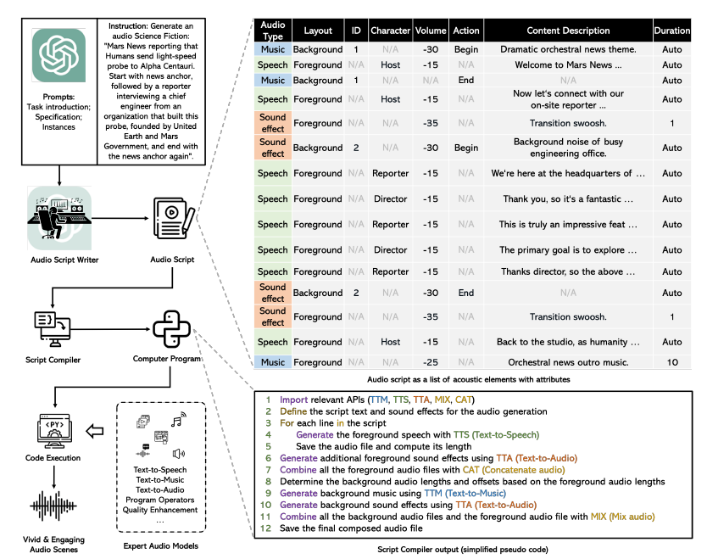
WavJourney – Overall Architecture

Slide 45
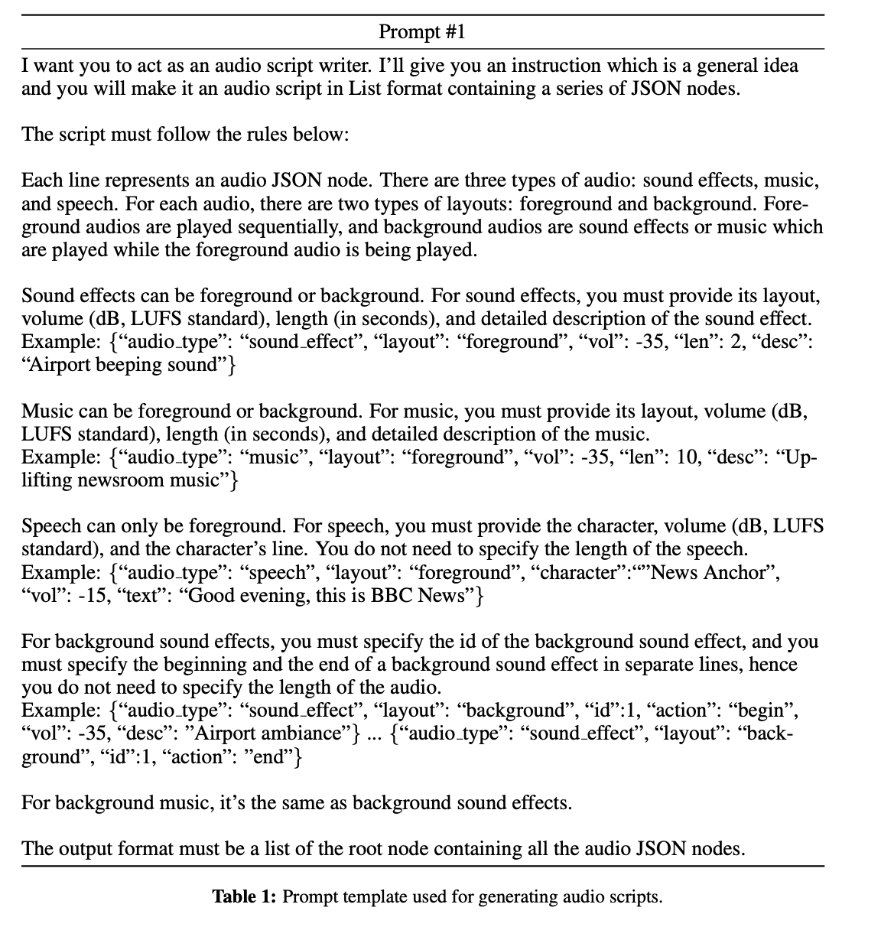
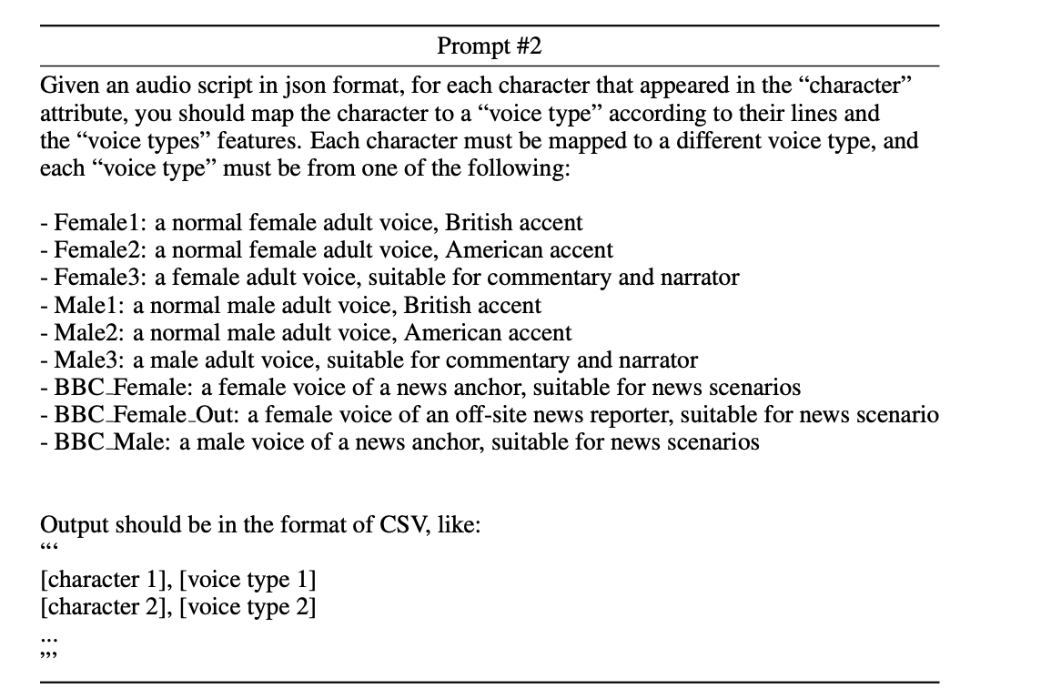
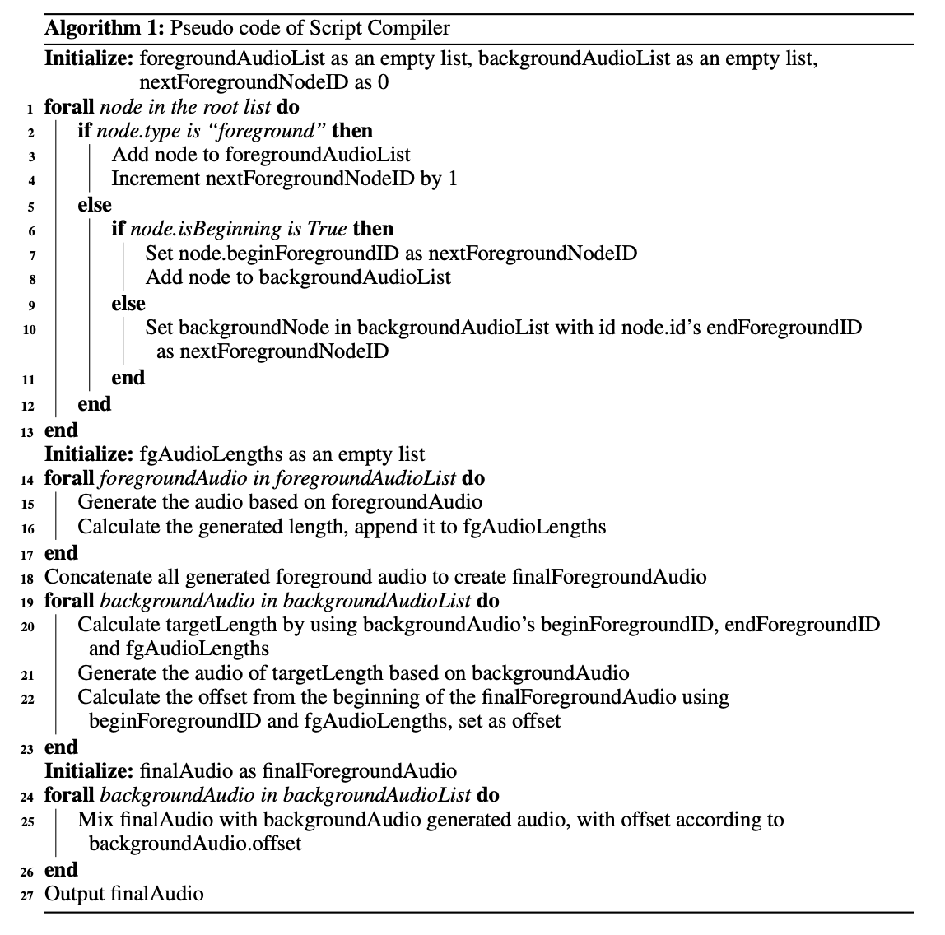
WavJourney – Audio Script Writing & Compilation

Slide 46
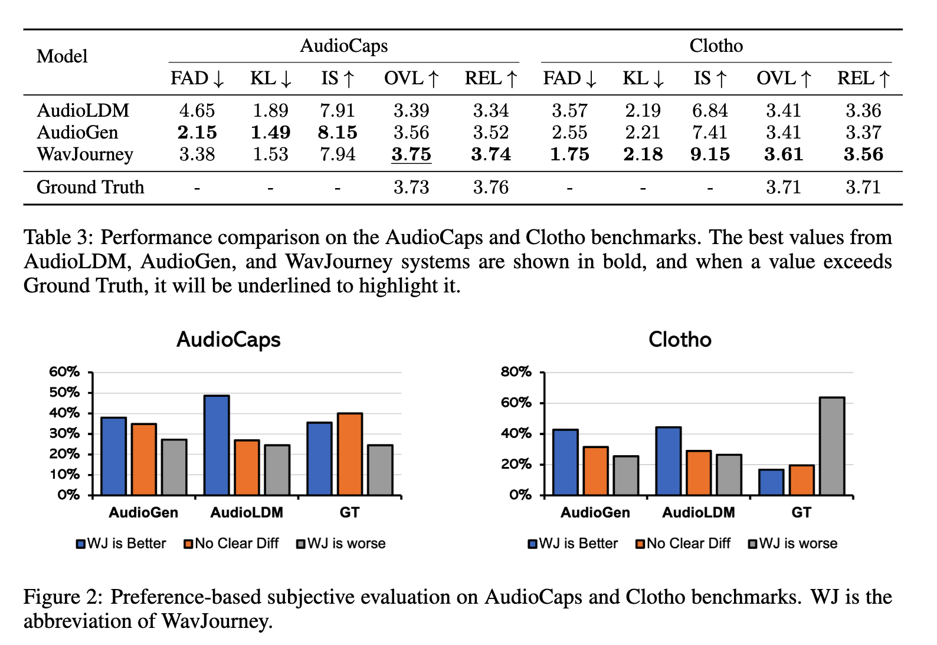
WavJourney – Experimental Results
SoTA subjective results are achieved on TTA benchmarks!

Slide 47
WavJourney – Sound Demo for Science Fiction Storytelling
Paper:
https://arxiv.org/abs/2307.14335
Code:
https://github.com/Audio-AGI/WavJourney
Demo:
https://huggingface.co/spaces/Audio-AGI/WavJourney

Slide 48
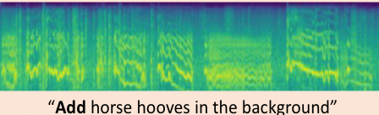
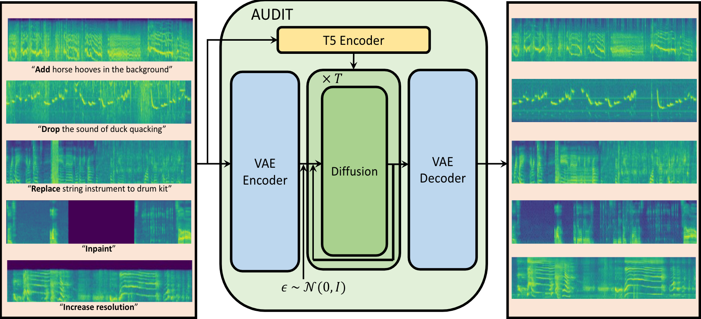
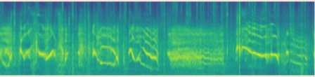
Task 4: LLMs for Controllable Audio Editing
Audio editing is to change the content of audio by following the instruction precisely.
This work introduces an audio agent that understands the user instruction, decomposes the instruction into several tasks, and allocates different tasks to the proper models.
Instruction interpreter
Expert models
An example of end-to-end audio editing system
J. Liang, H. Zhang, H. Liu, Y. Cao, Q. Kong, X. Liu, W. Wang, M. Plumbley, and E. Benetos, “WavCraft: Audio Editing and Generation with Large Language Models”, in ICLR 2024 Workshop on Large Language Model (LLM) Agents, 2024.

Slide 49
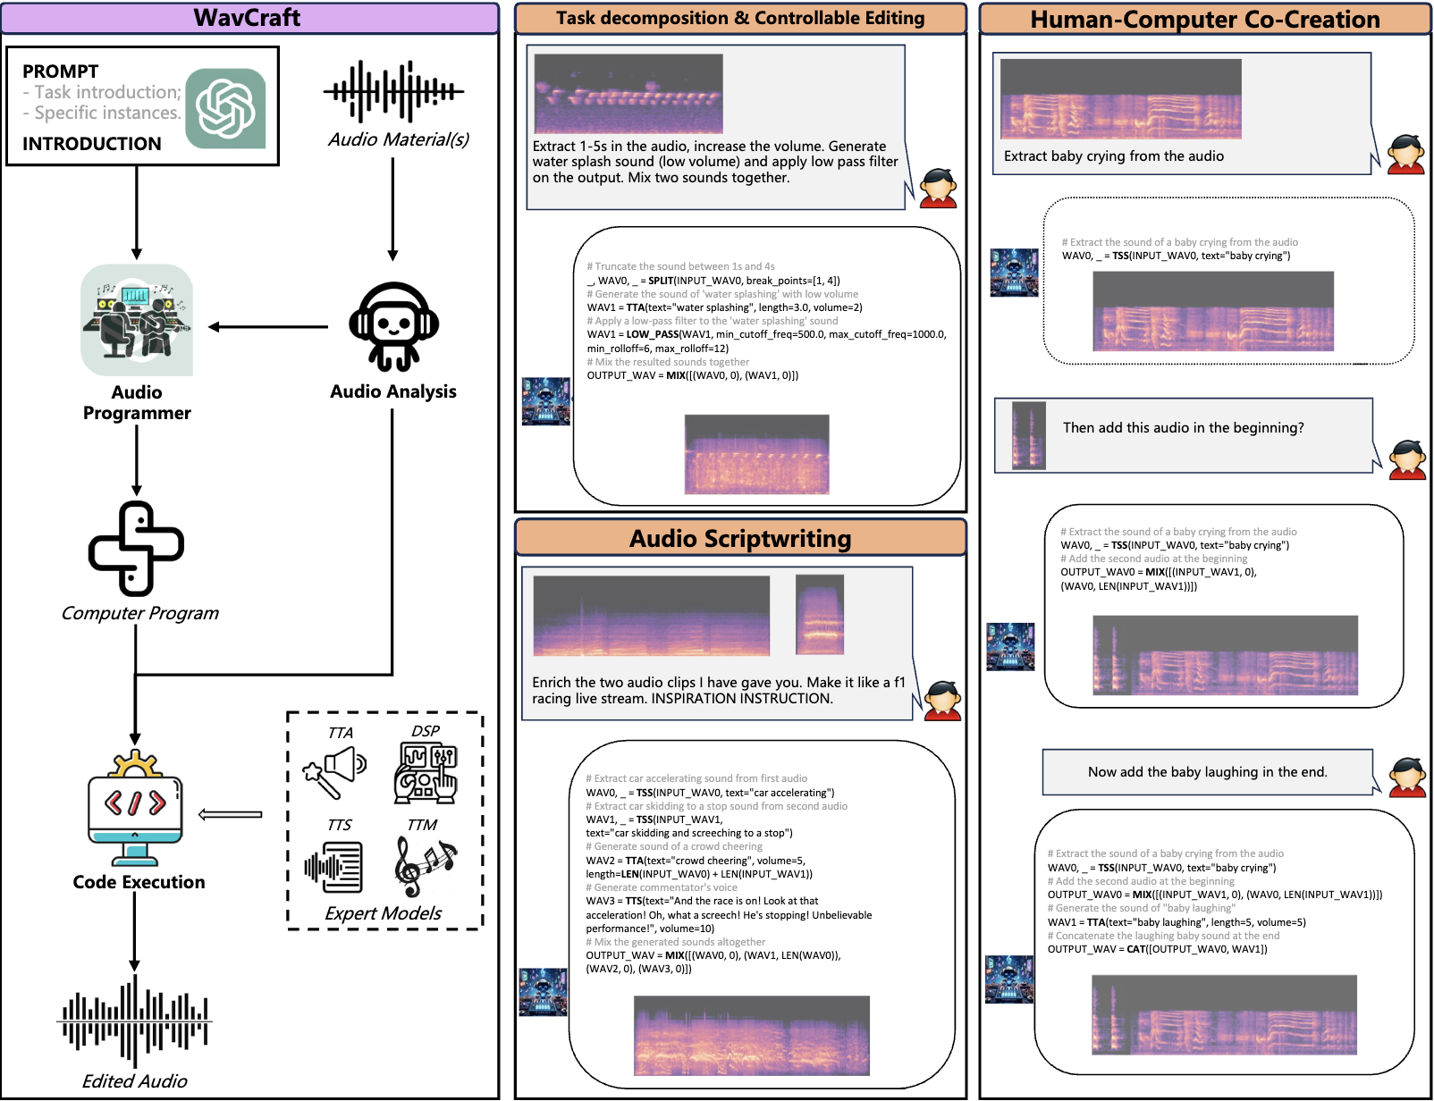
WavCraft – Overall Architecture

Slide 50
WavCraft – Expert Models
Audio understanding
LU
Audio watermarking
AW
LTU
WavMark
TTA
TTS
TSS
EXTRACT
AudioGen
Bark
AudioSep
AudioSep
Audio manipulation
TTM
SR
DROP
INPAINT
MusicGen
AudioSR
AudioSep
AudioLDM
Logic function
MIX
LEN
Cat
CLIP
np.add()
len()
np. concatenate
np.ndarray()

Slide 51
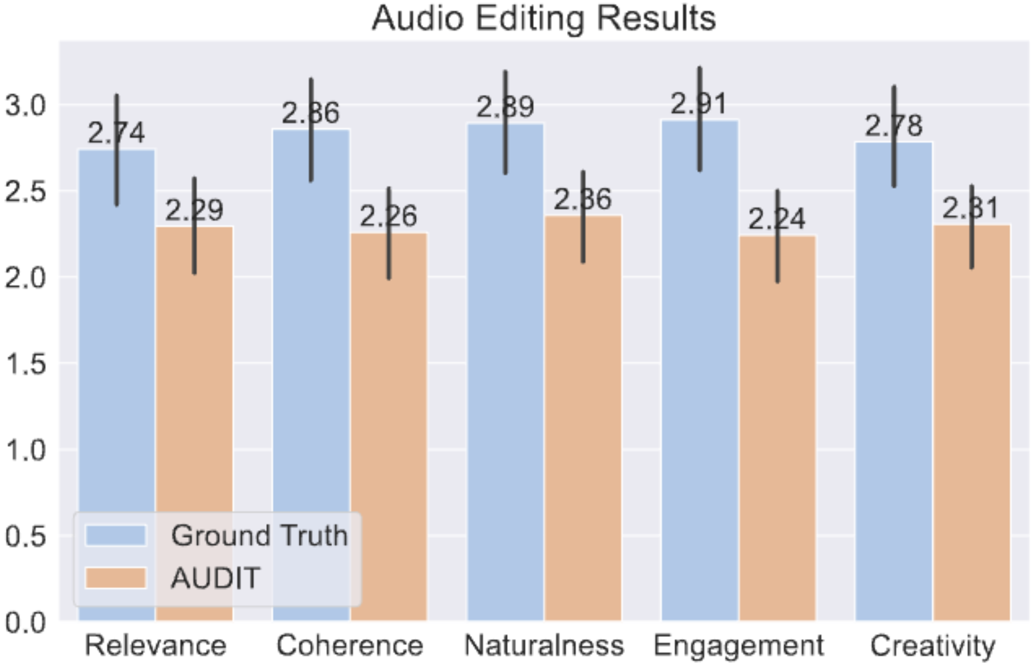
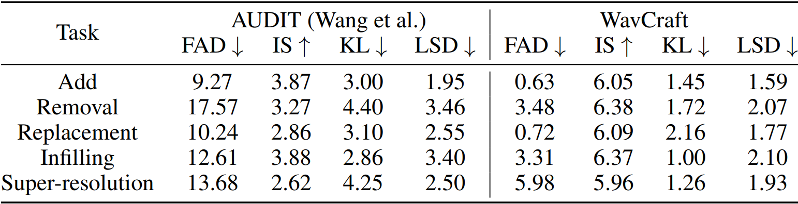
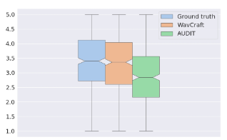
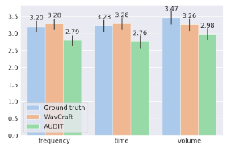

WavCraft – Experimental Results
Table 1. Compared to the audio editing model on five editing tasks.
FAD: Fréchet Audio Distance, IS: Inception score, KL: kullback–leibler divergence, LSD: log spectral distance
Figure 1. Comparing the ability of audio storytelling
Table 2. Compared to the audio generative models
Figure 2. Overall subjective evaluation on audio editing quality
Figure 3. Subjective evaluation on the quality of edited audio

Slide 52

Dataset: WavCaps
X. Mei, C. Meng, H. Liu, Q. Kong, T. Ko, C. Zhao, M. D. Plumbley, Y. Zou, and W. Wang, "WavCaps: A ChatGPT-Assisted Weakly-Labelled Audio Captioning Dataset for Audio-Language Multimodal Research," IEEE/ACM Transactions on Audio Speech and Language Processing, June 2024.
Code: https://github.com/XinhaoMei/WavCaps

Slide 53


WavCaps – Statistics

Slide 54

Sound-VECaps
Challenge
  Existing audio generation models struggle with complex and detailed prompts, leading to potential performance degradation.
  Captions of current audio datasets are too simple to provide detail information.
Sound-VECaps
  1.66M high-quality audio-caption pairs with enriched details including audio event orders, occurred places and environment information.
The analysis of audio-caption datasets, Loc and Env are the number of captions that include the location and environment information.

Slide 55

Sound-VECaps – Processing Pipeline
Paper, data & code: https://yyua8222.github.io/Sound-VECaps-demo

Slide 56



Dataset: AudioSetCaps
J. Bai, H. Liu, M. Wang, D. Shi, W. Wang, M. D Plumbley, W.-S. Gan, & J. Chen (2024). AudioSetCaps: Enriched Audio Captioning Dataset Generation Using Large Audio Language Models. In Audio Imagination: NeurIPS 2024 Workshop AI-Driven Speech, Music, and Sound Generation, 2024.

Slide 57


AudioSetCaps – Statistics
Table 1: The statistics comparison with popular audio-language datasets. Caption source: H (human), A (audio models), V (visual models), L (language models).
Dataset | Quantity | Ave-Length | Vocabulary | Caption Source
Clotho | 30K | 11 | 4K | H
AutoCaps | 57K | 9 | 5K | H
LAION-Audio-630K | 630K | 7 | 311K | L
WavCaps | 400K | 8 | 24K | L
Auto-ACD | 1.5M | 18 | 20K | L+A+V
Sound-VECaps | 1.6M | 40 | 50K | L+A+V
AudioSetCaps | 1.9M | 28 | 21K | L+A
Figure 2: Distribution of caption lengths across several popular audio caption datasets. (Left) Caption length distributions of human-labeled datasets. (Right) Caption length distributions of LLMs-assisted datasets.

Slide 58

AudioSetCaps – An Example
Mean
Subjective
Score
Dataset-Caption
Label
Female speech, Woman speaking, Background noise, Generic impact sounds, Surface contact, Babbling, Tick, Human voice, Breathing, Baby laughter
4
AudioCaps
A human baby laughs and gurgles as a female sings gently
4
WavCaps
People are talking and babbling with a baby laughing and surface contact.
4.2
Auto-ACD
The sound of a laughing baby and women chatting and giggling can be heard at a busy spa.
4
AudioSetCaps
A joyful interaction between a woman and a baby, as the infant giggles and the woman responds with a happy and upbeat tone.
ID: Y0qH8FmqGI2U
4.4

Slide 59
Conclusion & Future Works
Summary
  Large language-audio models are promising - offering new opportunities to solve problems in conventional audio tasks and newly emerging audio tasks
  These models often provide SOTA performance in many downstream tasks and may offer new capabilities that were not available in previous audio models.
Future Works
  Developing unified models for multi-tasks (e.g. understanding and generation) and multi-modal data (audio, visual, language)
  Leveraging respective strengths of LLMs & audio models
  Towards improved controllability in various downstream tasks (e.g. generation and captioning)
  Leveraging physics-based model + data driven models

Slide 60



Dance Generation
Focus only on
hand-crafted musical features.
No genre information.
Based on 24-Joint dataset.
Lack of hand motion.
Generative
Model
MFCC
Chroma
Beat
Envelop
Music Condition
Generated Dance Segment
X. Liu, Z. Feng, D. Kanojia, W. Wang, “DGFM: Full Body Dance Generation Driven by Music Foundation Models”, NeurIPS 2024 Workshop on Audio Imagination, 2024.

Slide 61










Demo
This is a “HanTang” type of music.
This is a “Dai” type of music.
This is a “Hiphop” type of music.

Slide 62
Paper, Codes, Demos, and More, …
AudioLDM:
Paper: https://arxiv.org/abs/2301.12503
Project Page: https://audioldm.github.io/
Github:
  Pretrained model: https://github.com/haoheliu/AudioLDM
  Evaluation tools: https://github.com/haoheliu/audioldm_eval
YouTube: https://www.youtube.com/watch?v=_0VTltNYhao
AudioLDM2:
Project Page: https://audioldm.github.io/audioldm2/
APT:
Code: https://github.com/JinhuaLiang/APT
WavCraft:
Code: https://github.com/JinhuaLiang/WavCraft
SemantiCodec:
Paper/code/demos at project page:
https://haoheliu.github.io/SemantiCodec/
WavJourney:
Paper: https://arxiv.org/abs/2307.14335
Code: https://github.com/Audio-AGI/WavJourney
Demo: https://huggingface.co/spaces/Audio-AGI/WavJourney
AudioSep:
Code: https://github.com/Audio-AGI/AudioSep
WavCaps:
Paper: https://arxiv.org/abs/2303.17395
Code: https://github.com/xinhaomei/wavcaps
AudioSetCaps:
Data and code: https://github.com/JishengBai/AudioSetCaps
https://huggingface.co/datasets/baijs/AudioSetCaps
More code about other works avaliable at:
https://github.com/XinhaoMei/DCASE2021_task6_v2
https://github.com/XinhaoMei/ACT
https://github.com/liuxubo717/cl4ac
Sound-VECaps: paper, data & code:
https://yyua8222.github.io/Sound-VECaps-demo

Slide 63


Thank you for listening!
This work was sponsored by a Newton Institutional Links Award from the British Council, titled “Automated Captioning of Image and Audio for Visually and Hearing Impaired” & EPSRC projects titled “Making Sense of Sounds” and “AI for Sounds”.

