Slide 1
Neural Audio Codec: Recent Progress and a Case Study with SemantiCodec
Wenwu Wang
Centre for Vision, Speech and Signal Processing (CVSSP)
University of Surrey
Joint work with Haohe Liu, Xuenan Xu, Yi Yuan, Mengyue Wu, Mark D. Plumbley

Slide 2
Outline
Background: Audio Codec & Neural Audio Codec
Motivation: Limitations with Current Neural Codecs
Proposed Method: SemantiCodec
Experimental Results:
Conclusions and Future Works

Slide 3
Audio Codec
A device or software that encodes or decodes digital audio data for transmission, storage, or playback.
Compressor-decompressor → “Codec”
MP3, FLAC, AAC, Vorbis, etc.

Slide 4
Neural Audio Codec
SoundStream (Zeghidour et al. 2021)
Encodec (Défossez et al. 2021)
Descript (Kumar et al. 2023)
HiFi-Codec (Yang et al. 2023)
SpeechTokenizer (Zhang et al, 2023)
Codec Superb Benchmark (Wu et al. 2024)
https://github.com/voidful/Codec-SUPERB

Slide 5
Beyond Communication
AudioGen (Kreuk et al. 2022), AudioLM (Borsos et al. 2023), MusicLM (Agostinelli et al. 2023), MusicGen (Copet et al. 2024)
VALL-E (Wang et al. 2023), XTTS (Casanova et al. 2024)
FlashSpeech (Ye et al. 2024), NaturalSpeech 3 (Ju et al. 2024)
Used as tokenizer of audio (AR modeling), or the latent representation of audio (Diffusion modeling)

Slide 6
Limitations of Current Neural Codecs
High token rate (long token sequence)
e.g., 6kbps Descript audio codec has 600 tokens per second
Make auto-regressive modeling challenging and computational expensive
Poor reconstruction quality at low bit rate (e.g., 0.6 kbps).
Most previous studies work on bit rate > 2kbps
Can we go further under 1.0 kbps?
Falling short in capturing semantic information
For example, latent encodings given by 6kbps achieved an average accuracy of only 33% on the HEAR benchmark, while AudioMAE latent encodings achieved an accuracy of 61% (without finetuning).

Slide 7
Motivations
Shorter sequence: Lower token rates at 25, 50, or 100 tokens per second.
Better reconstruction at lower bit rate: 0.3~1.4 kbps
Improved semantic in the codec tokens (which potentially can lead to better language modelling)

Slide 8
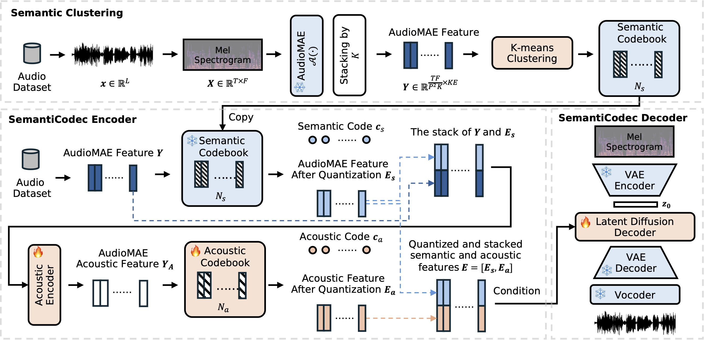
SemantiCodec
Large scale k-means is challenging
AudioSet + Million Song Dataset + GigaSpeech
https://github.com/haoheliu/kmeans_pytorch
Ultra-low bit rate (0.31 kbps ~1.40 kbps, token rate 25, 50, or 100 per second) & Strong semantics in the token & Variable vocabulary sizes
AudioMAE
Encoder
https://haoheliu.github.io/SemantiCodec/
CrossAtten

Slide 9
AudioMAE (Huang et al. 2022)
Self-supervised pretrained ViTs for reconstructing missing mel-spectrogram patches
Meaningful representation of the mel-spectrogram patches

Slide 10
Why AudioMAE?
AudioMAE has a better structured latent space.
Better represent the semantic of audio for LLM training

Slide 11
Diffusion Model
Forward Diffusion: Start with real data $x$(or $z_{0}$).
Reverse Diffusion: Train a model to predict $z_{t−1}$from $z_{t}:$
Markov chain
Constant
$z_{t}$in closed form
Gaussian Identity
Conditional diffusion distribution in closed form
Diffusion Model Decoder
Derived from the Evidence Lower Bound of
Diffusion Model Decoder Training

Slide 12
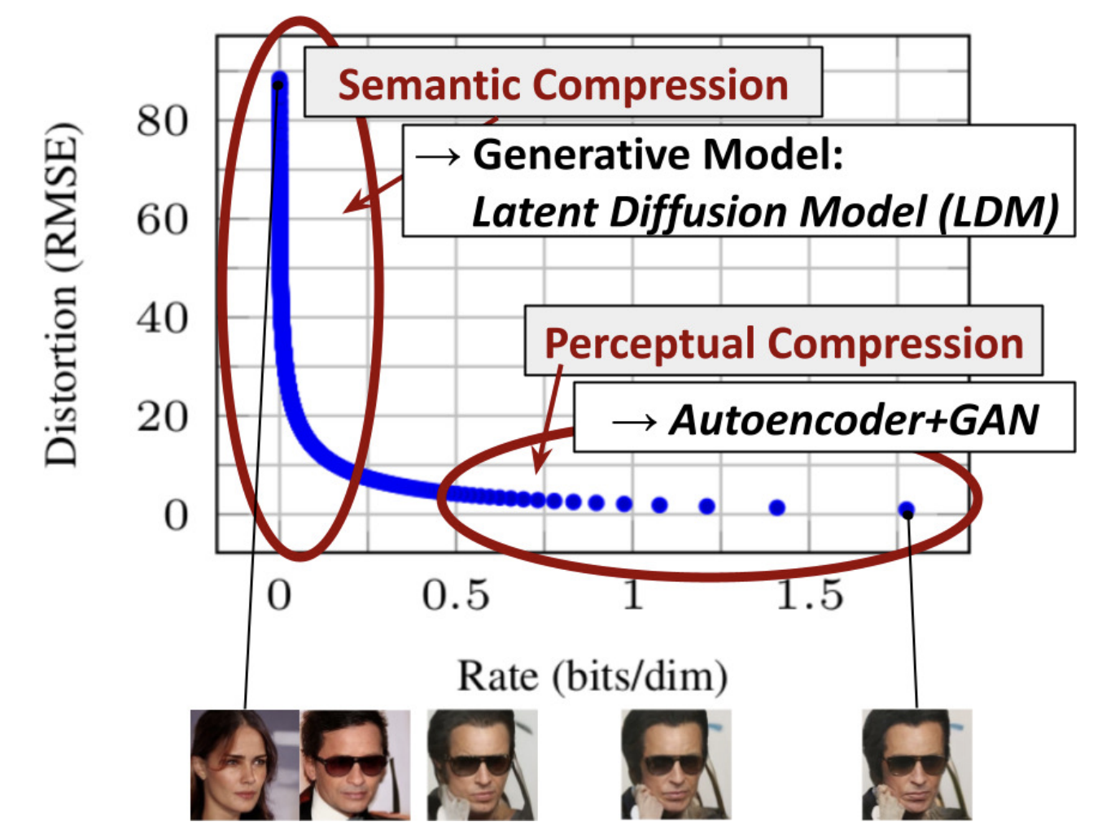
Latent Diffusion Model (Rombach et al. 2021)
Diffusion modeling in a compressed space
Less computation
Better generative modeling
Credit: Latent Diffusion Models: Is the Generative AI Revolution Happening in Latent Space? (NeurIPS 2023 Tutorial)

Slide 13
Experimental Evaluations
Metrics:
MEL: Mel spectrogram distance
STFT: Short-time Fourier Transform Distance
ViSQOL: Virtual Speech Quality Objective Listener Score
WER: Word Error Rate
Accuracy: Audio classification task accuracy
MUSHRA Scores
Datasets (we only use audio):
GigaSpeech (10K hours), Million Song Dataset (510K music tracks), MedleyDB (122 tracks), MUSDB18 (10 hours), AudioSet (2M), VGGSound (190K), WavCaps (7K hours)

Slide 14
Experimental Evaluations
Baselines:
Encodec (EC): 23M parameters
Descript Codec (DAC): 74M
HiFi-Codec (HC): 63M
Evaluations:
Reconstruction performance evaluation: LibriTTS clean test set (300 speech utterances), AudioSet general sound (500 audio signals), MUSDB18 (50 songs covering vocals, drums, bass, etc.); 1050 audio clips in total
Semantic information evaluation: HEAR benchmark (NSPitch, ESC-50, LibriCount, CREMA-D, Vocal Imitations (VoImit), Speech Commands(SC))
Subjective evaluations: MUSHRA test: 10 raters, 10% of evaluation data (25 music tracks, 30 speech recordings, and 50 general sound samples)

Slide 15
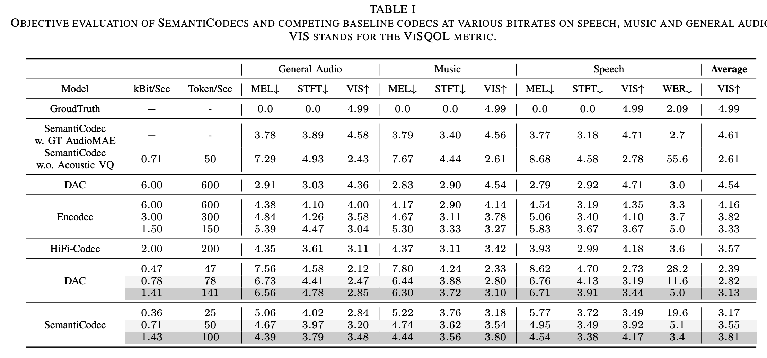
Better Reconstruction Quality

Slide 16
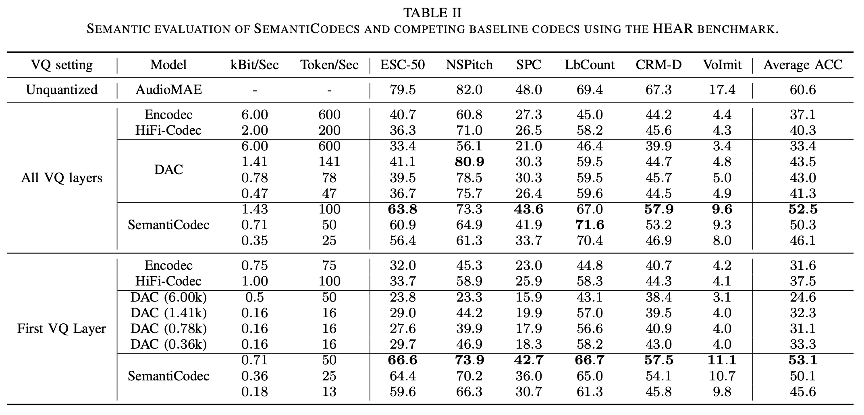
Better Semantic in the Tokens
Significantly better when using only a single codebook

Slide 17
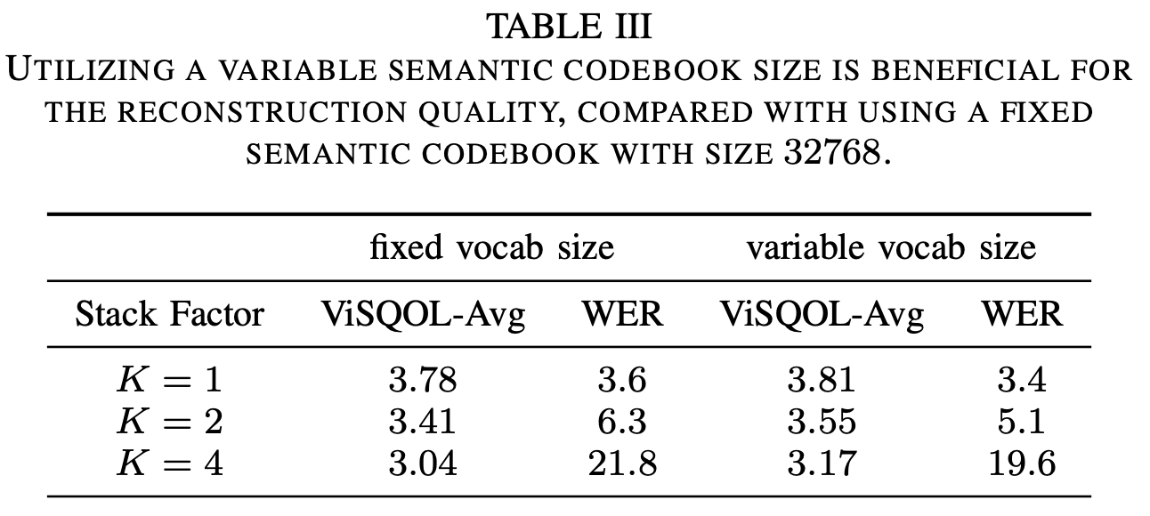
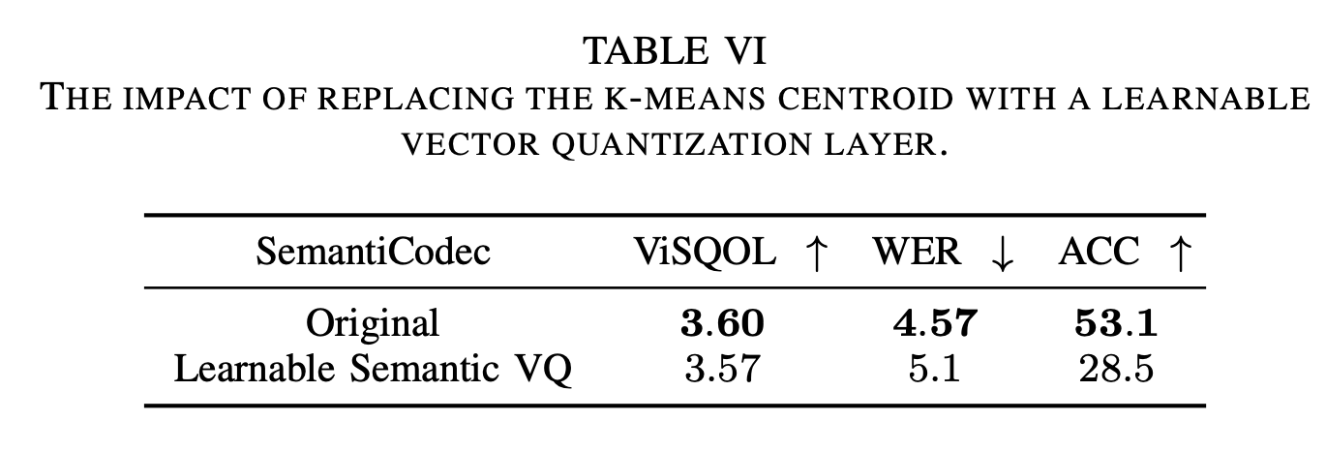
Using Multi-semantic-Codebook is Beneficial
Learnable v.s. Frozen Semantic Codebook

Slide 18
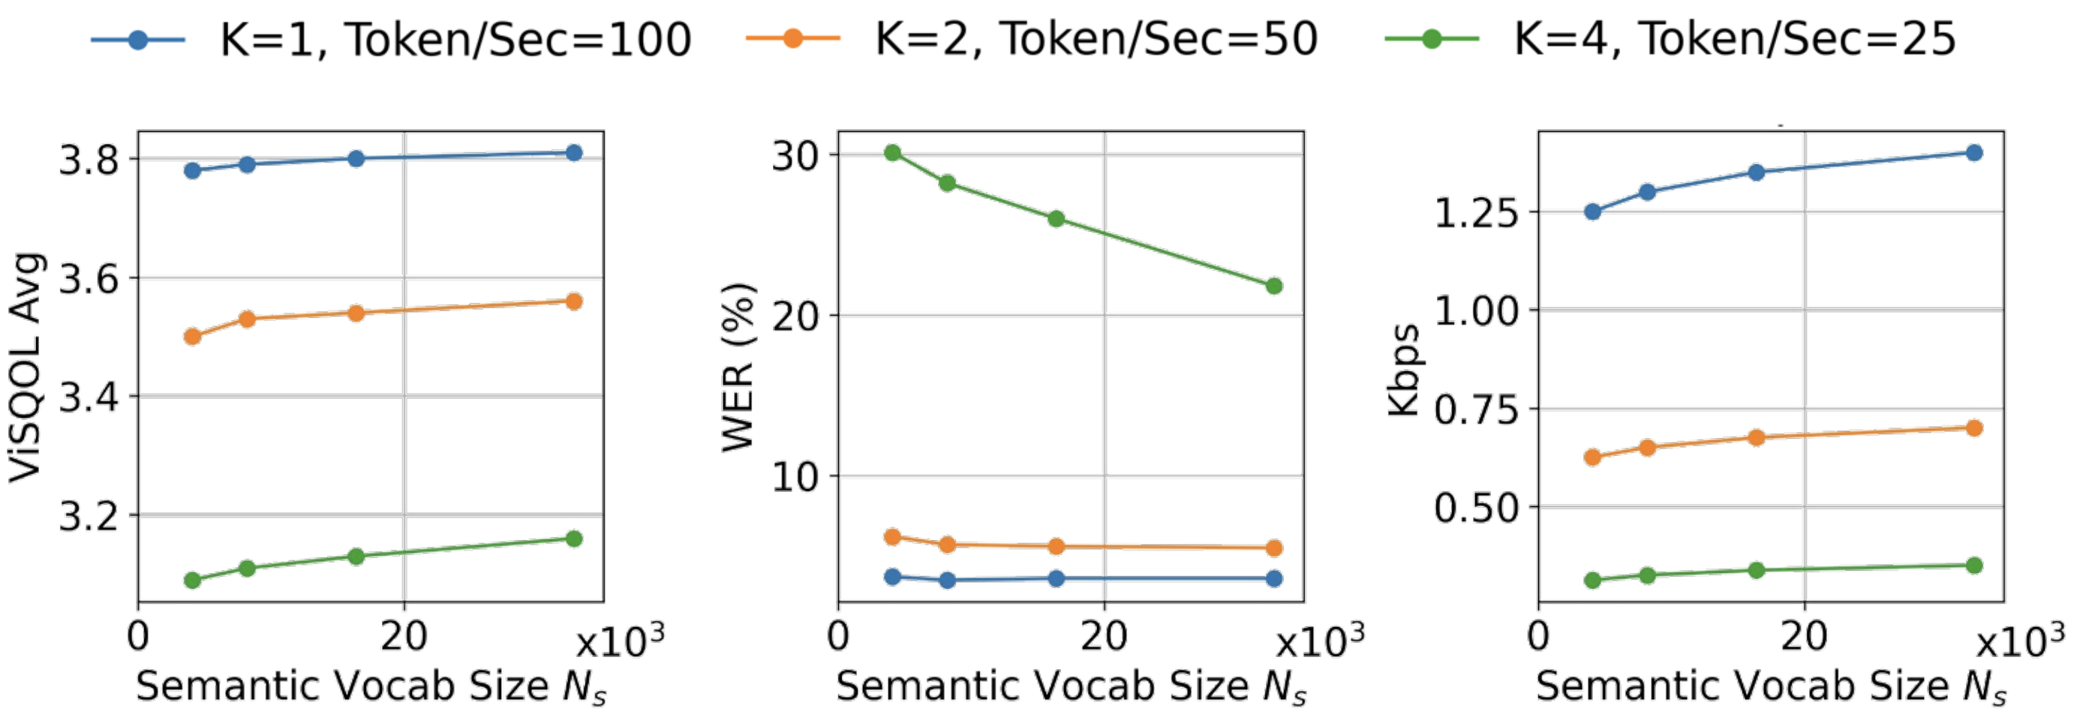
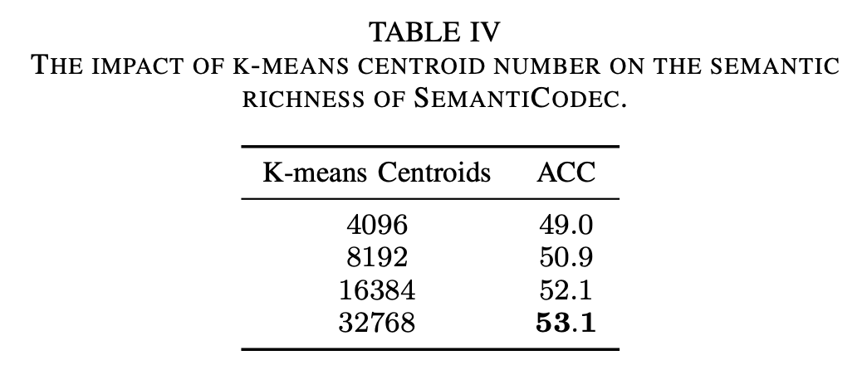
Classifier-Free Guidance Helps, but not a lot.
Cluster ↑ → Semantic ↑ / Reconstruction ↑

Slide 19
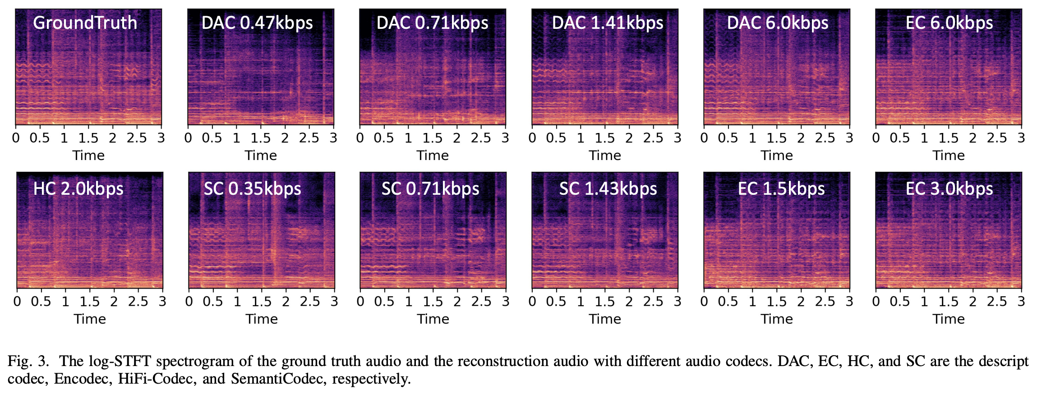
Samples Comparison

Slide 20
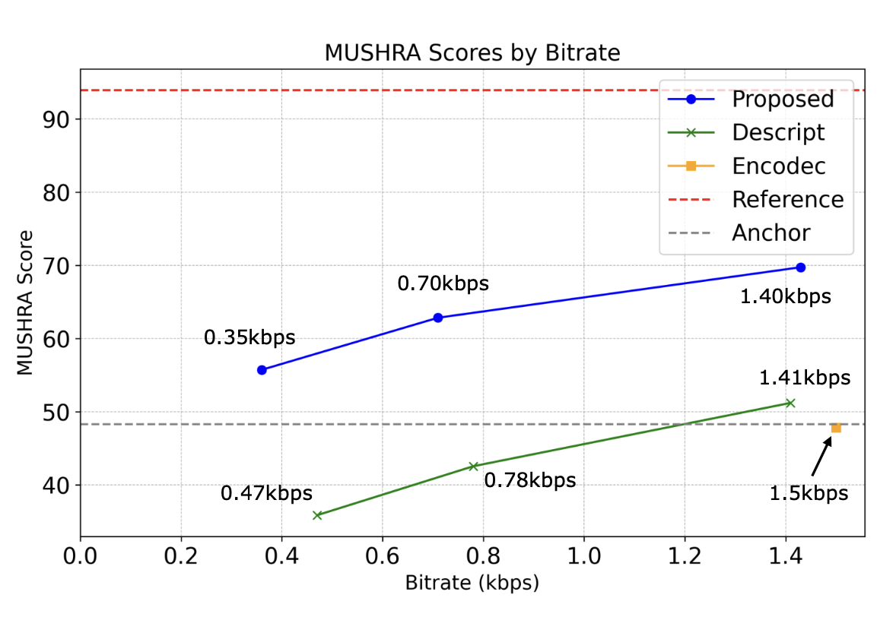
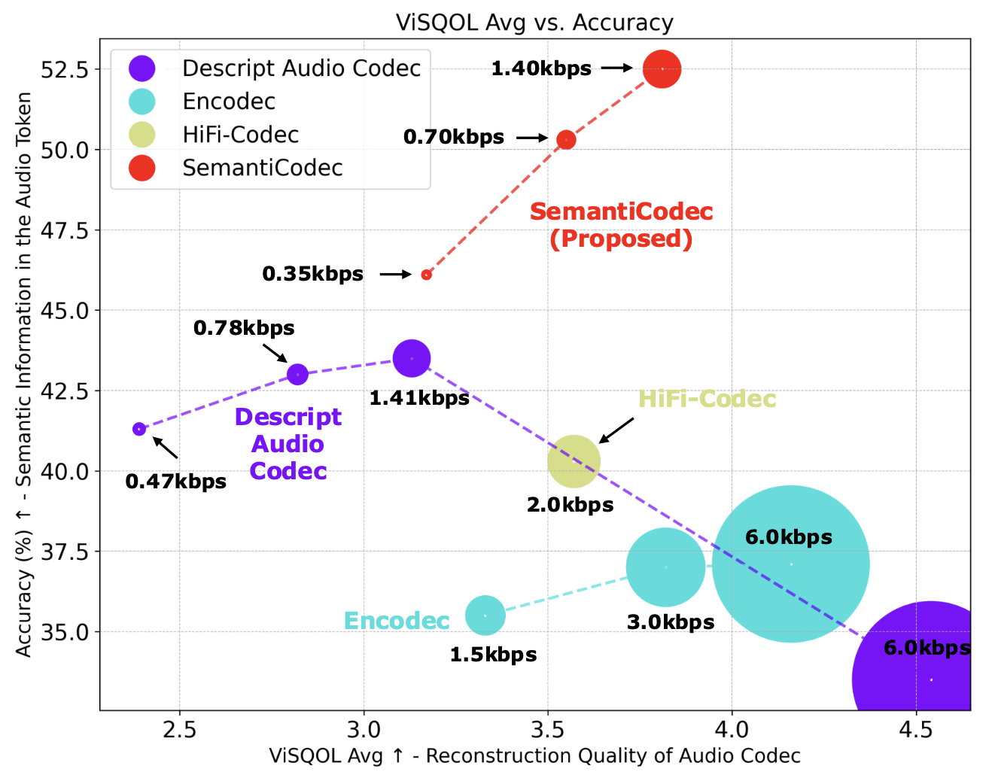
Visual Comparison
Better reconstruction with a lower bit rate
Better semantic in the audio token (potentially better Audio LLM?)
Sound demos:
https://haoheliu.github.io/SemantiCodec/

Slide 21
Demos
Original
HiFi-Codec
(2.0 kbps)
Encodec
(1.5 kbps)
DAC
(1.41 kbps)
SemantiCodec
(1.43 kbps)
DAC
(0.47 kbps)
SemantiCodec
(0.35 kbps)
Music
(MUSDB18)
General Audio
(AudioSet)
Speech
(Libri)
More sound demos:
https://haoheliu.github.io/SemantiCodec/

Slide 22
Conclusion & Future Work
We have presented SemantiCodec, which produces audio tokens of more semantic, lower token rate, with thus enabling ultra-low bit rate audio codec, and works for any length audio.
Future works:
How does the semantic of audio token related with LM performance?
Can shortened audio token sequence alleviate LM robustness issue?
Specialized SemantiCodec

Slide 23
Acknowledgements
Thanks to Haohe for providing slides.
The project is funded in part by EPSRC and British Council.

Slide 24
Take Aways
Arxiv Paper: https://arxiv.org/abs/2405.00233
Project Page: https://haoheliu.github.io/SemantiCodec/
Open-source Code: https://github.com/haoheliu/SemantiCodec-inference
Demos: https://haoheliu.github.io/SemantiCodec/

