Slide 1
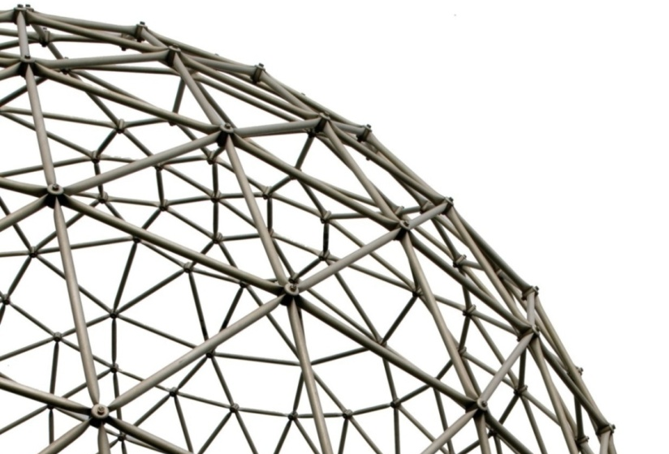
Language Queried Audio Source Separation
Wenwu Wang
Centre for Vision, Speech and Signal Processing (CVSSP)
& Surrey Institute for People Centred Artificial Intelligence
University of Surrey
United Kingdom
Email: w.wang@surrey.ac.uk
Web: https://personalpages.surrey.ac.uk/w.wang/
06/12/2024

Slide 2
Outline
Introduction
A bit history about my work on source separation
    Speech source separation
    Audio-visual speech source separation
    Singing voice separation
    Universal audio source separation
Language queried audio source separation
  AudioSep
  FlowSep
  DCASE challenge
Conclusions and future works

Slide 3

Many thanks to…
Xubo Liu
Yi Yuan
Junqi Zhao
Qingju Liu,
Qiuqiang Kong
Jian Guan
Feiyang Xiao
Yong Xu
Yin Cao
Qiaoxi Zhu
Jonathon Chambers
Philip Jackson
Mark Barnard,
Atiyeh Alinaghi,
Swati Chandna,
Jian Guan,
Jing Dong,
Alfredo Zermini,
Yang Yu,
Tariq Jan,
Tao Xu,
Josef Kittler,
Mark Plumbley,
Saeid Sanei,
DeLiang Wang
…
Funding from:
UK Engineering and Physical Sciences Research Council (EPSRC) & University Defence Research Collaboration (UDRC).

Slide 4

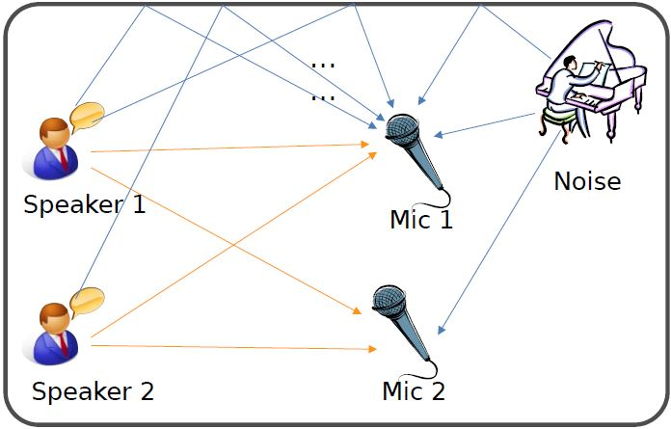
Cocktail party problem
Cocktail party problem may involve a few tasks:
How many speakers?
(Source counting)
Where are they?
(Localization and tracking）
Who speaks and when?
(Diarization）
What are the individual speech sources?
(Speech separation）
What has been said?
(Automatic speech recognition）
What kind environment?
(Acoustic scene recognition, event detection, room acoustics)
Cocktail-party problem (Cherry 1953) or ball-room problem (Helmholtz, 1863)
4
“No machine has yet been constructed to do just that [solving the cocktail party problem].” (Cherry, 1957)
Notes:
In this section, I will show you, what is audio-visual multi-speaker tracking, what is its application, which challenges are often met, and I will show you some popular multi-tracking methods and their drawbacks.

Slide 5
Speech source separation
Potential techniques for the speech separation problem
  Beamforming
  Adaptive filtering
  Blind source separation and independent component analysis
  Sparse representation and matrix factorization
  Matrix/tensor factorization techniques
  Computational auditory scene analysis (e.g. time-frequency masking)
  Learning based techniques
  Exploiting multimodality (e.g. audio-visual coherence)
  …
5
Notes:
In this section, I will show you, what is audio-visual multi-speaker tracking, what is its application, which challenges are often met, and I will show you some popular multi-tracking methods and their drawbacks.

Slide 6
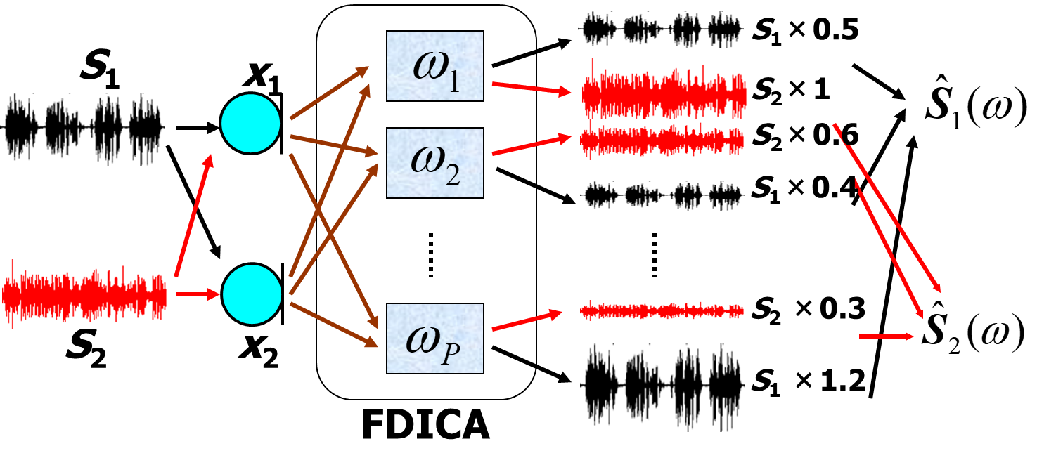

FDICA: Sound Demonstration
Sources
Mixtures
Parra&Spence
Our approach
Two speaking sentences artificially mixed together
A man speaking with TV on
W. Wang, S. Sanei, and J. A. Chambers, Penalty function based joint diagonalization approach for convolutive blind separation of nonstationary sources, in IEEE Trans. Signal Processing, vol. 53, no. 5, pp. 1654-1669, May 2005.

Slide 7
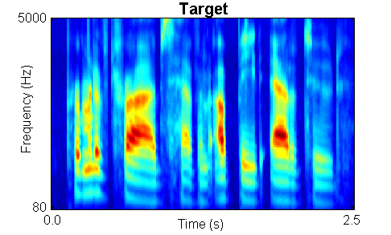
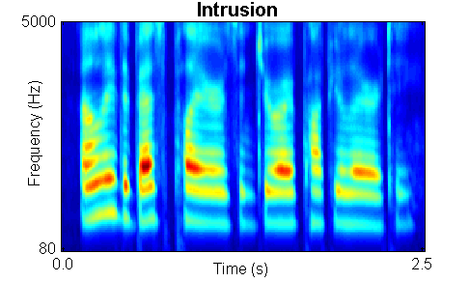

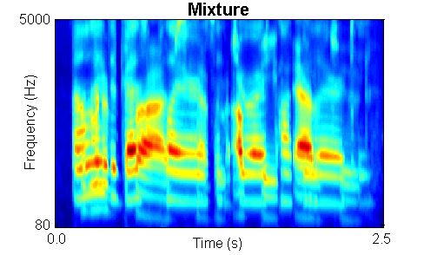
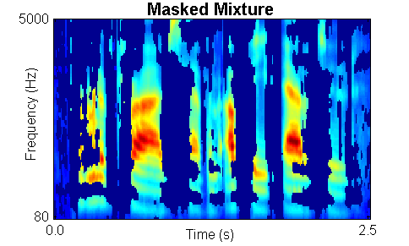
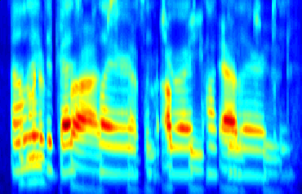
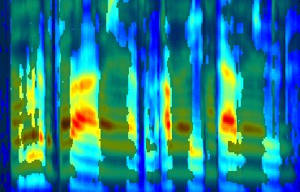
Time-Frequency Masking (TFM)
Psychophysical tests show that the ideal binary mask results in dramatic speech intelligibility improvements (Brungart et al.’06; Li & Loizou’08). Acknowledgement to D.L. Wang.

Slide 8

TFM: An Example
2-source case:
Mandel et al.
Sawada et al.
Alinaghi et al.
Original
left
es1
right
es2
A. Alinaghi, P. Jackson, Q. Liu, and W. Wang, "Joint Mixing Vector and Binaural Model Based Stereo Source Separation", IEEE Transactions on Audio Speech and Language Processing, 2014.

Slide 9
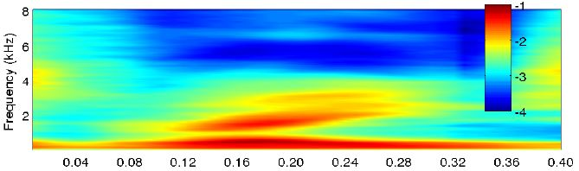
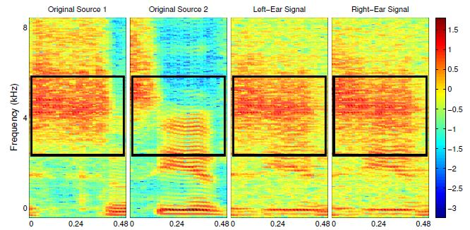
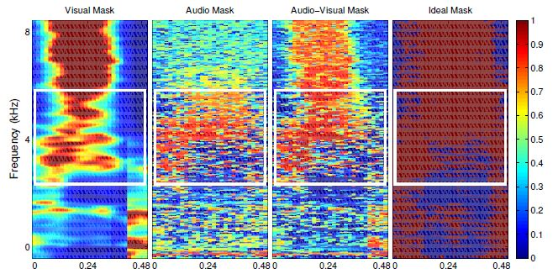
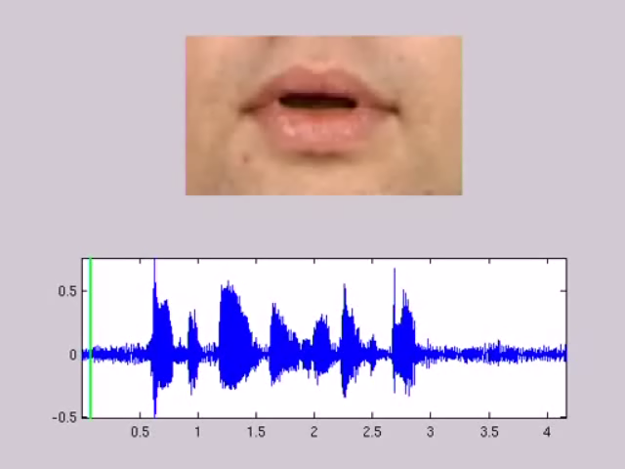

AV Speech Source Separation- Demo
 | Mixture | Ideal | Mandel | AV-LIU | AVDL-BSS | Rivet | AVMP-BSS
A
B
C
D
Q. Liu, W. Wang, et al., “Source separation of convolutive and noisy mixtures using audio-visual dictionary learning and probabilistic time-frequency masking", IEEE Transactions on Signal Processing, vol. 61, no. 22, pp. 5520-5535, 2013.
Notes:
In this section, I will show you, what is audio-visual multi-speaker tracking, what is its application, which challenges are often met, and I will show you some popular multi-tracking methods and their drawbacks.

Slide 10
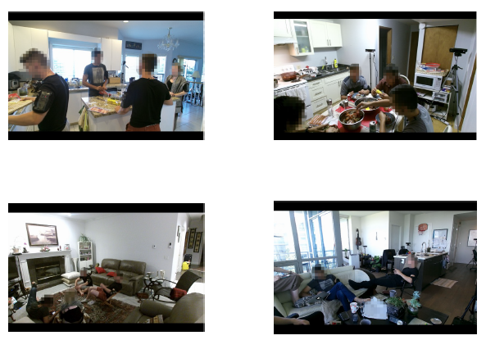
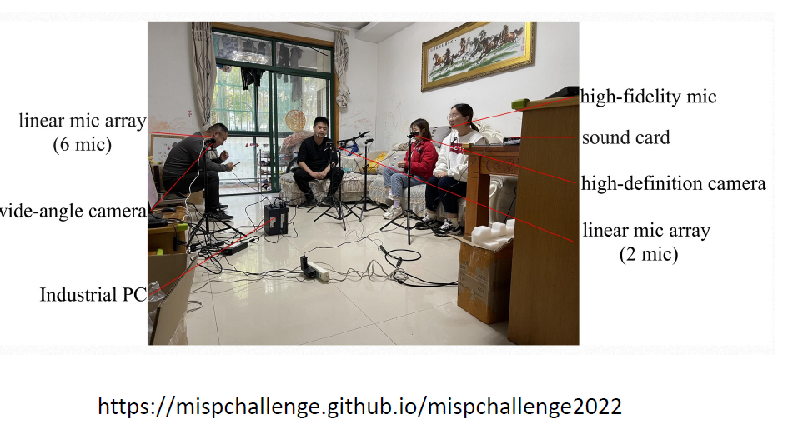

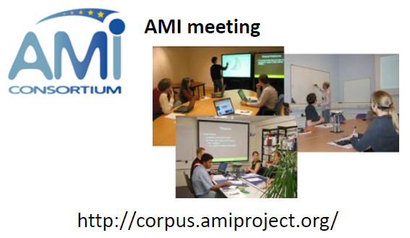
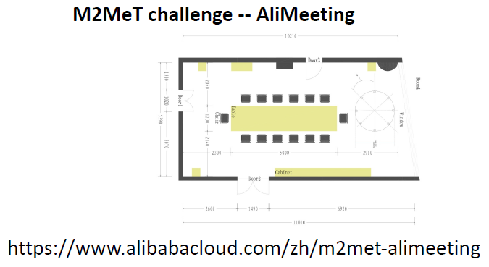
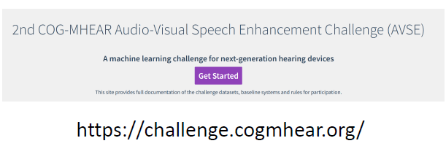
Data Challenges in (AV) Speech Separation
MMCSG (Multi-Modal Conversations in Smart Glasses) dataset
https://ai.meta.com/datasets/mmcsg-dataset/
Notes:
In this section, I will show you, what is audio-visual multi-speaker tracking, what is its application, which challenges are often met, and I will show you some popular multi-tracking methods and their drawbacks.

Slide 11
Other Recent Developments
AV speech separation
R. Gao and K. Grauman, “VISUALVOICE: Audio-Visual Speech Separation with Cross-Modal Consistency,” Proc. CVPR, 2021.
A. Nagrani, et al., “Seeing Voices and Hearing Faces: Cross-modal biometric matching,” in Proc. CVPR, 2018.
AV general sound separation
C. Gan, et al. “Music Gesture for Visual Sound Separation,” in Proc. CVPR, 2020.
E. Tzinis, S. Wisdom, T. Remez, and J.R. Hershey, “AudioScopeV2: Audio-Visual Attention Architectures for Calibrated Open-Domain On-Screen Sound Separation", in Proc. ECCV, 2022.
Universal sound separation
I. Kavalerov, et al., “Universal Sound Separation,” in Proc. IEEE WASPAA, 2019.
Q. Kong et al., “Universal Source Separation with Weakly Labelled Data,” arXiv:2305.07447, 2023.
Queried sound source separation
X. Liu, et al. “Separate What You Describe: Language-Queried Audio Source Separation,” in Proc. Interspeech 2022.
X. Liu, et al. “AudioSep : Separate Anything You Describe”, arXiv:2308.05037, 2023.
Language guided AV source separation
Dong, et al., “CLIPSep: Learning Text-queried Sound Separation with Noisy Unlabeled Videos,” in ICLR 2022.
R. Tan, et al., “Language-Guided Audio-Visual Source Separation via Trimodal Consistency,” in Proc. CVPR, 2023.
Singing voice separation
W. Yuan, et al, "Unsupervised Deep Unfolded Representation Learning for Singing Voice Separation," IEEE/ACM Transactions on Audio Speech and Language Processing, vol. 31, pp. 3206 - 3220, 2023.
W. Yuan, et al, "Evolving multi-resolution pooling CNN for monaural singing voice separation", IEEE/ACM Transactions on Audio Speech and Language Processing, vol. 29, pp. 807-821, 2021.
Notes:
In this section, I will show you, what is audio-visual multi-speaker tracking, what is its application, which challenges are often met, and I will show you some popular multi-tracking methods and their drawbacks.

Slide 12
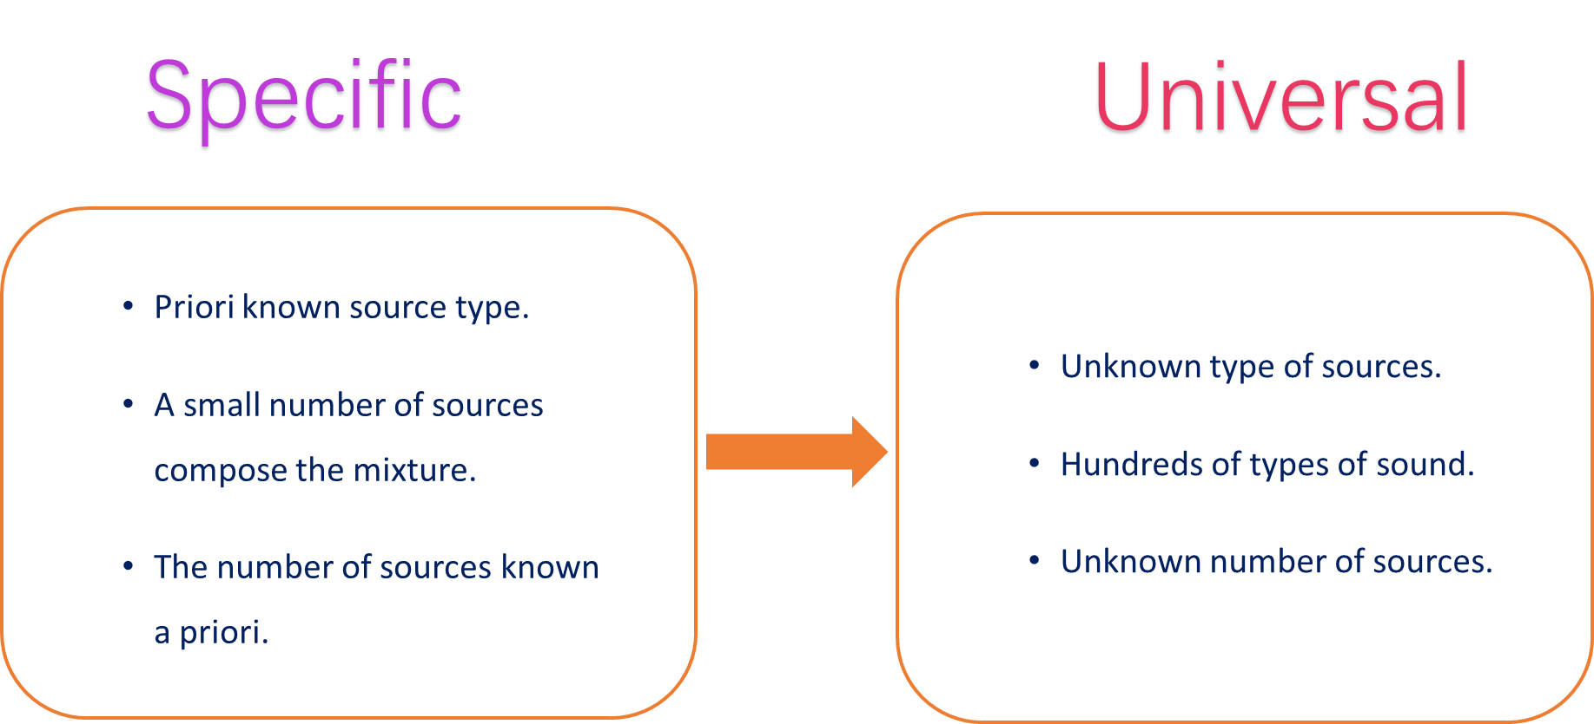
Universal Audio Source Separation
[1] Kavalerov et al, “Universal sound separation,” WASPAA 2019.
[2] Tzinis et al, “Improving universal sound separation using sound classification”, ICASSP 2020.
[3] Wisdom et al, “What’s all the fuss about free universal sound separation data?,” ICASSP 2021.
[4] Kong et al, “Universal Source Separation with Weakly Labelled Data,” arXiv 2023.
Notes:
In this section, I will show you, what is audio-visual multi-speaker tracking, what is its application, which challenges are often met, and I will show you some popular multi-tracking methods and their drawbacks.

Slide 13
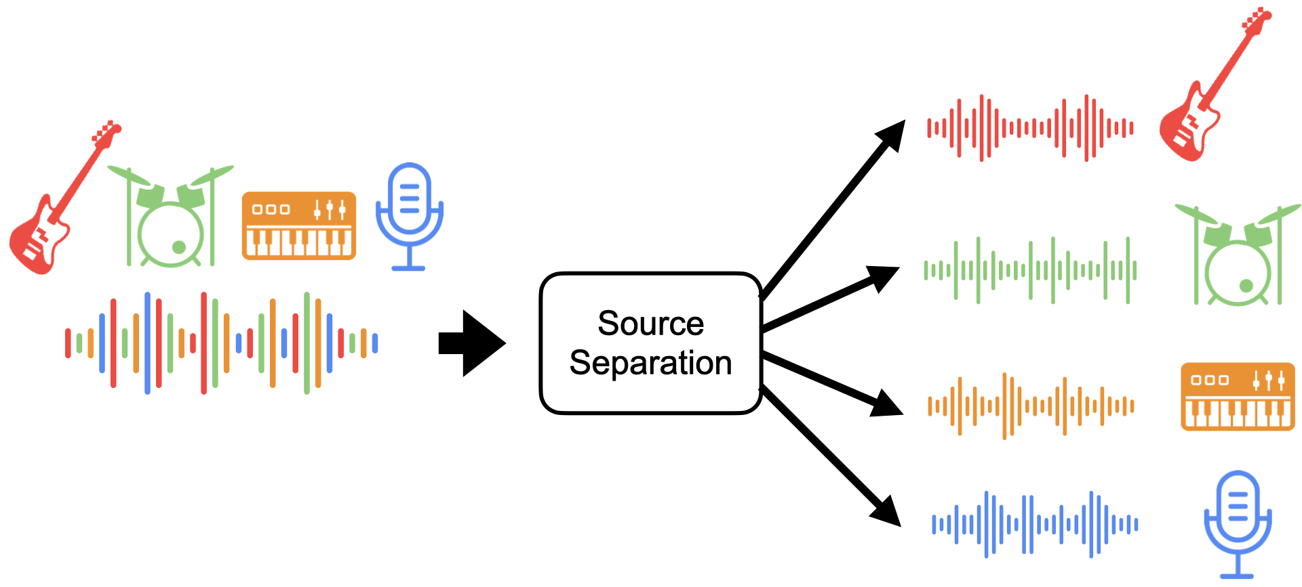
Query-based Audio Source Separation
  Query type: vision, audio, labels, …
  Not flexible and straightforward to separate desired sounds
13
Notes:
In this section, I will show you, what is audio-visual multi-speaker tracking, what is its application, which challenges are often met, and I will show you some popular multi-tracking methods and their drawbacks.

Slide 14
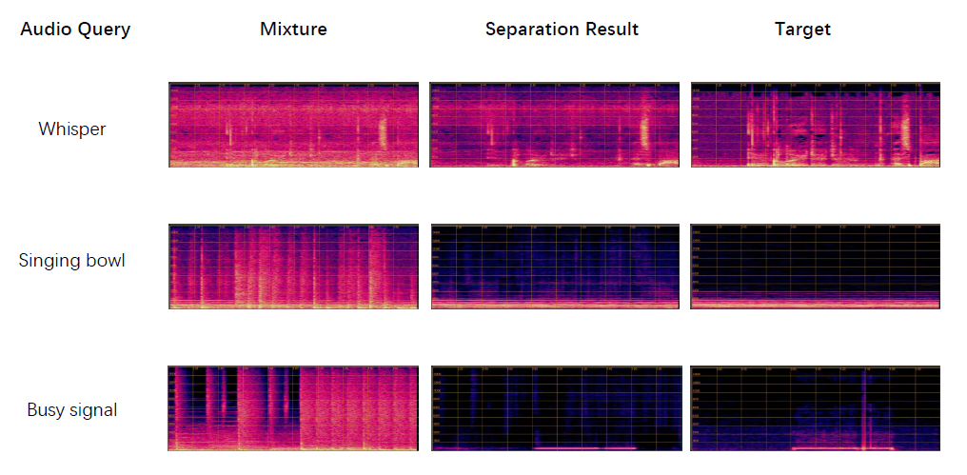
Universal Audio Source Separation with Query by Embeddings
Use embedding from audio query to extract the sound of interest
J. Zhao, X. Liu, J. Zhao, Y. Yuan, Q. Kong, M. Plumbley, and W. Wang, "Universal Sound Separation with Self-Supervised Audio Masked Autoencoder," in Proceedings of the 32nd European Signal Processing Conference (EUSIPCO 2024), Lyon, France, August 26-30, 2024.
Notes:
In this section, I will show you, what is audio-visual multi-speaker tracking, what is its application, which challenges are often met, and I will show you some popular multi-tracking methods and their drawbacks.

Slide 15
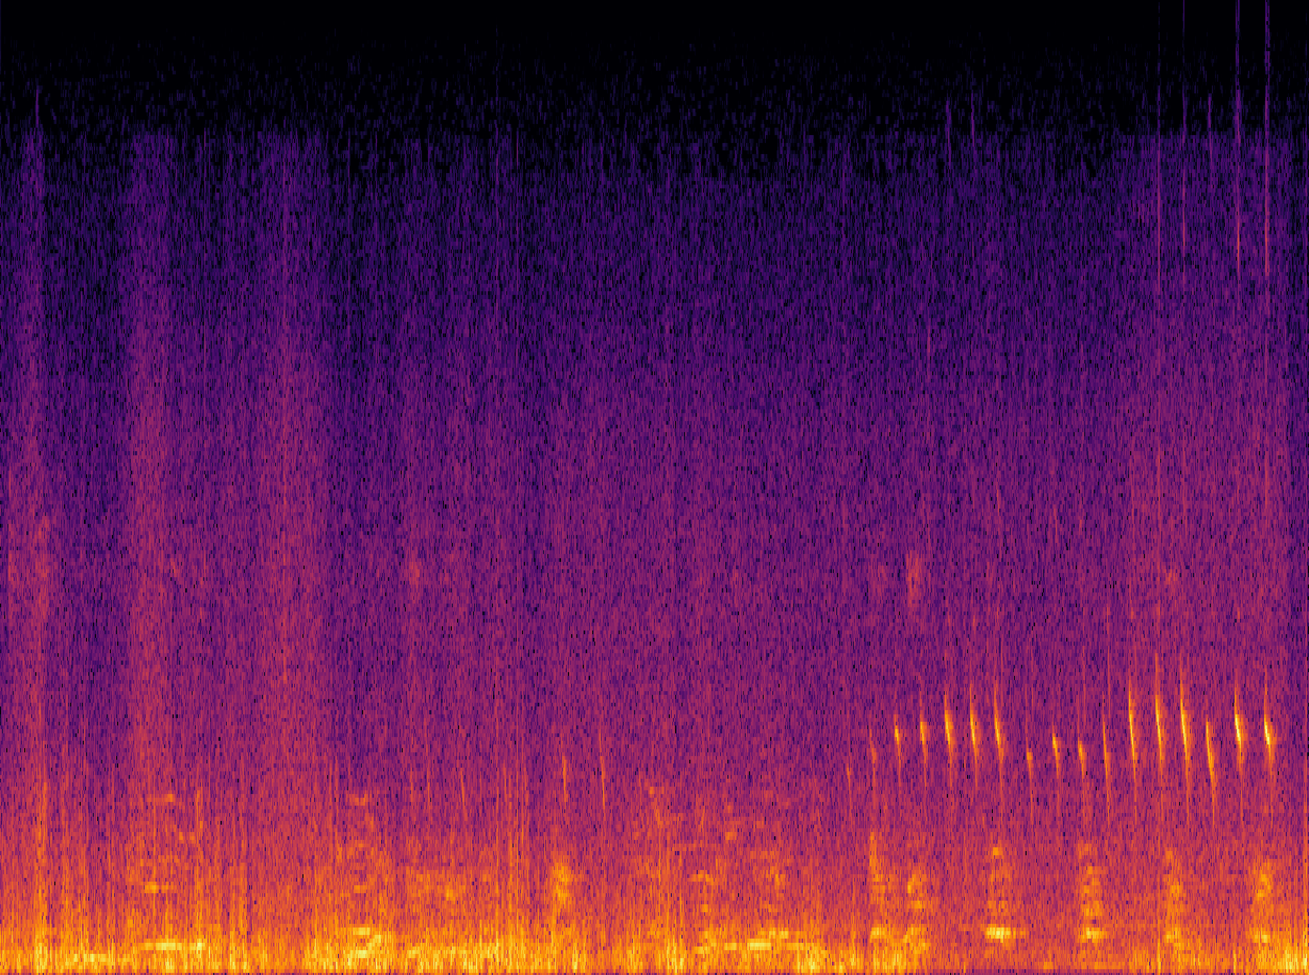
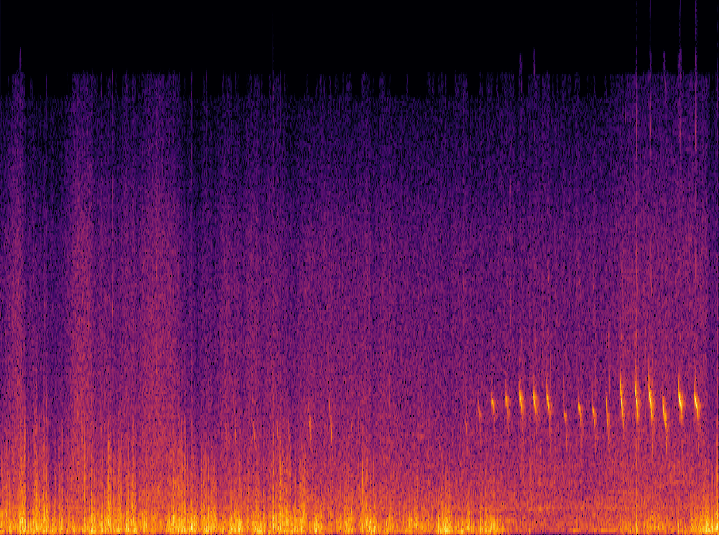
Language Queried Audio Source Separation
LASS – Separate a target source from an audio mixture based on the natural language descriptions of the target source
First attempt bridging audio source separation and natural language processing
Support input arbitrary text to separate desired sound sources
Language Query: A bird is chirping under the thunder storm
LASS
15
X. Liu, H. Liu, Q. Kong, X. Mei, J. Zhao, Q. Huang, M.D. Plumbley, and W. Wang,"Separate What You Describe: Language-Queried Audio Source Separation," in Proc. 23rd Interspeech Conference (INTERSPEECH 2022), 18-22 September, 2022, Incheon, Korea.
Notes:
In this section, I will show you, what is audio-visual multi-speaker tracking, what is its application, which challenges are often met, and I will show you some popular multi-tracking methods and their drawbacks.

Slide 16
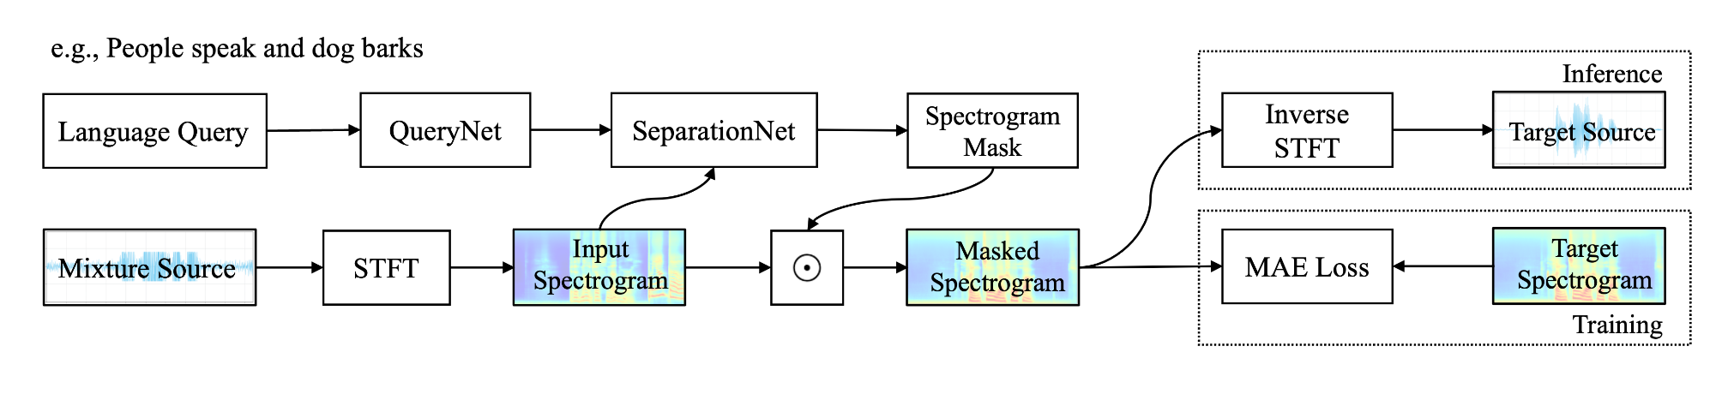
Challenges and Methods
How to construct training data?
  Training with synthetic mixtures generating from audio-text datasets
LASS-Net
  QueryNet (BERT) + SeparationNet (ResUNet) + FiLM fusion
  Trained with 17 hours of data from AudioCaps dataset
X. Liu, H. Liu, Q. Kong, X. Mei, J. Zhao, Q. Huang, M.D. Plumbley, and W. Wang,"Separate What You Describe: Language-Queried Audio Source Separation," in Proc. 23rd Interspeech Conference (INTERSPEECH 2022), 18-22 September, 2022, Incheon, Korea.
Notes:
In this section, I will show you, what is audio-visual multi-speaker tracking, what is its application, which challenges are often met, and I will show you some popular multi-tracking methods and their drawbacks.

Slide 17
Recent LASS
Leverage aligned multimodal supervision
  Visual supervision (e.g., CLIPSep, Dong et al. 2023)
  Audio supervision (e.g., SoundFilter, Kilgour 2022)
Great potential to leverage unlabeled rich modality, but
  They were trained with small-scale of data (e.g., VGGSound, 500 hours)
  They may not meet the expectation of open-domain sound separation with texts
Notes:
In this section, I will show you, what is audio-visual multi-speaker tracking, what is its application, which challenges are often met, and I will show you some popular multi-tracking methods and their drawbacks.

Slide 18
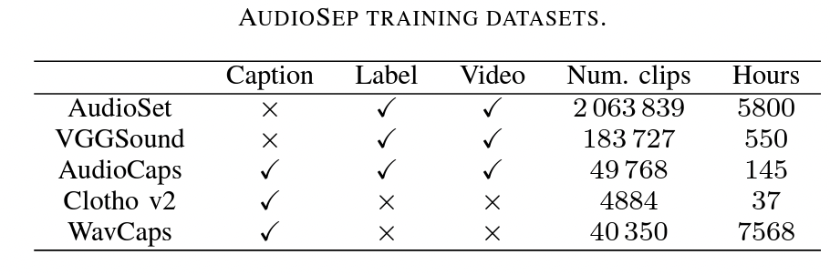
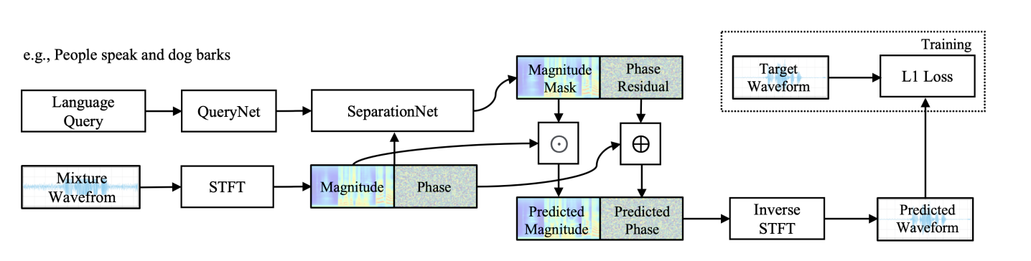
Method 1: AudioSep
CLAP/CLIP + ResUNet, trained with 14,000 hours of multimodal data
A foundation model for open-domain sound separation with texts
Impressive zero-shot performance in separating speech, music, sounds
Paper:
https://arxiv.org/pdf/2308.05037.pdf
Code:
https://github.com/Audio-AGI/AudioSep
Demo:
https://huggingface.co/spaces/Audio-AGI/AudioSep
Notes:
In this section, I will show you, what is audio-visual multi-speaker tracking, what is its application, which challenges are often met, and I will show you some popular multi-tracking methods and their drawbacks.

Slide 19
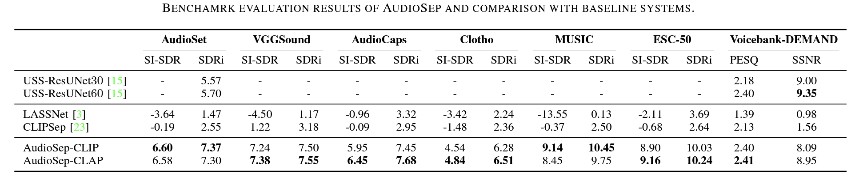
Experimental Results
AudioSep achieved the state-of-the-art results on multiple datasets.
Impressive zero-shot separation performance on MUSIC and ESC-50.
X. Liu, Q. Kong, Y. Zhao, H. Liu, Y. Yuan, Y. Liu, R. Xia, Y. Wang, M.D. Plumbley, and W. Wang,“Separate Anything You Describe" in IEEE/ACM Transactions on Audio Speech and Language Processing, 2024, accepted.
Notes:
In this section, I will show you, what is audio-visual multi-speaker tracking, what is its application, which challenges are often met, and I will show you some popular multi-tracking methods and their drawbacks.

Slide 20
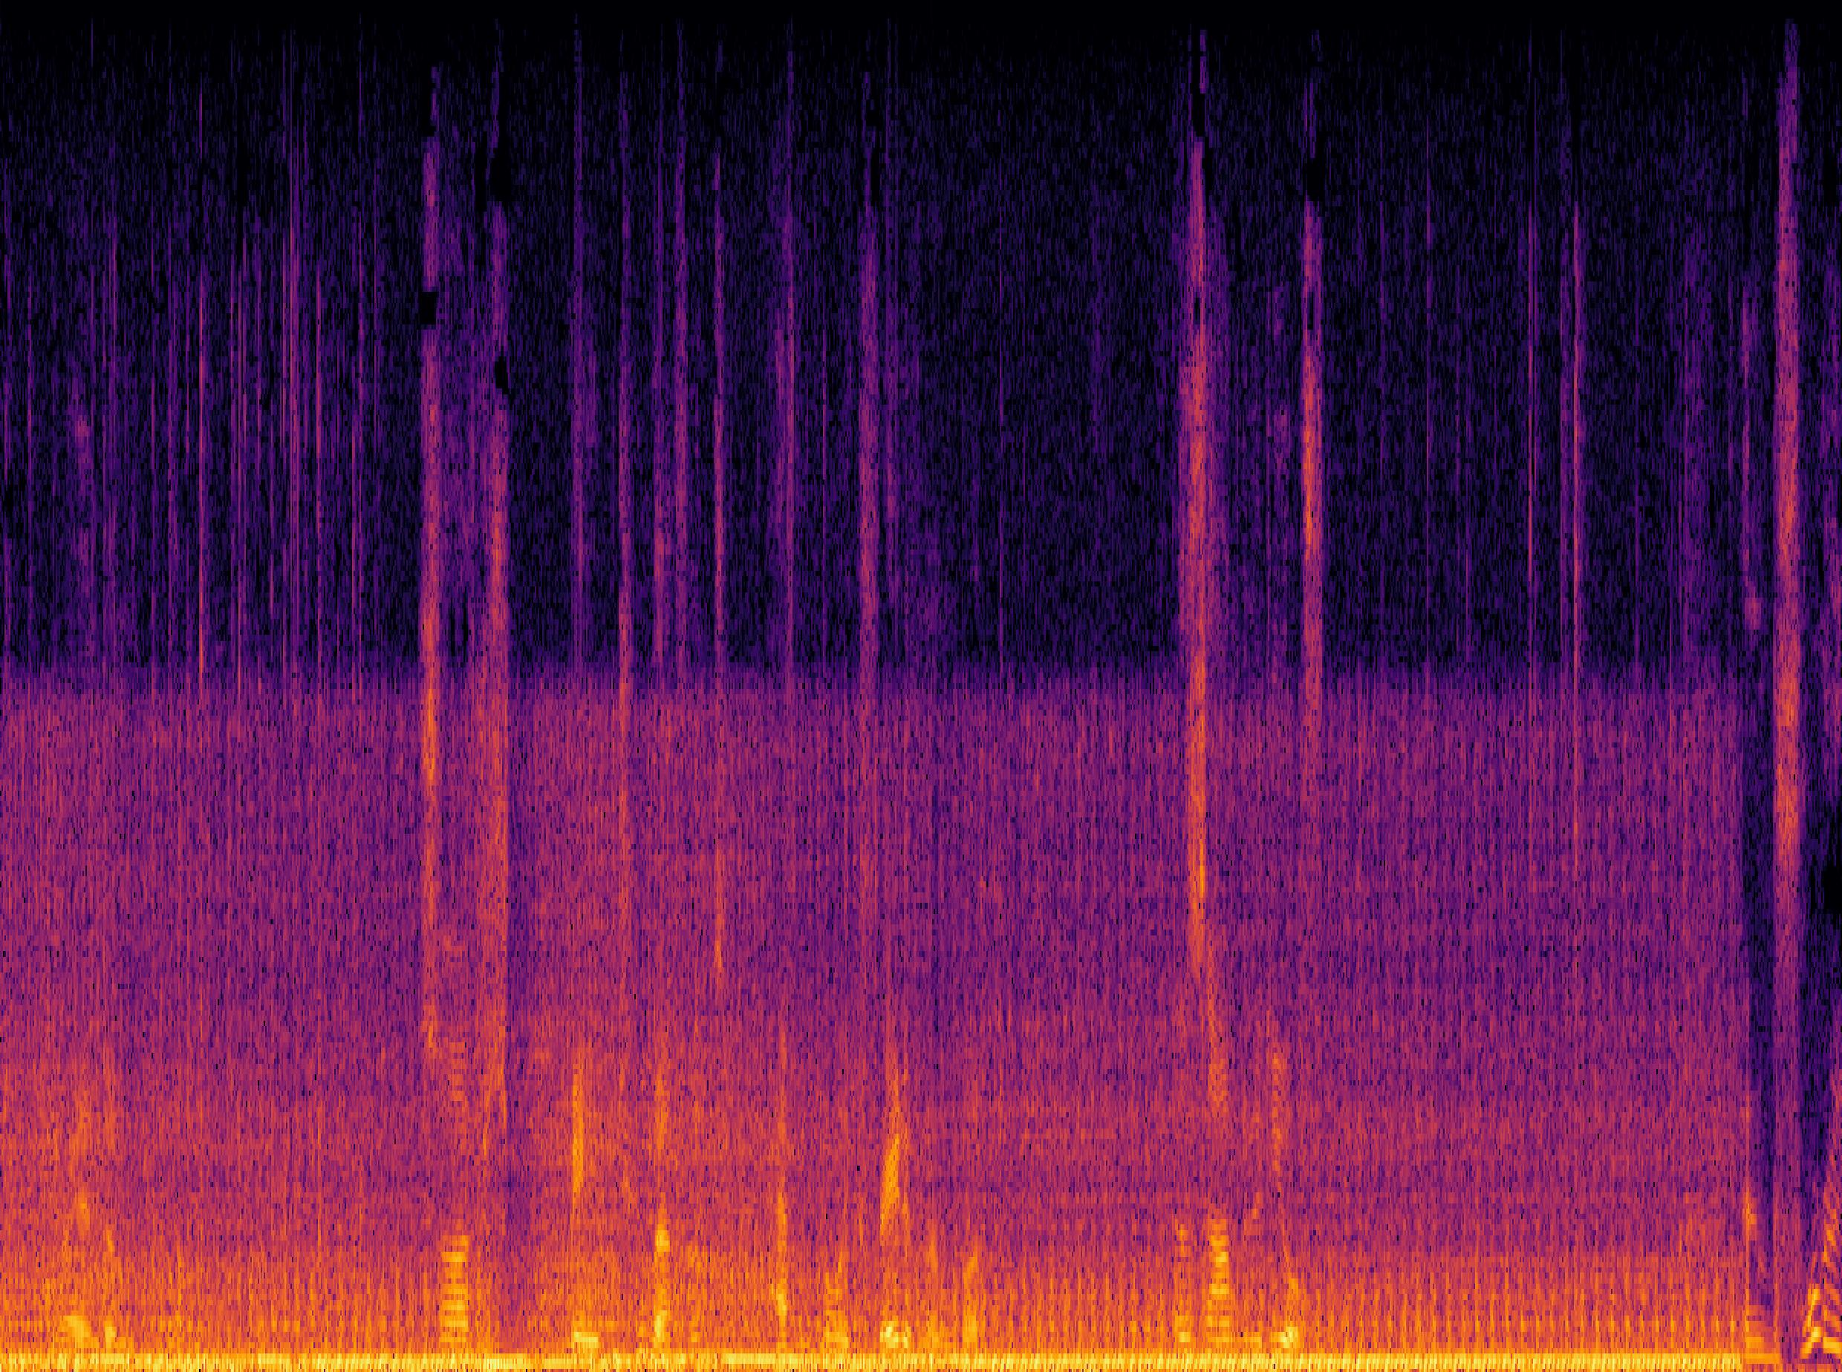
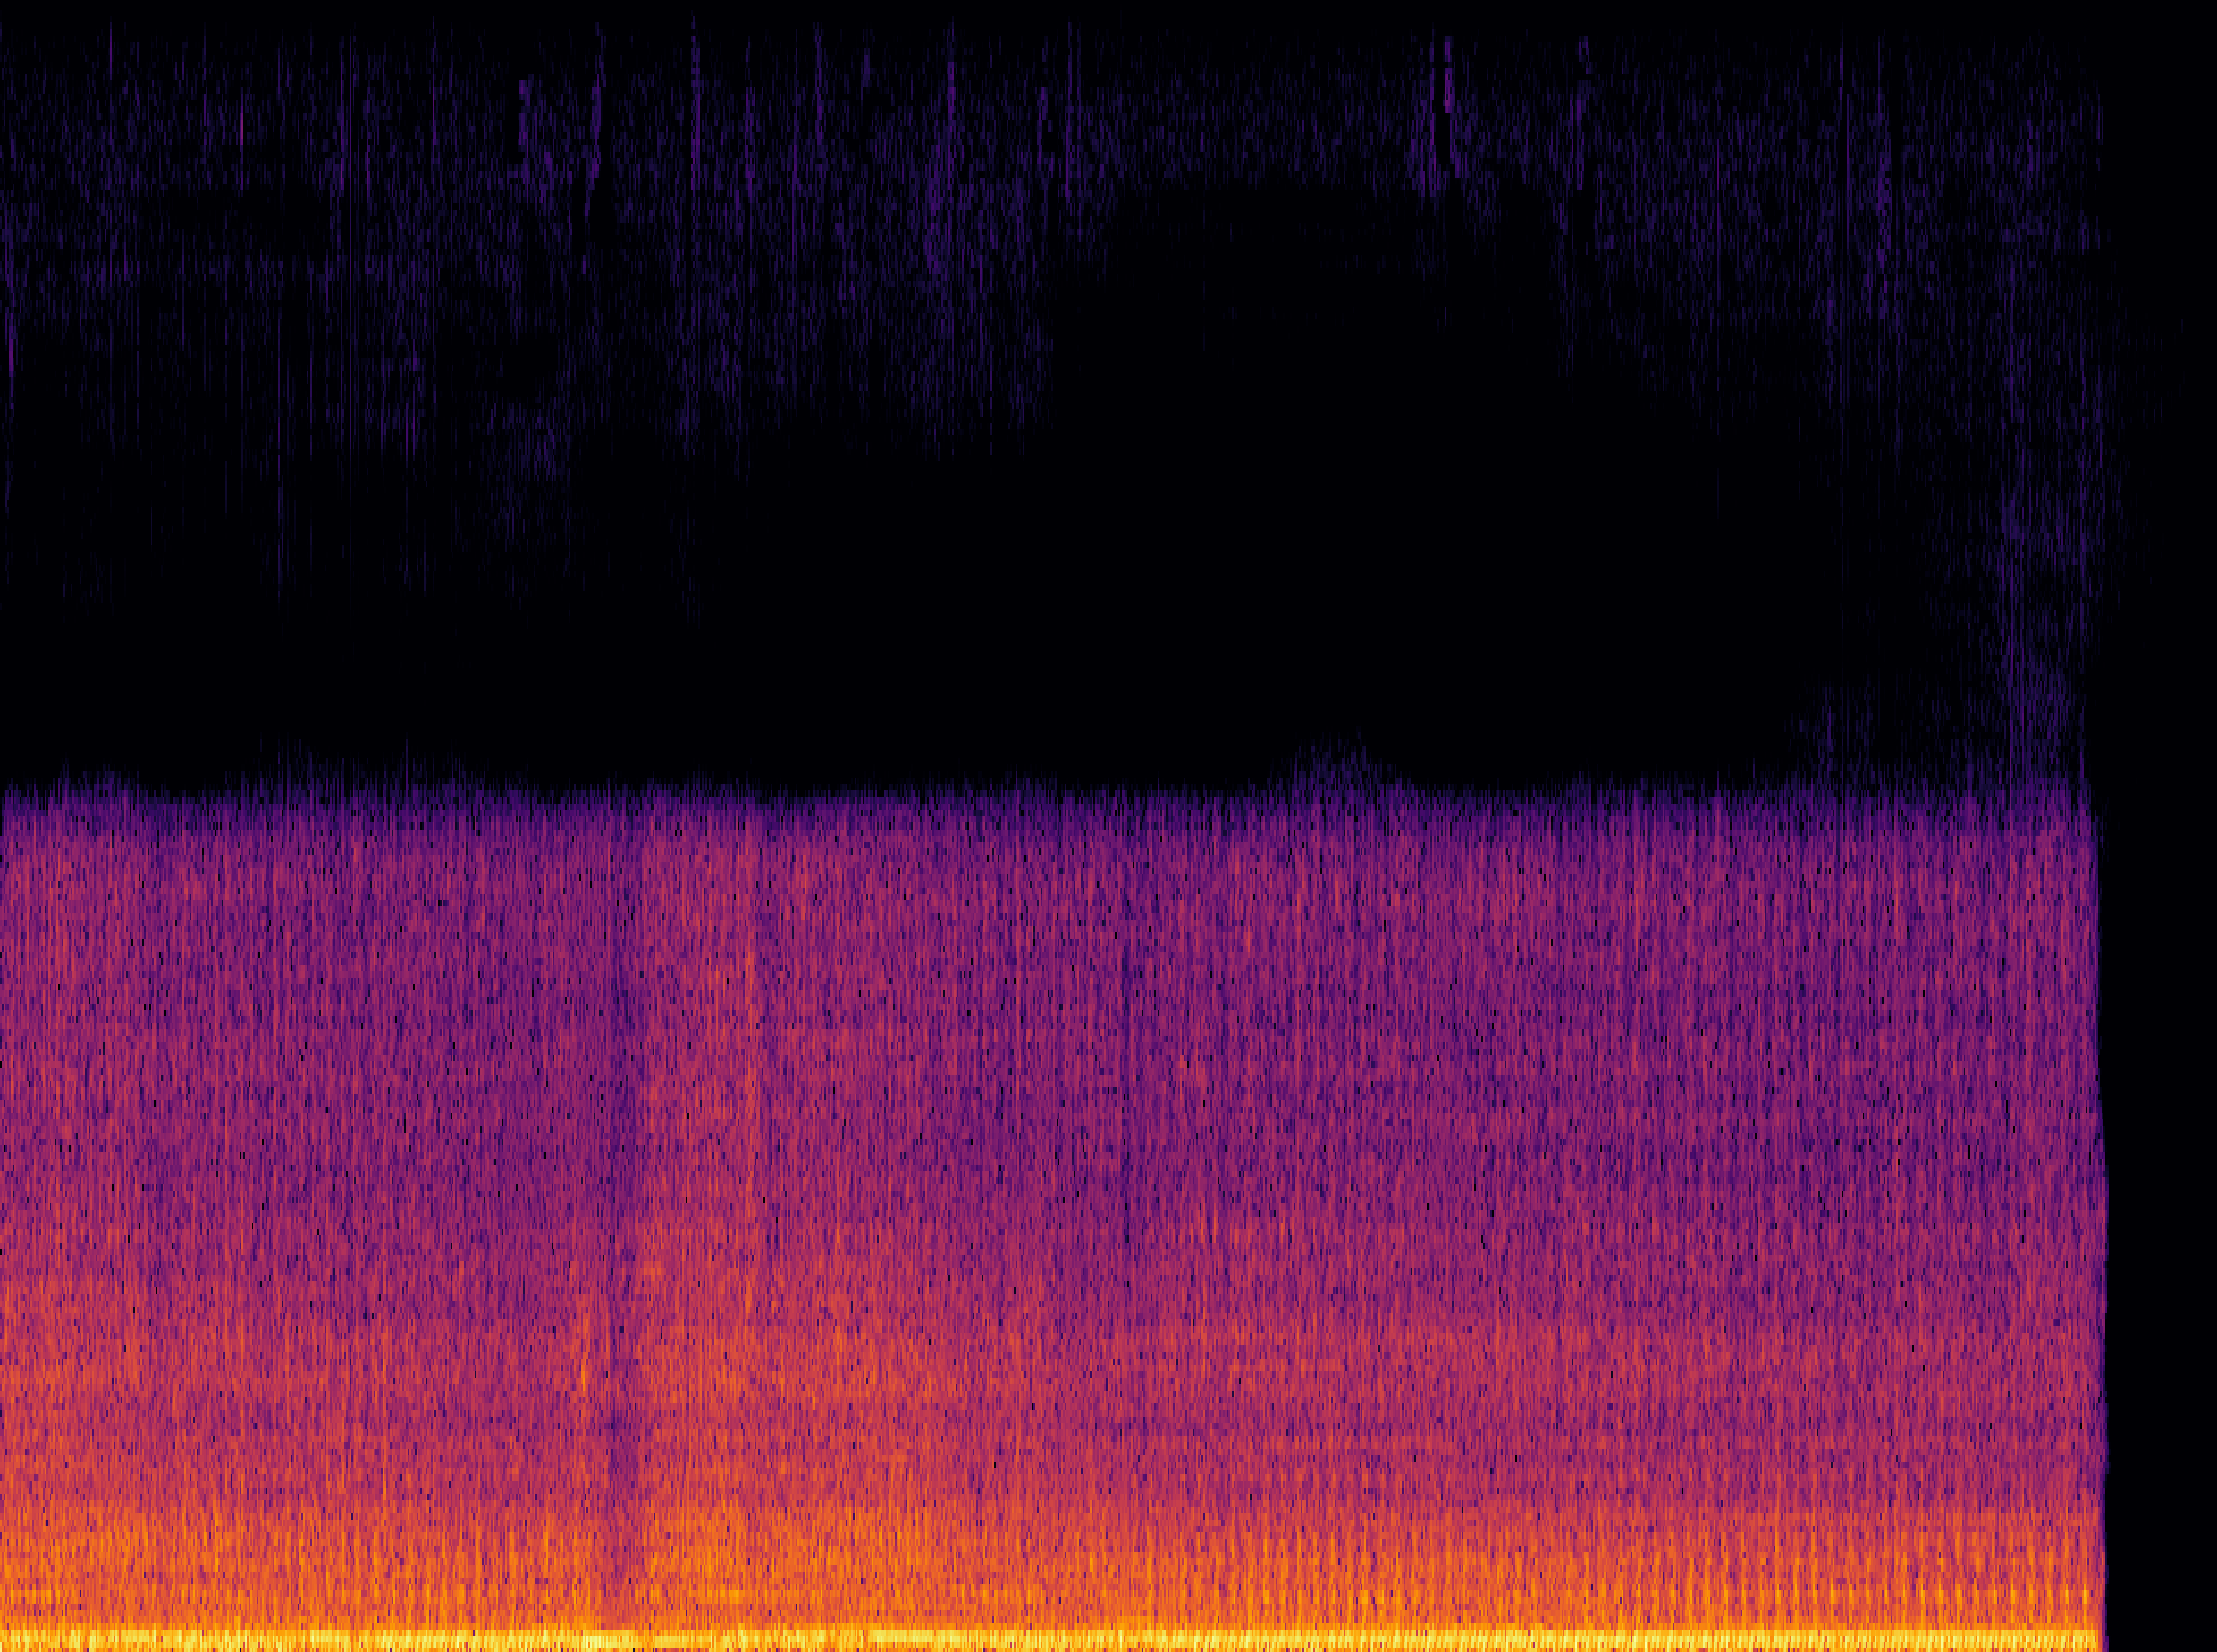
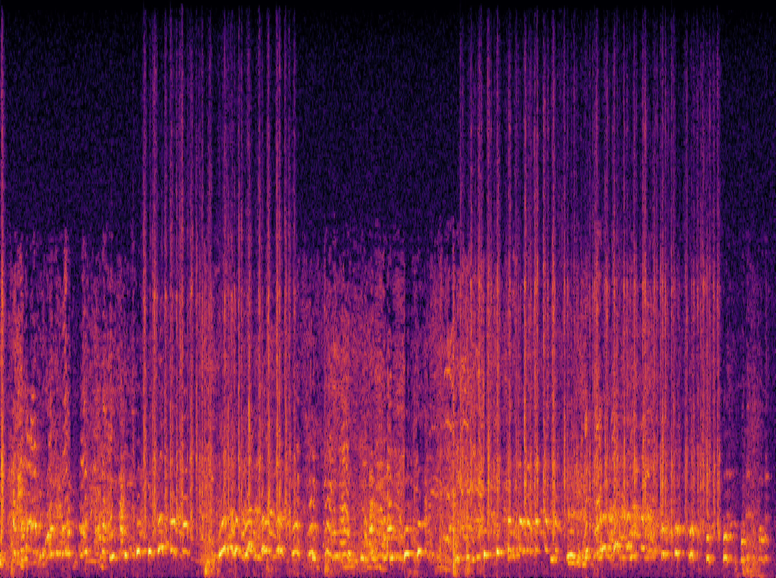
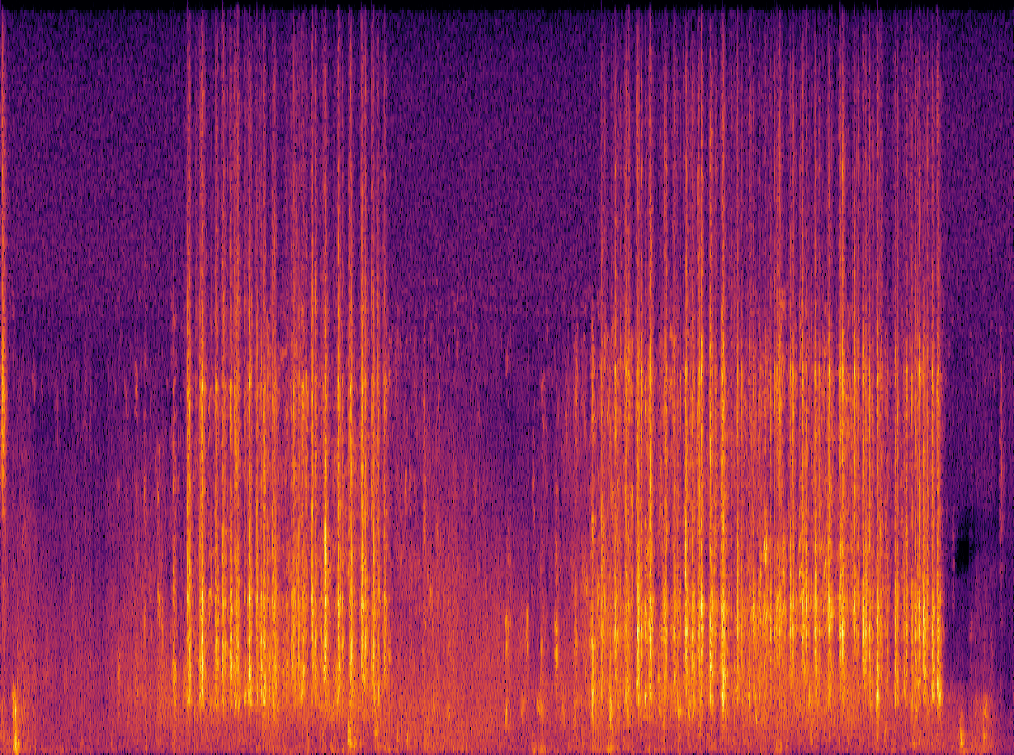
AudioSep: Sound Demos
Human query: “The engine sound of a vehicle”
Mix
Separated
Human query: “The sound of hitting the keyboard”
Mix
Separated
Notes:
In this section, I will show you, what is audio-visual multi-speaker tracking, what is its application, which challenges are often met, and I will show you some popular multi-tracking methods and their drawbacks.

Slide 21
Method 2: FlowSep
Existing Ideas:
A “New” Idea:
  Discriminative approaches.
  Time-frequency masking on spectrogram to remove the noise sound sources.
  Using the generative approaches.
  Diffusion-based generation framework with rectified flow matching.
  Separation system by generating new audio samples with the noise clips and text prompts as a condition.
Challenges:
  Challenging with overlapping sound events.
  Excessive and insufficient masking leads to artifacts, including spectral holes and incomplete separation.
Notes:
In this section, I will show you, what is audio-visual multi-speaker tracking, what is its application, which challenges are often met, and I will show you some popular multi-tracking methods and their drawbacks.

Slide 22
FlowSep: Architecture
  Text-to-audio generation model as the backbone, Rectified Flow Matching for feature generation.
  Extended VAE latent space to integrate the noise audio feature.
  Flan-T5 text encoder, VAE latent decoder and BigVGAN vocoder.
Y. Yuan, X. Liu, H. Liu, M.D. Plumbley, and W. Wang,“FlowSep: Language-Quried Sound Separation with Rectified Flow Matching" in ICASSP 2025, submitted.
Notes:
In this section, I will show you, what is audio-visual multi-speaker tracking, what is its application, which challenges are often met, and I will show you some popular multi-tracking methods and their drawbacks.

Slide 23
Training Data
  A total of 1,680 hours of audio from various datasets for training. When creating the mixture audio samples, every two audio clips are ensure not sharing any overlapping sound source classes. All the segments are padded or cropped to 10 seconds with 16kHz sampling rate, and we mixture two waveform with a random SNR between -15 and 15 dB.
  AudioCaps:
    One of the largest publicly available audio captioning dataset, containing 49837 10-second audio clips with human annotated captions.
  VGGSound:
    Audio dataset with 200,000 audio clips. Each sample has a duration of 10 seconds and annotated with labels.
  WavCaps
    Large-scale audio dataset with weakly-labelled captions generated with LLM. We only use the samples less than 10 seconds and collected a total of 400,000 clips.
Notes:
In this section, I will show you, what is audio-visual multi-speaker tracking, what is its application, which challenges are often met, and I will show you some popular multi-tracking methods and their drawbacks.

Slide 24
Evaluation Data
  VGGSound:
    2000 mixtures generated from a group of 200 clean and distinct audio samples, mixed with random LUFS loudness between -35 and -25 dB.
  ESC-50:
    2000 mixtures with a SNR at 0 dB.
  AudioCaps:
    928 samples by mixing the audio from testing set under random SNR rate between -15 and 15 dB.
  DCASE2024 Task 8:
    DCASE-Synth includes 3000 mixtures from 1000 selected audio clips under an SNR rate between -15 and 15 dB.
    DCASE-Real consists of 100 audio clips from read-world scenarios.
Notes:
In this section, I will show you, what is audio-visual multi-speaker tracking, what is its application, which challenges are often met, and I will show you some popular multi-tracking methods and their drawbacks.

Slide 25
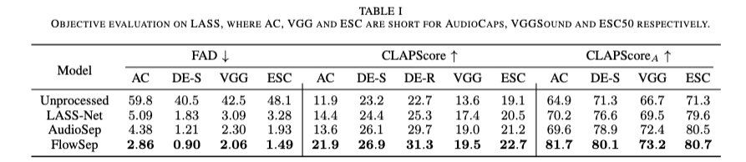
Experimental Results
  Unlike discriminative network that modify on the original audio clips, generated results do not strictly align with the target audio sample in the temporal dimension.
  Hence, traditional objective metrics are not suitable for generative based models.
  We apply FAD, CLAPScore and CLAPScoreA from generative tasks to evaluate the performance.
25
Notes:
In this section, I will show you, what is audio-visual multi-speaker tracking, what is its application, which challenges are often met, and I will show you some popular multi-tracking methods and their drawbacks.

Slide 26
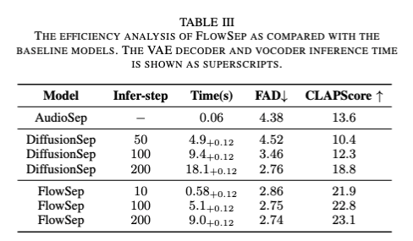
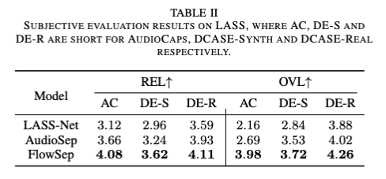
Experimental Results (Cont.)
  Results on subjective evaluations.
  Ablation studies between RFM and traditional diffusion-based models.
26
Notes:
In this section, I will show you, what is audio-visual multi-speaker tracking, what is its application, which challenges are often met, and I will show you some popular multi-tracking methods and their drawbacks.

Slide 27
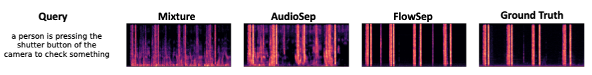

FlowSep - Demos
  Baseline models show incomplete separation with noticeable spectral gaps.
  FlowSep demonstrates promising capabilities in such situations.
  More demos please refer to https://audio-agi.github.io/FlowSep_demo/.
27
Y. Yuan, X. Liu, H. Liu, M.D. Plumbley, and W. Wang,“FlowSep: Language-Quried Sound Separation with Rectified Flow Matching" in ICASSP 2025, submitted.
Notes:
In this section, I will show you, what is audio-visual multi-speaker tracking, what is its application, which challenges are often met, and I will show you some popular multi-tracking methods and their drawbacks.

Slide 28
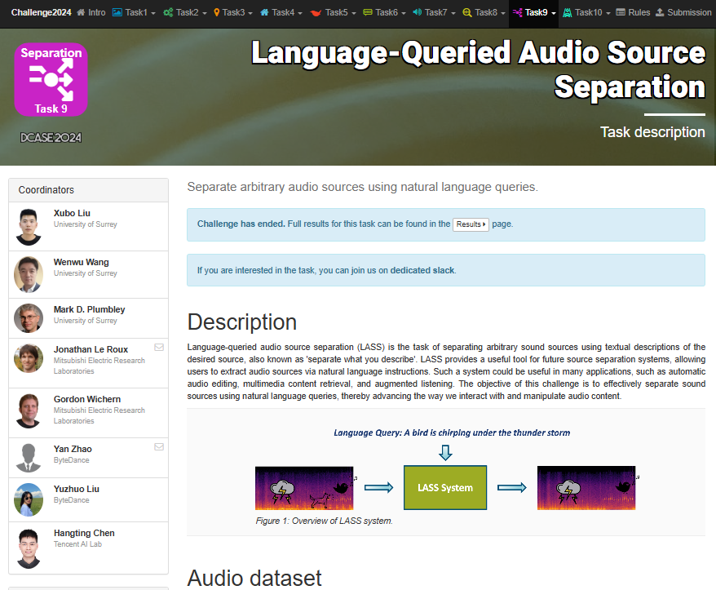
DCASE Challenge –Task 10
28
https://dcase.community/challenge2024/task-language-queried-audio-source-separation
Notes:
In this section, I will show you, what is audio-visual multi-speaker tracking, what is its application, which challenges are often met, and I will show you some popular multi-tracking methods and their drawbacks.

Slide 29
Possible Future Directions
Conclusions:
Language queried audio source separation offers tools for users to control which sound to be separated from the sound mixtures, using language-based queries.
Future directions:
Leverage generative models (e.g., diffusion models) to improve the perceptual quality of separated sounds.
Explore advanced reasoning capabilities of LLMs for LASS (e.g., separating complex queries like "the second sound" or "annoyed sounds").
Apply self-supervised techniques (e.g., MixIT) for pre-training to enhance separation performance.
29
Notes:
In this section, I will show you, what is audio-visual multi-speaker tracking, what is its application, which challenges are often met, and I will show you some popular multi-tracking methods and their drawbacks.

Slide 30
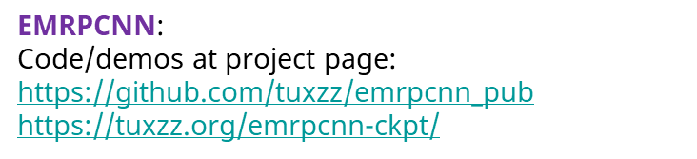










Take Away
My contact:
Email: w.wang@surrey.ac.uk
Web: https://personalpages.surrey.ac.uk/w.wang/
FlowSep:
Paper/Code/Demo:
https://audio-agi.github.io/FlowSep_demo
AudioSep:
Code/paper/demo:
DCASE 2024 Task 9: “Language-Queried Audio Source Separation”
GitHub: https://github.com/Audio-AGI/AudioSep
HuggingFace: https://huggingface.co/spaces/Audio-AGI/AudioSep
Media coverage:
Notes:
In this section, I will show you, what is audio-visual multi-speaker tracking, what is its application, which challenges are often met, and I will show you some popular multi-tracking methods and their drawbacks.

