Slide 1
Audio Encoder Capability Challenge 2025

Slide 2
Workshop Agenda
Start Time | End Time | Duration | Topics | Presenters
10:15 AM | 10:25 AM | 0:10 | Welcome and Introduction | Wenwu Wang
10:25 AM | 10:35 AM | 0:10 | Baseline Sharing | Yadong Niu
10:35 AM | 10:40 AM | 0:05 | Award winners with certificates | Wenwu Wang
10:40 AM | 10:50 AM | 0:10 | Share thoughts on neural audio codec | Wenwu Wang
10:50 AM | 10:55 AM | 0.05 | Q&A by Wenwu Wang | Wenwu Wang
10:55 AM | 11:00 AM | 0:05 | Share thoughts on data related topics | Helen Wang
11:00 AM | 11:10 AM | 0:10 | Presentation 1 by Team Audiocodec | Team Audiocodec
11:10 AM | 11:15 AM | 0:05 | Q&A by Team Audiocodec
11:15 AM | 11:25 AM | 0:10 | Presentation 2 by Team SAMoVA | Team SAMoVA
11:25 AM | 11:30 AM | 0:05 | Q&A by Team SAMoVA

Slide 3
Challenge Introduction

Slide 4
Motivation
“Strongly inspired by the HEAR benchmark, this challenge introduces several key enhancements: a diverse task set, a focus on real-world applications, a combination of parameterized and parameter-free evaluation, and a new open-sourced, efficient evaluation system.”

Slide 5
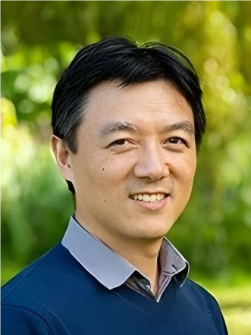
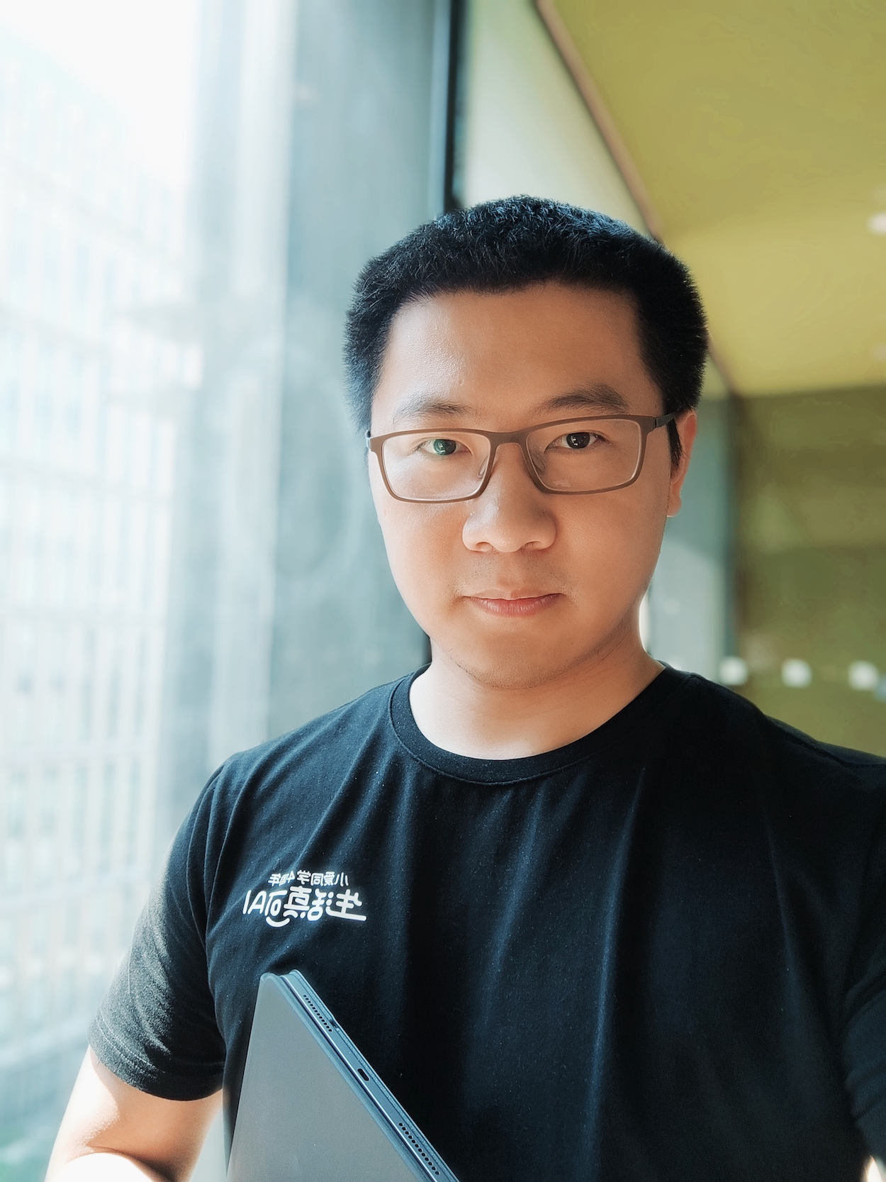
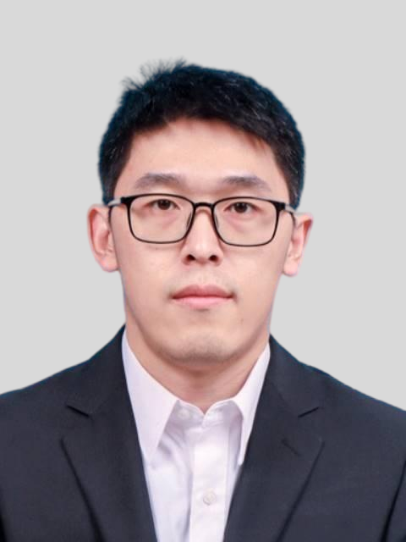
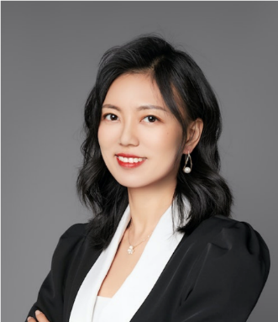
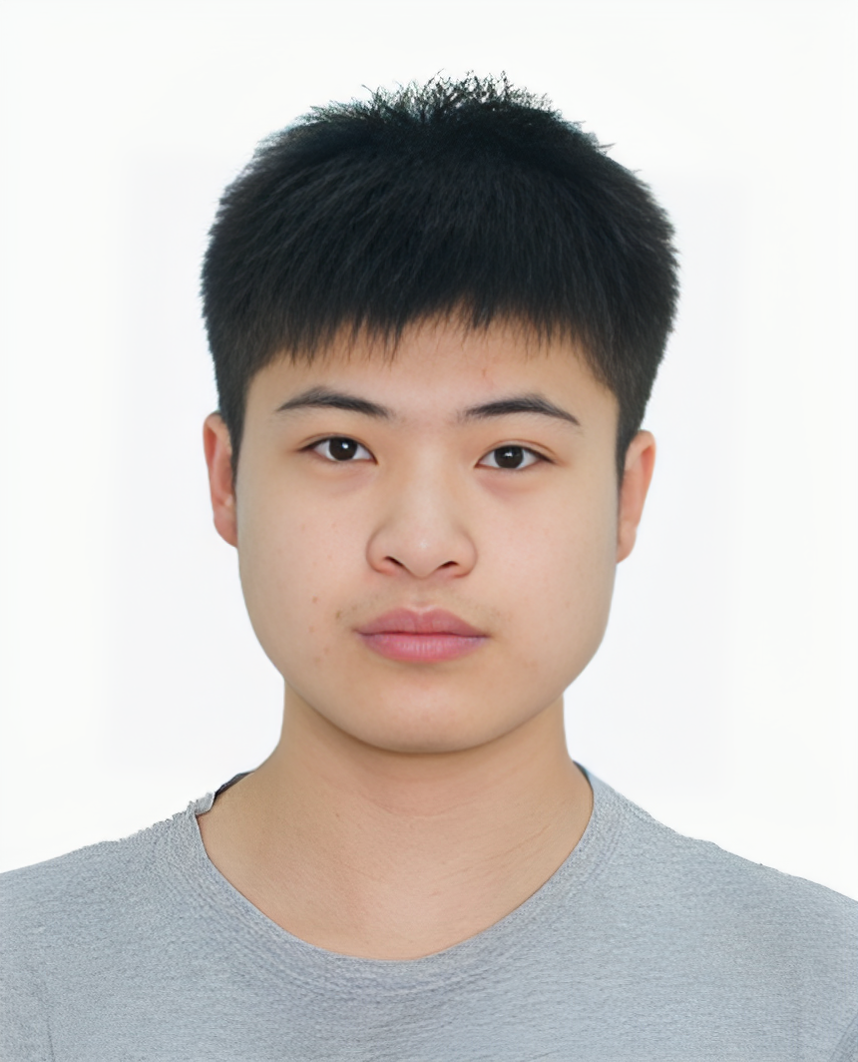
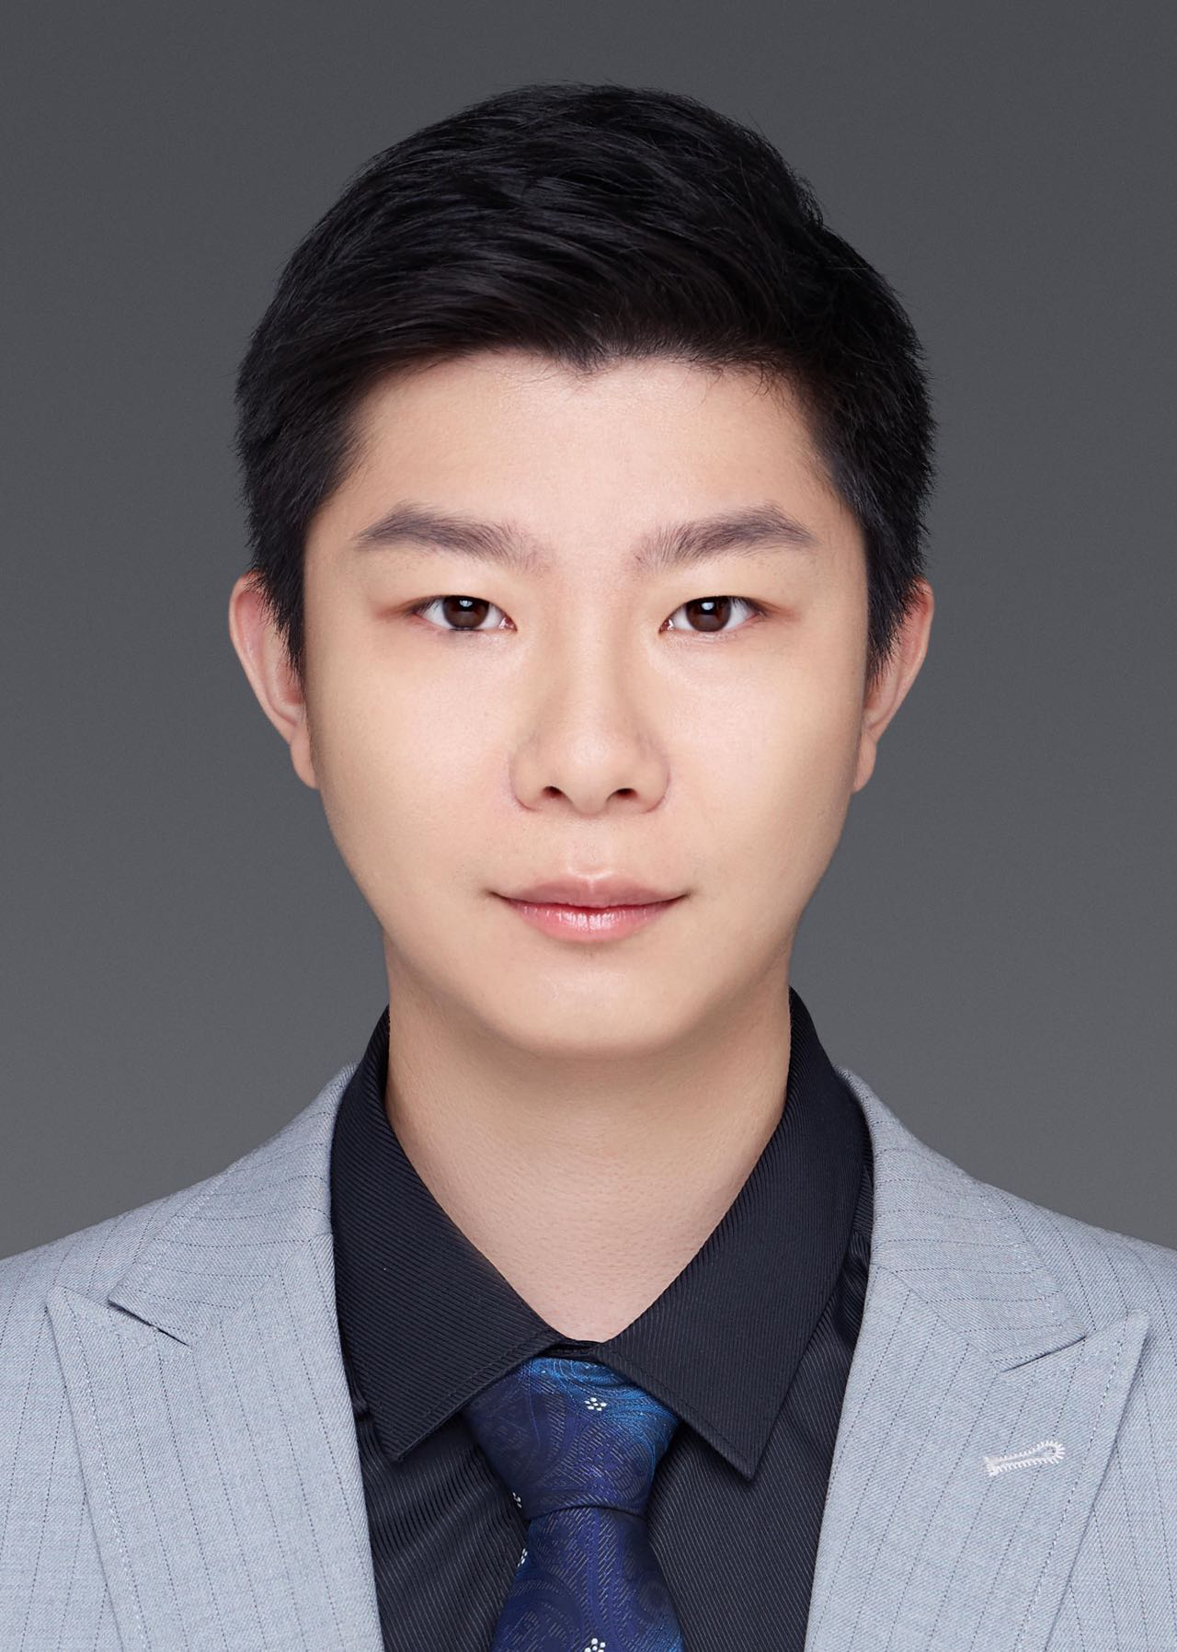
Organization committee
Wenwu Wang
Junbo Zhang
Yadong Niu
Helen Wang
Guanbo Wang
Chris Wu

Slide 6
Timeline
Registration kick-off
2025/02/07
Data release
2025/02/07
Baseline system release
2025/02/07
Deadline for registration
2025/04/01
Deadline for result submission
2025/04/30
Workshop at ICME 2025
2025/07/01

Slide 7
Statistics
40
7

Slide 8
Leaderboard
Track A: MLP Results
Affiliation | Team | Weighted Averaged Score
ByteDance | audiocodec | 0.865
ByteDance | GAEBT | 0.860
ByteDance | AudioX | 0.836
Carnegie Mellon University | CMU | 0.827
Alibaba | Aluminumbox | 0.807
NTT | Probin | 0.709
IRIT | SAMoVA | 0.516

Slide 9
Leaderboard
Track B: KNN Results
Affiliation | Team | Weighted Averaged Score
ByteDance | audiocodec | 0.792
ByteDance | GAEBT | 0.782
ByteDance | AudioX | 0.778
NTT | Probin | 0.710
Carnegie Mellon University | CMU | 0.707
Alibaba | Aluminumbox | 0.641
IRIT | SAMoVA | 0.480

Slide 10
Best Result in Each Track
Track | Affiliation | Team | Weighted Averaged Score
Track A: MLP Results | ByteDance | audiocodec | 0.865
Track B: KNN Results | ByteDance | audiocodec | 0.792

Slide 11
Baseline Sharing
Yadong Niu
Notes:
Good Morning.
Thanks for joining this audio encoder chanllege.
Today, we introduce the information of the baseline

Slide 12
Motivation
Audio models exhibit a generalization gap:
speech-trained models not work well for sounds
Sound pretraining does not work for speech
Self-supervised learning (SSL) audio representations show promise but lack exploration in scaled model and dataset sizes for cross-domain generalization.
Need for a unified encoder to bridge speech, sound, and music domains efficiently.
Notes:
Current audio models suffers from domain fragmentation
Speech models underperforms on music and environmental sounds
Sound pretrained models struggle with speech recognition
We thought this gap limits the application in real-world.
Therefore, we need an unified audio representation to bridge speech, sound and music

Slide 13
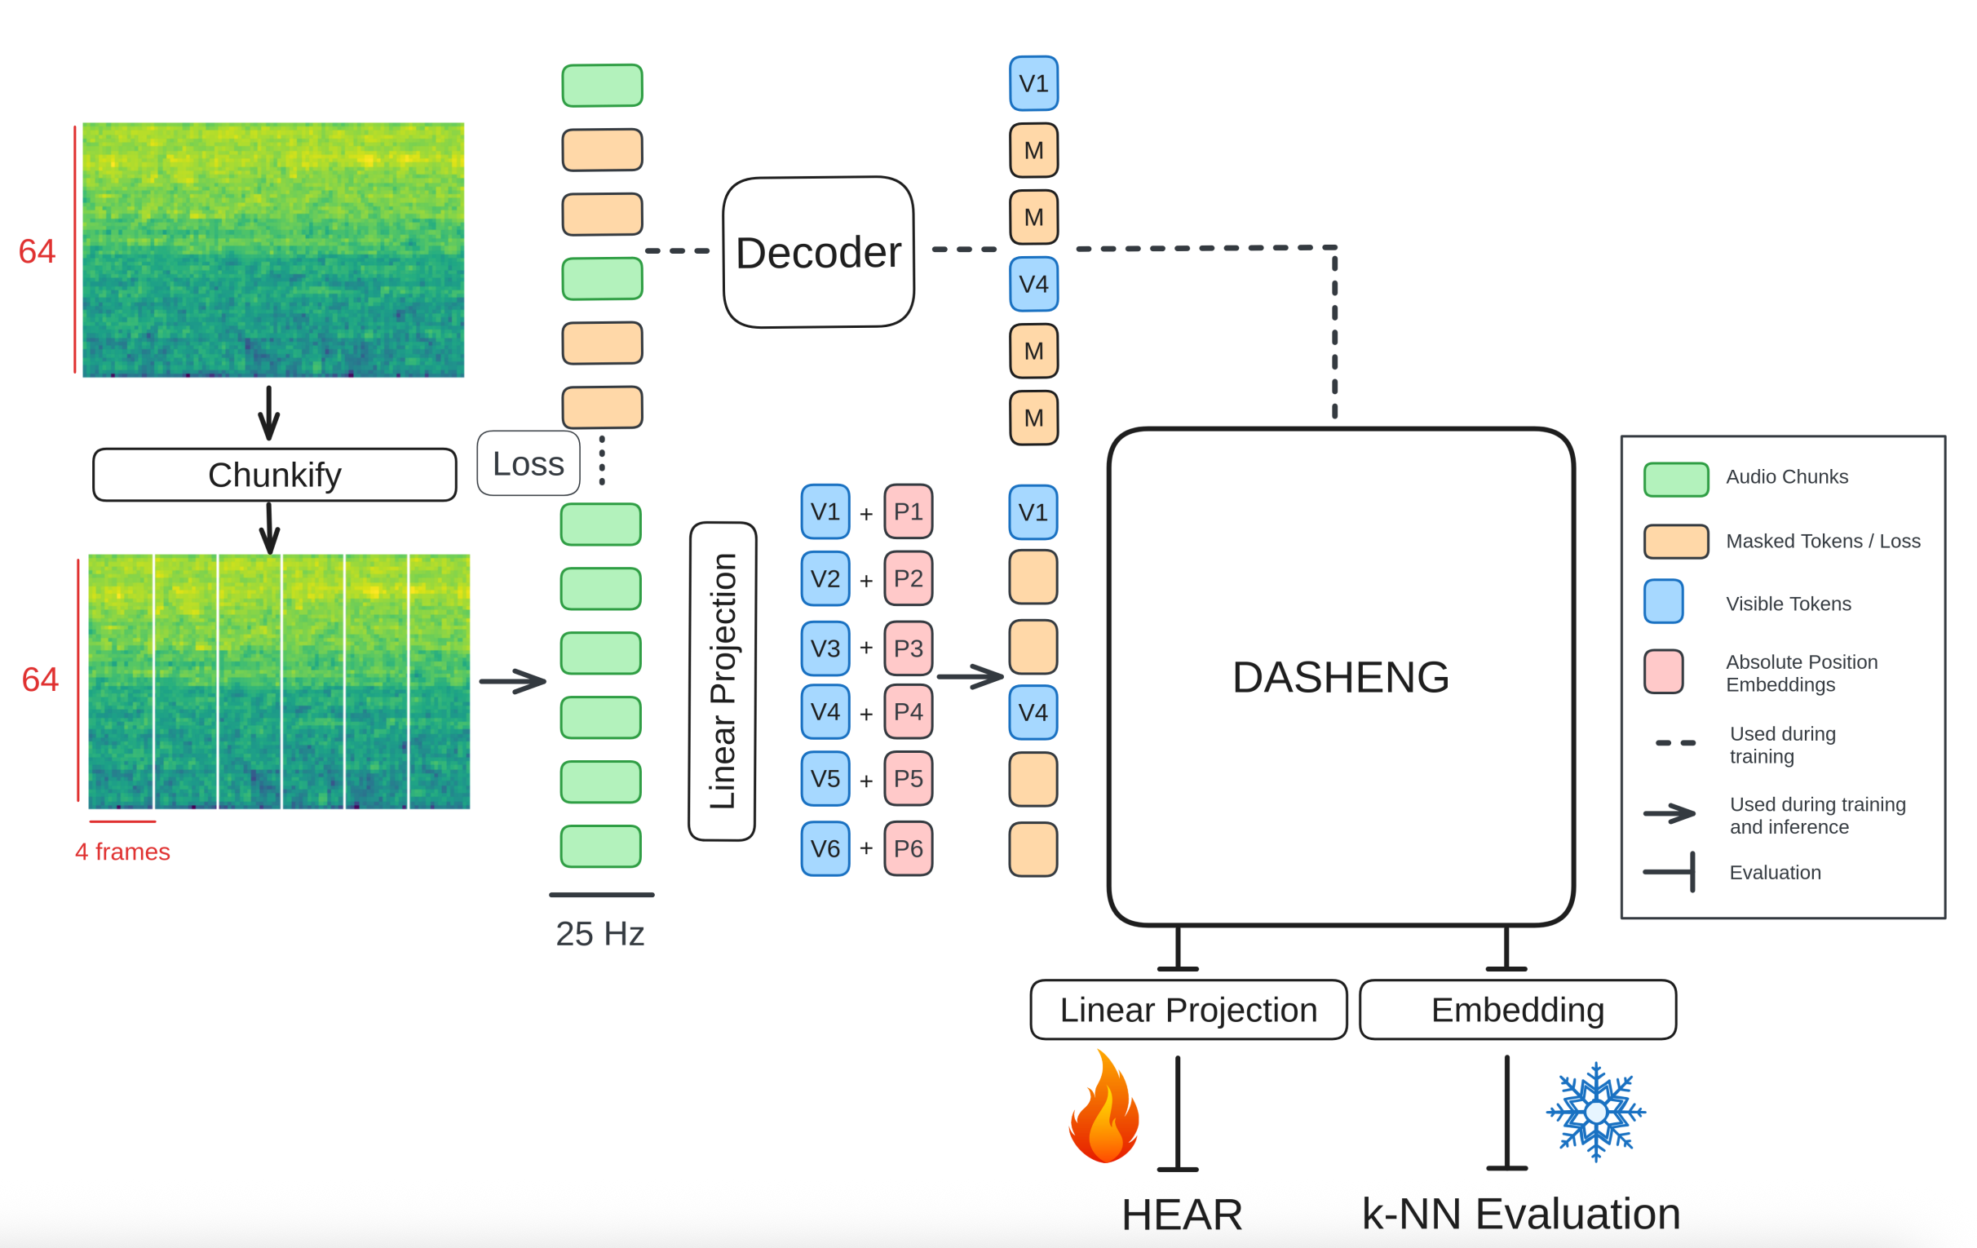
Proposed Method: Dasheng
Design: Masked Autoencoder (MAE) + Unprecedented Scale​
Features
training-data: 272k hours
parameters: max to 1.2B
frame-level representation
Fig. 1. The Dasheng Training Framework
Dasheng: Deep Audio-Signal Holistic Embeddings
Notes:
Dasheng try to solve this with scaled masked autoencoder (MAE)
It reconstrucs masked spectral patches during training
We trainied three models, with paraemtes from eighty-six million to one point two biliion parameters
This training used two hundred senventy two kilo hours of audio,
Including speech, music, environment sound
This enables model to capture general representation of these domains

Slide 14
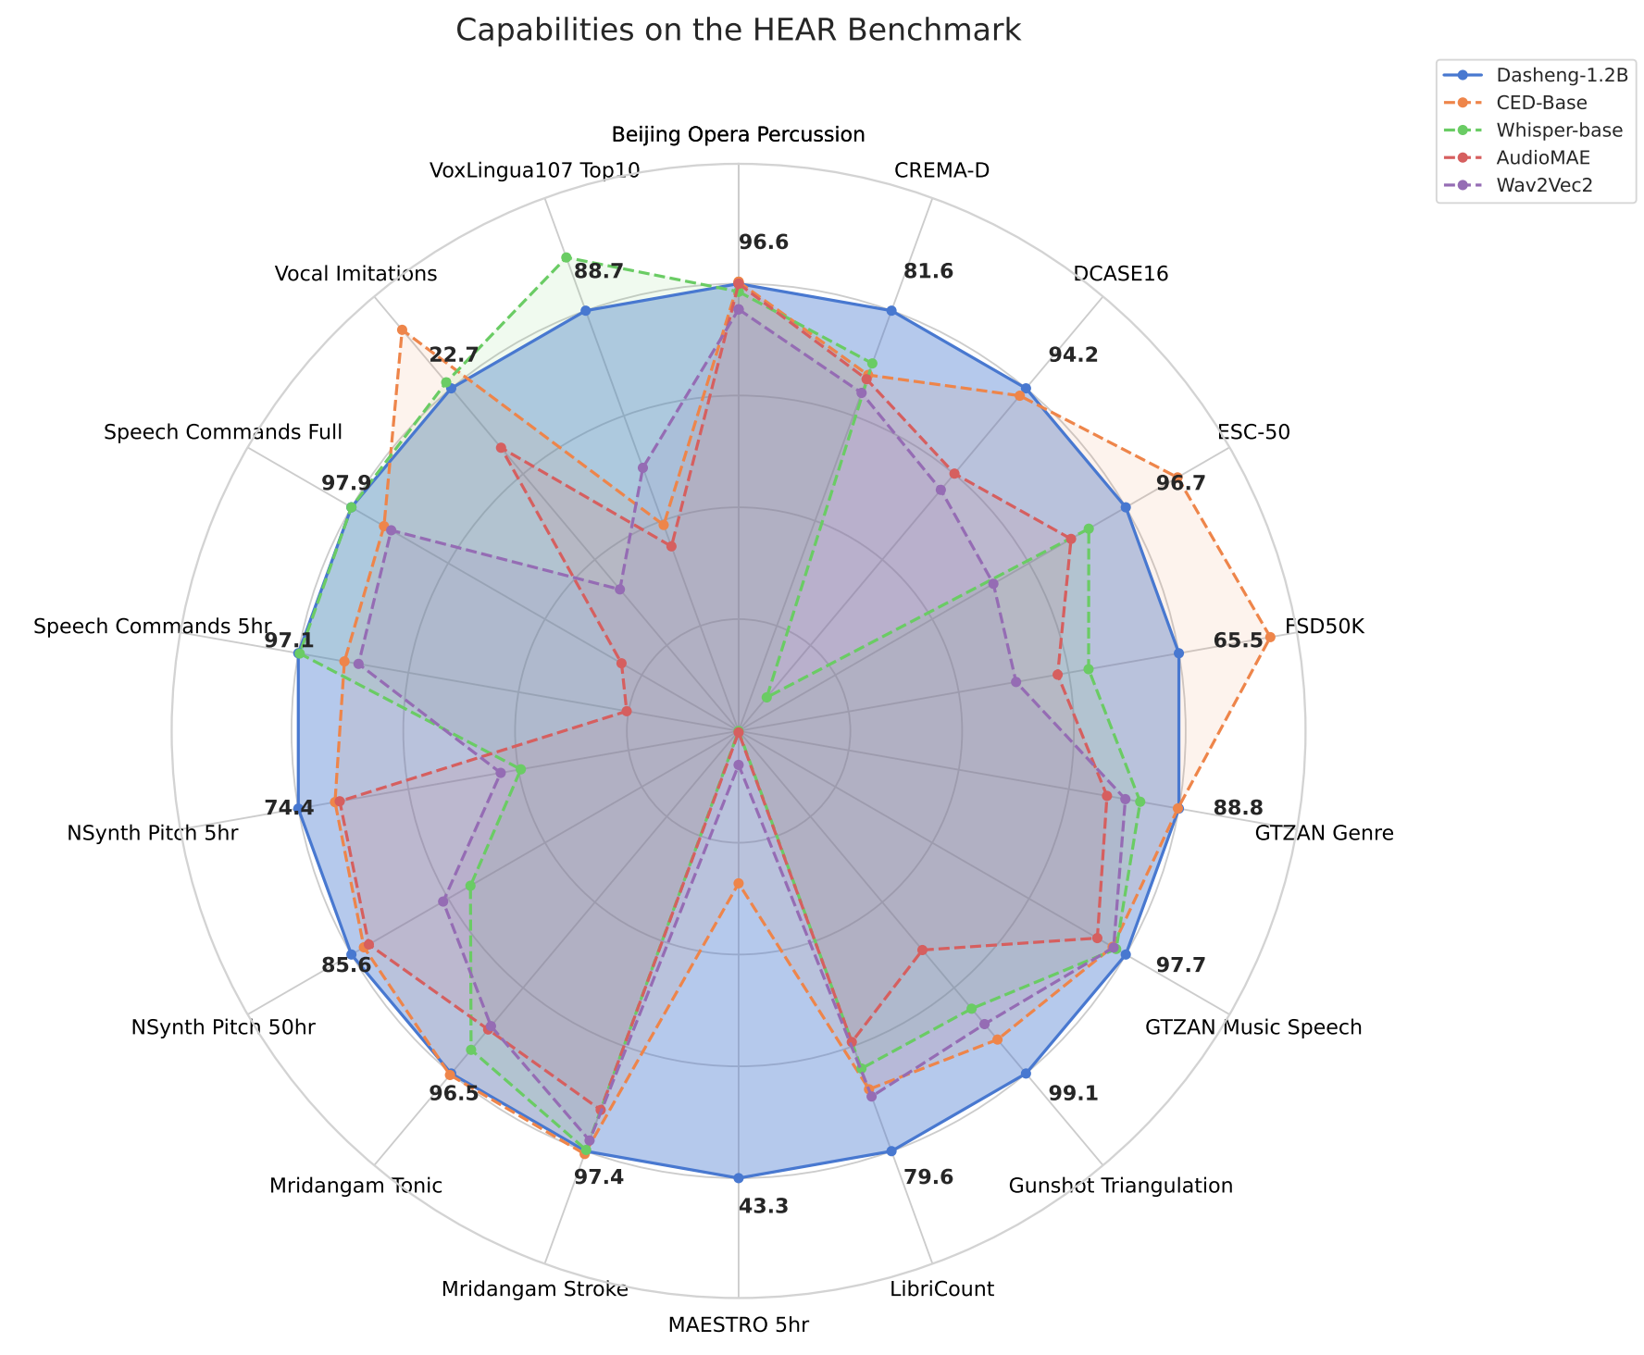
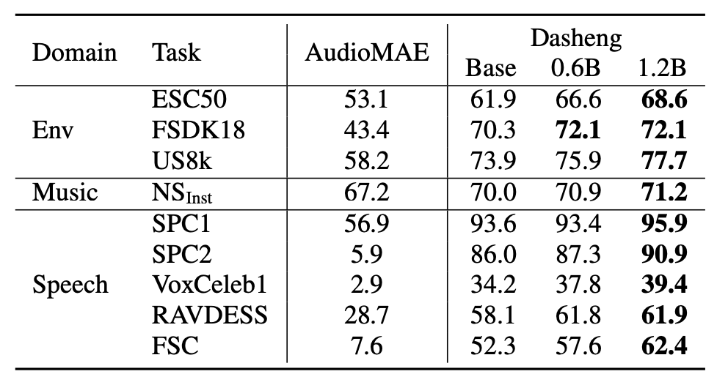
Dominant Results
Evaluation on HEAR Benchmark (Dasheng: Blue line in Fig.2)
Embeddings inherently capture rich information across domains
Table 1. Evaluation using a k-NN classifier
Fig. 2. Evaluation on the HEAR benchmark
Notes:
Dasheng showed balanced capabilities across audio domains.
We thought Its embeddings could capture universal patterns through self-supervised learning.
It can be verified using non-parametric learning KNN

Slide 15
Dominant Results
Evaluation: X-ARES Benchmark
Domain: speech, sound, music
Tracks: Parametric & Non-parametric
Table 2. Average result on X-ARES Benchmark
Notes:
On the basis of HEAR benchmark, we head this challenge. We want to get a compenhensive evauation of the audio encoders’ performance
It spans twenty-six real-audio tasks.
Not just lab-recordings- but also authentic field audio
ôˈTHen(t)ik field audio.
Like dashboard recordings inside or outside of the car, Subway station recordings
And we provide two evaluation track,
One is parameteric tesing, we add lightweight multilayer perpeption heads
To measures tasks-specific adaptabili
Second track is Non-parametric KNN
Direct tests raw representation quality
No fine-tuning – pure feature exampination.
Why both?
Real application needs them:
Ready-to use features for quicky deployment
Add Adaptable features for custominization

Slide 16
Dominant Results
Evaluation: X-ARES Benchmark
Table 3. Average result on X-ARES Benchmark
Accessibility | Method | Dasheng | Wav2vec2 | Whisper | Data2vec
Public Dataset | MLP | 0.699 | 0.490 | 0.632 | 0.598
 | KNN | 0.504 | 0.262 | 0.299 | 0.388
Total Dataset | MLP | 0.801 | 0.664 | 0.740 | 0.694
 | kNN | 0.683 | 0.469 | 0.475 | 0.455
Notes:
Dasheng serves as our baseline across 26 tasks.
Its performance validates the benchmark’ rigor

Slide 17
Conclusion
Audio encoders are vital for unified audio understanding, closing domain gaps through scaled SSL.
Collaborative focus on speech, sound, and music enables generalizable models with real-world impact.
Future: unified audio understanding + generation ?
Notes:
The result of Dasheng proves that the feasibility of unified audio encoder
considering it was part of audio understanding, If there any possibility of one unified audio generation?

Slide 18
Thanks
Notes:
Thanks for your attention, and please free to ask question or raise an issue in the website.
Questions:
为什么根据样本数量确定权重？
We have noticed everyone’s concern about this issue. . Of course, this may no be the best way. But we though the number of samples could reflect the difficulty of information collection.
How to train dasheng?
Dasheng was trained with MAE on two hundred sentency two kilo hours.
Its objective to predict the masked spectral patches
The sampler of speech, music and environment is also crucial for the final results
Is there any possibility of unified audio generations/
It may be chanlleging. But I thougth there’s one way to solve it, for example, someone would simulate various sounds.

Slide 19
Award Winners with Certificates
Wenwu Wang

Slide 20
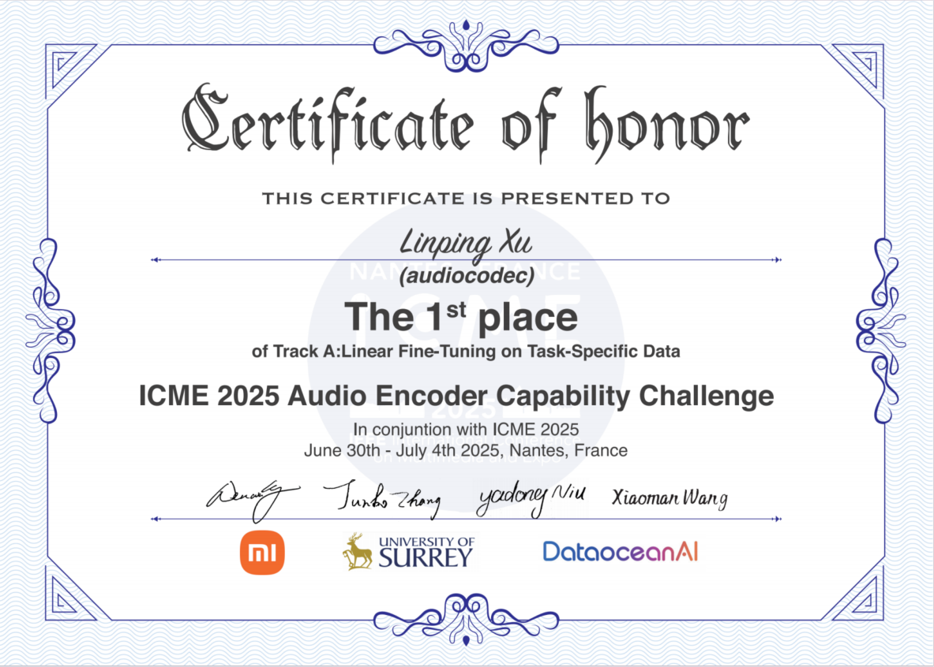
1st Place of Track A
Team: audiocodec Linping Xu

Slide 21
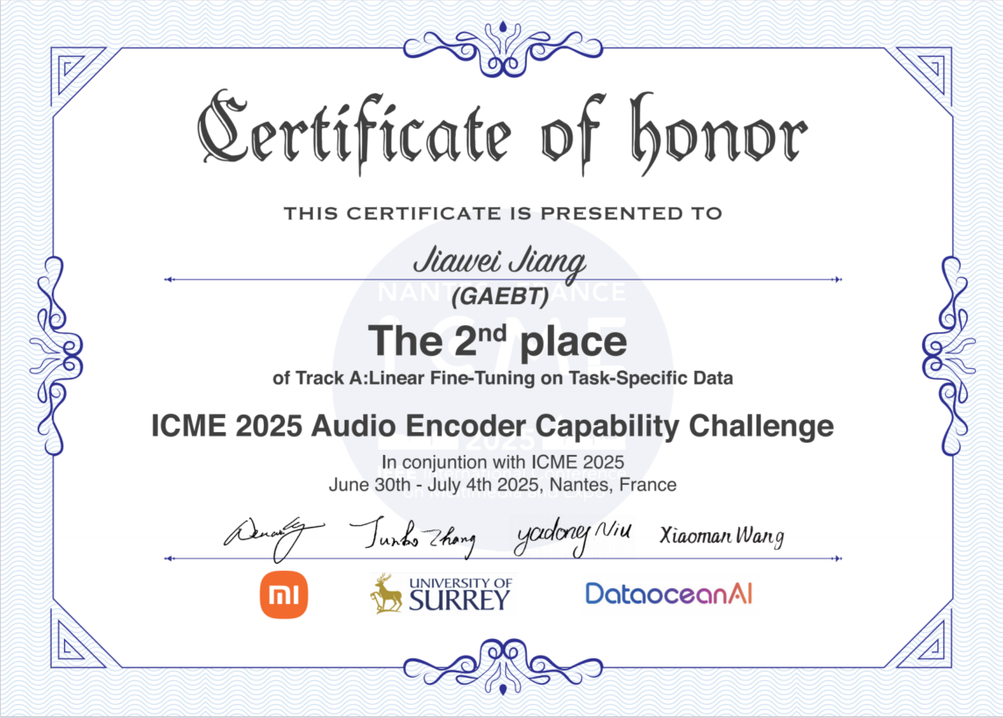
2nd Place of Track A
Team: GAEBT Jiawei Jiang

Slide 22
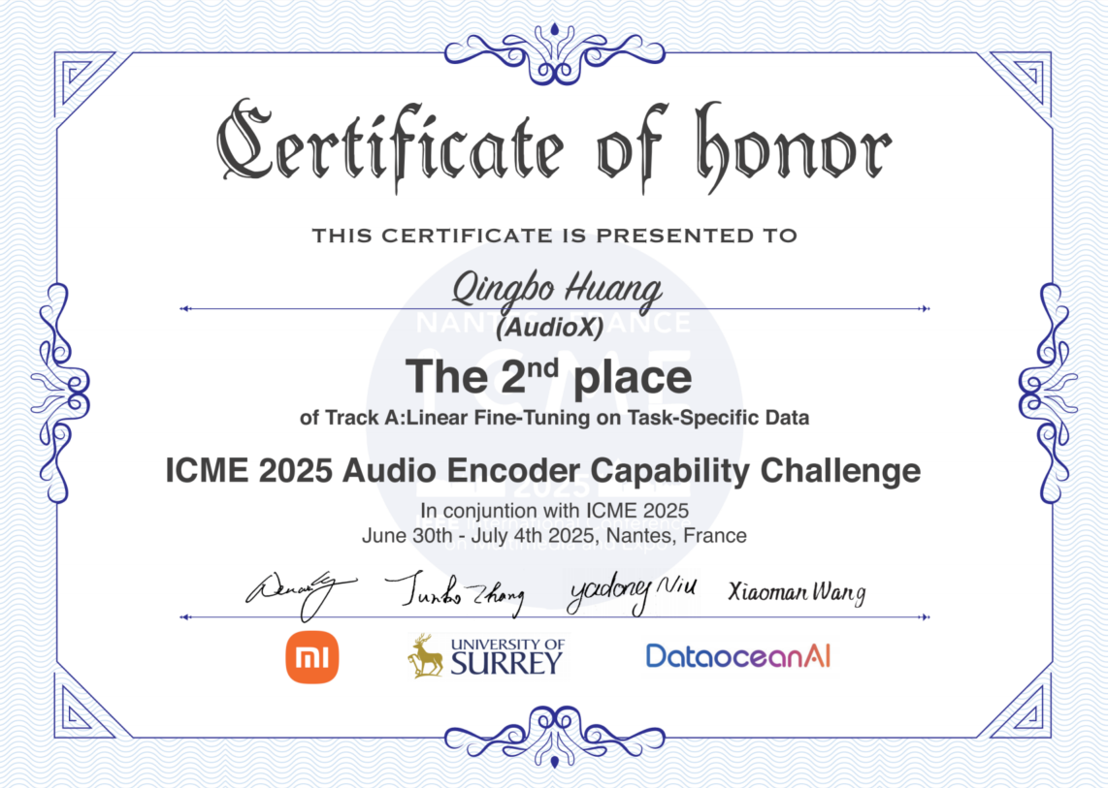
2nd Place of Track A
Team: AudioX Qingbo Huang

Slide 23
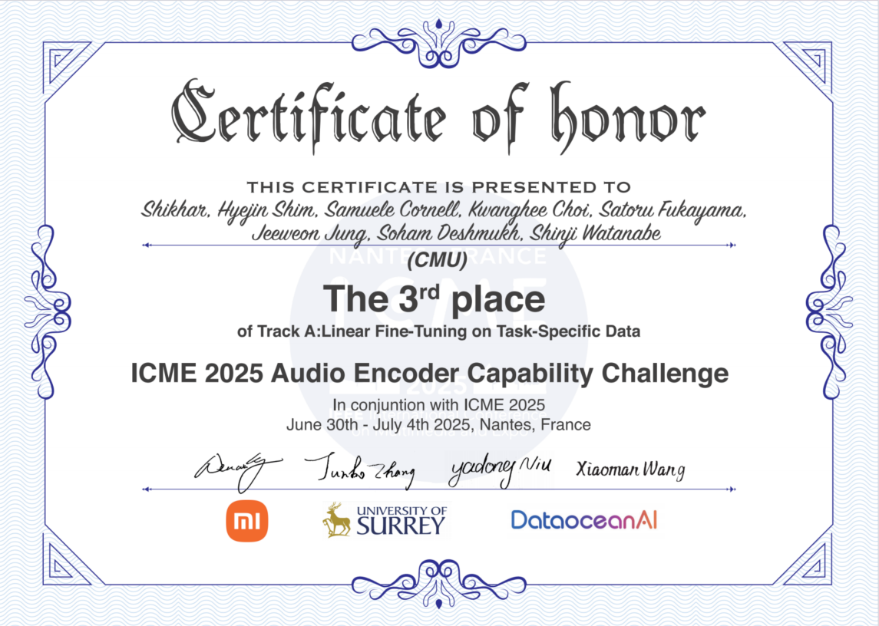
3rd Place of Track A
Team: CMU
Shikhar, Hyejin Shim, Samuele Cornell, Kwanghee Choi, Satoru Fukayama, Jeeweon Jung, Soham Deshmukh, Shinji Watanabe

Slide 24
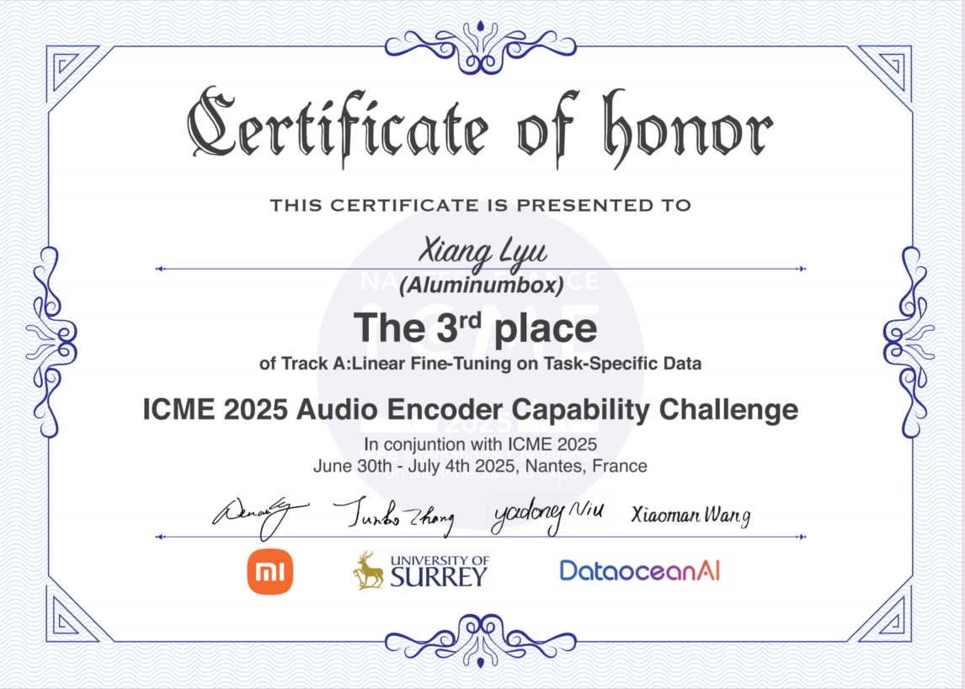
3rd Place of Track A
Team: Aluminumbox Xiang Lyu

Slide 25
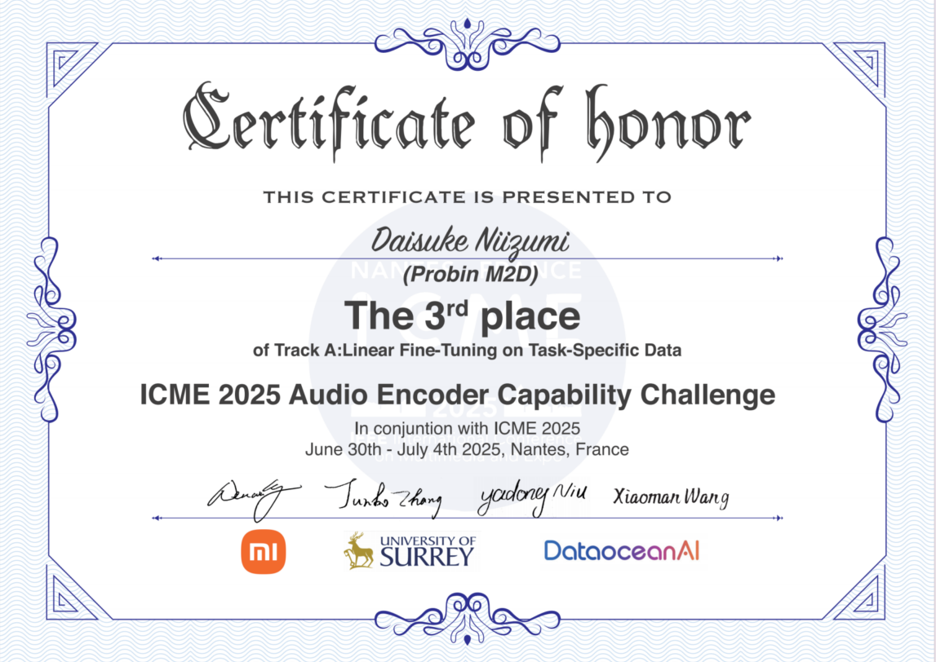
3rd Place of Track A
Team: Probin M2D Daisuke Niizumi

Slide 26
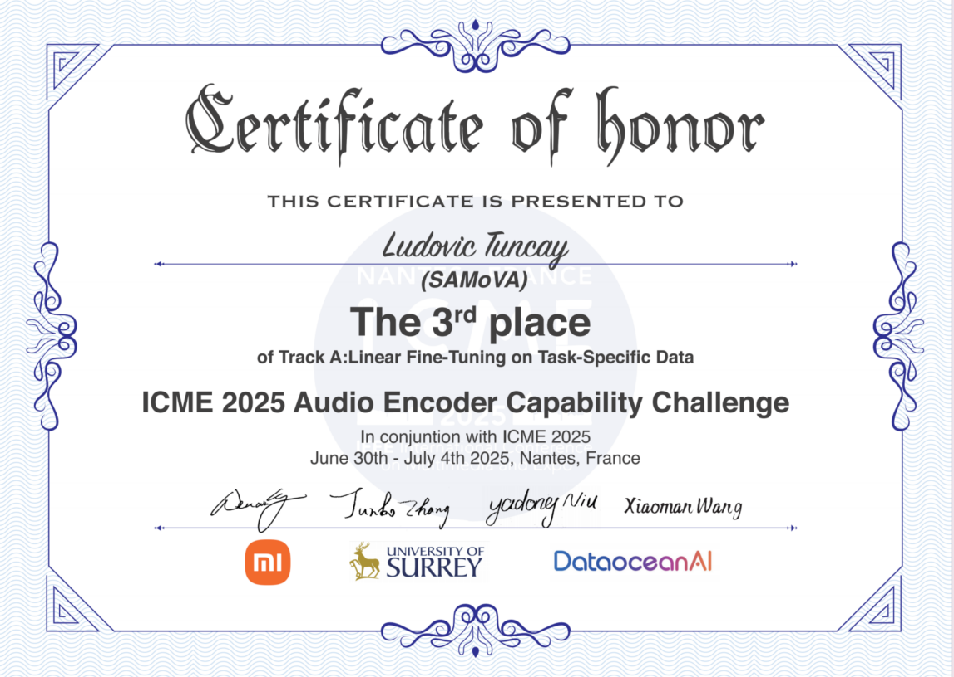
3rd Place of Track A
Team: SAMoVA Ludovic Tuncay

Slide 27
1st Place of Track B
Team: audiocodec Linping Xu

Slide 28
2nd Place of Track B
Team: GAEBT Jiawei Jiang

Slide 29
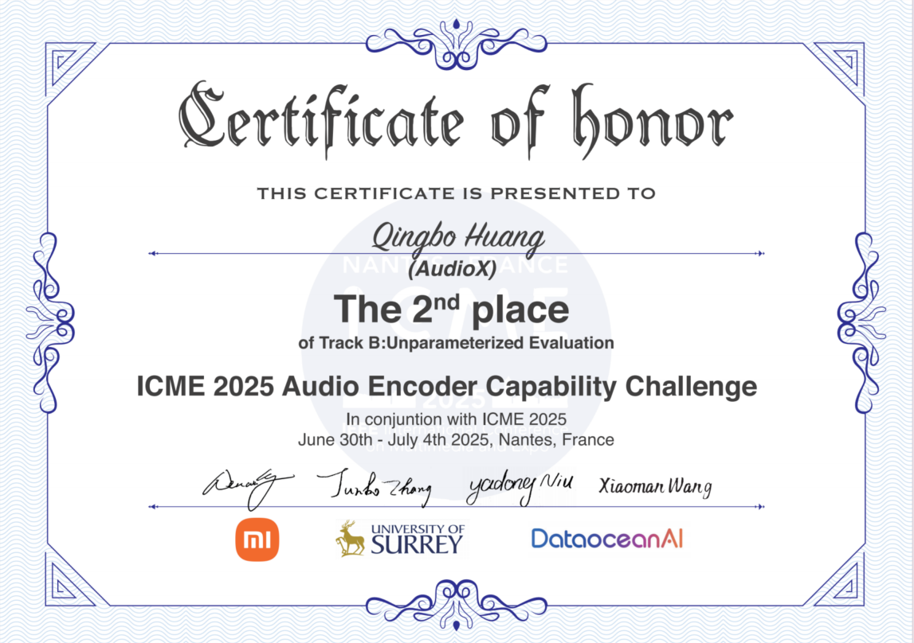
2nd Place of Track B
Team: AudioX Qingbo Huang

Slide 30
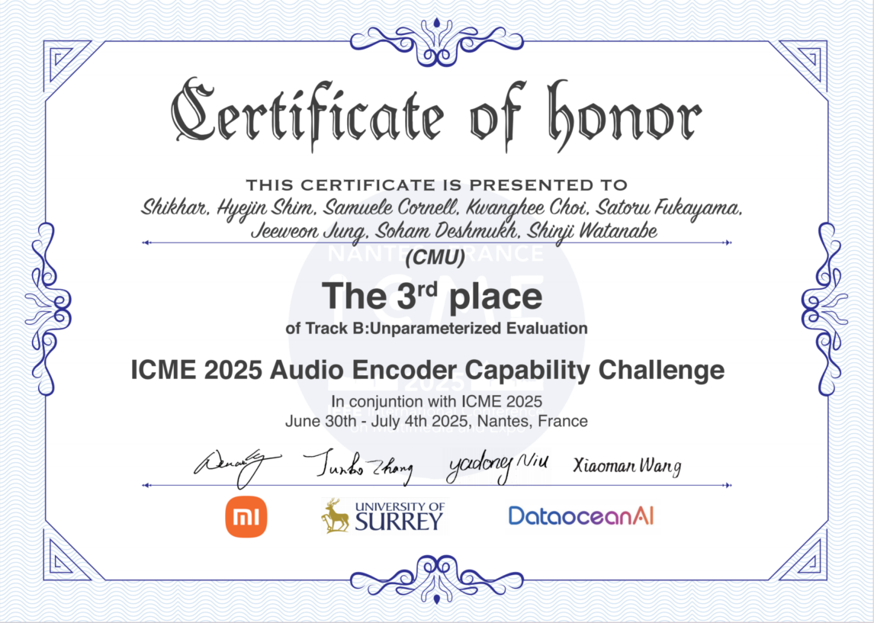
3rd Place of Track B
Team: CMU
Shikhar, Hyejin Shim, Samuele Cornell, Kwanghee Choi, Satoru Fukayama, Jeeweon Jung, Soham Deshmukh, Shinji Watanabe

Slide 31
3rd Place of Track B
Team: Aluminumbox Xiang Lyu

Slide 32
3rd Place of Track B
Team: Probin M2D Daisuke Niizumi

Slide 33
3rd Place of Track B
Team: SAMoVA Ludovic Tuncay

Slide 34
Reminder
If you did not join ICME in person ，we will send the
e-certificate by email after the workshop.

Slide 35
Neural Audio Codec
Wenwu Wang
Centre for Vision, Speech and Signal Processing (CVSSP)
University of Surrey
United Kingdom

Slide 36
Outline
Background: Audio Codec & Neural Audio Codec
Motivation: Limitations with Current Neural Codecs
Proposed Method: SemantiCodec
Experimental Results
Conclusions and Future Works

Slide 37
Audio Codec
A device or software that encodes or decodes digital audio data for transmission, storage, or playback.
Compressor-decompressor → “Codec”
MP3, FLAC, AAC, Vorbis, etc.

Slide 38
Neural Audio Codec
SoundStream (Zeghidour et al. 2021)
Encodec (Défossez et al. 2021)
Descript (Kumar et al. 2023)
HiFi-Codec (Yang et al. 2023)
SpeechTokenizer (Zhang et al, 2023)
Codec Superb Benchmark (Wu et al. 2024)
https://github.com/voidful/Codec-SUPERB

Slide 39
Limitations of Current Neural Codecs
High token rate (long token sequence)
e.g., 6kbps Descript audio codec has 600 tokens per second
Make auto-regressive modeling challenging and computational expensive
Poor reconstruction quality at low bit rate (e.g., 0.6 kbps).
Most previous studies work on bit rate > 2kbps
Can we go further under 1.0 kbps?
Falling short in capturing semantic information
For example, latent encodings given by 6kbps achieved an average accuracy of only 33% on the HEAR benchmark, while AudioMAE latent encodings achieved an accuracy of 61% (without finetuning).

Slide 40
Motivations
Shorter sequence: Lower token rates at 25, 50, or 100 tokens per second.
Better reconstruction at lower bit rate: 0.3~1.4 kbps
Improved semantic in the codec tokens (which potentially can lead to better language modelling)

Slide 41
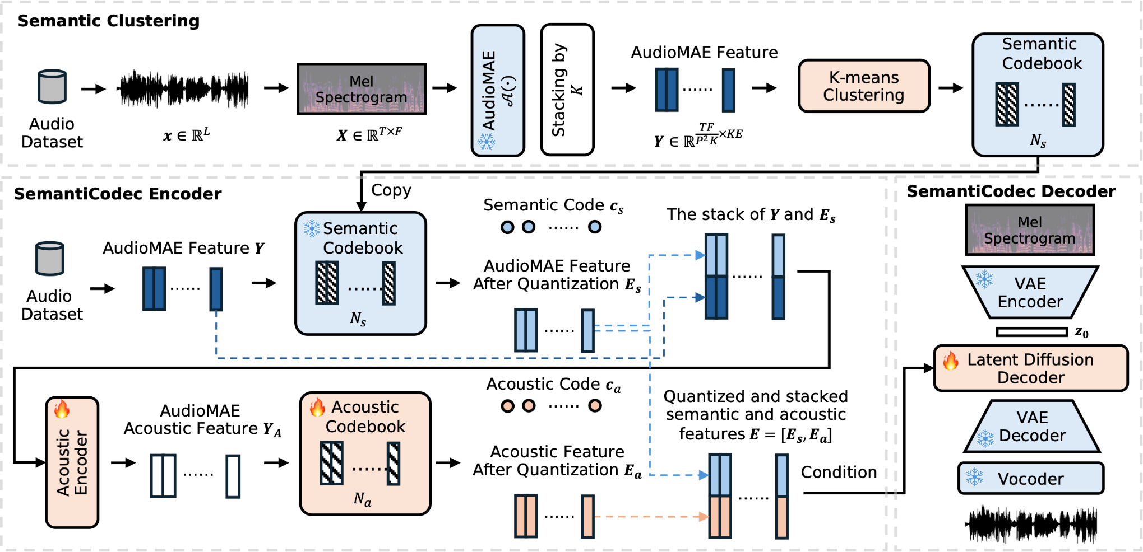
SemantiCodec
Large scale k-means is challenging
AudioSet + Million Song Dataset + GigaSpeech
https://github.com/haoheliu/kmeans_pytorch
Ultra-low bit rate (0.31 kbps ~1.40 kbps, token rate 25, 50, or 100 per second) & Strong semantics in the token & Variable vocabulary sizes
AudioMAE
Encoder
https://haoheliu.github.io/SemantiCodec/
CrossAtten

Slide 42
Experimental Evaluations
Metrics:
MEL: Mel spectrogram distance
STFT: Short-time Fourier Transform Distance
ViSQOL: Virtual Speech Quality Objective Listener Score
WER: Word Error Rate
Accuracy: Audio classification task accuracy
MUSHRA Scores
Datasets (we only use audio):
GigaSpeech (10K hours), Million Song Dataset (510K music tracks), MedleyDB (122 tracks), MUSDB18 (10 hours), AudioSet (2M), VGGSound (190K), WavCaps (7K hours)

Slide 43
Experimental Evaluations
Baselines:
Encodec (EC): 23M parameters
Descript Codec (DAC): 74M
HiFi-Codec (HC): 63M
Evaluations:
Reconstruction performance evaluation: LibriTTS clean test set (300 speech utterances), AudioSet general sound (500 audio signals), MUSDB18 (50 songs covering vocals, drums, bass, etc.); 1050 audio clips in total
Semantic information evaluation: HEAR benchmark (NSPitch, ESC-50, LibriCount, CREMA-D, Vocal Imitations (VoImit), Speech Commands(SC))
Subjective evaluations: MUSHRA test: 10 raters, 10% of evaluation data (25 music tracks, 30 speech recordings, and 50 general sound samples)

Slide 44
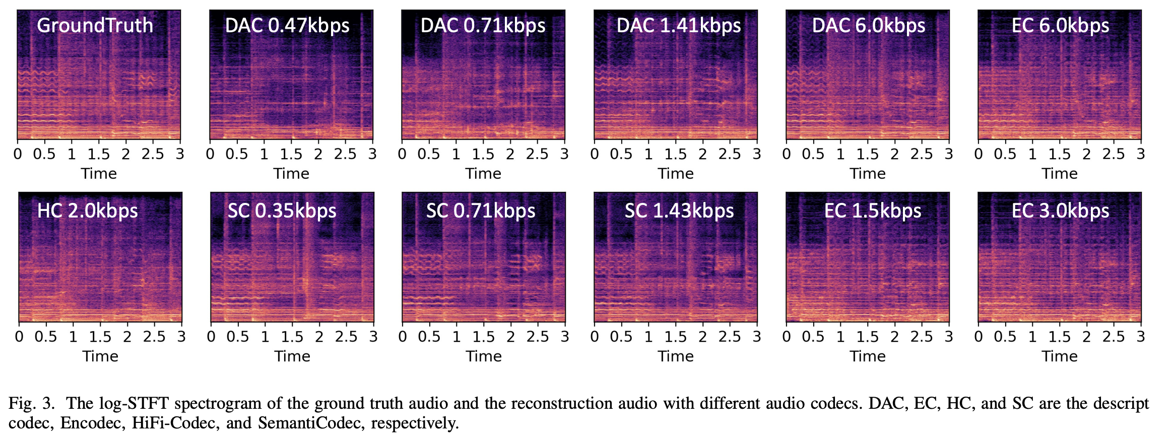
Samples Comparison

Slide 45
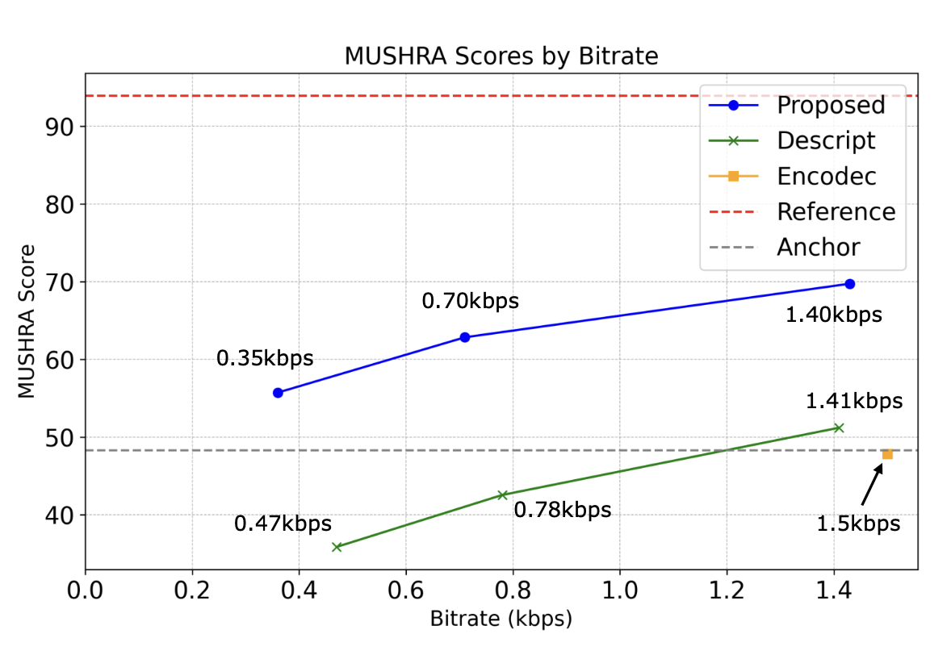
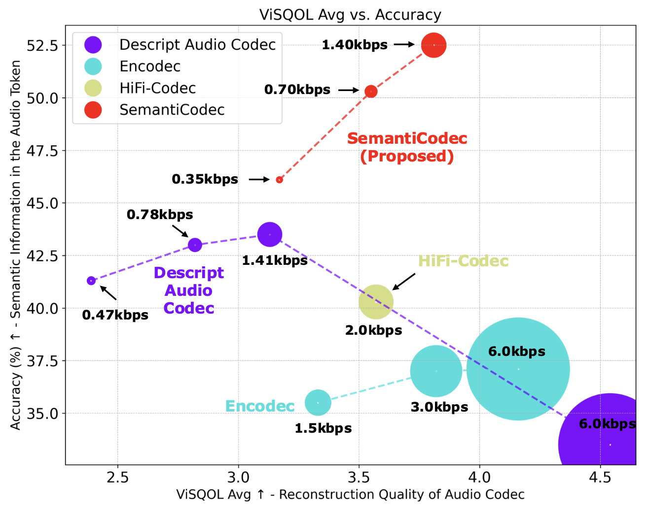
Visual Comparison
Better reconstruction with a lower bit rate
Better semantic in the audio token (potentially better Audio LLM?)
Sound demos:
https://haoheliu.github.io/SemantiCodec/

Slide 46
Demos
Original
HiFi-Codec
(2.0 kbps)
Encodec
(1.5 kbps)
DAC
(1.41 kbps)
SemantiCodec
(1.43 kbps)
DAC
(0.47 kbps)
SemantiCodec
(0.35 kbps)
Music
(MUSDB18)
General Audio
(AudioSet)
Speech
(Libri)
More sound demos:
https://haoheliu.github.io/SemantiCodec/
H. Liu, X. Xu, Y. Yuan, M. Wu, W. Wang, M.D. Plumbley, "SemantiCodec: An Ultra Low Bitrate Semantic Audio Codec for General Sound," IEEE Journal on Selected Topics in Signal Processing, vol. 18, no. 8, pp. 1448--1461, 2024.

Slide 47
Conclusion & Future Work
We have presented SemantiCodec, which produces audio tokens of more semantic, lower token rate, with thus enabling ultra-low bit rate audio codec, and works for any length audio.
Future works:
How does the semantic of audio token related with LM performance?
Can shortened audio token sequence alleviate LM robustness issue?
Specialized SemantiCodec

Slide 48
Acknowledgements
Thanks to Haohe for providing slides.
The project is funded in part by EPSRC, British Council and GAIN program (Research England).

Slide 49
Take Aways
Arxiv Paper: https://arxiv.org/abs/2405.00233
Project Page: https://haoheliu.github.io/SemantiCodec/
Open-source Code: https://github.com/haoheliu/SemantiCodec-inference
Demos: https://haoheliu.github.io/SemantiCodec/

Slide 50
Dataocean AI Company Overview
Helen Wang

Slide 51
High-Quality ASR Dataset for Incarbin and outside
Overview
Volume: 15,000 Sentences (10,000 for training / 5,000 for evaluation)
Participants: 430 speakers
Recording Location: Inside and outside vehicles
Scenarios: Outdoor and underground parking lots

Slide 52
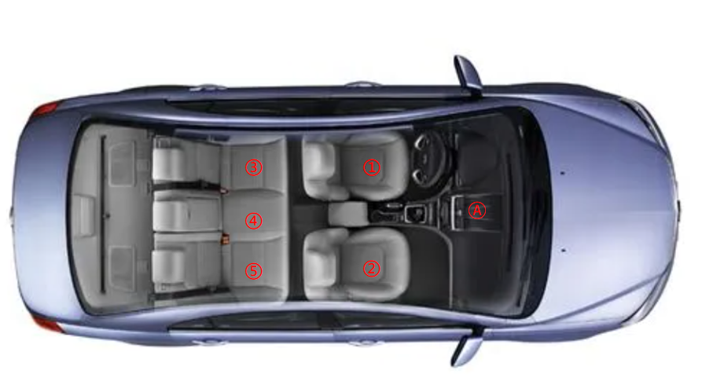
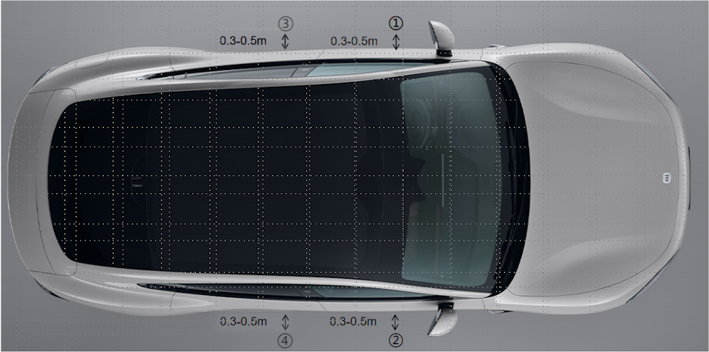
High-Quality ASR Dataset for Incarbin and outside
Data Collection Details (In-Car)
5 fixed speaker positions
Microphone fixed at point A
7,500 sentences total (1,500 per point)
Data Collection Details (Outside-Car)
4 recording positions around the vehicle
Microphone fixed at point A
Recording Conditions
Windows fully closed
Window slightly open near the sound source
Recording Conditions
Windows fully open
Windows fully closed
Windows slightly open

Slide 53
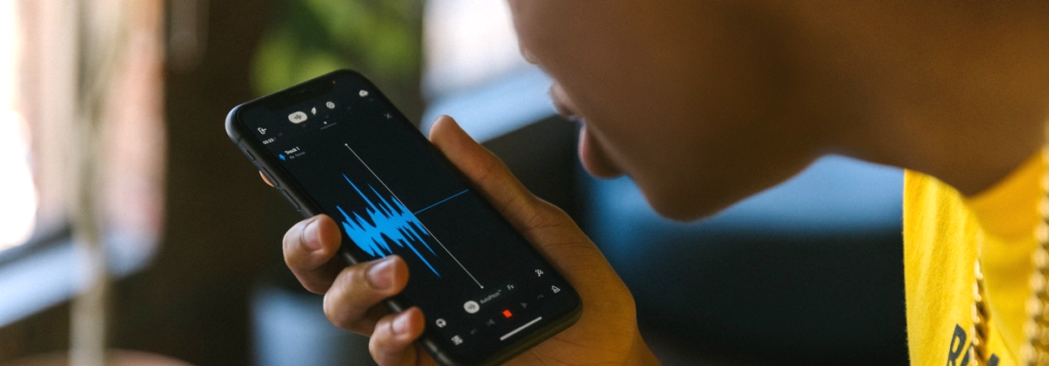
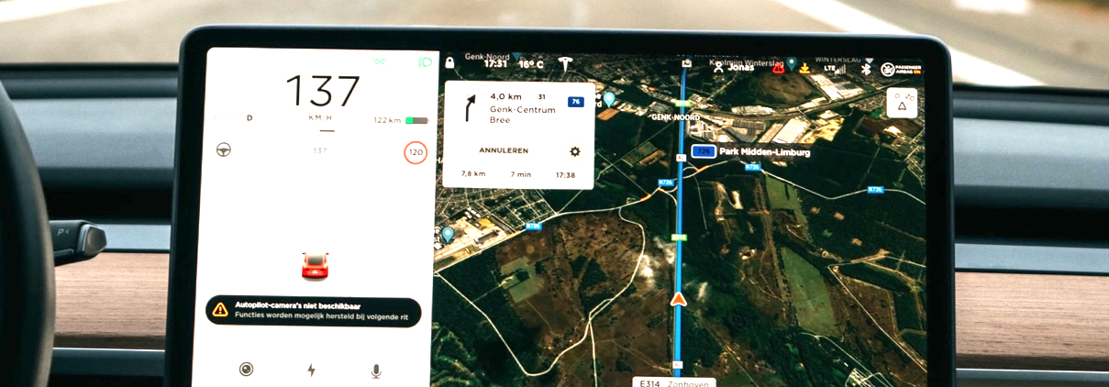
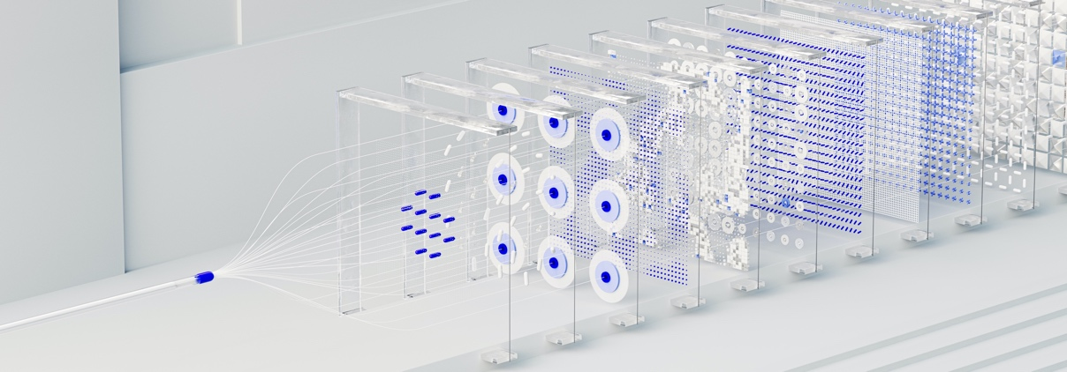
Off-The-Shelf Datasets
Over 1600 OTS datasets ready to go！
1179
SPEECH RECOGNITION
SPEECH SYNTHESIS
138
360
NATURAL LANGUAGE
PROCESSING
COMPUTER VISION
Application Scenarios
Personal assistant, voice input, smart home, intelligent customer service, robot, voice navigation, intelligent broadcast, voice translation, mobile social networking, virtual human, smart finance, etc. | Intelligent driving, mobile socialization, virtual humans, smart finance, smart transportation, smart city, OCR recognition, etc. | CoT, coding, machine translation, intelligent Q&A, information extraction, sentiment analysis, etc.

Slide 54
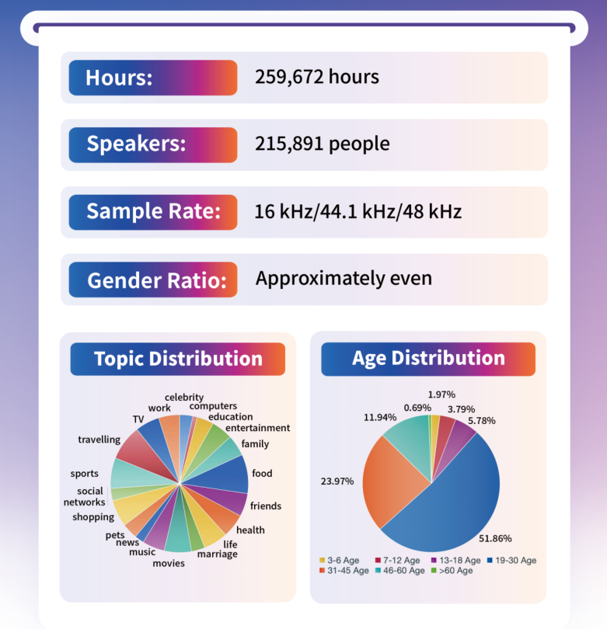
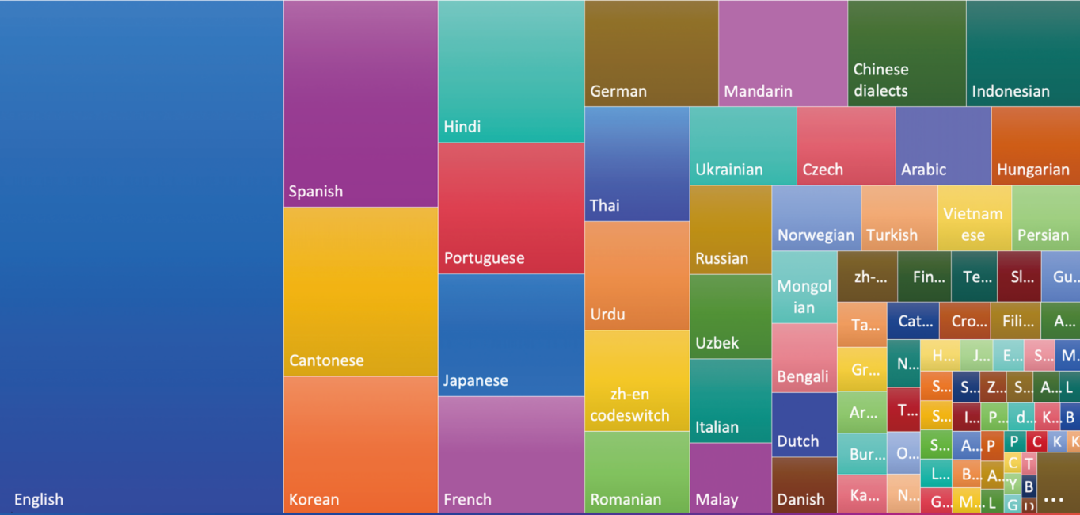
High Quality 100+ Languages Speech Dataset

Slide 55
Let us take a look!

Slide 56
Thanks！
Website: Dataoceanai.com

Slide 57
Presentation 1 by Team audiocodec

Slide 58
DQFAudio Encoder:
A Solution for Audio Downstream Tasks
Based on Model Ensemble and FineTuning
ByteDance MMLab
Team: audiocodec
Linping Xu
xulinping.678@bytedance.com
Notes:
Good morning, everyone! My name is Linping Xu. It’s my great honor to share our work DQFAudio Encoder.
I am from the Audio Team under the Multimedia Laboratory of ByteDance.
Our team is primarily responsible for audio processing in streaming media, provide support for company's businesses such as Douyin and TikTok.
Specifically, our group focused on audio compression, where we optimized the OPUS and AAC codecs, developed a spatial audio codec, iSAC.
We are actively working on applying AI models to streaming media, such as the low-bitrate AI codec.
You are welcome to exchange ideas with me.
Well, let me begin my presentation.

Slide 59
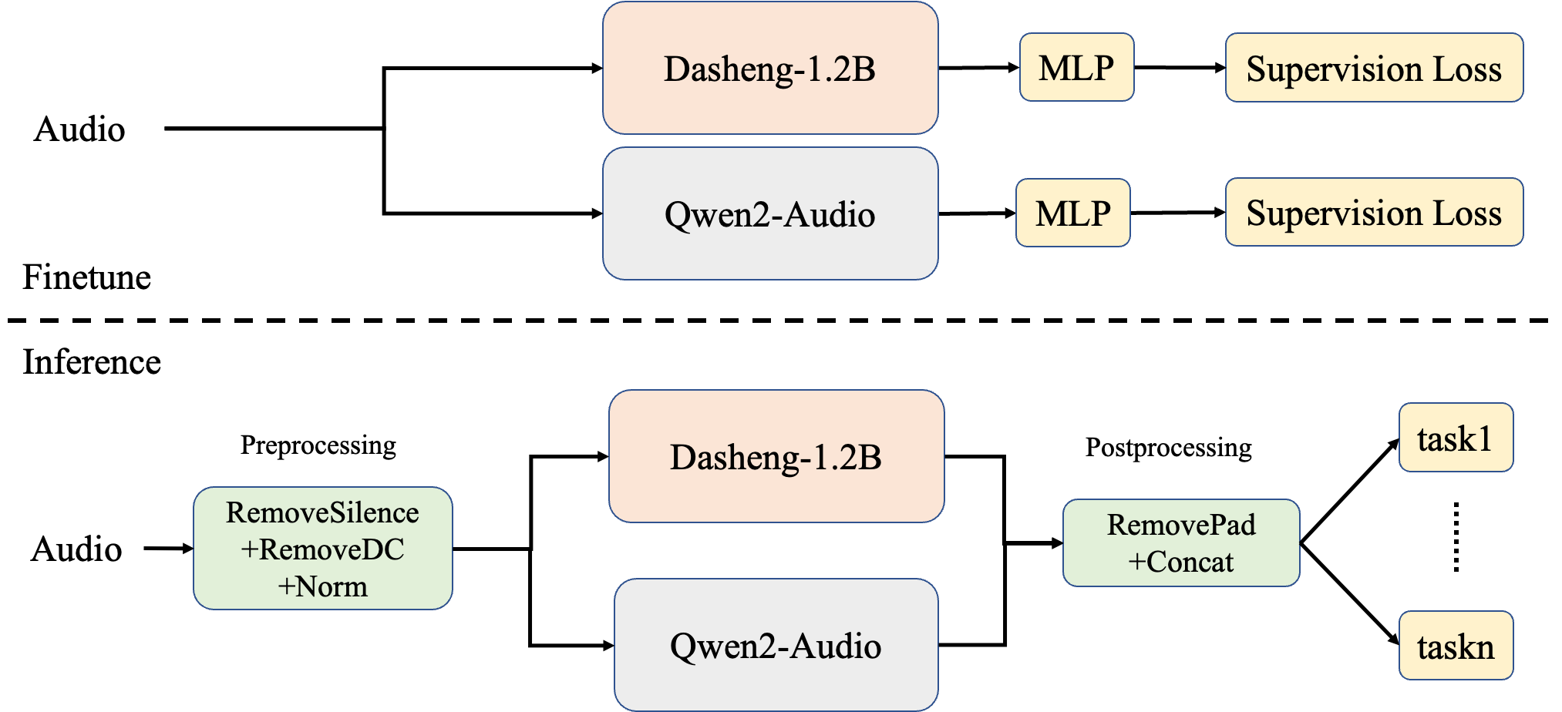
Tasks Analysis
Pre & Postprocessing
Model Ensemble
Model Fine-tuning
Simple System Description
Notes:
Our work focuses on two critical problems: mitigating the dilution effect of silence on embeddings and optimizing the performance of multiple models.
In the following presentation, I will introduce the details of system, including task analysis, pre- and post-processing, model ensemble, and fine-tuning method.

Slide 60
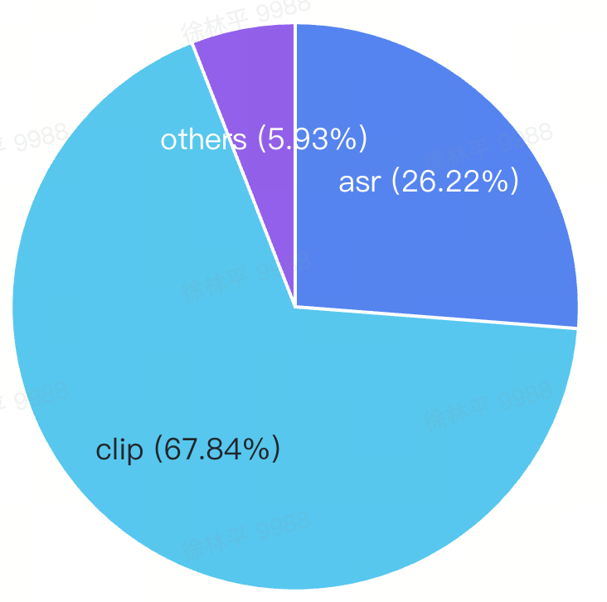
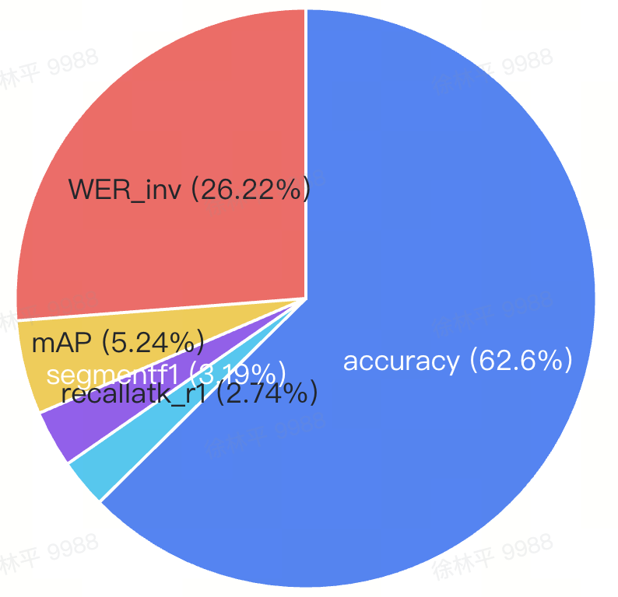
Tasks Analysis
23 Tasks Evaluation Weight
Clip-Level Tasks: 67+% (by task type)
Classification Tasks: 62+% (by type & metrics)
Speech Recognition: 26+%
Model Selection & Fine-tuning
Integrate audio and speech model
Fine-tuning focus clip classification tasks
Tasks type eval weight
Metrics type eval weight
Evaluation Efficiency optimization
14 quick-representative tasks for development
Process split: Encoder Inference ║ Task Evaluation
Benefits: Faster results • Higher GPU efficiency
Note: Development-time Xares evaluation stats, not synced with latest commit.
Notes:
When we started working on this challenge, the very first thing we did was figure out how much each task type mattered in the overall evaluation.
So we tallied up the task types and their evaluation weight distributions.
As you can see from the figure, clip-level tasks and classification tasks occupy a large part of the evaluation.
Meanwhile, the speech recognition task, even though it's just one task, still accounts for about twenty-six percent 26%.
This breakdown was every important for us , it directly influenced how we chose our models and how we fine-tuned them.
We needed a backbone model that could handle both audio and speech well, and during fine-tuning, we had to focus on those clip-level classification tasks.
Oh, and another thing we did to speed things up was pick fourteen (14) tasks that were both quick to run and representative. We also changed evaluation workflow. We separated the encoder inference from the task evaluation.
So, we got results faster, and our GPUs could also be used more efficiently.

Slide 61
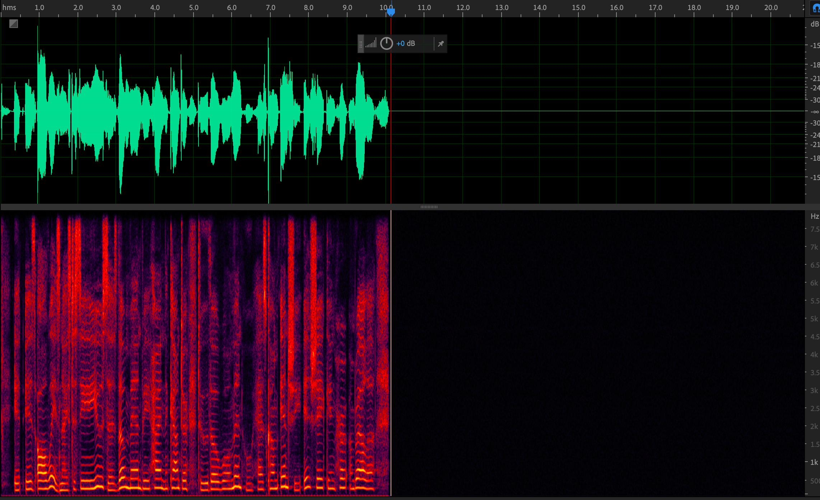
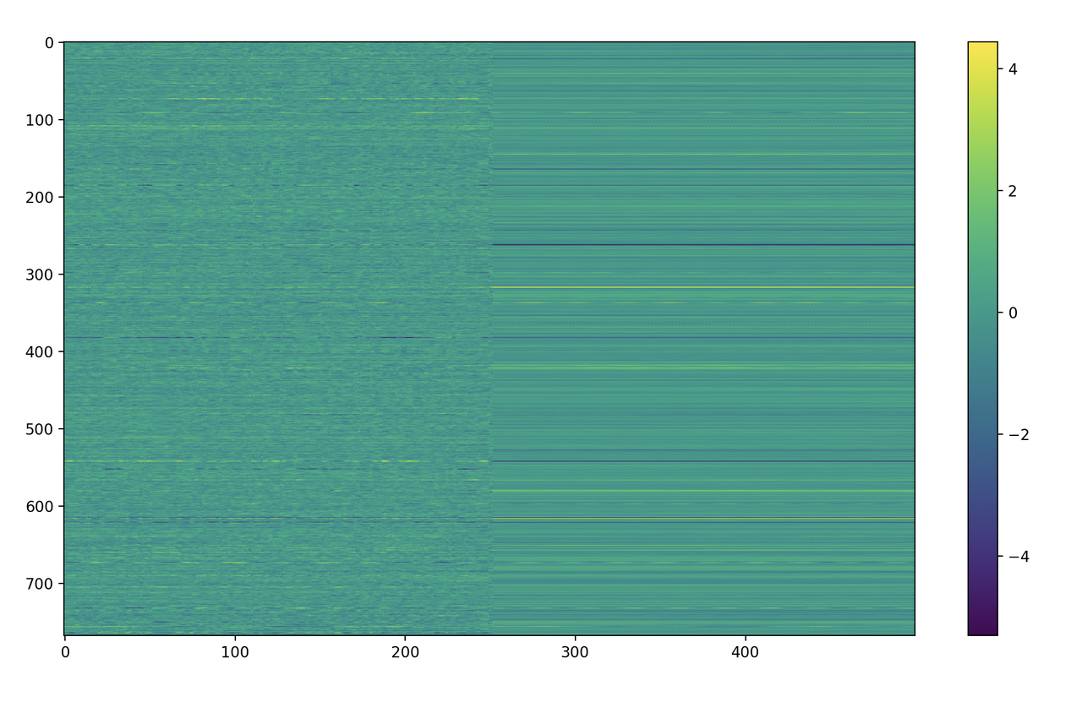
Pre & Postprocessing
Silent Padding Impact on Embeddings
Evaluation Audio Analysis
Long silent segments (≥0.5s)
Fixed-length input requirement (e.g., Dasheng 10s, Whisper 30s)
Silence padding for sub-length sequences when inference
Silent segments influence
Dilutes effective information in audio features
Degrades encoder’s performance especially Clip-Level Tasks
Notes:
Then, when we dug into the task data and how the encoder actually runs, we noticed something key: some audio files had silent segments longer than half a second.
And Transformer encoders require fixed-length inputs during inference, so silence padding was employed for sub-length inputs.
But those presented a problem, all that silence padding ends up going into the encoder.
The figure on the right shows how this hurts the audio embeddings.
The encoder can't filter out the silence by itself, and effective information is diluted.
This really degraded the encoder's performance on downstream tasks, especially those clip-level tasks.

Slide 62
Pre & Postprocessing
Preprocessing:
Detect & filter silent segments (10ms units)
Applied DC removal + amplitude normalization
Postprocessing:
Remove invalid features from silent padding
Impact: 14 tasks' weighted scores up! 📈
Remove Silence
MLP: 0.705 → 0.712
KNN: 0.524 → 0.582
Remove DC and Norm
KNN: 0.582 → 0.598 🌟
 | Preprocessing & Postprocessing |  |  | 14 tasks’ weighted scores
BatchSize | RemSil | RemDC | Norm | MLP | KNN
16 | \ | \ | \ | 0.704 | 0.504
1 | \ | \ | \ | 0.705 | 0.524
1 | \ | on | \ | 0.705 | 0.523
1 | on | \ | \ | 0.711 | 0.582
1 | on | on | \ | 0.712 | 0.596
1 | on | on | on | 0.710 | 0.598
16 | on | on | on | 0.707 | 0.546
Note:
Best inference performance achieved at batch size=1.
When batch size = 16, some invalid features are retained, due to the tensor [B, C, T] requirement.
Notes:
So to tackle these issues, we came up with a three-step process:
First, we built an algorithm to detect and filter silence longer than 10 milliseconds.
Next, we applied DC components removal and amplitude normalization .
Last, in post-processing, we removed extra invalid features from silent padding.
These changes really paid off! MLP and KNN score got better.
Our tests showed the system worked best when batch size is 1.
While this is not efficient enough for challenge organizer evaluation, in practical use it may be worthwhile to pre- and post-process each audio independently to achieve better results.

Slide 63
Model Ensemble
Task Divergence
Audio vs. speech tasks exhibit different characteristics, with speech recognition carrying significant evaluation weightage
SSL for Speech & Audio
Speech | Audio
Wav2vec2 | Dasheng
Whisper | Beats
Qwen2-Audio encoder | ···
Parameter Flexibility
The challenge imposes no constraints on model parameter count, enabling architecture scaling.
1+1 > 2 ？
Model Domain Preferences
SSL Audio Encoders can be broadly categorized by application scenarios into Speech and Audio.
Ensembling Speech and Audio models may yield better performance than single models.
Notes:
Beyond the pre and post-processing, picking the right backbone model was critical for our system's performance, especially with different tasks.
Since the challenge didn't has constraints on parameter count, we went with model ensemble—it's a robust strategy.
First, we investigated some pre-trained speech and audio models: such as Whisper, Dasheng, and Qwen2Audio.
We spent time figuring out how to take advantage of their respective strengths.​

Slide 64
Model Ensemble
Model Integration Trials:
Dasheng
Dasheng + Whisper
Dasheng + Qwen2-Audio Encoder
Key Note: Embedding alignment required in temporal dimension for ensemble models
Model | MLP | KNN
Dasheng1.2B | 0.731 | 0.560
Dasheng1.2B+Whisper | 0.743 | 0.586
Dasheng1.2B+Qwen2Audio | 0.761 | 0.682
Notes:
This figure details of our system.
During inference, the input audio first goes through a series of preprocessing steps.
Then it splits into parallel branches—each branch extracts features separately.
After that, we removed all silent feature frames that came from zero padding in each branch.
Finally, we merge the features from both branches together across the channel dimension.
Here‘s a key detail: Dasheng and Qwen2Audio output embeddings at 25Hz, but Whisper runs at 50Hz. To combine Dasheng with Whisper, we upsampled Whisper embedding by a factor of two.
The table right shows that the combination of Dasheng and Qwen2Audio outperformed all other setups.

Slide 65
Model Fine-tuning & Ensemble
Audioset for Fine-tuning
Multi-task fitness: 527 classes
Audio variety: speech, music environmental sounds
Data scale: 5100+h
Fine-tuning Strategy
Approach: Fine-tune Qwen2-Audio Encoder and Dasheng separately, then fused embeddings.
Model: Encoder + MLP
Fine-tuning Details
Model | Optimizer | learning rate | Masking Rate | Layer Freezing | others
Dasheng 1.2B | AdamW8bit | 1.00E-05 | 0 | ALL Layers | 4*V100 BatchSize=12 EpochLength=500
Qwen2-Audio Encoder |  |  |  | Last 5 Layers
In model fine-tuning, pre-/post-processing are applied
Notes:
Alright, so while we were integrating the models, we also did some supervised fine-tuning to make the pre-trained encoders work better for the challenge tasks.
We picked Audioset for fine-tuning because it‘s super comprehensive— five hundred and twenty-seven (527) classes and five thousand (5,000) hours of audio data.
That includes speech, music, environmental sounds
.
Now, because of GPU memory limits, we decided to fine-tune Dasheng and Qwen2-Audio separately. Just like the task evaluation, we added simple MLP layer to the encoders for fine-tuning.
The table breaks down the details: we did full-parameter fine-tuning for Dasheng, but for Qwen2Audio, we only tuned the last five layers.

Slide 66
Model Fine-tuning & Ensemble
Fine-tuning Strategy & Key Result
Dasheng Base Model Results
Fine-tuning significantly improved KNN scores
Minimal impact on MLP performance
Same Method to Larger Models
Applied same fine-tuning pipeline to: Dasheng 1.2B and Qwen2-Audio Encoder
Observed consistent KNN improvements across models
Best solution
Dasheng 1.2 Finetuned + Qwen2Audio Finetuned Audio Encoder
Model | MLP | KNN
Dasheng base | 0.704 | 0.504
Dasheng base* | 0.703 | 0.622
Dasheng1.2B | 0.731 | 0.560
Dasheng1.2B* | 0.731 | 0.647
Dasheng1.2B+Qwen2Audio | 0.761 | 0.682
Dahseng1.2B*+Qwen2Audio | 0.756 | 0.722
Dasheng1.2B*+Qwen2Audio* | 0.759 | 0.726
* Indicates the model has undergone fine-tuning.
Notes:
So, thinking about development efficiency, we first tried fine-tuning on Dasheng-Base to test if our approach worked.
And here's the key result—KNN scores improved significantly
After that, we then applied the same method to larger models.
We observed the consistent KNN improvements across models.
When we tried different model ensemble setups, the fine-tuned Dasheng and Qwen2Audio performed best.
That‘s why we submitted this solution to the challenge. And that's also why it's named the DQF Audio Encoder.

Slide 67
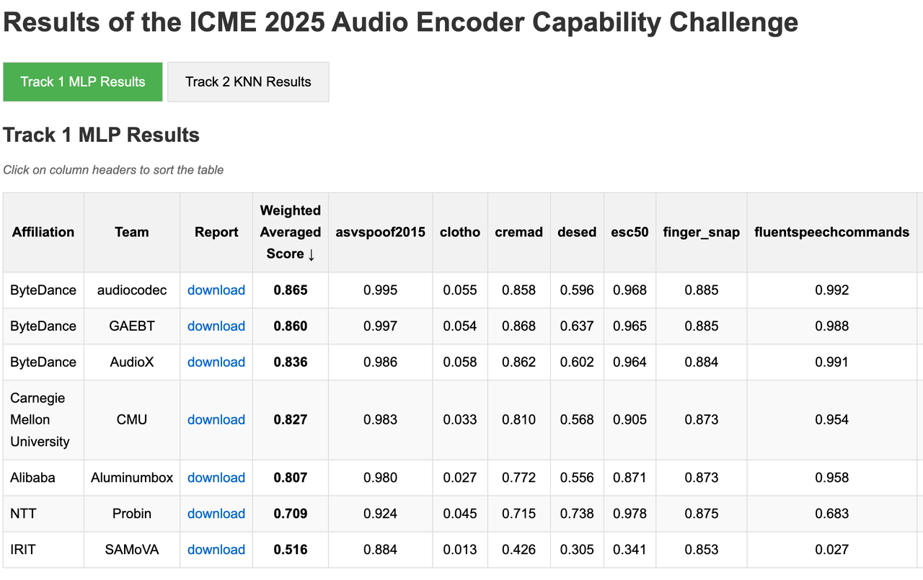
Challenge Results
DQFAudio Encoder secured first place in the Weighted Averaged Score.
Notes:
The challenge results affirm the effectiveness of our system: the DQFAudio Encoder ranked first in the weighted average score.
According to the results, our audio encoder scored zero point nine（0.9） on multiple tasks, and some even reach an accuracy of over 0.99（zero point nine nine）.
These results totally showcase the pre-trained audio encoder's advantage in feature extraction and representation.
So that's really pushed us to put the Audio Encoder into more applications.

Slide 68
THANKS.
Notes:
Finally, I would like to thank the AECC committee for providing the platform. Thank you for your attention.
You are welcome to ask any questions about our research.
If there are no more questions, I'll wrap up here. Feel free to come chat with me about any audio tech—happy to dive into the details!
Thank you again for your participation.

Slide 69
Presentation 2 by Team SAMoVA

Slide 80
Take a group photo

Slide 81
Thanks，see you next year！

