Slide 1


Large Audio-Language Models: Algorithms and Applications
Wenwu Wang
Professor, Centre for Vision, Speech and Signal Processing (CVSSP)
Associate Head in External Engagement, School of Computer Science and Electronic Engineering
Principal AI Fellow, Surrey Institute for People Centred Artificial Intelligence
University of Surrey, UK
Email: w.wang@surrey.ac.uk
Web: https://personalpages.surrey.ac.uk/w.wang/
Invited talk @ Conversational AI Reading Group,
Mila, Quebec Artificial Intelligence Institute in Montreal, Canada
30/04/2026

Slide 2



Many thanks to…
Xinhao Mei
Haohe Liu
Xubo Liu
Jinhua Liang
Yi Yuan
Yiming Zhang
Qiuqiang Kong
Jisheng Bai
Zehua Chen
Xinran Liu
Liting Gao
Yuanbo Hou
Yuelan Cheng
Junqi Zhao
Mark Plumbley
Turab Iqbal
Jianyuan Sun
Jian Guan
Feiyang Xiao
Yong Xu
Yin Cao
Jinzheng Zhao
Yuxuan Wang
Qiaoxi Zhu
Volkan Kilic
Zhanyu Ma
Danilo Mandic
Philip Jackson
Qiang Huang
David Frohlich
Emily Corrigan-Kavanagh
Marc Green
Andres Fernandes
Christian Kroos
Trevor Cox
Arshdeep Singh
…
Funding from:
UK Engineering and Physical Sciences Research Council (EPSRC) & British Council Newton Institutional Links Award

Slide 3
Outline
Introduction
Large audio models & large language models
Large audio-language models
  Example models & datasets
  Typical methods for fusing/aligning audio and language
  Open challenges
  Integration of audio and language models
Applications of LALMs to various cross-modal generation tasks
  Audio captioning (e.g. audio to text generation)
  Audio question answering and reasoning
  Text to audio generation & composition & storytelling
  LLMs for controllable audio editing
  Neural audio coding
Conclusions and future works

Slide 4
Audio Signal Processing
Tasks:
Audio source separation
Audio source localisation/tracking
Audio event detection/localisation
Audio scene classification
Audio tagging
Audio search and retrieval
Audio rendering
Audio recognition
…
Models:
Physics-based models
Perceptually motivated models
Data-driven models
Hybrid models
….
Data:
Audio-only
Multimodal (audio, visual, texts, EEG, etc)

Slide 5
(Large) Audio Models
Learning general/universal audio representations from large scale audio data shows promising performance in downstream tasks (classification, separation, retrieval, etc):
PANNs (Kong, et al, 2020): large scale CNN-based audio model
Audio2Vec (Tagliasacchi et al, 2020): sequence to sequence unsupervised model
CLAR (Al-Tahan and Mohsenzadeh, 2021): self-supervised model
COLA (Saeed et al, 2021): self supervised model
BOYL-A (Niizumi et al, 2021): self supervised model
AST (Gong et al, 2021): large scale transformer-based audio model
ATST (Li and Li, 2022): transformer-based model
MAE-AST (Baade et al, 2022): self-supervised model
SSAST (Gong et al, 2022): self-supervised AST model
Audio-MAE (Huang et al, 2022): self-supervised model
BEATs (Chen et al, 2023): audio pre-training with acoustic tokenizers
ASiT (Atito et al, 2024): self-supervised models for general audio representation
SSLAM (Alex et al, 2025): self-supervised learning from audio mixtures
mean Average Precision (mAP) on AudioSet: 31.4 (2017) -> 55.8 (2025)

Slide 6
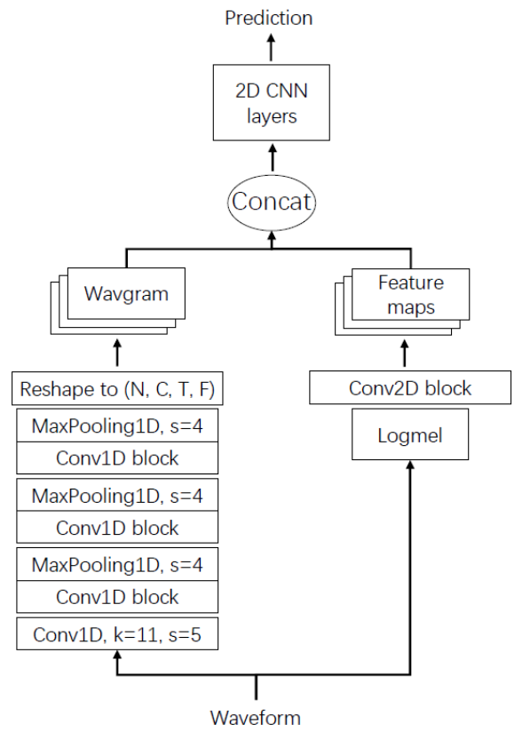
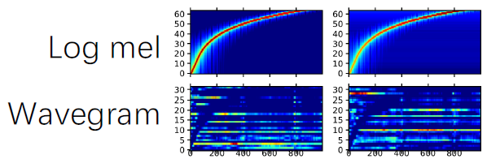
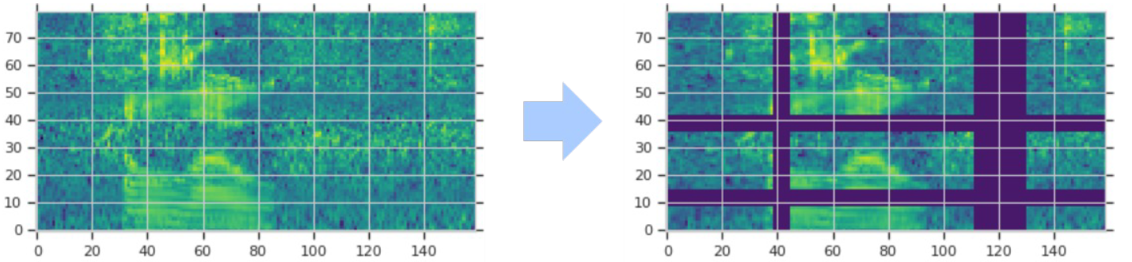
PANNs: Large-Scale Pre-trained Audio Neural Networks
Wavegram-Logmel-CNN for AudioSet tagging
Time-domain (“Wavegram”), plus
Log mel spectrogram
Data augmentation, e.g. use SpecAugment:
randomly mask time and frequency stripes of log mel spectrogram
Q. Kong, Y. Cao, T. Iqbal, Y. Wang, W. Wang, and M. D. Plumbley, "PANNs: large-scale pretrained audio neural networks for audio pattern recognition", IEEE/ACM Transactions on Audio Speech and Language Processing, 2020. [PDF] [code]

Slide 7
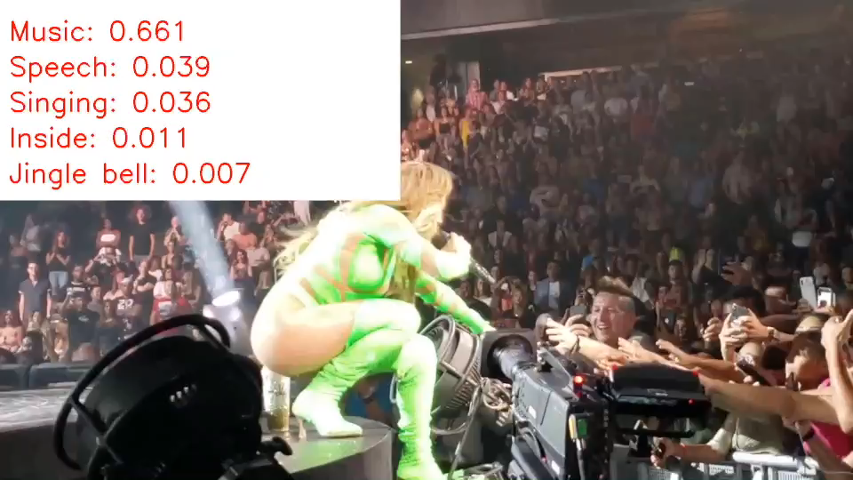
PANNs: Demo

Slide 8
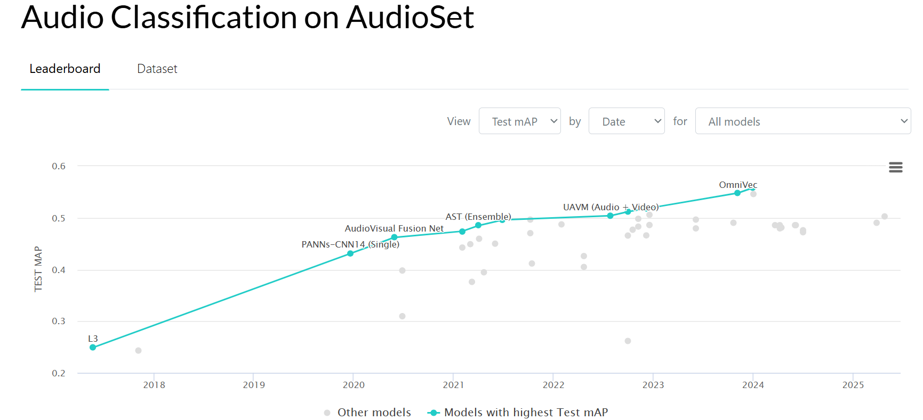
(Large) Audio Models
Leaderboard:
https://paperswithcode.com/sota/audio-classification-on-audioset
https://www.codesota.com/audio/classification

Slide 9
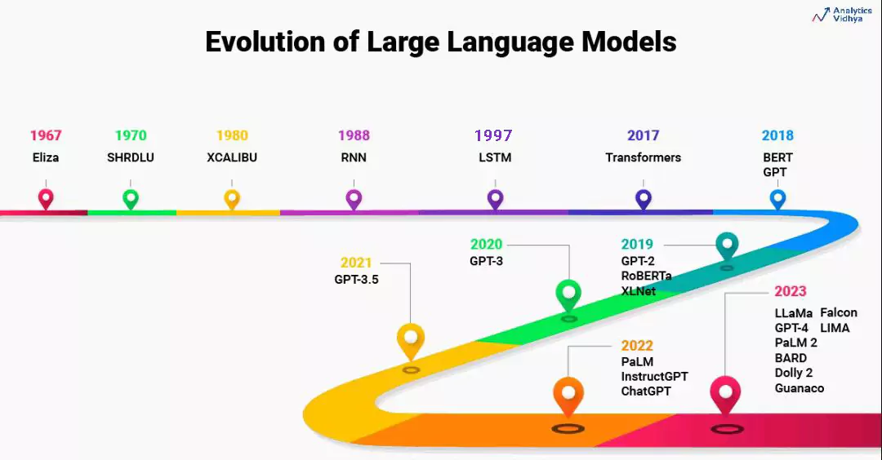
Large Language Models (LLMs)
Courtesy to Aravind Pai: https://www.analyticsvidhya.com/blog/2023/07/beginners-guide-to-build-large-language-models-from-scratch/

Slide 10
Large Language Models (LLMs)
Figures from Ryan O'Connor: https://www.assemblyai.com/blog/emergent-abilities-of-large-language-models/
Wei et al, “Emergent abilities of large language models,” Transactions on Machine Learning Research, 2022.

Slide 11
Large Audio-Language Models: Why?
Leverage knowledge within LLMs to address the limitations of audio models
  Zero-shot or few-shot classification
Explore homogeneity across tasks with LLMs
  Use LLMs as an agent to solve multi-task problems
Extend the capabilities of audio models for new tasks
  Extending from audio classification to audio captioning/question answering & reasoning
  Extending from audio generation to storytelling & controllable editing
  Extending from audio source separation to language queried audio source separation

Slide 12

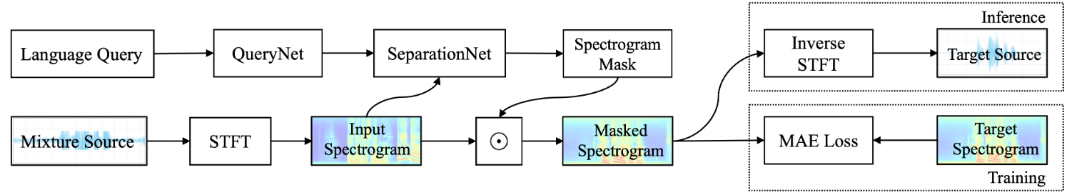

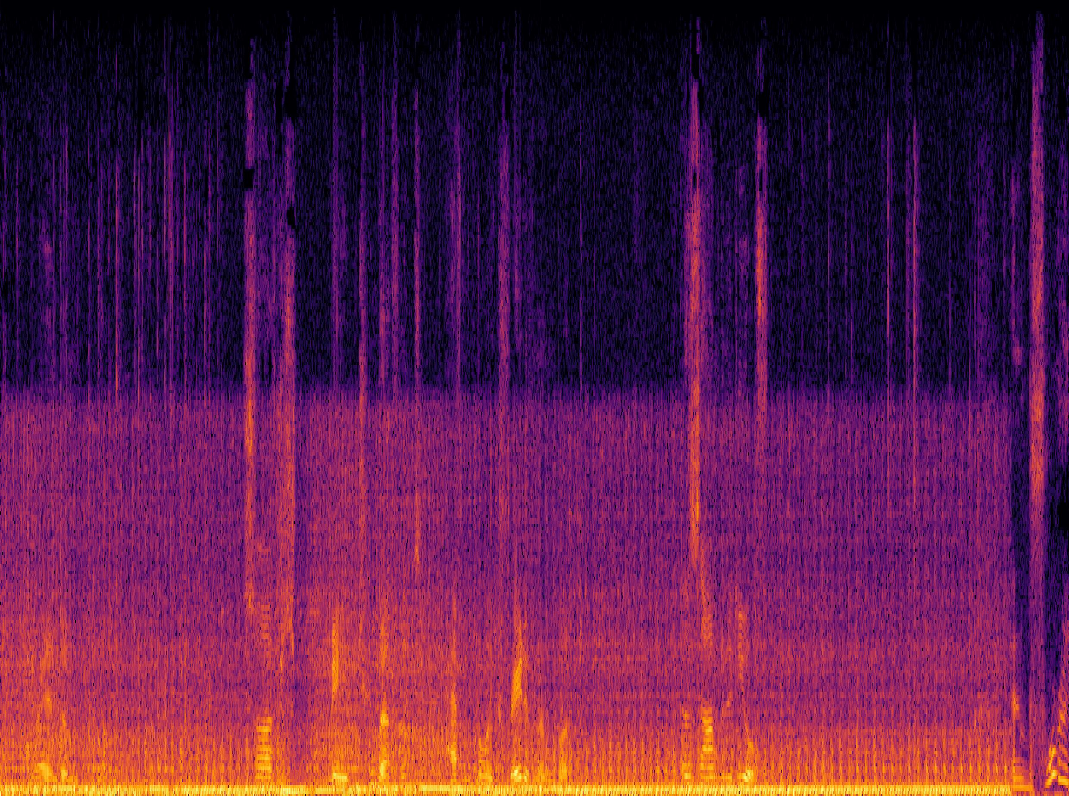
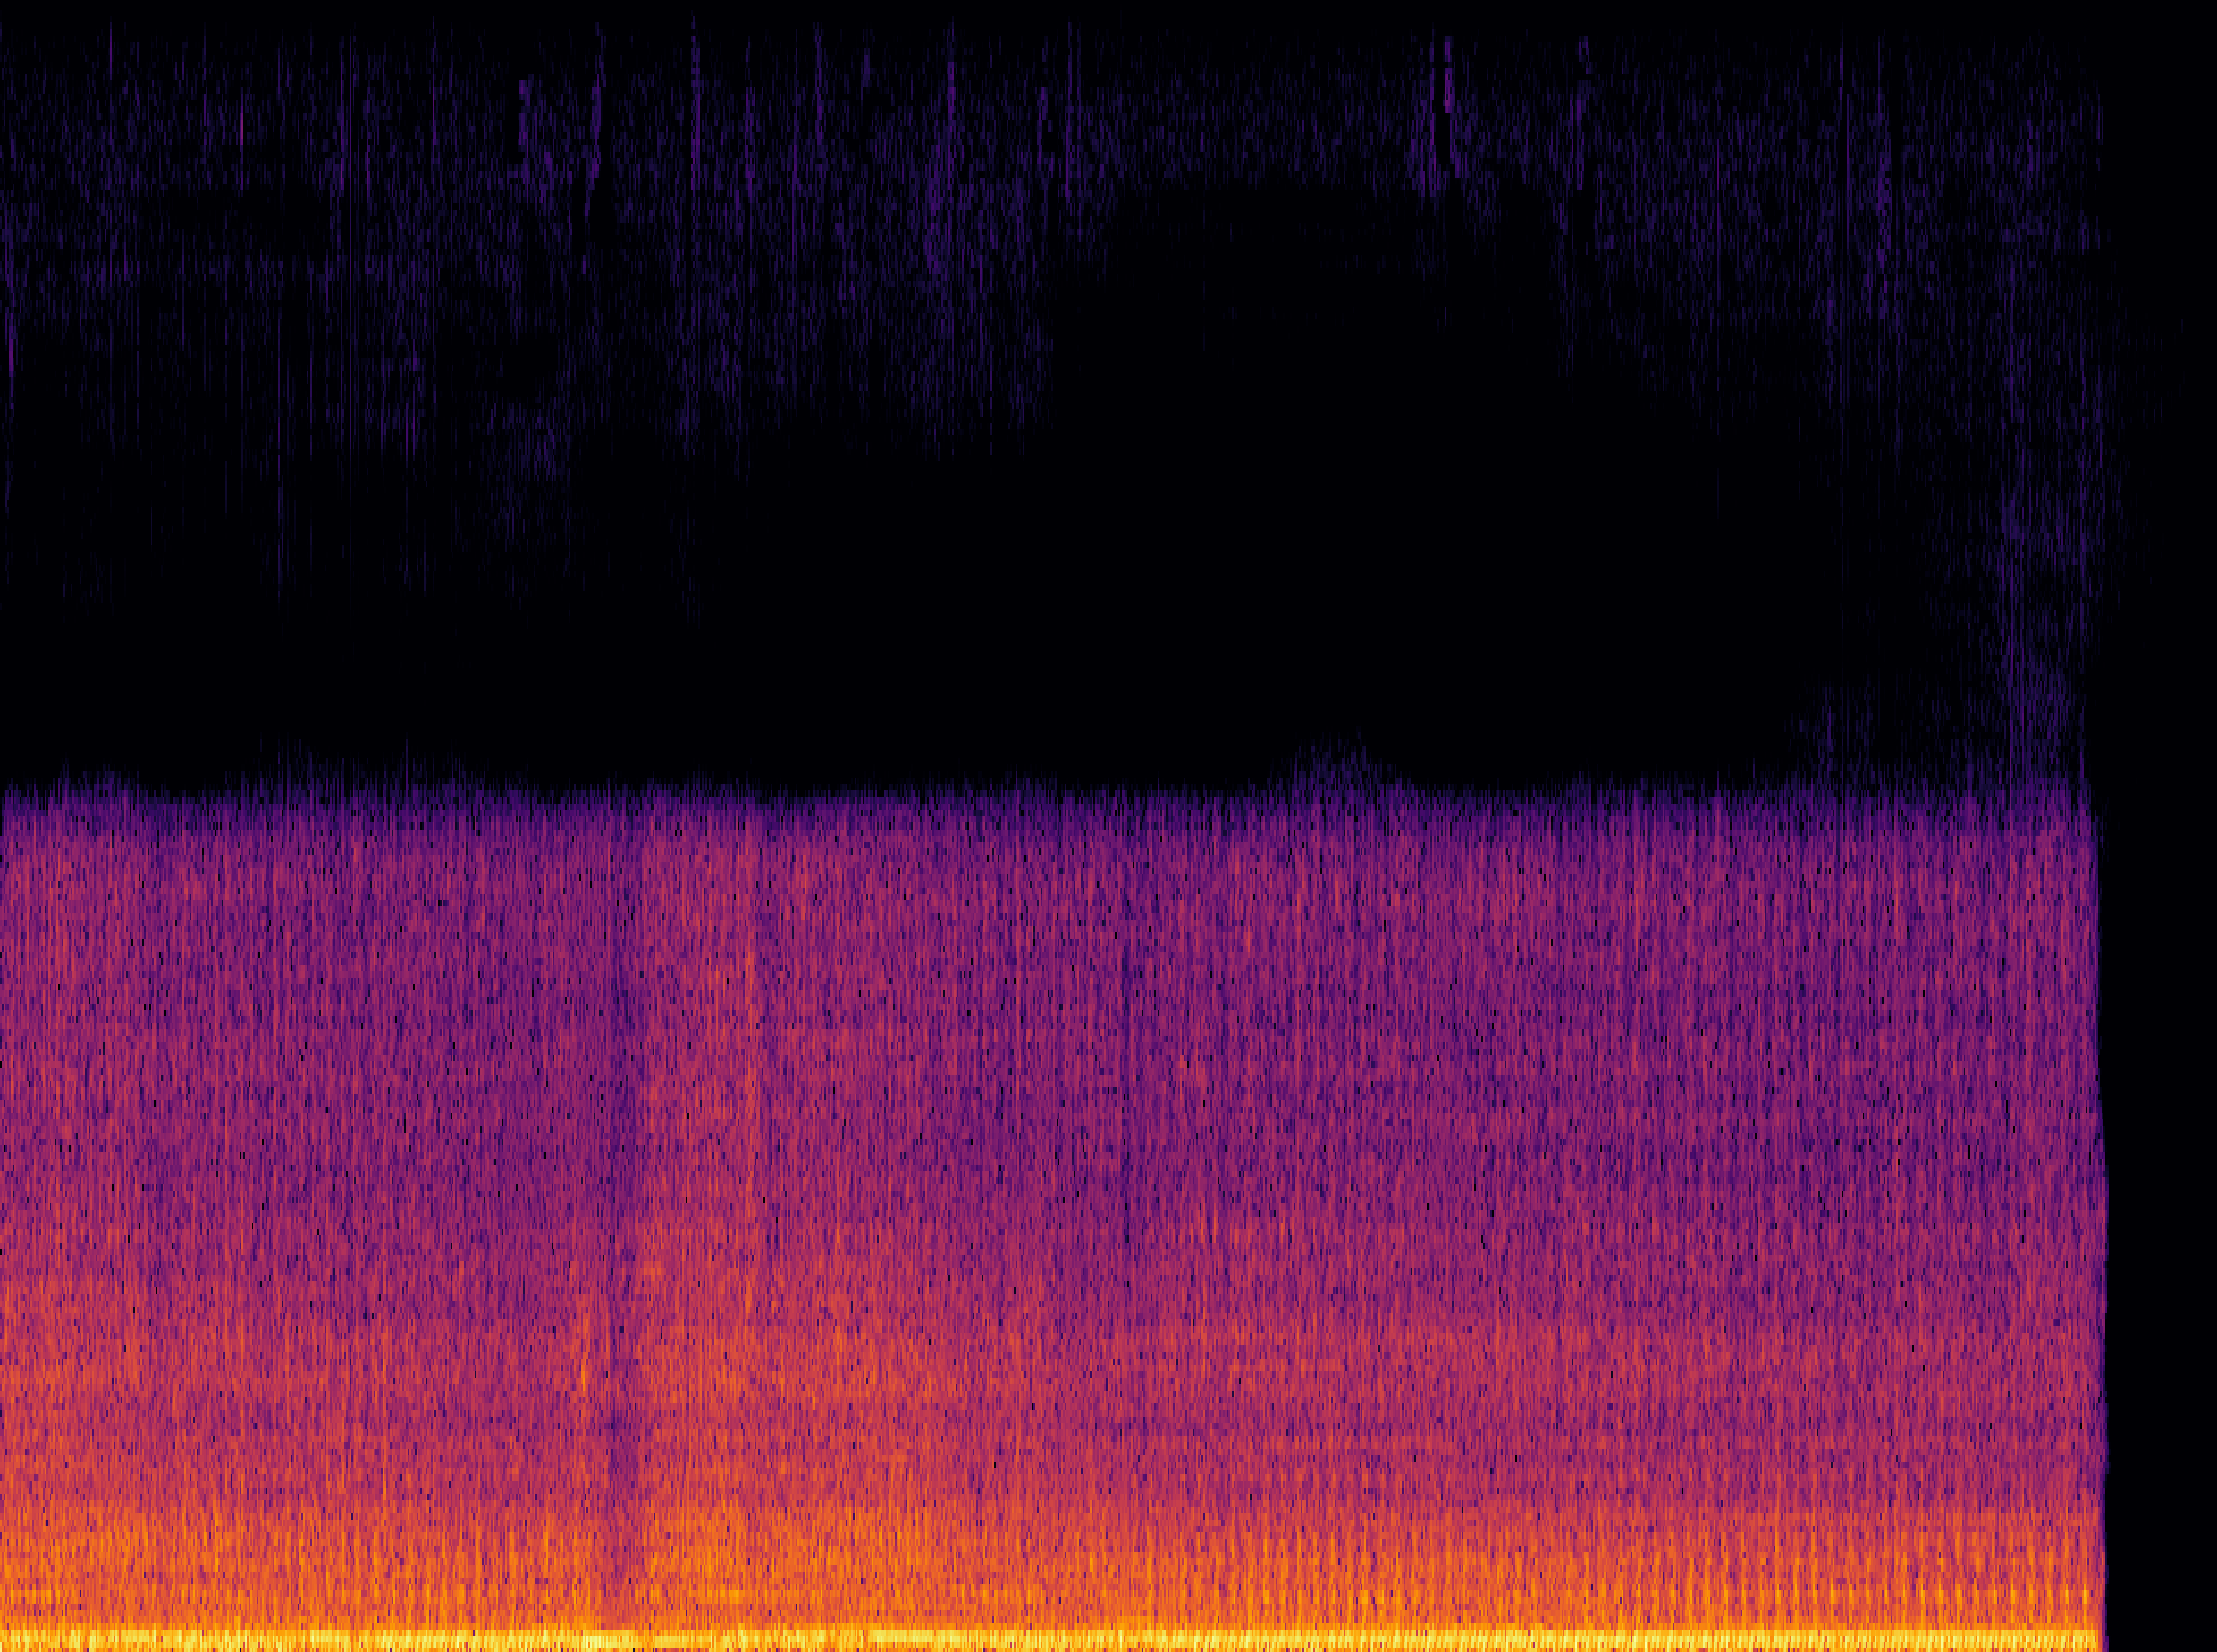
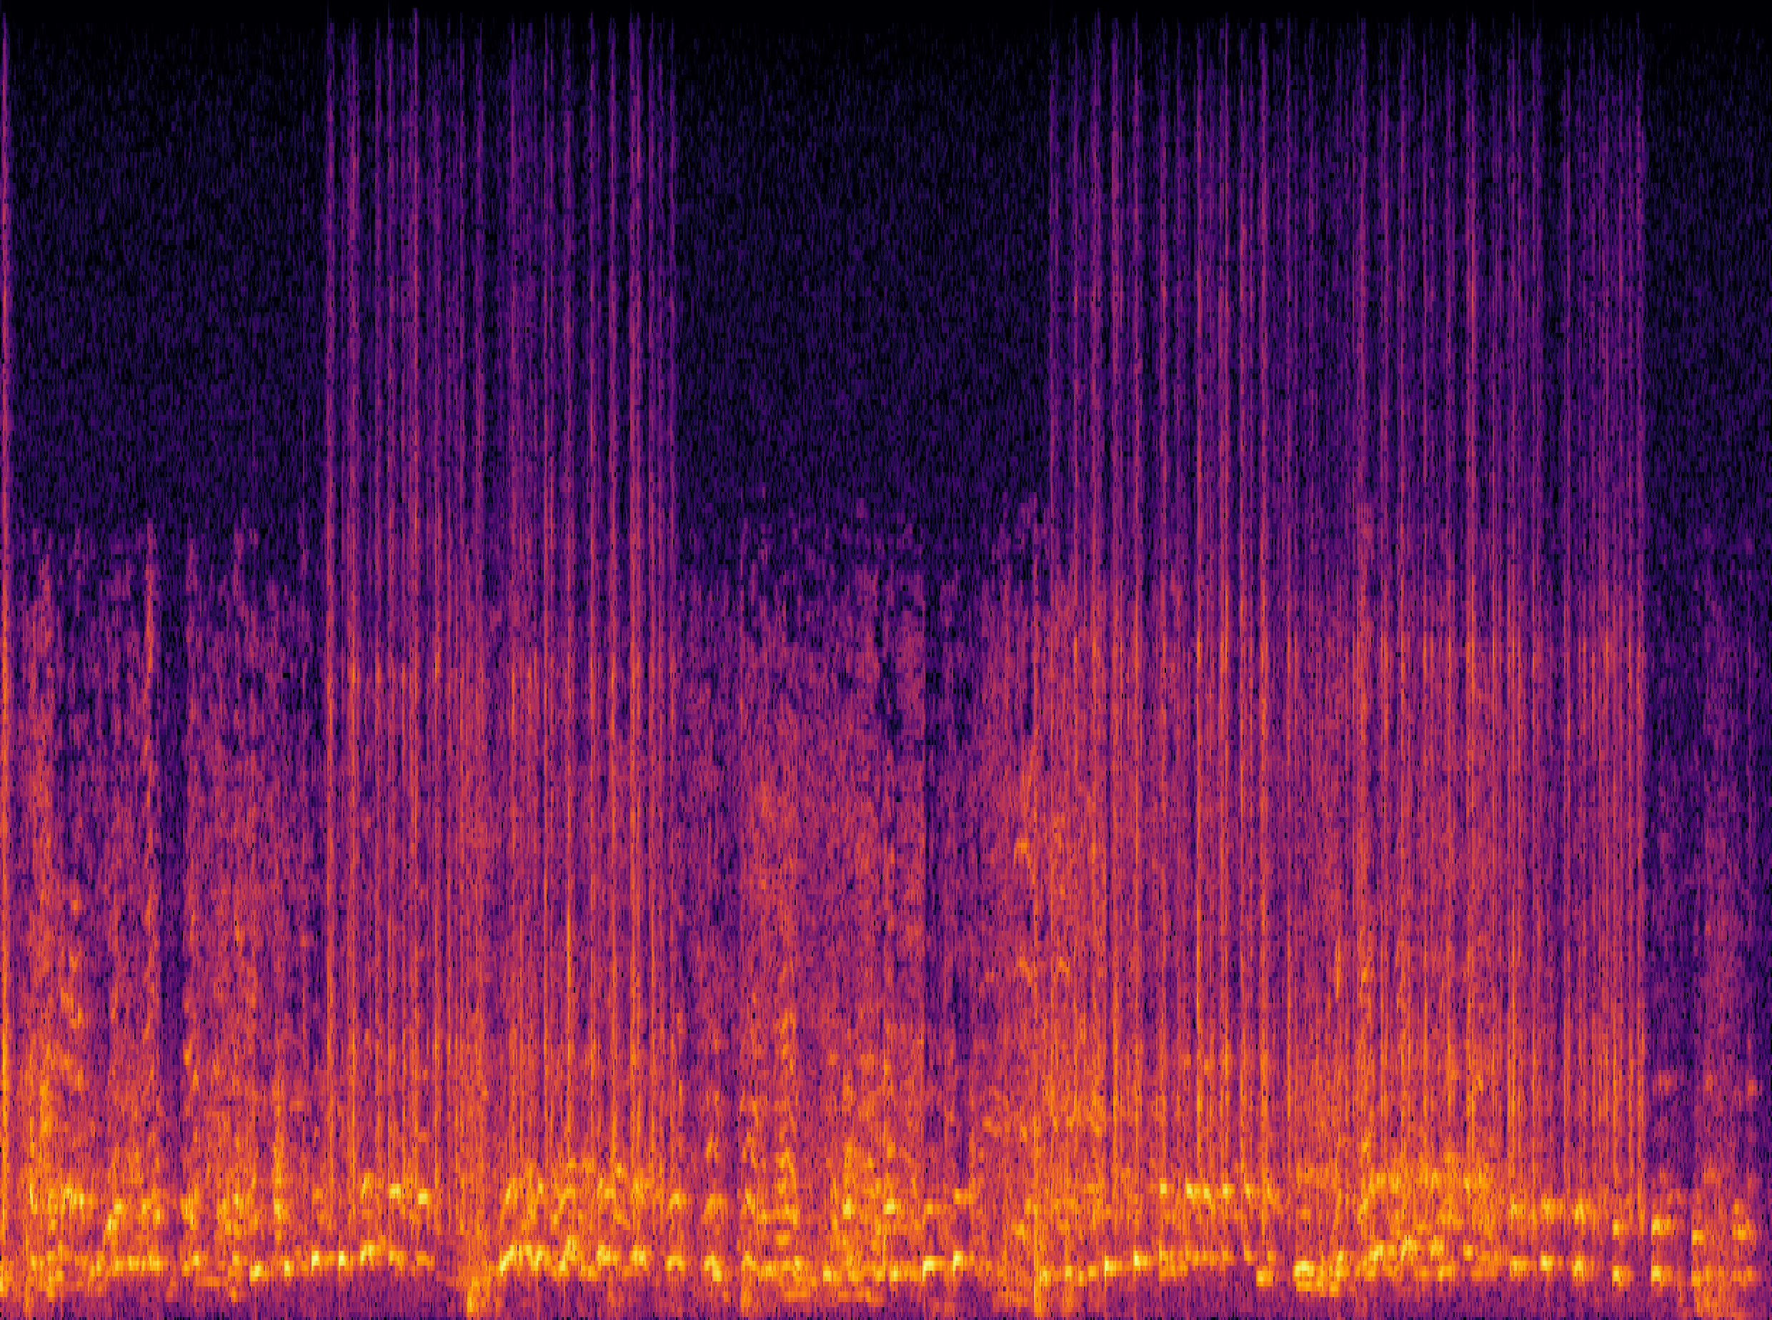
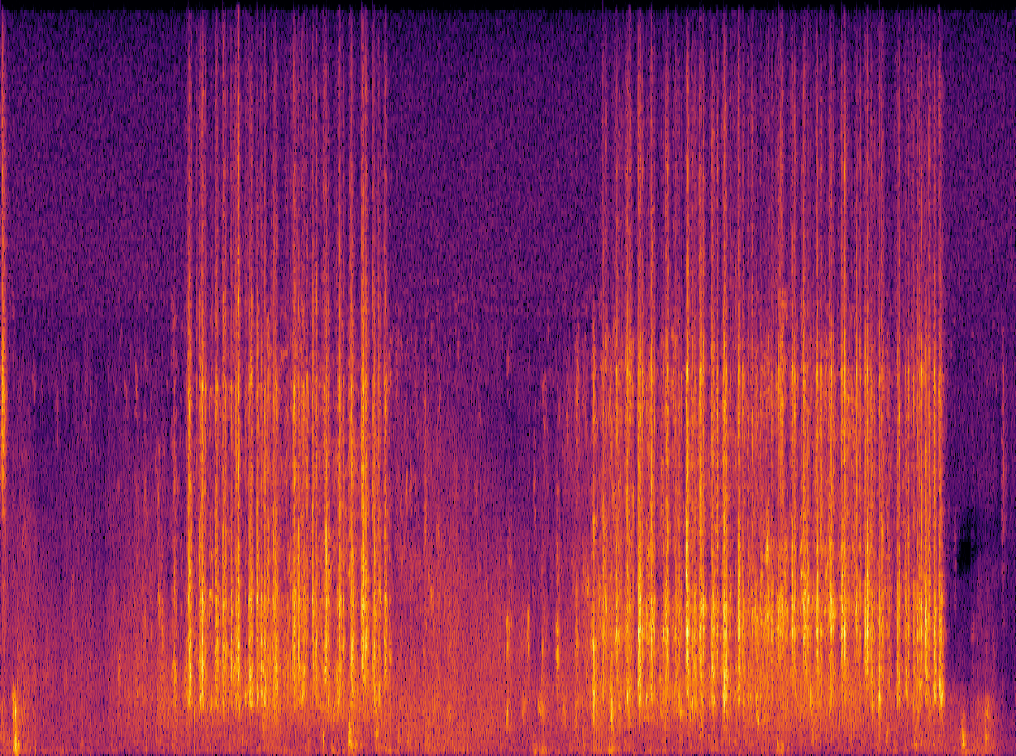
An Example: Language-Queried Audio Source Separation
Use language query to extract target source
BERT-mini
(Transformer-based)
ResUNet-based
separation net
Same shape as
input spectrogram
Mean absolute error for training
Human query: “The engine sound of a vehicle”
Human query: “The sound of hitting the keyboard”
Mix
Separated
Mix
Separated
X. Liu, H. Liu, Q. Kong, X. Mei, J. Zhao, Q. Huang, M.D. Plumbley, and W. Wang,"Separate What You Describe: Language-Queried Audio Source Separation," in Proc. 23rd Interspeech Conference (INTERSPEECH 2022), 18-22 September, 2022, Incheon, Korea.
X. Liu, Q. Kong, Y. Zhao, H. Liu, Y. Yuan, Y. Liu, R. Xia, Y. Wang, M. D. Plumbley, and W. Wang, "Separate anything you describe," IEEE Transactions on Audio Speech and Language Processing, vol. 33, 458--471, 2025. [PDF] [code]

Slide 13
Large Audio Language Models - Examples
Whisper: automatic speech recognition (ASR)
Wav2Vec 2.0: speech to text (STT)
DeepSpeech: open-source ASR
Coqui AI: speech synthesis and TTS
Jasper and QuartzNet: ASR
GPT-3 with Whisper: ASR + LLMs
Sonix.ai: speech transcription and analysis
SpeechBrain: platform for speech models
OpenSTT: ASR
Gemini: text/image/speech
WavLLM: speech LLMs
MuseNet: music instrumental composition & style transfer
MusicVAE: melody generation, remixing, and style interpolation
JukeBox: raw music with vocals and lyrics
Riffusion: text to music generation
MusicLM: text to music generation
REMI: symbolic music generation (e.g. MIDI)
DeepBach: classic music composition
AIVA: music generation assistant
Wav2CLIP: audio and language mapping
AudioCLIP: audio-text-image alignment
CLAP: audio-text alignment
CLAP-LAION: audio-text alignment
Pengi: audio classification & AQA
Qwen-Audio: speech, music, general audio
AudioLM: Speech/music generation
LTU: audio QA and reasoning
SALMONN: speech-audio-music LLMs
ImageBind: image, text, audio, depth
ONE-PEACE: audio-text-image
AudioGPT: Speech, Music, Talking Head
UniAudio: speech/sound/music/singing
AudioLDM: text to audio generation
AudioLDM 2: text to audio generation
Re-AudioLDM: text to audio generation
T-CLAP: audio-text alignment
WavCraft: text prompted audio editing
APT-LLM: LLM based AQA and reasoning

Slide 14
(Large) Audio-Language Datasets
AudioCaps (Kim et al, 2019)
Clotho (Drossos et al, 2020)
SoundDescs (Koepke et al, 2021)
LAION-Audio-630K (Wu et al, 2023)
Auto-ACD (Xu et al, 2024)
Audio-FLAN (Xue et al, 2025)
SeaBench-Audio (Liu et al, 2025)
MusicSem (Salganik et al, 2026)
WavCaps (Mei et al, 2023)
Sound-VECaps (Yuan et al, 2024)
AudioSetCaps (Bai et al, 2025)
CLEAR (Abdelnour et al, 2018)
DAQA (Fayek and Johnson, 2019)
Clotho-AQA (Lipping et al, 2022)
MUSIC-AVQA (Li et al, 2022)
mClothoAQA (Behera et al, 2023)
OpenAQA-5M (Gong et al, 2023)
AudioMCQ (He et al, 2025)
Audio Flamingo 3 (Goel et al, 2025)
Jamendo-MT-QA (Koh et al, 2026)

Slide 15
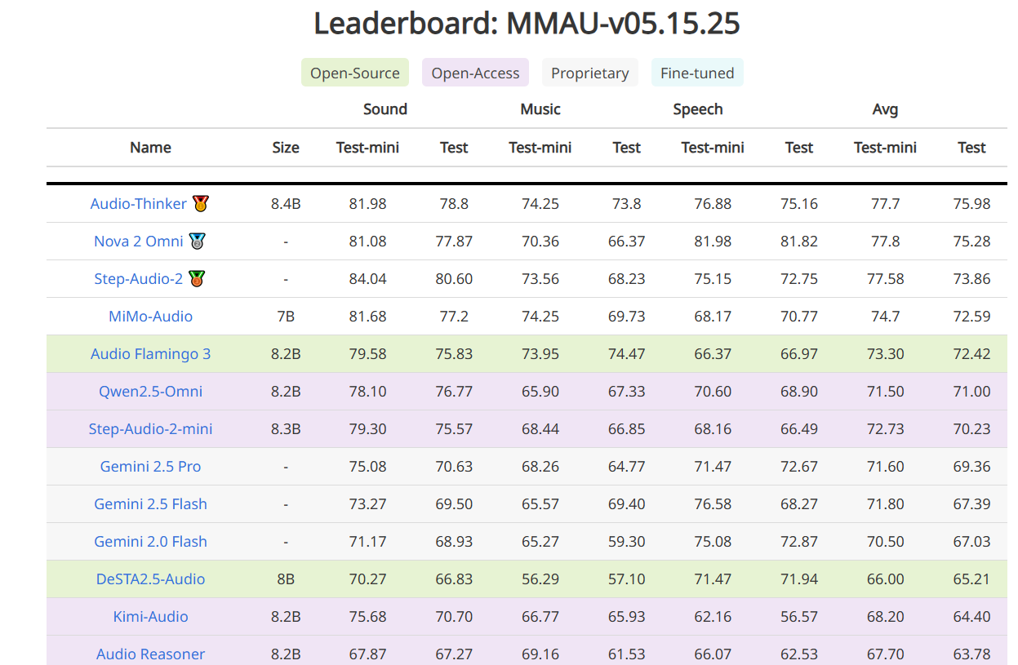
Large Audio-Language Models- Recent Progress
https://sakshi113.github.io/mmau_homepage/#leaderboard-v15-parsed

Slide 16
Trends and Open Questions in LLAMs
Open challenges:
Fusion of audio and language models: aligning/fusing audio-text data
Applications to audio tasks: addressing existing challenges in audio tasks
Extending to multi-modality: text, audio, visual, or more modalities
Data scarcity: audio-language dataset shortage for building audio-language models
Extending to multi-tasks: exploring in new tasks & solving multi-task problems
Multi-lingual models and datasets: lacking multi-lingual models and datasets
Real-time streaming: demands for real-time processing for applications in live captioning, gaming, and customer service
Low-resource language support: growing interest in training models for underrepresented languages for inclusiveness
Safety issues: growing concerns about toxicity and privacy issues
Explaining models: explaining and interpreting different choices and decisions made by the model
Object hallucination: struggling in answering discriminative questions related to the identification of specific object sounds within an audio clip
Performance evaluations: lack of common evaluation protocols, tools and benchmarks
Applications:
Accessibility, voice assistants, content creation, and human-computer interaction

Slide 17
Typical Methods for Fusing Audio and Language
Aligning audio-texts with contrastive pretraining
  Examples: CLAP, CLAP-LAION, AudioCLIP, Wav2CLIP, T-CLAP, etc.
Tokenizing audio and texts, then followed by LLMs
  Examples: Moshi, VITA, LSLM, Voicebox, FunAudioLLM, LauraGPT, etc.
Fusing embeddings with cross-attention
  Examples: Q-former
Cascading acoustic models with LLMs
  Examples: naive ASR+LLM+TTS
Combination of the above schemes
  Examples: SPIRIT-LM, Spectron, etc.

Slide 18
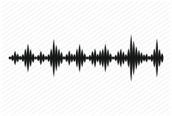
Task 1: Audio to Text Generation
Automated audio captioning (AAC) is a cross-modal translation task which aims at generating a natural language description given an audio clip.
This task requires detecting the audio events and their spatial-temporal relationships and describing these information using natural language.
Applications
  Audio retrieval
  Assist hearing-impared to understand environmental sounds
  Subtitle for sounds in TV programs
AAC started in 2017, and has received increasing attention in recent three years with freely available datasets released and being held as a task in DCASE Challenges 2020-2022.
AAC system
“a woman talks nearby as water pours”

Slide 19
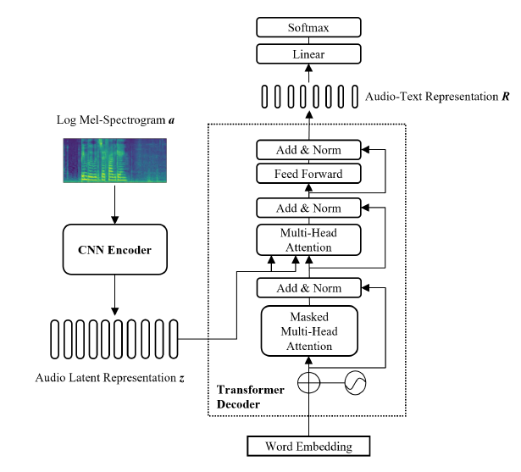
An Example: CNN-Transformer Encoder-Decoder
Common challenges in automated audio captioning:
Data scarcity
Representations of audio, text and audio-text
Diversity of captions
Multi-lingual captioning
Interactions with other modalities (e.g. vision)
….
Y. Hou, Q. Ren, A. Mitchell, W. Wang, J. Kang, T. Belpaeme, and D. Botteldooren, "Soundscape Captioning using Sound Affective Quality Network and Large Language Model," IEEE Transactions on Multimedia, 2026.
Y. Zhu, Y. Zhang, L. Xiao, W. Wang, and A. Men, "Zero-shot Diverse Audio Captioning with Diffusion Models", Knowledge Based Systems, 2026.
Y. Zhang, X. Xu, R. Du, H. Liu, Y. Dong, Z.-H. Tan, W. Wang, and Z. Ma, "Zero-Shot Audio Captioning Using Soft and Hard Prompts," IEEE Transactions on Audio Speech and Language Processing, vol. 33, pp. 2045 - 2058, May 2025.
Y. Zhang, H. Yu, R. Du, Z.-H. Tan, W. Wang, Z. Ma, Y. Dong, "ACTUAL: audio captioning with caption feature space regularization," IEEE/ACM Transactions on Audio Speech and Language Processing, vol. 31, pp. 2643 - 2657, 2023.
X. Mei, X. Liu, M. Plumbley, and W. Wang, "Automated audio captioning: an overview of recent progress and new challenges", EURASIP Journal on Audio Speech and Music Processing, 2022.
F. Xiao, J. Guan, H. Lan, Q. Zhu, and W. Wang, "Local information assisted attention-free decoder for audio captioning," IEEE Signal Processing Letters, vol. 29, pp. 1604-1608, 2022.

Slide 20

Audio Captioning Demos

Slide 21
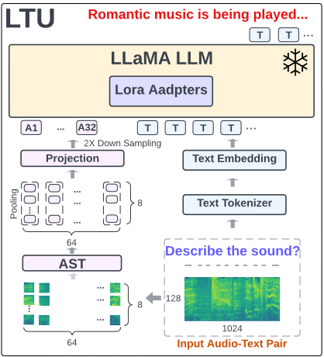
Task 2: Audio Question Answering & Reasoning
Acoustic Prompt Tuning (APT): an adapter extending LLMs/VLMs to the audio domain using an improved soft-prompting approach
Motivation:
Existing works on LALMs used pretrained audio embeddings as soft prompt and adjust the LLM with Parameter-Efficient Fine-Tuning (PEFT).
However, they cannot generalize to multi-modal setting, e.g., audio-visual language models.
Can we extend the off-the-shelf language models to the audio domain rather than training a dedicated LLM (~7B to 70B)?
Fig. An example of an audio LLM structure (LTU (Gong et al, 2023)).
J. Liang, X. Liu, W. Wang, M. D. Plumbley, H. Phan, E. Benetos, “Acoustic Prompt Tuning: Empowering Large Language Models with Audition Capabilities”, IEEE Transactions on Audio Speech and Language Processing, vol. 33, 949 - 961, 2025. arXiv:2312.00249

Slide 22
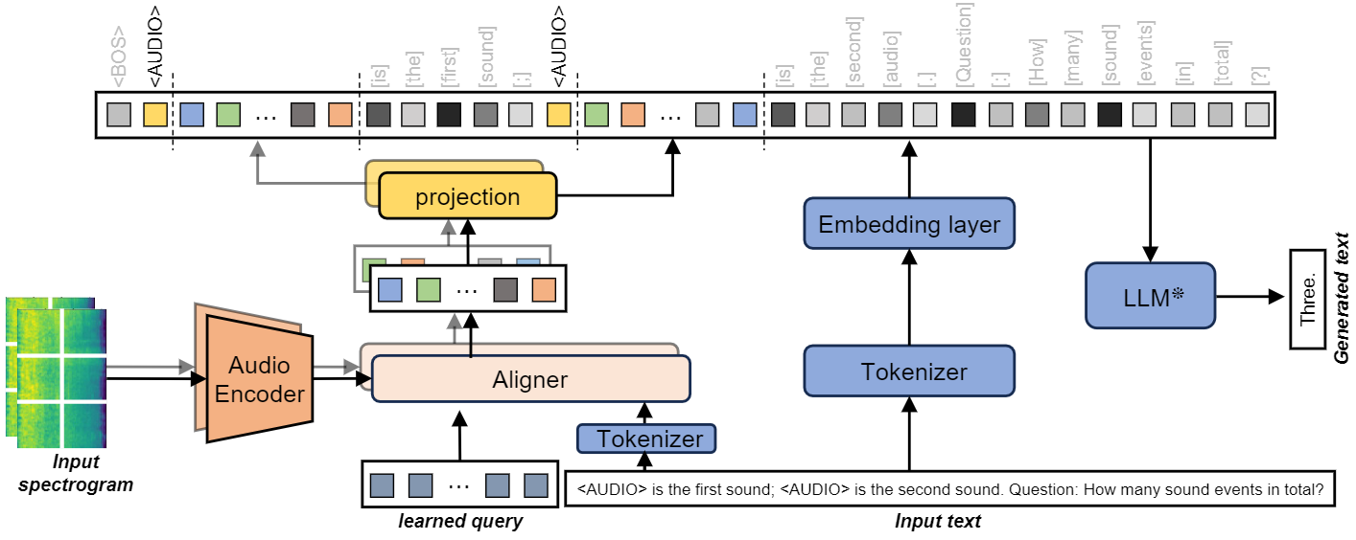
Task: Audio Reasoning – APT
Acoustic Prompt Tuning (APT): an adapter extending LLMs/VLMs to the audio domain using an improved soft-prompting approach
1. Interleaved acoustic and text embeddings
2. Instruction-aware architecture
3. Multi-task training

Slide 23
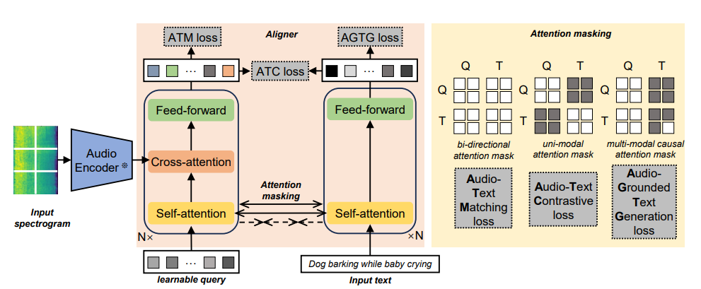
APT – Instruction Aware-Architecture
We adapt a 4-layer transformer and pretrain it with three loss, following BLIP-2.
ATM - learn to predict if the audio-text pair is from the same recording.
ATC - learn to identify the matched audio-text pair out of a batch of negative (mismatched) pairs
AGTG – learn to predict the next textual token provided the acoustic and previous textual tokens

Slide 24
APT – Curriculum Learning
target sound event detection
Audio tagging
AudioSet-SL
Few-shot learning
AudioSet
Temporal event retrieval
AudioSet
AudioSet-SL
Audio captioning
WavCaps
Sound event counting
Complex reasoning
AudioCaps
AudioSet-SL
NLAR
Clotho
Audio Q&A
ClothoAQA
Stage 1
Stage 2
Stage 3

Slide 25
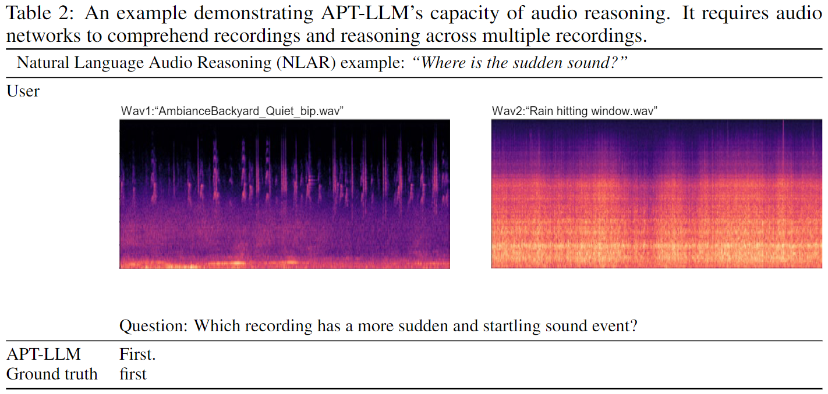
APT – Reasoning Example
The model developed is used to analyse audio clips by comparison and summarisation.
Data collection
Data cleaning
Event description
Q&A Generation
Rejected
Human Inspect
Accepted

Slide 26
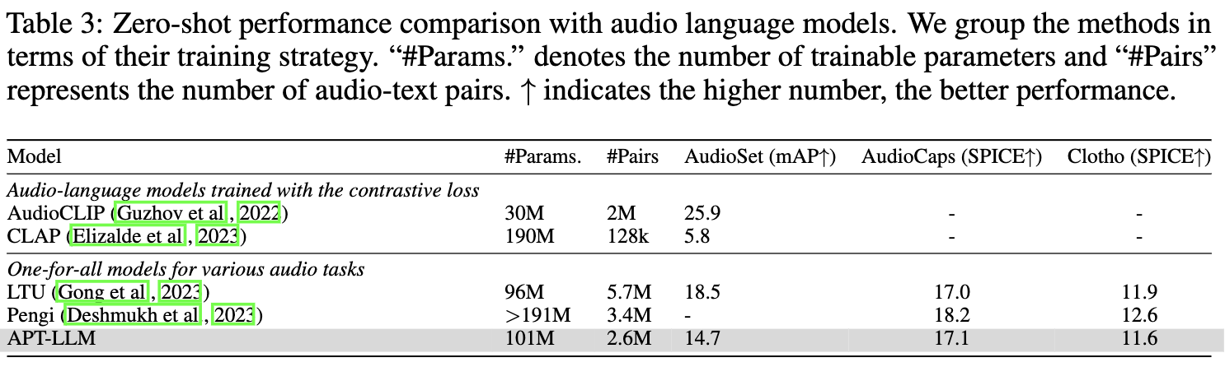
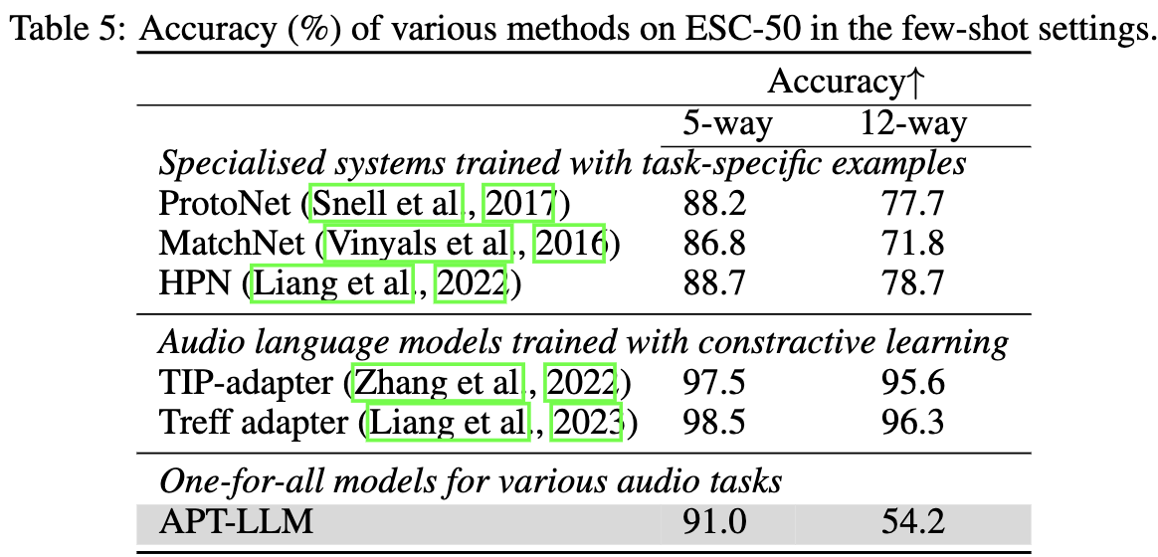
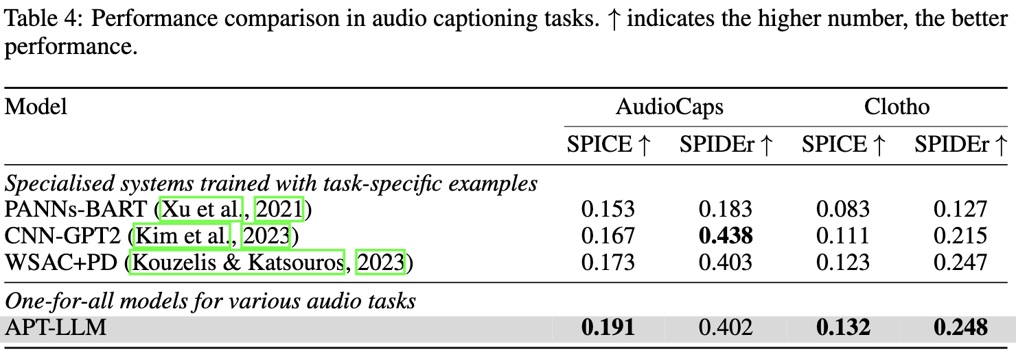
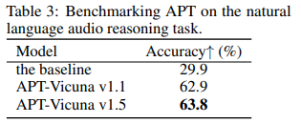
APT – Experimental Results
APT-LLM has a promising result on common audio tasks without fine-tuning on task-specific data. After fine-tuning for two epochs, APT-LLM achieves the best performance on downstream tasks.

Slide 27
APT – Demos
"first_recording": "Creaking pier.wav",
"second_recording": "Machetes sliding 2.wav",
"question": "In which recording are the sound events more evenly distributed?",
"answer": "second“
"first_recording": "Rain and Storm.wav",
"second_recording": "Car vs. Freight Train.wav",
"question": "Does the second recording have a calming effect like the first recording?",
"answer": "yes"
"first_recording": "Creaking pier.wav"
"second_recording": "Machetes sliding 2.wav"
"first_recording": "Rain and Storm.wav"
"second_recording": "Car vs. Freight Train.wav"
Code: https://github.com/JinhuaLiang/APT
Paper: https://arxiv.org/abs/2312.00249

Slide 28
Task 3: Text to Audio Generation
Potential Applications:
Related Works:
Computational “foley artist”:
  Game developer: e.g., A ghost is haunting a house.
  Audio producer: e.g., high heels hitting metal ground.
  Movie producer: e.g., the laser sound from a laser gun.
  …
Automatic content creation
  Endless music
  Audiobook with ambient noises
  White noise for meditation
  …
Data Augmentations
Label-to-Audio Generation
  Acoustic Scene (Kong et al., 2019), Sound event (Liu et al., 2019), FootStep (Comunit et al. 2019), …
Text-to-Audio Generation
  DiffSound (Yang et al., 2022), AudioGen (Kreuk et al., 2022), Make-an-Audio (Huang et al., 2023)
Text-to-Music Generation
  MusicLM (Andrea et al., 2023)
  Moûsai (Flavio et al., 2023)
  Noise2Music (Huang et al., 2023)
Others
  JukeBox (Dhariwal et al., 2020), AudioLM (Borsos et al., 2022), SingSong (Donahue et al., 2023),…

Slide 29
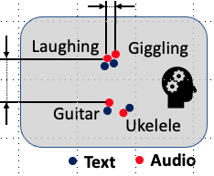
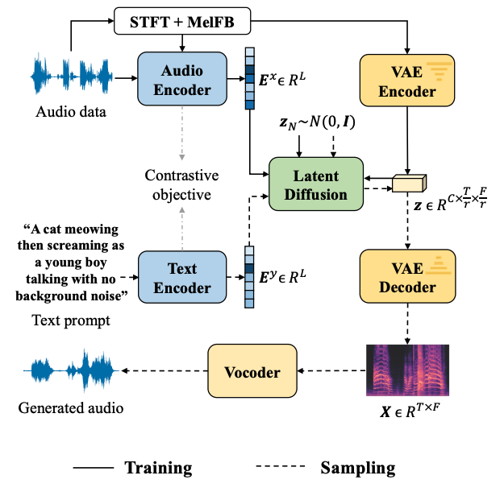
AudioLDM
Self-supervised training
Contrastive Language-Audio Learning (CLAP) Encoders
  Align audio and text in one space.
Latent Diffusion Models
  Learn to generate VAE latent conditioned on CLAP embedding
Mel-spectrogram Autoencoder
  Learn latent representations.
Mel-to-Waveform Vocoder
  Reverse Mel back to waveform
H. Liu, Z. Chen, Y. Yuan, X. Mei, X. Liu, D. Mandic, W. Wang, M. D. Plumbley, "AudioLDM: text-to-audio generation with latent diffusion models," in Proc. IEEE International Conference on Machine Learning (ICML 2023), Hawaii, USA, 23-29 July, 2023.

Slide 30
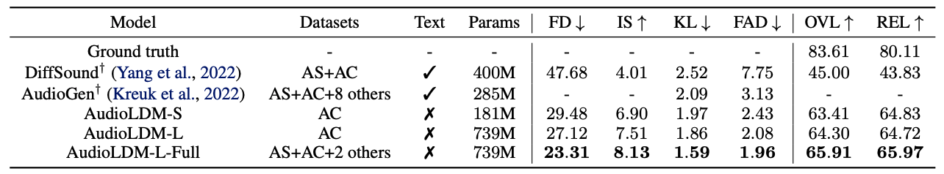
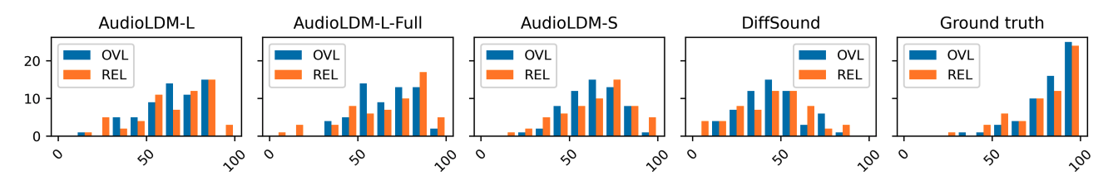
AudioLDM – Experimental Results
Trained on a single 3090 or A100 GPU!

Slide 31
AudioLDM 2 – LLM+LDM
Waveform
Waveform Generation
Auto-regressive modeling:
  ✅ Explicit modeling of temporal dependencies.
  ✅ Enjoy the advance of recent LLM development.
  ✅ Good in-context learning performance.
  ❌ Long generation sequence/ lack of parallelism
  ❌ Long range dependencies
  ❌ Error propagation
Diffusion-based approach:
  ✅ Stable
  ✅ State-of-the-art generation quality
  ✅ Flexible formulation for manipulation, interpolation, etc.
  ❌ Do not explicitly model temporal dependencies
  ❌ Less flexible on duration
Can we utilize both advantages from LLM and Diffusion?
“Audio Translator”
Diffusion Model
Language of Audio
AR modeling
LLM
e.g., 16 vectors for 10 seconds
Training
Conditions (e.g., text)
Inference
Waveform Generation
Diffusion Model
Language of Audio
LLM
Conditions (e.g., text)
Code:
https://github.com/haoheliu/audioldm2

Slide 32
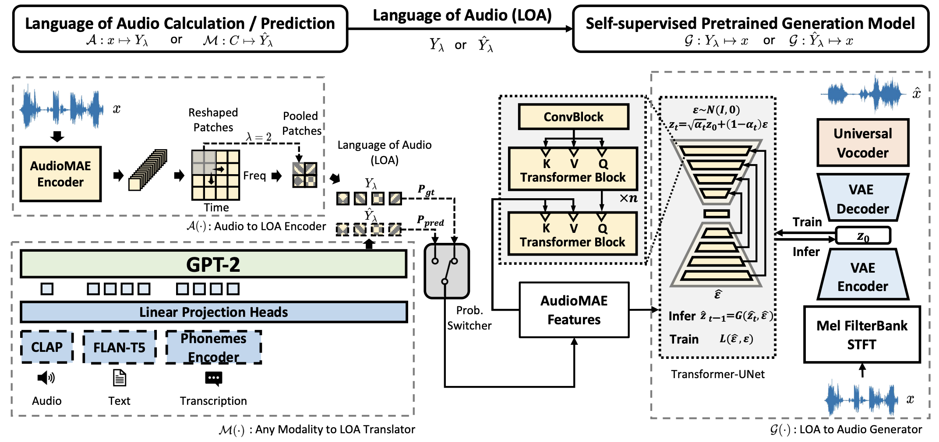
AudioLDM 2 - Architecture
H. Liu , Y. Yuan , X. Liu , X. Mei , Q. Kong , Q. Tian , Y. Wang , W. Wang, Y. Wang , M. D. Plumbley, "AudioLDM 2: Learning holistic audio generation with self-supervised pretraining," IEEE/ACM Transactions on Audio Speech and Language Processing, vol. 32, pp. 2871-2883, 2024. [PDF] [code]

Slide 33
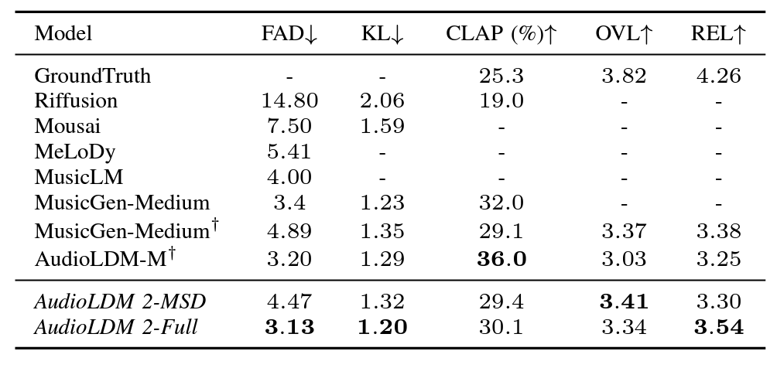
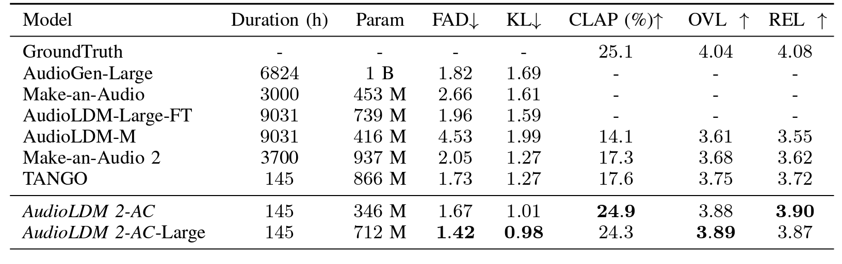
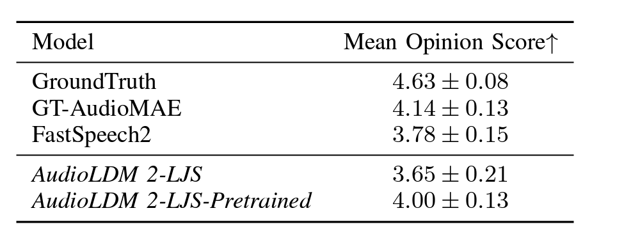
AudioLDM 2 - Performance
Text-to-Music Generation on MusicCaps
SoTA performance on Text-to-Audio/Music/Speech Generation Tasks
Text-to-Audio Generation on AudioCaps
Text-to-Speech Generation on LJSpeech

Slide 34
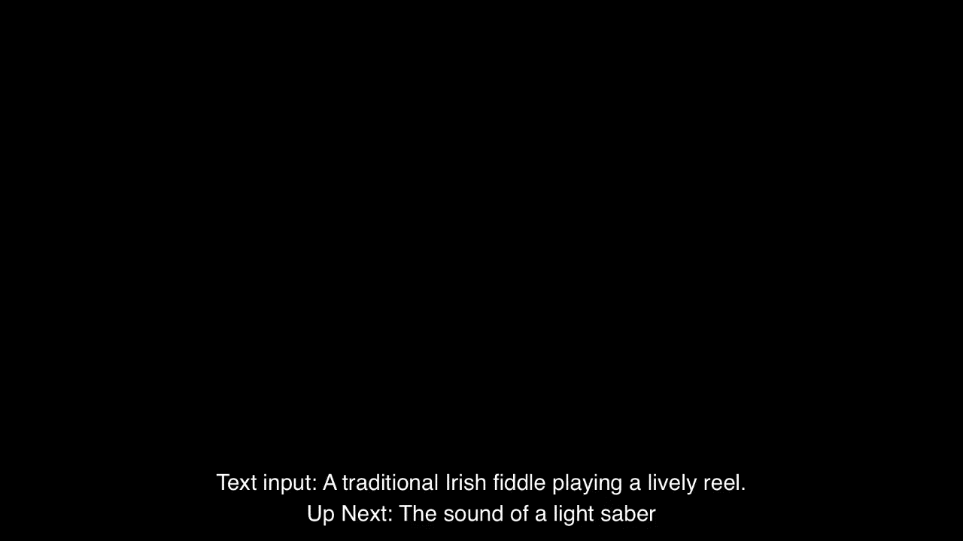
AudioLDM 2 - Demo
We generated a total of 350 audio files with prompts (generated by ChatGPT) without cherry-picking.
Codes and more demos: https://audioldm.github.io/audioldm2/

Slide 35
Audio Storytelling - WavJourney
WavJourney - Compositional Audio Creation with LLMs
Open Challenges:
Advantages offered by WavJourney:
Create audio storytelling with:
  Personalized speakers
  Lifelike speech
  Immersive music
  Impactful sound effects
  All simply from texts!
Contextual comprehension and design
  Understand text instructions
  Design storytelling with speech/music/SFX
Audio production and composition
  Dynamic spatial-temporal relationship
Interpretable and interactive creation
Paper:
https://arxiv.org/abs/2307.14335
Code:
https://github.com/Audio-AGI/WavJourney
Demo:
https://huggingface.co/spaces/Audio-AGI/WavJourney

Slide 36
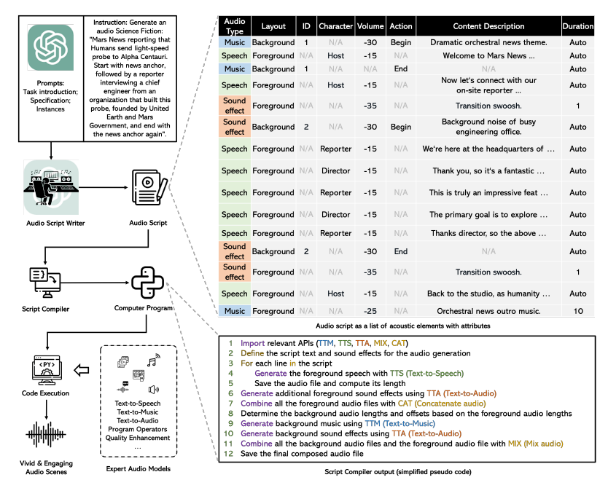
WavJourney – Overall Architecture

Slide 37
WavJourney – Sound Demo for Science Fiction Storytelling
Paper:
https://arxiv.org/abs/2307.14335
Code:
https://github.com/Audio-AGI/WavJourney
Demo:
https://huggingface.co/spaces/Audio-AGI/WavJourney

Slide 38

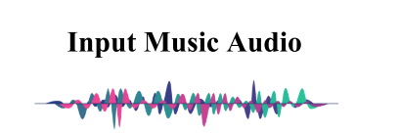
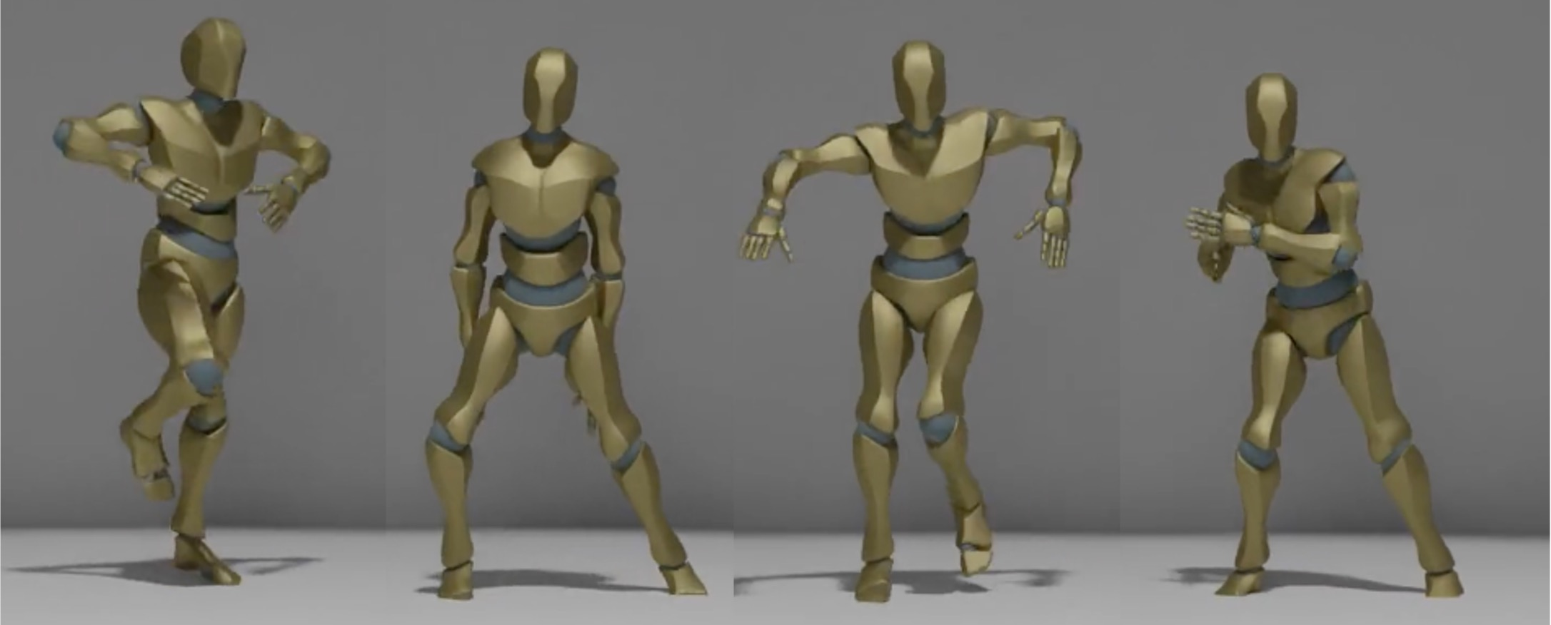
Dance Generation
Focus only on
hand-crafted musical features.
No genre information.
Based on 24-Joint dataset.
Lack of hand motion.
Generative
Model
MFCC
Chroma
Beat
Envelop
Music Condition
Generated Dance Segment
X. Liu, Z. Feng, D. Kanojia, W. Wang, “DGFM: Full Body Dance Generation Driven by Music Foundation Models”, NeurIPS 2024 Workshop on Audio Imagination, 2024.

Slide 39
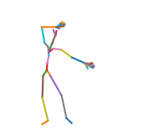
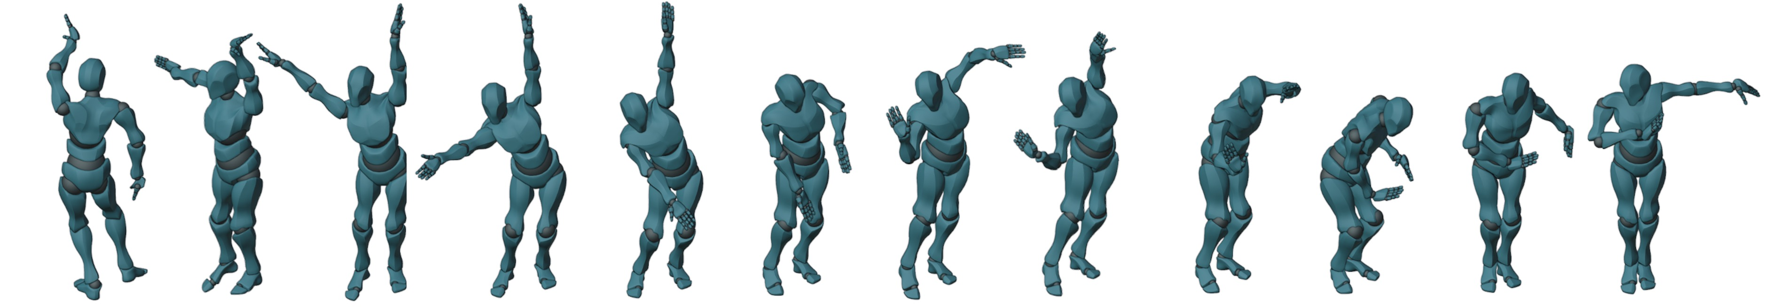



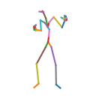
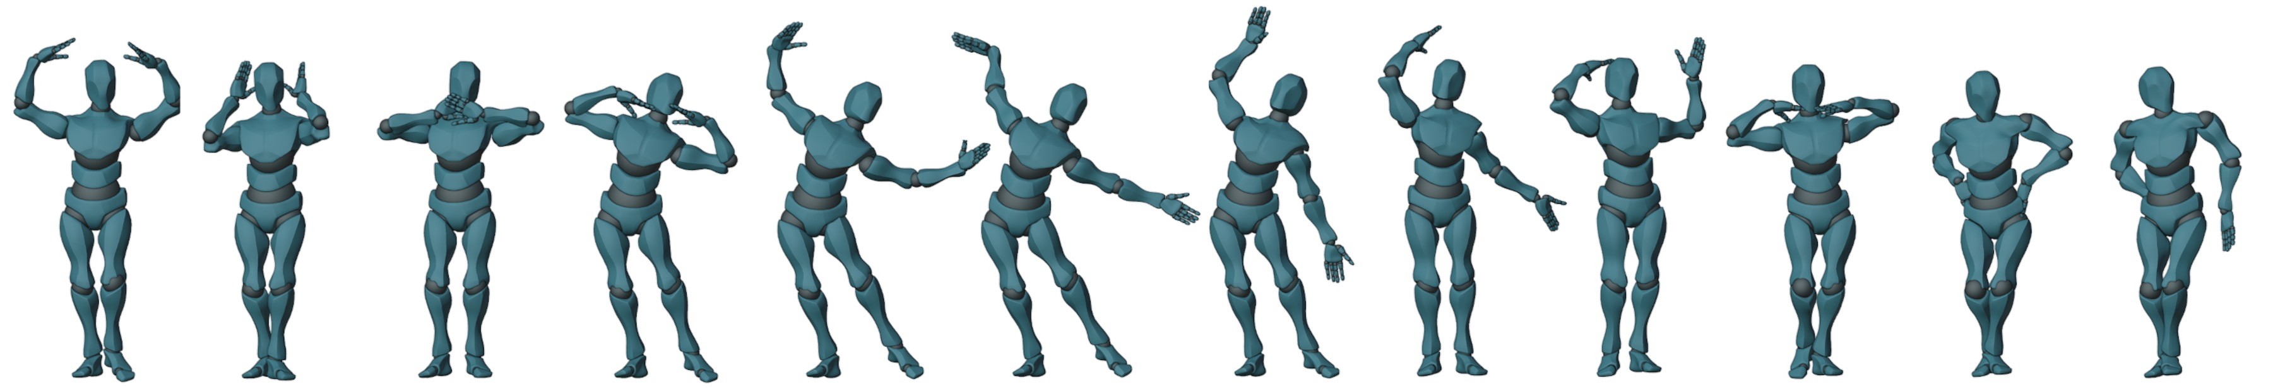
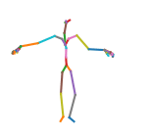
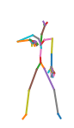
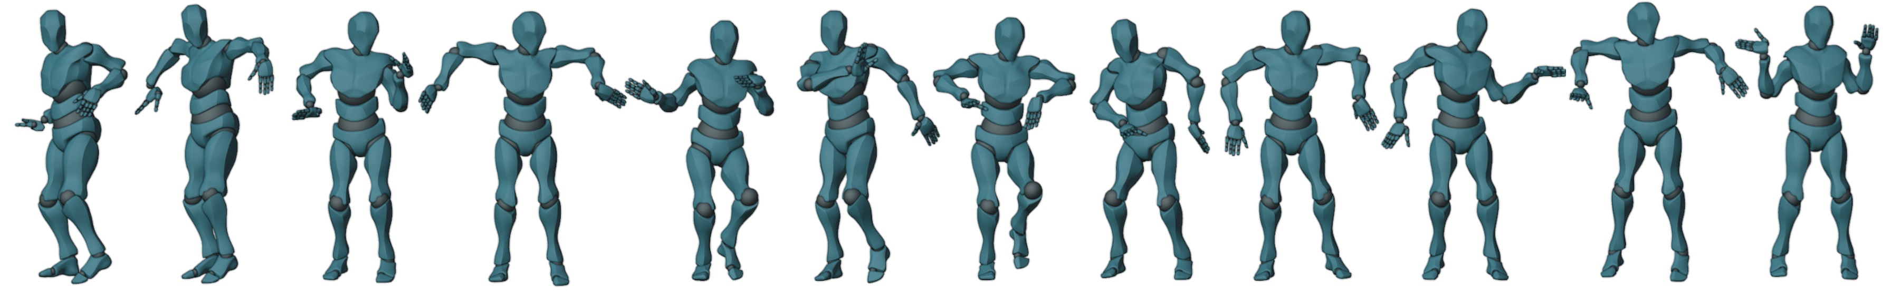
Demo
This is a “HanTang” type of music.
This is a “Dai” type of music.
This is a “Hiphop” type of music.
X. Liu, X. Dong, S. Qian, D. Kanojia, W. Wang, and Z. Feng, "GCDance: Genre-Controlled Music-Driven 3D Full Body Dance Generation," IEEE Transactions on Multimedia, 2026. [arXiv] [PDF] [code, data, & demo]

Slide 40
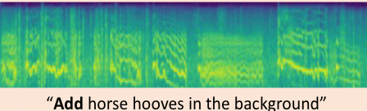
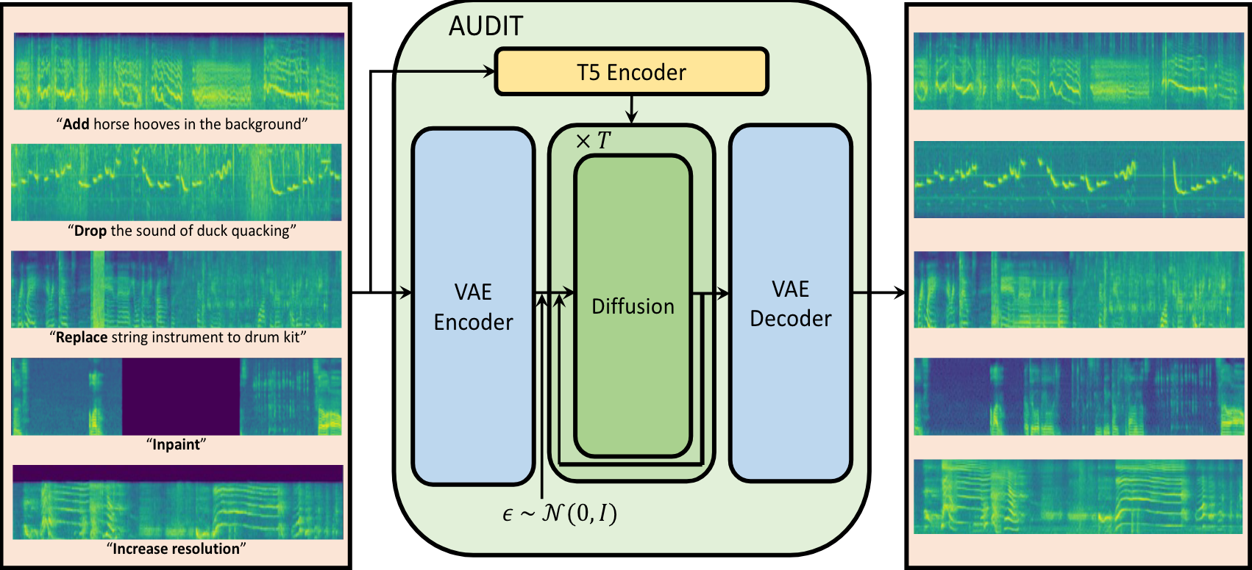
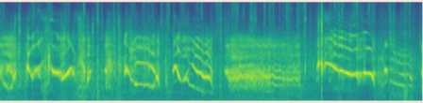
Task 4: LLMs for Controllable Audio Editing
Audio editing is to change the content of audio by following the instruction precisely.
This work introduces an audio agent that understands the user instruction, decomposes the instruction into several tasks, and allocates different tasks to the proper models.
Instruction interpreter
Expert models
An example of end-to-end audio editing system: AUDIT
J. Liang, H. Zhang, H. Liu, Y. Cao, Q. Kong, X. Liu, W. Wang, M. Plumbley, and E. Benetos, “WavCraft: Audio Editing and Generation with Large Language Models”, in ICLR 2024 Workshop on Large Language Model (LLM) Agents, 2024.

Slide 41
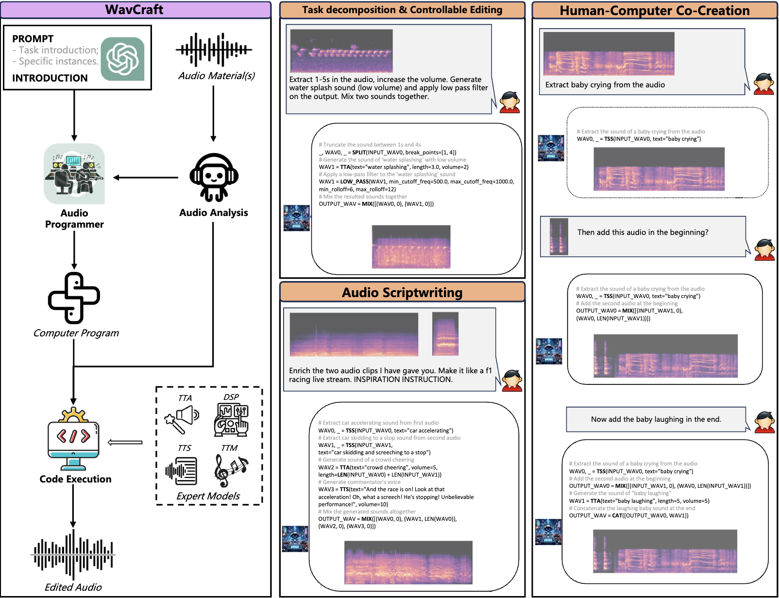
WavCraft – Overall Architecture

Slide 42
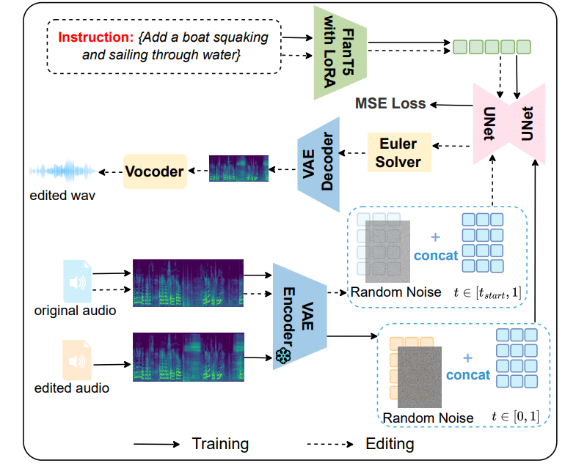
RFM-EDITING
Demos here:
https://katelin-glt.github.io/RFM-Editing-Demo/
Remove continuous frying noises:
Original:
Edited:
Replace someone suddenly sneezes out loud with several pigeons cooing:
Original:
Edited:
L. Gao, Y. Yuan, Y. Chen, Y. Cheng, Z. Li, J. Wen, S. Zhang, and W. Wang, "RFM-EDITING: Rectified Flow Matching for Text-Guided Audio Editing," in Proc. IEEE International Conference on Acoustics, Speech and Signal Processing (ICASSP 2026), Barcelona, Spain, May 4-8, 2026. [PDF]

Slide 43
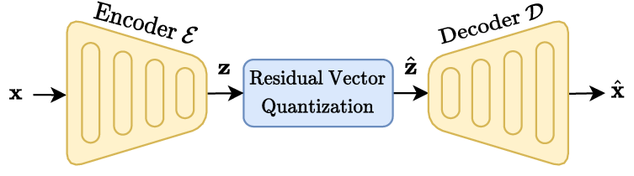
Task 5: Neural Audio Codec
Audio Codec:
Neural Audio Codec:
A device or software that encodes or decodes digital audio data for transmission, storage, or playback.
Compressor-decompressor → “Codec”
MP3, FLAC, AAC, Vorbis, etc.
SoundStream (Zeghidour et al. 2021)
Encodec (Défossez et al. 2021)
Descript (Kumar et al. 2023)
HiFi-Codec (Yang et al. 2023)
SpeechTokenizer (Zhang et al, 2023)
Codec Superb Benchmark (Wu et al. 2024)
  https://github.com/voidful/Codec-SUPERB

Slide 44
Task 5: Limitations & Motivations
Limitations of current neural codecs:
Motivations of our work:
High token rate (long token sequence)
  e.g., 6kbps Descript audio codec has 600 tokens per second
  Make auto-regressive modeling challenging and computational expensive
Poor reconstruction quality at low bit rate (e.g., 0.6 kbps).
  Most previous studies work on bit rate > 2kbps
  Can we go further under 1.0 kbps?
Falling short in capturing semantic information
  For example, latent encodings given by 6kbps achieved an average accuracy of only 33% on the HEAR benchmark, while AudioMAE latent encodings achieved an accuracy of 61% (without finetuning).
  Shorter sequence: Lower token rates at 25, 50, or 100 tokens per second.
  Better reconstruction at lower bit rate: 0.3~1.4 kbps
  Improved semantic in the codec tokens (which potentially can lead to better language modelling)

Slide 45
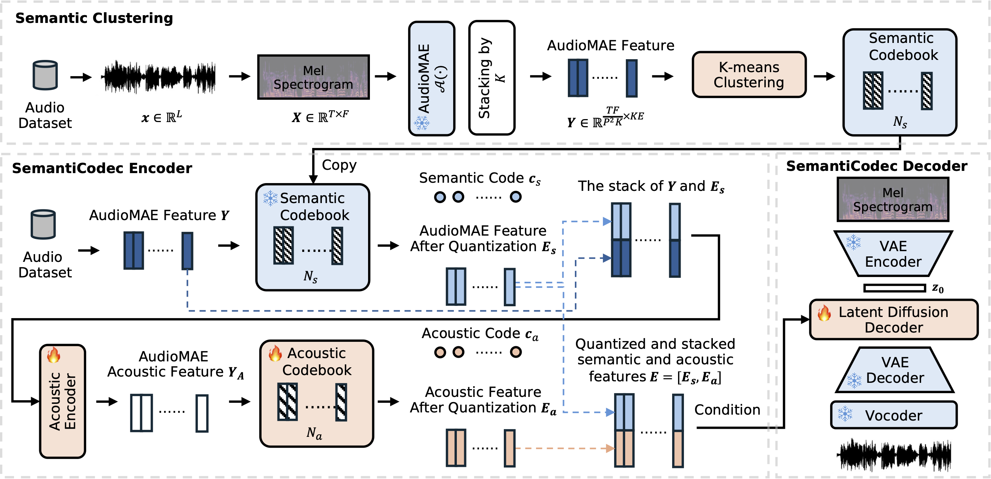
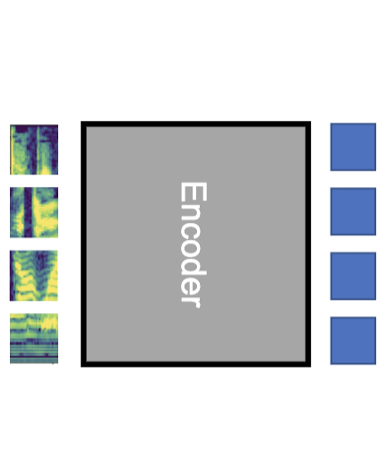
Large scale k-means is challenging
AudioSet + Million Song Dataset + GigaSpeech
https://github.com/haoheliu/kmeans_pytorch
Task 5: SemantiCodec
Ultra-low bit rate (0.31 kbps ~1.40 kbps, token rate 25, 50, or 100 per second) & Strong semantics in the token & Variable vocabulary sizes
AudioMAE
Encoder
https://haoheliu.github.io/SemantiCodec/
CrossAtten

Slide 46
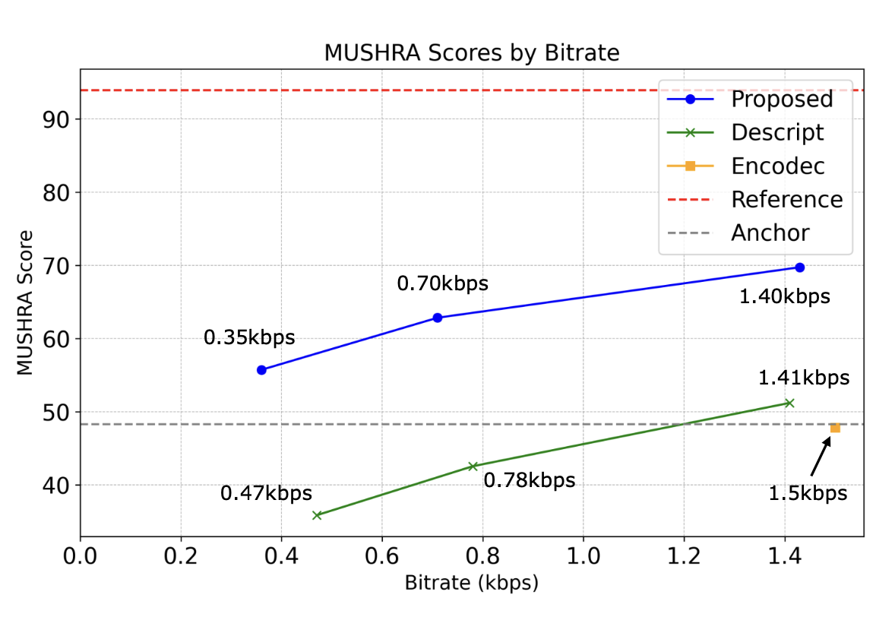

Task 5: Visual Comparison
Better reconstruction with a lower bit rate
Better semantic in the audio token (potentially better Audio LLM?)
H. Liu, X. Xu, Y. Yuan, M. Wu, W. Wang, M.D. Plumbley, "SemantiCodec: An Ultra Low Bitrate Semantic Audio Codec for General Sound," IEEE Journal on Selected Topics in Signal Processing, vol. 18, no. 8, pp. 1448 - 1461, 2024.

Slide 47
Task 5: Sound Demos
Original
HiFi-Codec
(2.0 kbps)
Encodec
(1.5 kbps)
DAC
(1.41 kbps)
SemantiCodec
(1.43 kbps)
DAC
(0.47 kbps)
SemantiCodec
(0.35 kbps)
Music
(MUSDB18)
General Audio
(AudioSet)
Speech
(Libri)
More sound demos:
https://haoheliu.github.io/SemantiCodec/

Slide 48

Dataset: WavCaps
X. Mei, C. Meng, H. Liu, Q. Kong, T. Ko, C. Zhao, M. D. Plumbley, Y. Zou, and W. Wang, "WavCaps: A ChatGPT-Assisted Weakly-Labelled Audio Captioning Dataset for Audio-Language Multimodal Research," IEEE/ACM Transactions on Audio Speech and Language Processing, vol. 32, pp. 3339-- 3354, 2024. [PDF] [arXiv] [code] (https://github.com/XinhaoMei/WavCaps)

Slide 49


WavCaps – Statistics

Slide 50

Sound-VECaps
Challenge
  Existing audio generation models struggle with complex and detailed prompts, leading to potential performance degradation.
  Captions of current audio datasets are too simple to provide detail information.
Sound-VECaps
  1.66M high-quality audio-caption pairs with enriched details including audio event orders, occurred places and environment information.
The analysis of audio-caption datasets, Loc and Env are the number of captions that include the location and environment information.

Slide 51

Sound-VECaps – Processing Pipeline
Y. Yuan, D. Jia, X. Zhuang, Y. Chen, Z. Chen, Y. Wang, Y. Wang, X. Liu, X. Kang, M.D. Plumbley, and W. Wang, "Sound-VECaps: Improving Audio Generation With Visual Enhanced Captions," in Proc. IEEE International Conference on Acoustics, Speech and Signal Processing (ICASSP 2025), Hyderabad, India, April 6-11, 2025. [PDF]
Paper, data & code: https://yyua8222.github.io/Sound-VECaps-demo

Slide 52



Dataset: AudioSetCaps
J. Bai, H. Liu, M. Wang, D. Shi, W. Wang, M. D. Plumbley, W.-S. Gan, and J. Chen, "AudioSetCaps: An Enriched Audio-Caption Dataset using Automated Generation Pipeline with Large Audio and Language Models," IEEE Transactions on Audio Speech and Language Processing, vol. 33, pp. 2817 - 2829, June 2025. [arXiv][code]

Slide 53


AudioSetCaps – Statistics
Table 1: The statistics comparison with popular audio-language datasets. Caption source: H (human), A (audio models), V (visual models), L (language models).
Dataset | Quantity | Ave-Length | Vocabulary | Caption Source
Clotho | 30K | 11 | 4K | H
AutoCaps | 57K | 9 | 5K | H
LAION-Audio-630K | 630K | 7 | 311K | L
WavCaps | 400K | 8 | 24K | L
Auto-ACD | 1.5M | 18 | 20K | L+A+V
Sound-VECaps | 1.6M | 40 | 50K | L+A+V
AudioSetCaps | 1.9M | 28 | 21K | L+A
Figure 2: Distribution of caption lengths across several popular audio caption datasets. (Left) Caption length distributions of human-labeled datasets. (Right) Caption length distributions of LLMs-assisted datasets.

Slide 54

AudioSetCaps – An Example
Mean
Subjective
Score
Dataset-Caption
Label
Female speech, Woman speaking, Background noise, Generic impact sounds, Surface contact, Babbling, Tick, Human voice, Breathing, Baby laughter
4
AudioCaps
A human baby laughs and gurgles as a female sings gently
4
WavCaps
People are talking and babbling with a baby laughing and surface contact.
4.2
Auto-ACD
The sound of a laughing baby and women chatting and giggling can be heard at a busy spa.
4
AudioSetCaps
A joyful interaction between a woman and a baby, as the infant giggles and the woman responds with a happy and upbeat tone.
ID: Y0qH8FmqGI2U
4.4

Slide 55
Conclusion & Future Works
Summary
  Large language-audio models are promising - offering new opportunities to solve problems in conventional audio tasks and newly emerging audio tasks
  These models often provide SOTA performance in many downstream tasks and may offer new capabilities that were not available in previous audio models.
Future Works
  Developing unified models for multi-tasks (e.g. understanding and generation) and multi-modal data (audio, visual, language)
  Improving controllability/personalization/customisation of LALMs in various downstream tasks (e.g. generation and captioning)
  Developing LALMs for long form audio activity understanding, reasoning
  Developing LALMs for spatial audio generation and reasoning
  Leveraging physics-based model + data driven models

Slide 56
Paper, Codes, Demos, and More, …
AudioLDM2:
Project Page: https://audioldm.github.io/audioldm2/
AudioLDM:
Paper: https://arxiv.org/abs/2301.12503
Project Page: https://audioldm.github.io/
Github:
  Pretrained model: https://github.com/haoheliu/AudioLDM
  Evaluation tools: https://github.com/haoheliu/audioldm_eval
YouTube: https://www.youtube.com/watch?v=_0VTltNYhao
APT:
Code: https://github.com/JinhuaLiang/APT
WavCraft:
Code: https://github.com/JinhuaLiang/WavCraft
SemantiCodec:
WavJourney:
Paper: https://arxiv.org/abs/2307.14335
Code: https://github.com/Audio-AGI/WavJourney
Demo: https://huggingface.co/spaces/Audio-AGI/WavJourney
Paper/code/demos at project page:
https://haoheliu.github.io/SemantiCodec/
AudioSep:
Code: https://github.com/Audio-AGI/AudioSep
RFM-EDITING:
https://katelin-glt.github.io/RFM-Editing-Demo/
AudioSetCaps:
Data and code: https://github.com/JishengBai/AudioSetCaps
https://huggingface.co/datasets/baijs/AudioSetCaps
WavCaps:
Paper: https://arxiv.org/abs/2303.17395
Code: https://github.com/xinhaomei/wavcaps
Sound-VECaps: paper, data & code:
https://yyua8222.github.io/Sound-VECaps-demo
More code about other works avaliable at:
https://github.com/XinhaoMei/DCASE2021_task6_v2
https://github.com/XinhaoMei/ACT
https://github.com/liuxubo717/cl4ac
GCDance: paper, data & code:
https://xinranliu7715.github.io/gcdance/

Slide 57

Thank you for listening!
This work was sponsored by a Newton Institutional Links Award from the British Council, titled “Automated Captioning of Image and Audio for Visually and Hearing Impaired” & EPSRC projects titled “Making Sense of Sounds” and “AI for Sounds”.

