Slide 1


Large Audio-Language Models and Applications
Wenwu Wang
Centre for Vision, Speech and Signal Processing (CVSSP) &
Surrey Institute for People Centred Artificial Intelligence
University of Surrey
Email: w.wang@surrey.ac.uk
Web: https://personalpages.surrey.ac.uk/w.wang/
Invited Talk on the CCF Speech and Audio Workshop @ Suzhou
29/07/2026

Slide 2



Many thanks to…
Xinhao Mei
Haohe Liu
Xubo Liu
Jinhua Liang
Yi Yuan
Yun Chen
Xinran Liu
Yiming Zhang
Liting Gao
Qiuqiang Kong
Jisheng Bai
Zehua Chen
Yuanbo Hou
Yuelan Cheng
Junqi Zhao
Mark Plumbley
Turab Iqbal
Jianyuan Sun
Jian Guan
Feiyang Xiao
Yong Xu
Yin Cao
Jinzheng Zhao
Yuxuan Wang
Qiaoxi Zhu
Volkan Kilic
Zhanyu Ma
Danilo Mandic
Philip Jackson
Qiang Huang
David Frohlich
Emily Corrigan-Kavanagh
Marc Green
Andres Fernandes
Christian Kroos
Trevor Cox
Arshdeep Singh
…
Funding from:
UK Engineering and Physical Sciences Research Council (EPSRC) & British Council Newton Institutional Links Award

Slide 3
Outline
Introduction
Large audio models & large language models
Large audio-language models
  Motivation
  Example models & datasets
  Open challenges
  Integration of audio and language models
Applications of LALMs to various cross-modal generation tasks
  Audio captioning (e.g. audio to text generation)
  Audio question answering and reasoning
  Text to audio generation & composition & storytelling
  Language guided audio source separation
  LLMs for controllable audio and speech editing
  Neural audio coding
Conclusions and future works

Slide 4
(Large) Audio Models
Learning general/universal audio representations from large scale audio data shows promising performance in downstream tasks (classification, separation, retrieval, etc):
PANNs (Kong, et al, 2020): large scale CNN-based audio model
Audio2Vec (Tagliasacchi et al, 2020): sequence to sequence unsupervised model
CLAR (Al-Tahan and Mohsenzadeh, 2021): self-supervised model
COLA (Saeed et al, 2021): self supervised model
BOYL-A (Niizumi et al, 2021): self supervised model
AST (Gong et al, 2021): large scale transformer-based audio model
ATST (Li and Li, 2022): transformer-based model
MAE-AST (Baade et al, 2022): self-supervised model
SSAST (Gong et al, 2022): self-supervised AST model
Audio-MAE (Huang et al, 2022): self-supervised model
BEATs (Chen et al, 2023): audio pre-training with acoustic tokenizers
ASiT (Atito et al, 2024): self-supervised models for general audio representation
SSLAM (Alex et al, 2025): self-supervised learning from audio mixtures
mean Average Precision (mAP) on AudioSet: 31.4 (2017) -> 55.8 (2025)

Slide 5
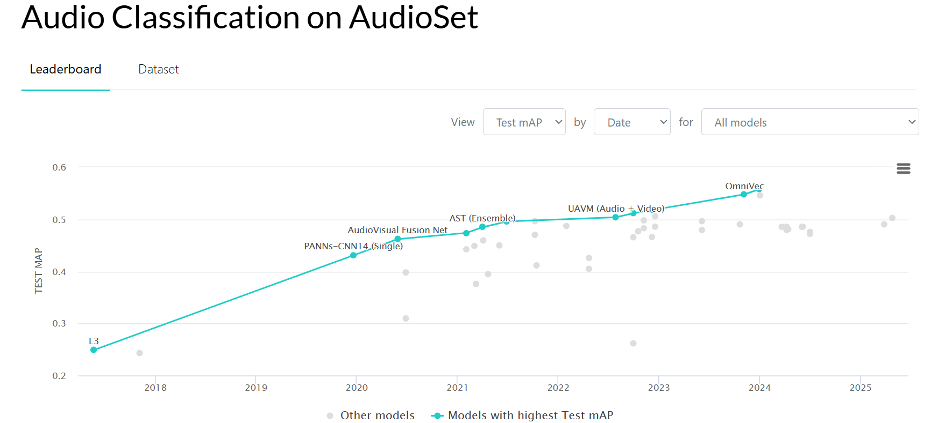
(Large) Audio Models
Leaderboard:
https://paperswithcode.com/sota/audio-classification-on-audioset
https://www.codesota.com/audio/classification

Slide 6
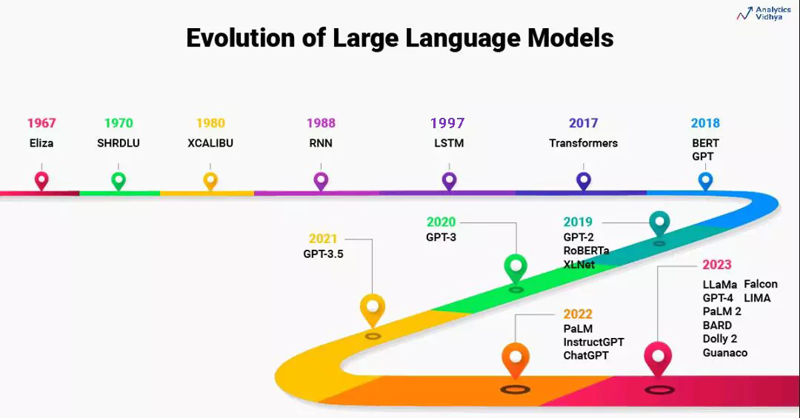
Large Language Models (LLMs)
Courtesy to Aravind Pai: https://www.analyticsvidhya.com/blog/2023/07/beginners-guide-to-build-large-language-models-from-scratch/

Slide 7
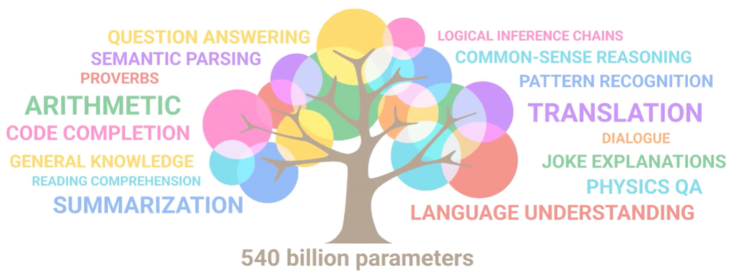
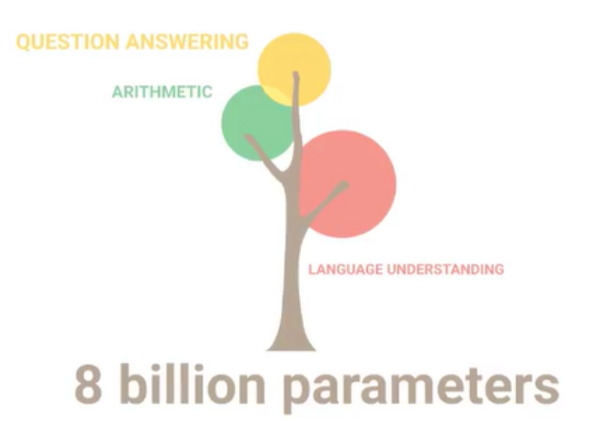
Large Language Models (LLMs)
Figures from Ryan O'Connor: https://www.assemblyai.com/blog/emergent-abilities-of-large-language-models/
Wei et al, “Emergent abilities of large language models,” Transactions on Machine Learning Research, 2022.

Slide 8
Large Audio-Language Models: Why?
Leverage knowledge within LLMs to address the limitations of audio models
  Zero-shot or few-shot classification
Explore homogeneity across tasks with LLMs
  Use LLMs as an agent to solve multi-task problems
Extend the capabilities of audio models for new tasks
  Extending from audio classification to audio captioning/question answering & reasoning
  Extending from audio generation to storytelling & controllable editing
  Extending from audio source separation to language queried audio source separation

Slide 9
Large Audio Language Models - Examples
Wav2CLIP: audio and language mapping
AudioCLIP: audio-text-image alignment
CLAP: audio-text alignment
CLAP-LAION: audio-text alignment
Pengi: audio classification & AQA
Qwen-Audio: speech, music, general audio
AudioLM: Speech/music generation
LTU: audio QA and reasoning
SALMONN: speech-audio-music LLMs
ImageBind: image, text, audio, depth
ONE-PEACE: audio-text-image
AudioGPT: Speech, Music, Talking Head
UniAudio: speech/sound/music/singing
AudioLDM/AudioLDM2/Re-AudioLDM/WavJourney: TTA generation
AudioSep/FlowSep/FlowSep2: language guided audio source separation
WavCraft/RFM-Editing/SFM-Adapter: text prompted audio/speech editing
APT-LLM: LLM based AQA and reasoning
DreamAudio: Customised text to audio generation
GCDance/TeMuDance: Language guided music to dance generation
Whisper: automatic speech recognition (ASR)
Wav2Vec 2.0: speech to text (STT)
DeepSpeech: open-source ASR
Coqui AI: speech synthesis and TTS
Jasper and QuartzNet: ASR
GPT-3 with Whisper: ASR + LLMs
Sonix.ai: speech transcription and analysis
SpeechBrain: platform for speech models
OpenSTT: ASR
Gemini: text/image/speech
WavLLM: speech LLMs
MuseNet: music instrumental composition & style transfer
MusicVAE: melody generation, remixing, and style interpolation
JukeBox: raw music with vocals and lyrics
Riffusion: text to music generation
MusicLM: text to music generation
REMI: symbolic music generation (e.g. MIDI)
DeepBach: classic music composition
AIVA: music generation assistant

Slide 10
(Large) Audio-Language Datasets
AudioCaps (Kim et al, 2019)
Clotho (Drossos et al, 2020)
SoundDescs (Koepke et al, 2021)
LAION-Audio-630K (Wu et al, 2023)
Auto-ACD (Xu et al, 2024)
Audio-FLAN (Xue et al, 2025)
SeaBench-Audio (Liu et al, 2025)
MusicSem (Salganik et al, 2026)
WavCaps (Mei et al, 2023)
Sound-VECaps (Yuan et al, 2024)
AudioSetCaps (Bai et al, 2025)
CLEAR (Abdelnour et al, 2018)
DAQA (Fayek and Johnson, 2019)
Clotho-AQA (Lipping et al, 2022)
MUSIC-AVQA (Li et al, 2022)
mClothoAQA (Behera et al, 2023)
OpenAQA-5M (Gong et al, 2023)
AudioMCQ (He et al, 2025)
Audio Flamingo 3 (Goel et al, 2025)
Jamendo-MT-QA (Koh et al, 2026)

Slide 11
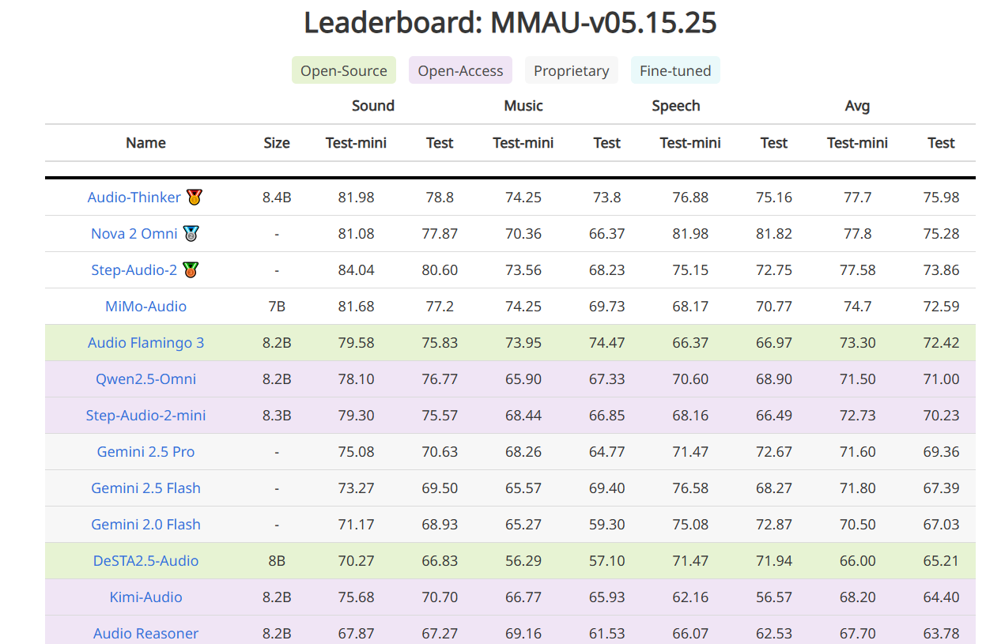
Large Audio-Language Models- Recent Progress
https://sakshi113.github.io/mmau_homepage/#leaderboard-v15-parsed

Slide 12
Trends and Open Questions in LLAMs
Open challenges:
Fusion of audio and language models: aligning/fusing audio-text data
Applications to audio tasks: addressing existing challenges in audio tasks
Extending to multi-modality: text, audio, visual, or more modalities
Data scarcity: audio-language dataset shortage for building audio-language models
Extending to multi-tasks: exploring in new tasks & solving multi-task problems
Multi-lingual models and datasets: lacking multi-lingual models and datasets
Real-time streaming: demands for real-time processing for applications in live captioning, gaming, and customer service
Low-resource language support: growing interest in training models for underrepresented languages for inclusiveness
Safety issues: growing concerns about toxicity and privacy issues
Explaining models: explaining and interpreting different choices and decisions made by the model
Object hallucination: struggling in answering discriminative questions related to the identification of specific object sounds within an audio clip
Performance evaluations: lack of common evaluation protocols, tools and benchmarks
Applications:
Accessibility, voice assistants, content creation, and human-computer interaction

Slide 13
Typical Methods for Fusing Audio and Language
Aligning audio-texts with contrastive pretraining
  Examples: CLAP, CLAP-LAION, AudioCLIP, Wav2CLIP, T-CLAP, etc.
Tokenizing audio and texts, then followed by LLMs
  Examples: Moshi, VITA, LSLM, Voicebox, FunAudioLLM, LauraGPT, etc.
Fusing embeddings with cross-attention
  Examples: Q-former
Cascading acoustic models with LLMs
  Examples: naive ASR+LLM+TTS
Combination of the above schemes
  Examples: SPIRIT-LM, Spectron, etc.

Slide 14

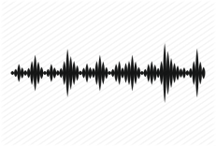
Task 1: Audio to Text Generation
Automated audio captioning (AAC) is a cross-modal translation task which aims at generating a natural language description given an audio clip.
This task requires detecting the audio events and their spatial-temporal relationships and describing these information using natural language.
Applications
  Audio retrieval
  Assist hearing-impared to understand environmental sounds
  Subtitle for sounds in TV programs
AAC started in 2017, and has received increasing attention in recent three years with freely available datasets released and being held as a task in DCASE Challenges 2020-2022.
AAC system
“a woman talks nearby as water pours”

Slide 15
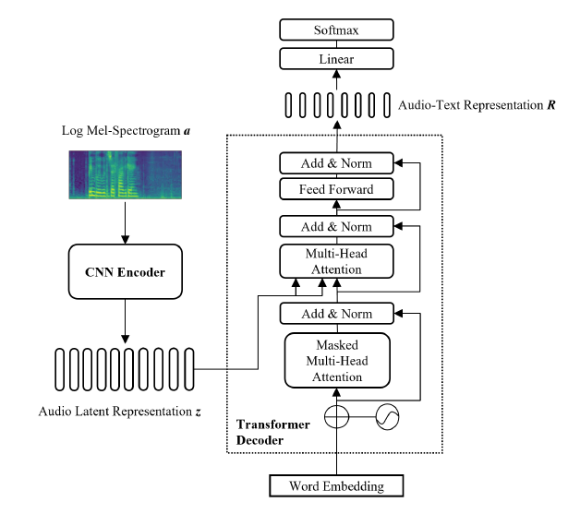
An Example: CNN-Transformer Encoder-Decoder
Common challenges in automated audio captioning:
Data scarcity
Representations of audio, text and audio-text
Diversity of captions
Multi-lingual captioning
Interactions with other modalities (e.g. vision)
….
Y. Hou, Q. Ren, A. Mitchell, W. Wang, J. Kang, T. Belpaeme, and D. Botteldooren, "Soundscape Captioning using Sound Affective Quality Network and Large Language Model," IEEE Transactions on Multimedia, 2026.
Y. Zhu, Y. Zhang, L. Xiao, W. Wang, and A. Men, "Zero-shot Diverse Audio Captioning with Diffusion Models", Knowledge Based Systems, 2026.
Y. Zhang, X. Xu, R. Du, H. Liu, Y. Dong, Z.-H. Tan, W. Wang, and Z. Ma, "Zero-Shot Audio Captioning Using Soft and Hard Prompts," IEEE Transactions on Audio Speech and Language Processing, vol. 33, pp. 2045 - 2058, May 2025.
Y. Zhang, H. Yu, R. Du, Z.-H. Tan, W. Wang, Z. Ma, Y. Dong, "ACTUAL: audio captioning with caption feature space regularization," IEEE/ACM Transactions on Audio Speech and Language Processing, vol. 31, pp. 2643 - 2657, 2023.
X. Mei, X. Liu, M. Plumbley, and W. Wang, "Automated audio captioning: an overview of recent progress and new challenges", EURASIP Journal on Audio Speech and Music Processing, 2022.
F. Xiao, J. Guan, H. Lan, Q. Zhu, and W. Wang, "Local information assisted attention-free decoder for audio captioning," IEEE Signal Processing Letters, vol. 29, pp. 1604-1608, 2022.

Slide 16

Audio Captioning Demos

Slide 17
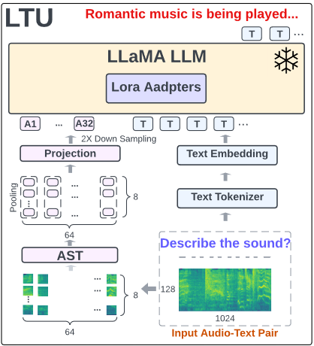
Task 2: Audio Question Answering & Reasoning
Acoustic Prompt Tuning (APT): an adapter extending LLMs/VLMs to the audio domain using an improved soft-prompting approach
Motivation:
Existing works on LALMs used pretrained audio embeddings as soft prompt and adjust the LLM with Parameter-Efficient Fine-Tuning (PEFT).
However, they cannot generalize to multi-modal setting, e.g., audio-visual language models.
Can we extend the off-the-shelf language models to the audio domain rather than training a dedicated LLM (~7B to 70B)?
Fig. An example of an audio LLM structure (LTU (Gong et al, 2023)).
J. Liang, X. Liu, W. Wang, M. D. Plumbley, H. Phan, E. Benetos, “Acoustic Prompt Tuning: Empowering Large Language Models with Audition Capabilities”, IEEE Transactions on Audio Speech and Language Processing, vol. 33, 949 - 961, 2025. arXiv:2312.00249

Slide 18
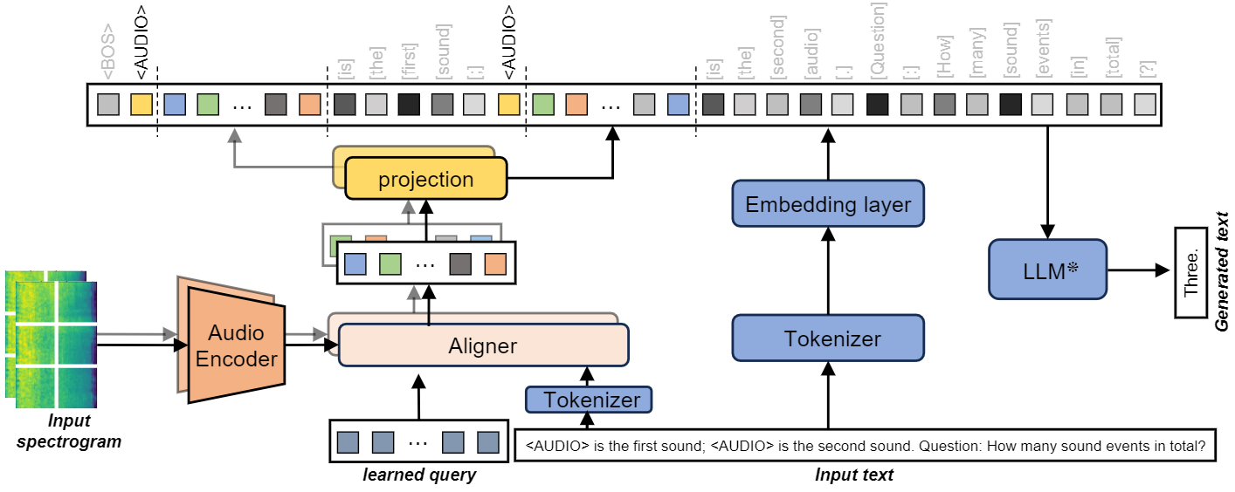
Audio Reasoning – APT
Acoustic Prompt Tuning (APT): an adapter extending LLMs/VLMs to the audio domain using an improved soft-prompting approach
1. Interleaved acoustic and text embeddings
2. Instruction-aware architecture
3. Multi-task training

Slide 19

APT – Demos
"first_recording": "Creaking pier.wav",
"second_recording": "Machetes sliding 2.wav",
"question": "In which recording are the sound events more evenly distributed?",
"answer": "second“
"first_recording": "Rain and Storm.wav",
"second_recording": "Car vs. Freight Train.wav",
"question": "Does the second recording have a calming effect like the first recording?",
"answer": "yes"
"first_recording": "Creaking pier.wav"
"second_recording": "Machetes sliding 2.wav"
"first_recording": "Rain and Storm.wav"
"second_recording": "Car vs. Freight Train.wav"
Code: https://github.com/JinhuaLiang/APT
Paper: https://arxiv.org/abs/2312.00249

Slide 20
Task 3: Text to Audio Generation
Potential Applications:
Related Works:
Computational “foley artist”:
  Game developer: e.g., A ghost is haunting a house.
  Audio producer: e.g., high heels hitting metal ground.
  Movie producer: e.g., the laser sound from a laser gun.
  …
Automatic content creation
  Endless music
  Audiobook with ambient noises
  White noise for meditation
  …
Data Augmentations
Label-to-Audio Generation
  Acoustic Scene (Kong et al., 2019), Sound event (Liu et al., 2019), FootStep (Comunit et al. 2019), …
Text-to-Audio Generation
  DiffSound (Yang et al., 2022), AudioGen (Kreuk et al., 2022), Make-an-Audio (Huang et al., 2023)
Text-to-Music Generation
  MusicLM (Andrea et al., 2023)
  Moûsai (Flavio et al., 2023)
  Noise2Music (Huang et al., 2023)
Others
  JukeBox (Dhariwal et al., 2020), AudioLM (Borsos et al., 2022), SingSong (Donahue et al., 2023),…

Slide 21
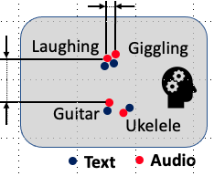
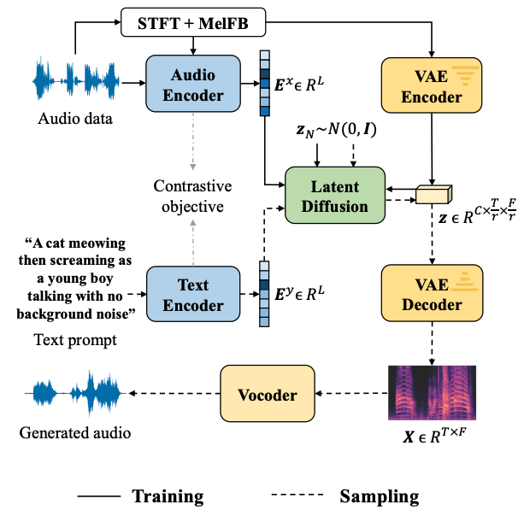
AudioLDM
Self-supervised training
Contrastive Language-Audio Learning (CLAP) Encoders
  Align audio and text in one space.
Latent Diffusion Models
  Learn to generate VAE latent conditioned on CLAP embedding
Mel-spectrogram Autoencoder
  Learn latent representations.
Mel-to-Waveform Vocoder
  Reverse Mel back to waveform
H. Liu, Z. Chen, Y. Yuan, X. Mei, X. Liu, D. Mandic, W. Wang, M. D. Plumbley, "AudioLDM: text-to-audio generation with latent diffusion models," in Proc. IEEE International Conference on Machine Learning (ICML 2023), Hawaii, USA, 23-29 July, 2023.

Slide 22
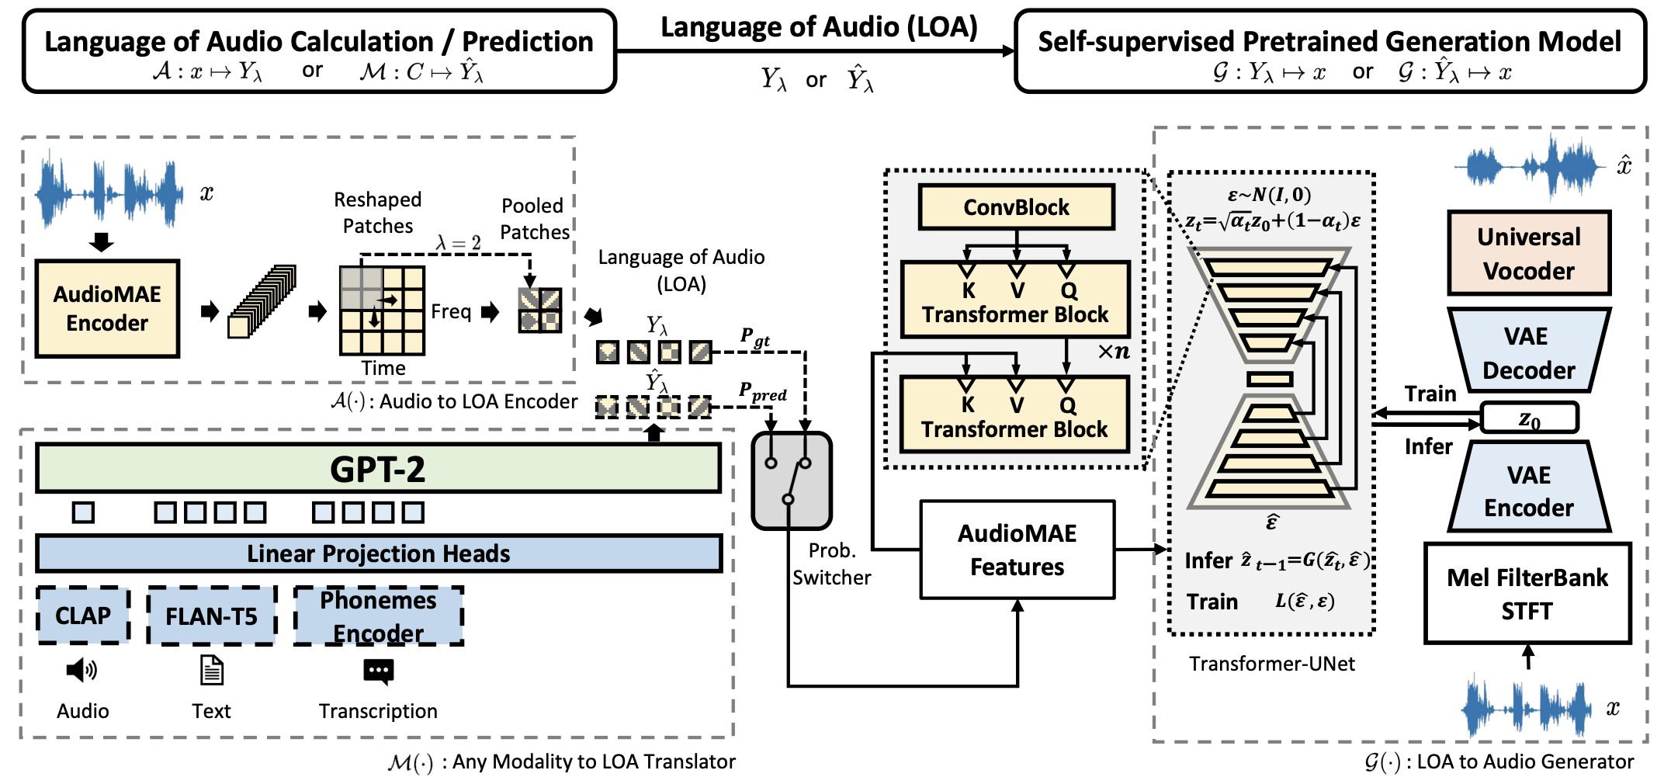
AudioLDM 2 - Architecture
H. Liu , Y. Yuan , X. Liu , X. Mei , Q. Kong , Q. Tian , Y. Wang , W. Wang, Y. Wang , M. D. Plumbley, "AudioLDM 2: Learning holistic audio generation with self-supervised pretraining," IEEE/ACM Transactions on Audio Speech and Language Processing, vol. 32, pp. 2871-2883, 2024. [PDF] [code]

Slide 23
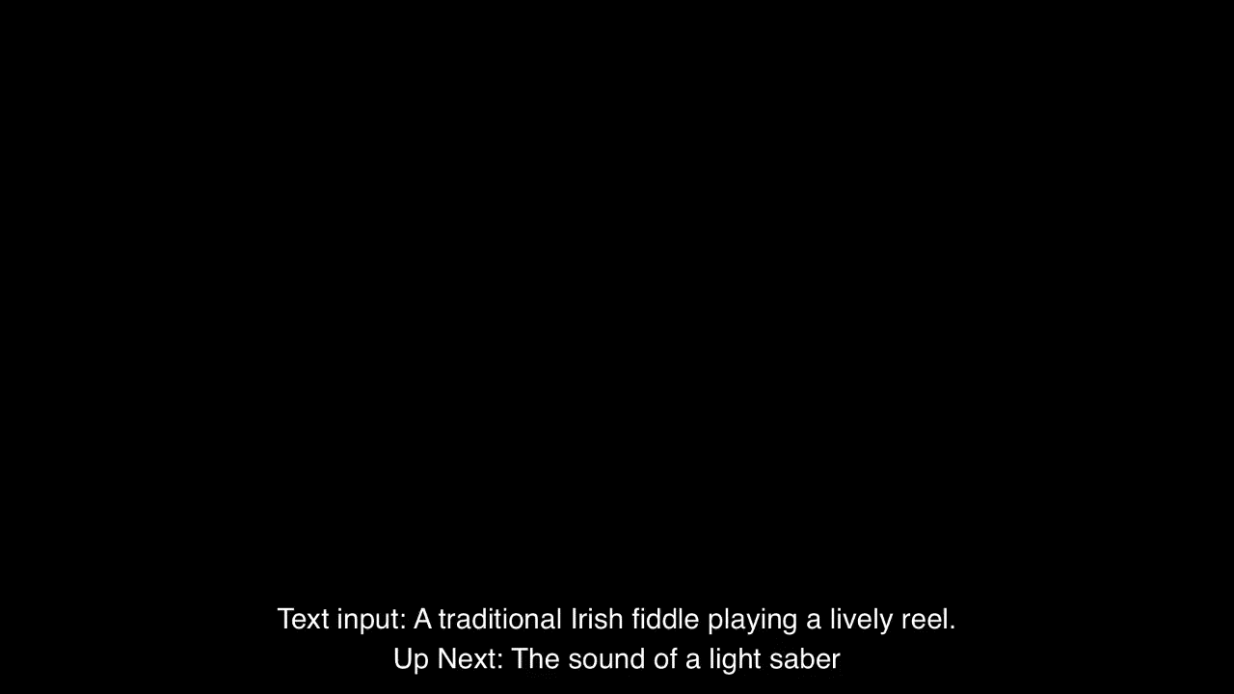
AudioLDM 2 - Demo
We generated a total of 350 audio files with prompts (generated by ChatGPT) without cherry-picking.
Codes and more demos: https://audioldm.github.io/audioldm2/

Slide 24
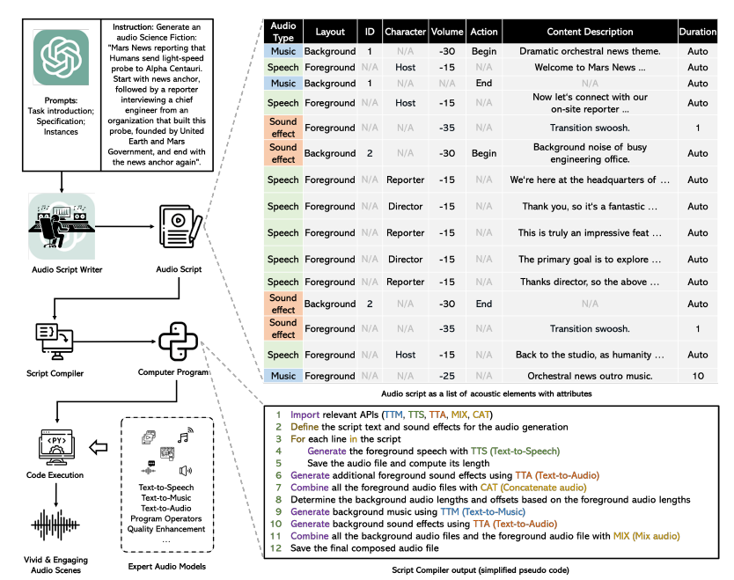
WavJourney – Storytelling

Slide 25
WavJourney – Sound Demo for Science Fiction Storytelling
Paper:
https://arxiv.org/abs/2307.14335
Code:
https://github.com/Audio-AGI/WavJourney
Demo:
https://huggingface.co/spaces/Audio-AGI/WavJourney

Slide 26
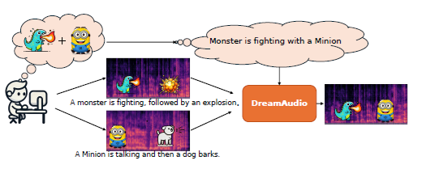
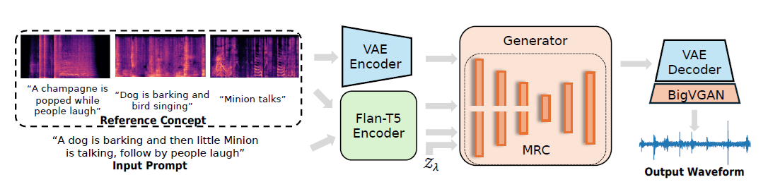
DreamAudio – Customised Text to Audio Generation
Y. Yuan, X. Liu, H. Liu, X. Kang, Z. Chen, Y. Wang, M. D. Plumbley, W. Wang, "DreamAudio: Customized Text-to-Audio Generation with Diffusion Models", IEEE Transactions on Audio Speech and Language Processing, 2026. [arXiv] [PDF] [code, data, & demo]

Slide 27
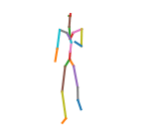
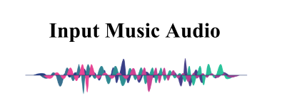
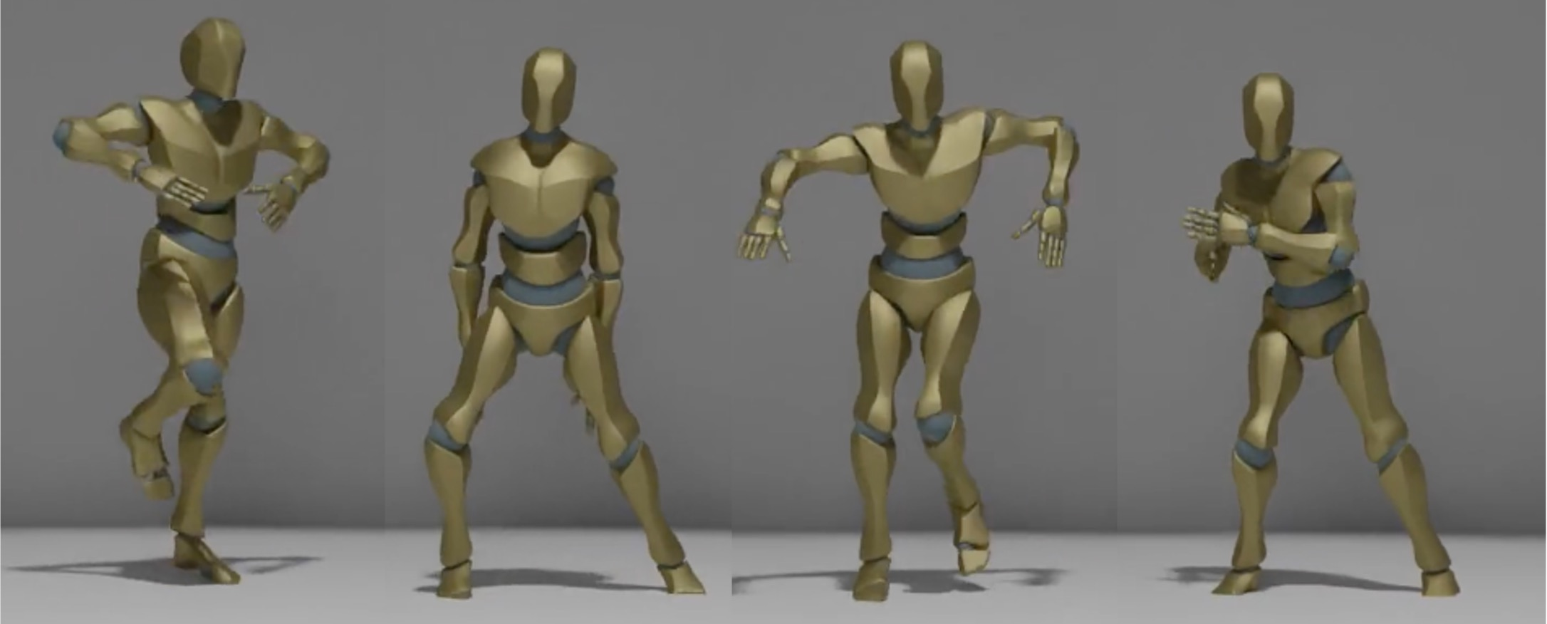
Controllable Music to Dance Generation
Focus only on
hand-crafted musical features.
No genre information.
Based on 24-Joint dataset.
Lack of hand motion.
Generative
Model
MFCC
Chroma
Beat
Envelop
Music Condition
Generated Dance Segment
X. Liu, Z. Feng, D. Kanojia, W. Wang, “DGFM: Full Body Dance Generation Driven by Music Foundation Models”, NeurIPS 2024 Workshop on Audio Imagination, 2024.

Slide 28
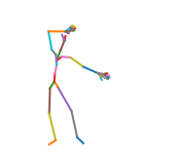
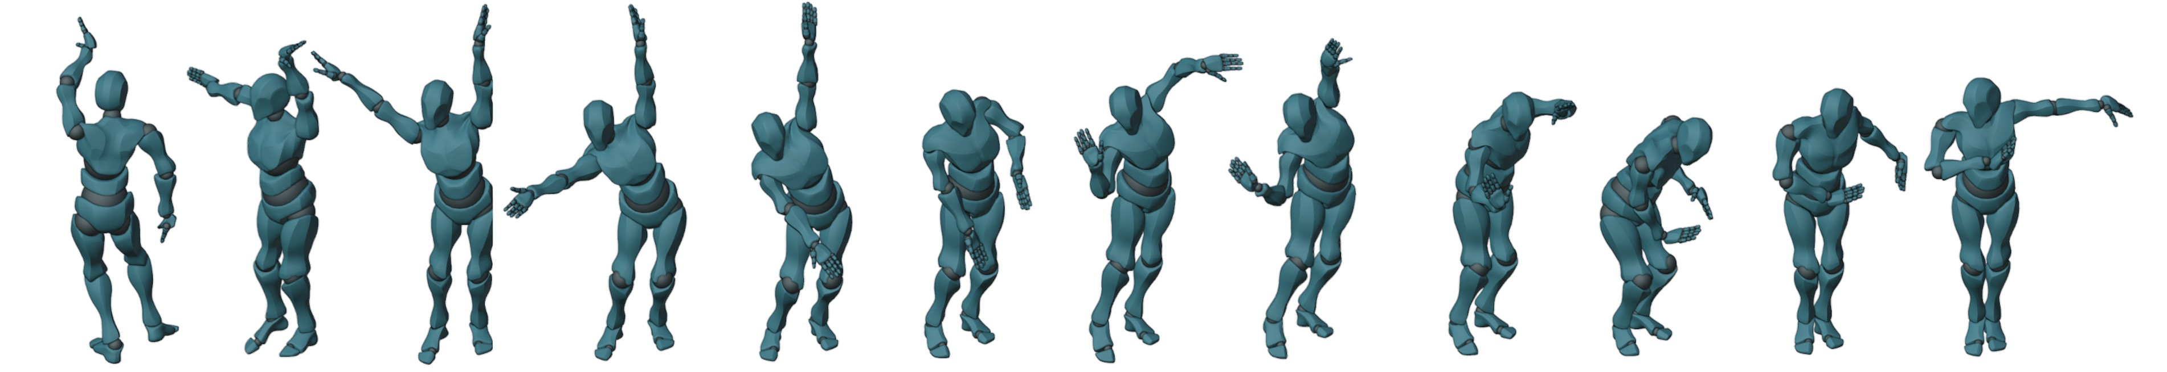



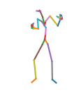
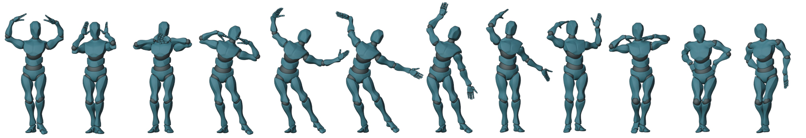
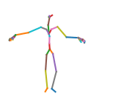
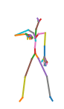
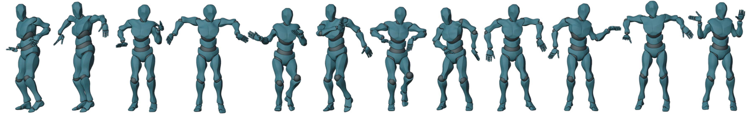
GCDance - Demo
This is a “HanTang” type of music.
This is a “Dai” type of music.
This is a “Hiphop” type of music.
X. Liu, X. Dong, S. Qian, D. Kanojia, W. Wang, and Z. Feng, "GCDance: Genre-Controlled Music-Driven 3D Full Body Dance Generation," IEEE Transactions on Multimedia, 2026. [arXiv] [PDF] [code, data, & demo]

Slide 29
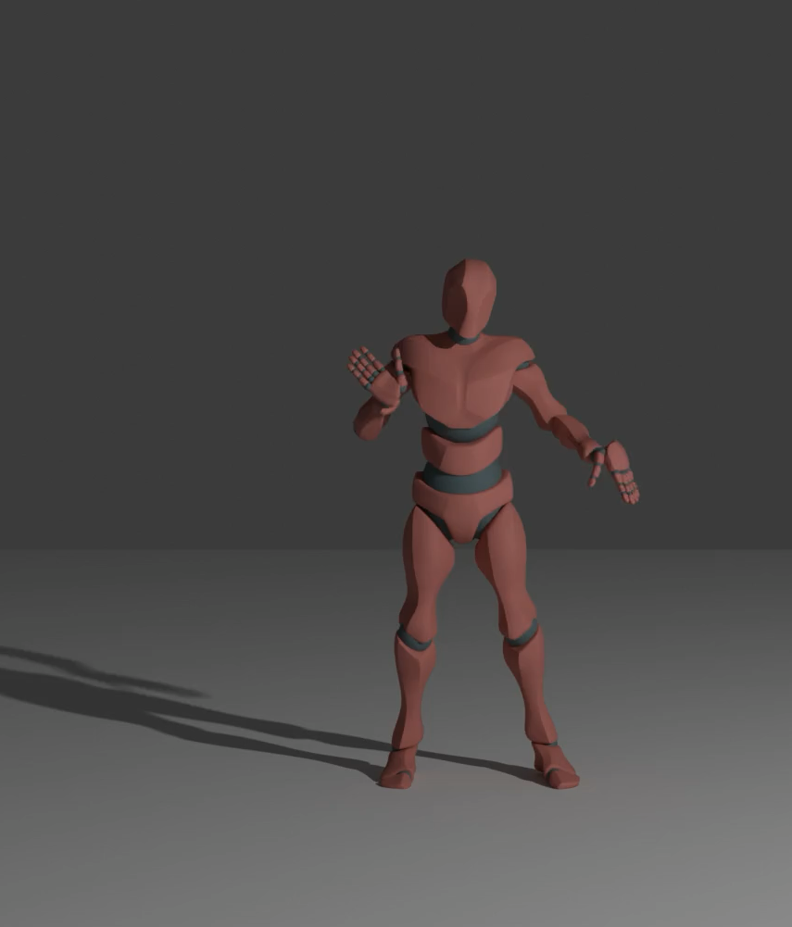
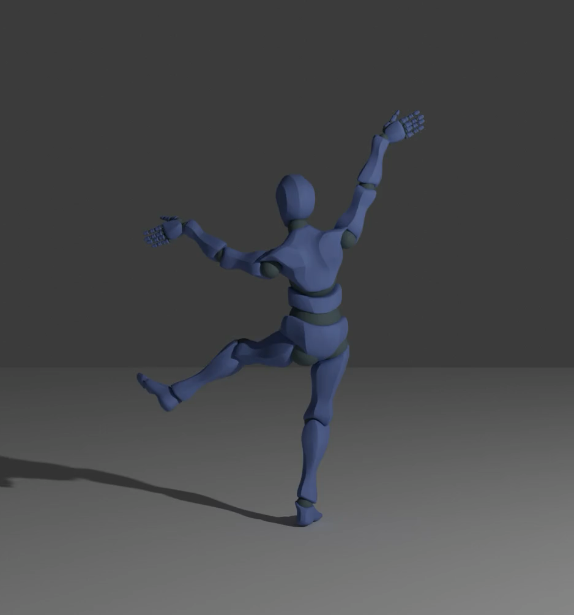
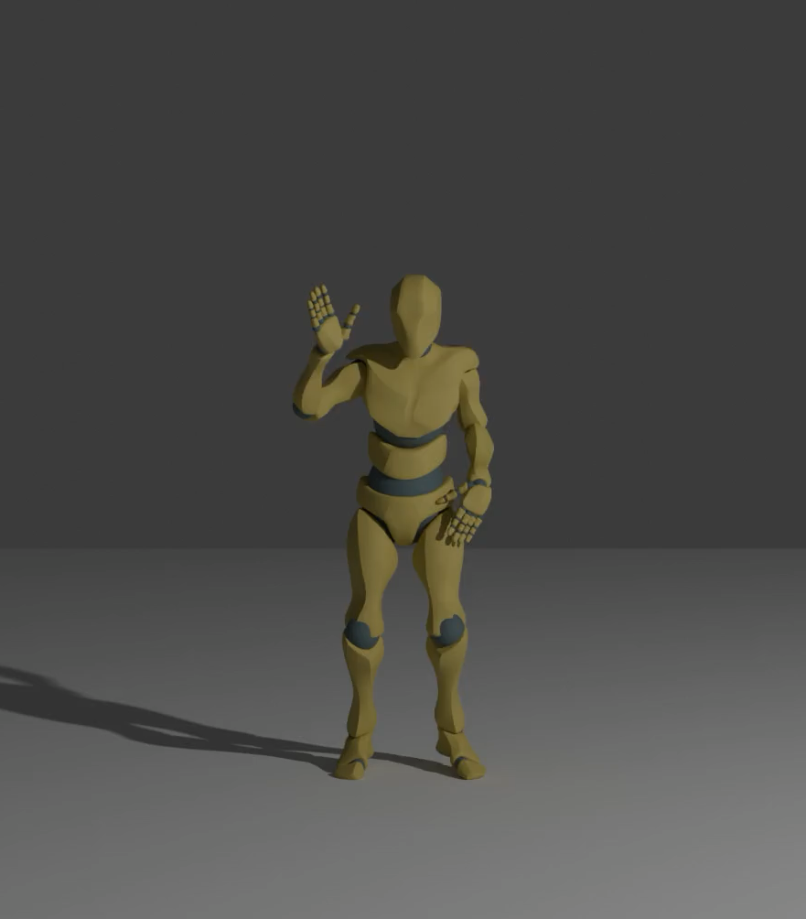
GCDance – More Demo
Breaking
HanTang
Korean
Notes:
To illustrate the alignment between the background music and the generated motions, we showcase three rendered dance videos paired with their corresponding music.
These videos highlight that the motion pauses are aligned with the beats of the music.

Slide 30
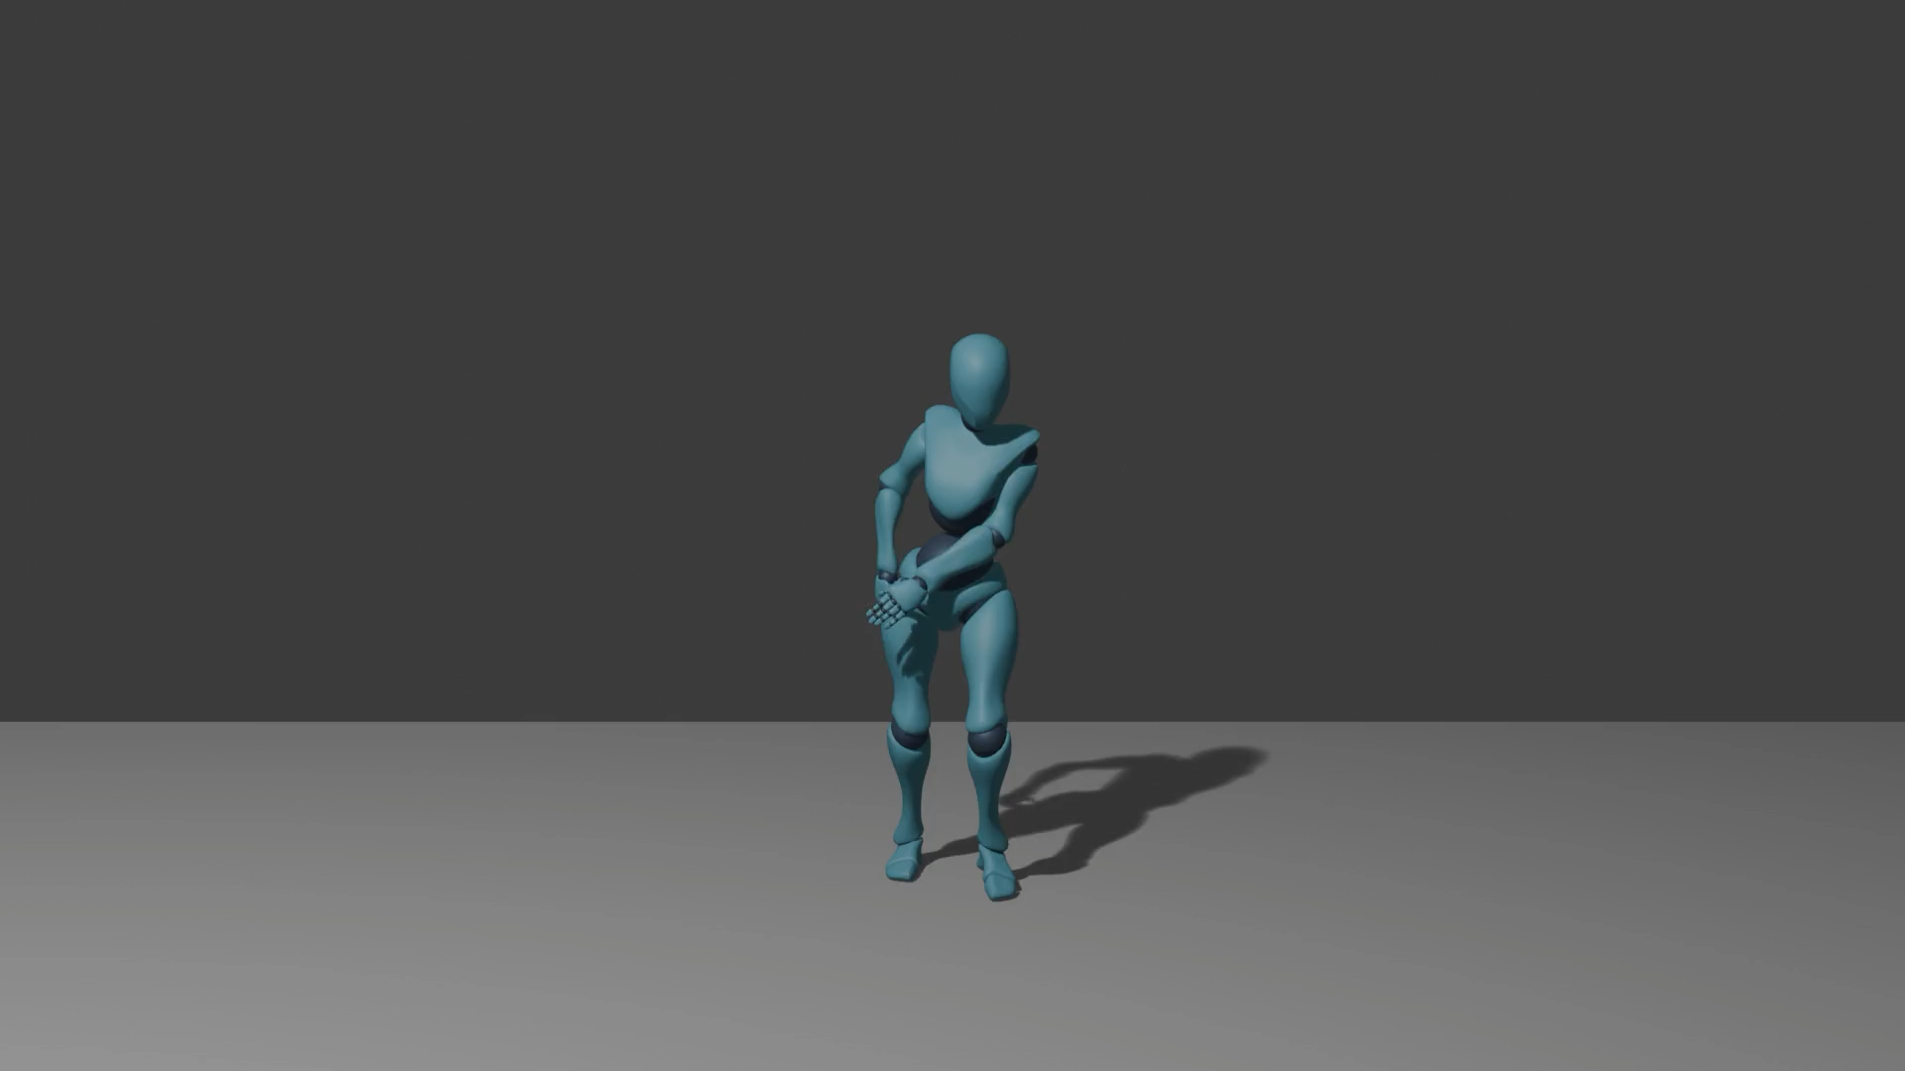
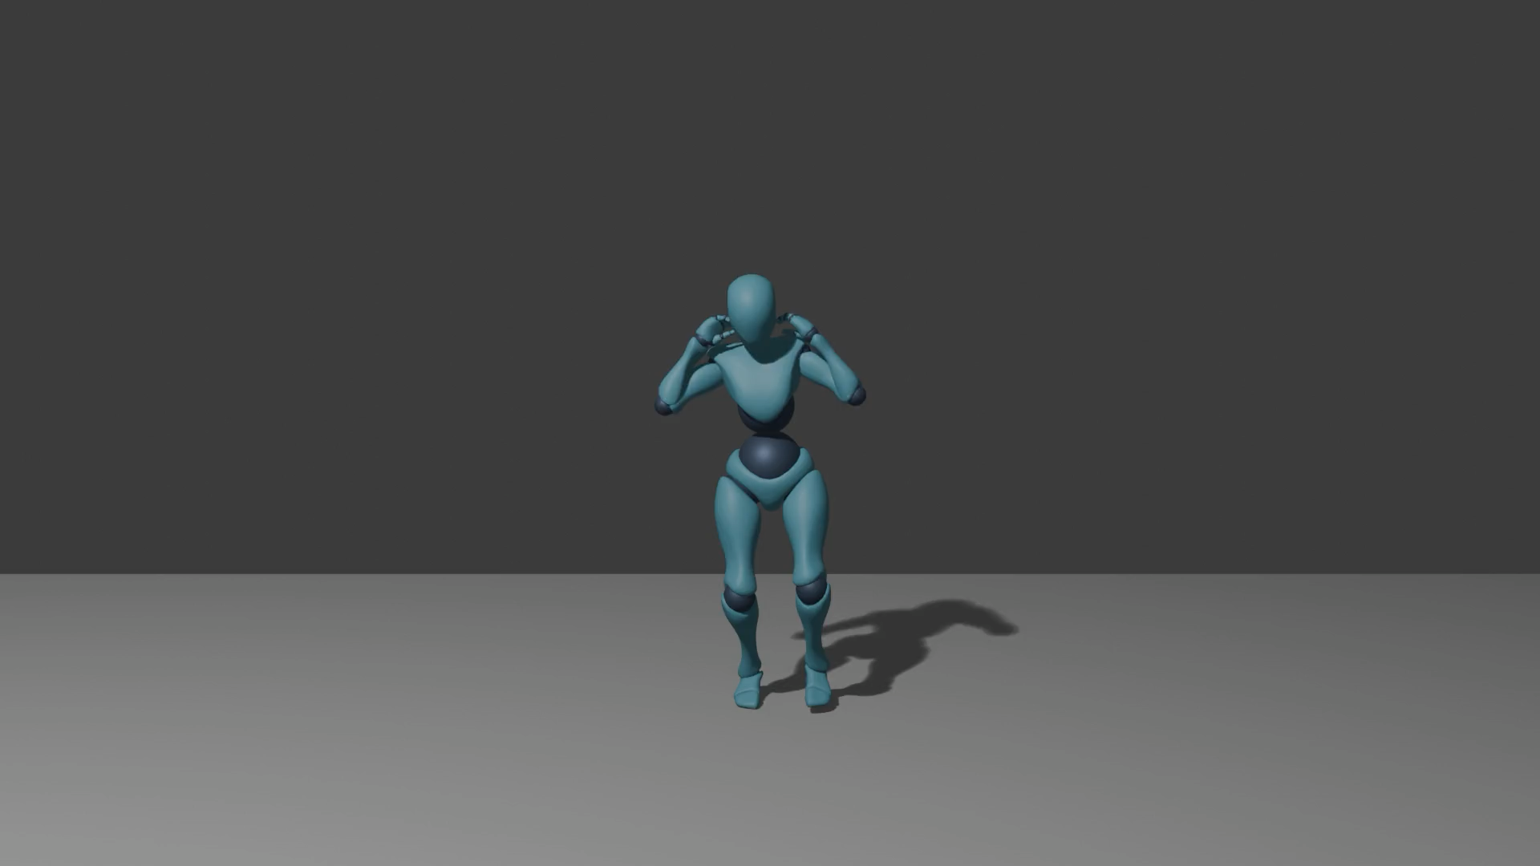
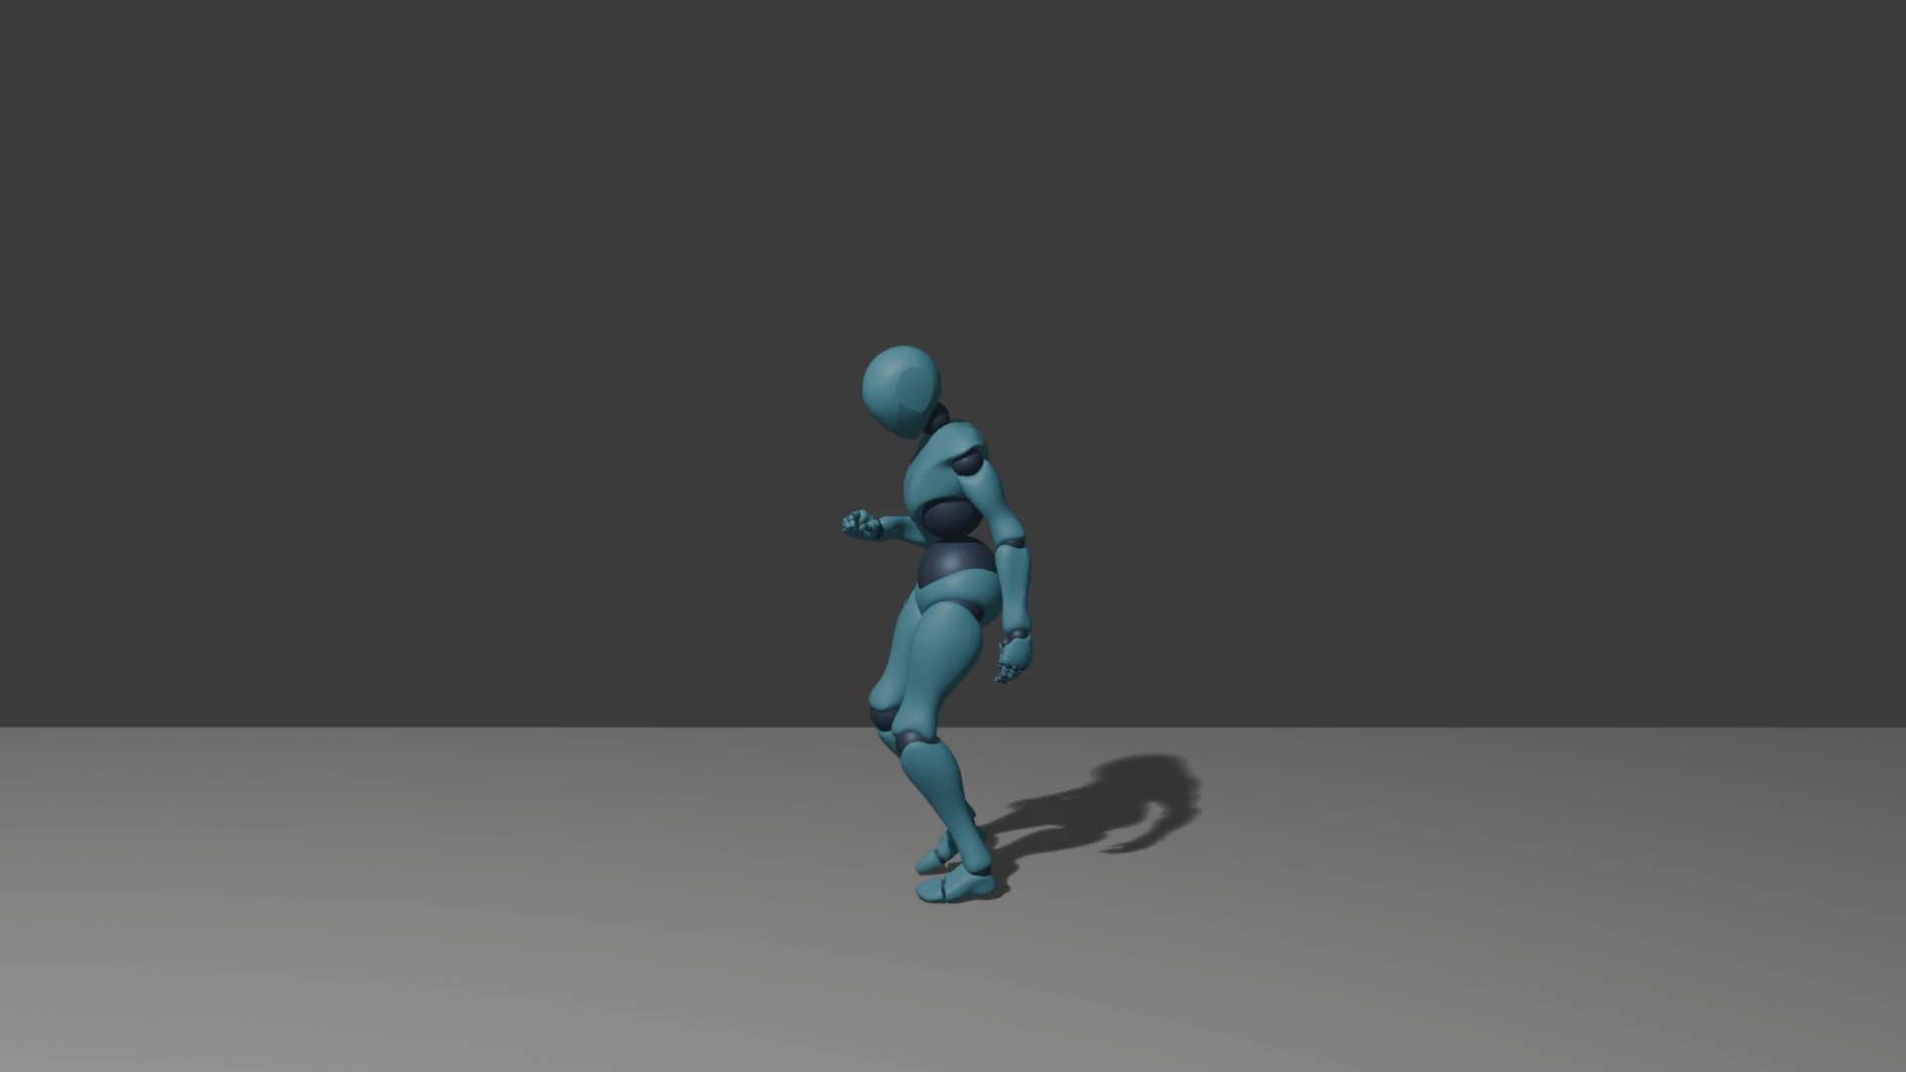
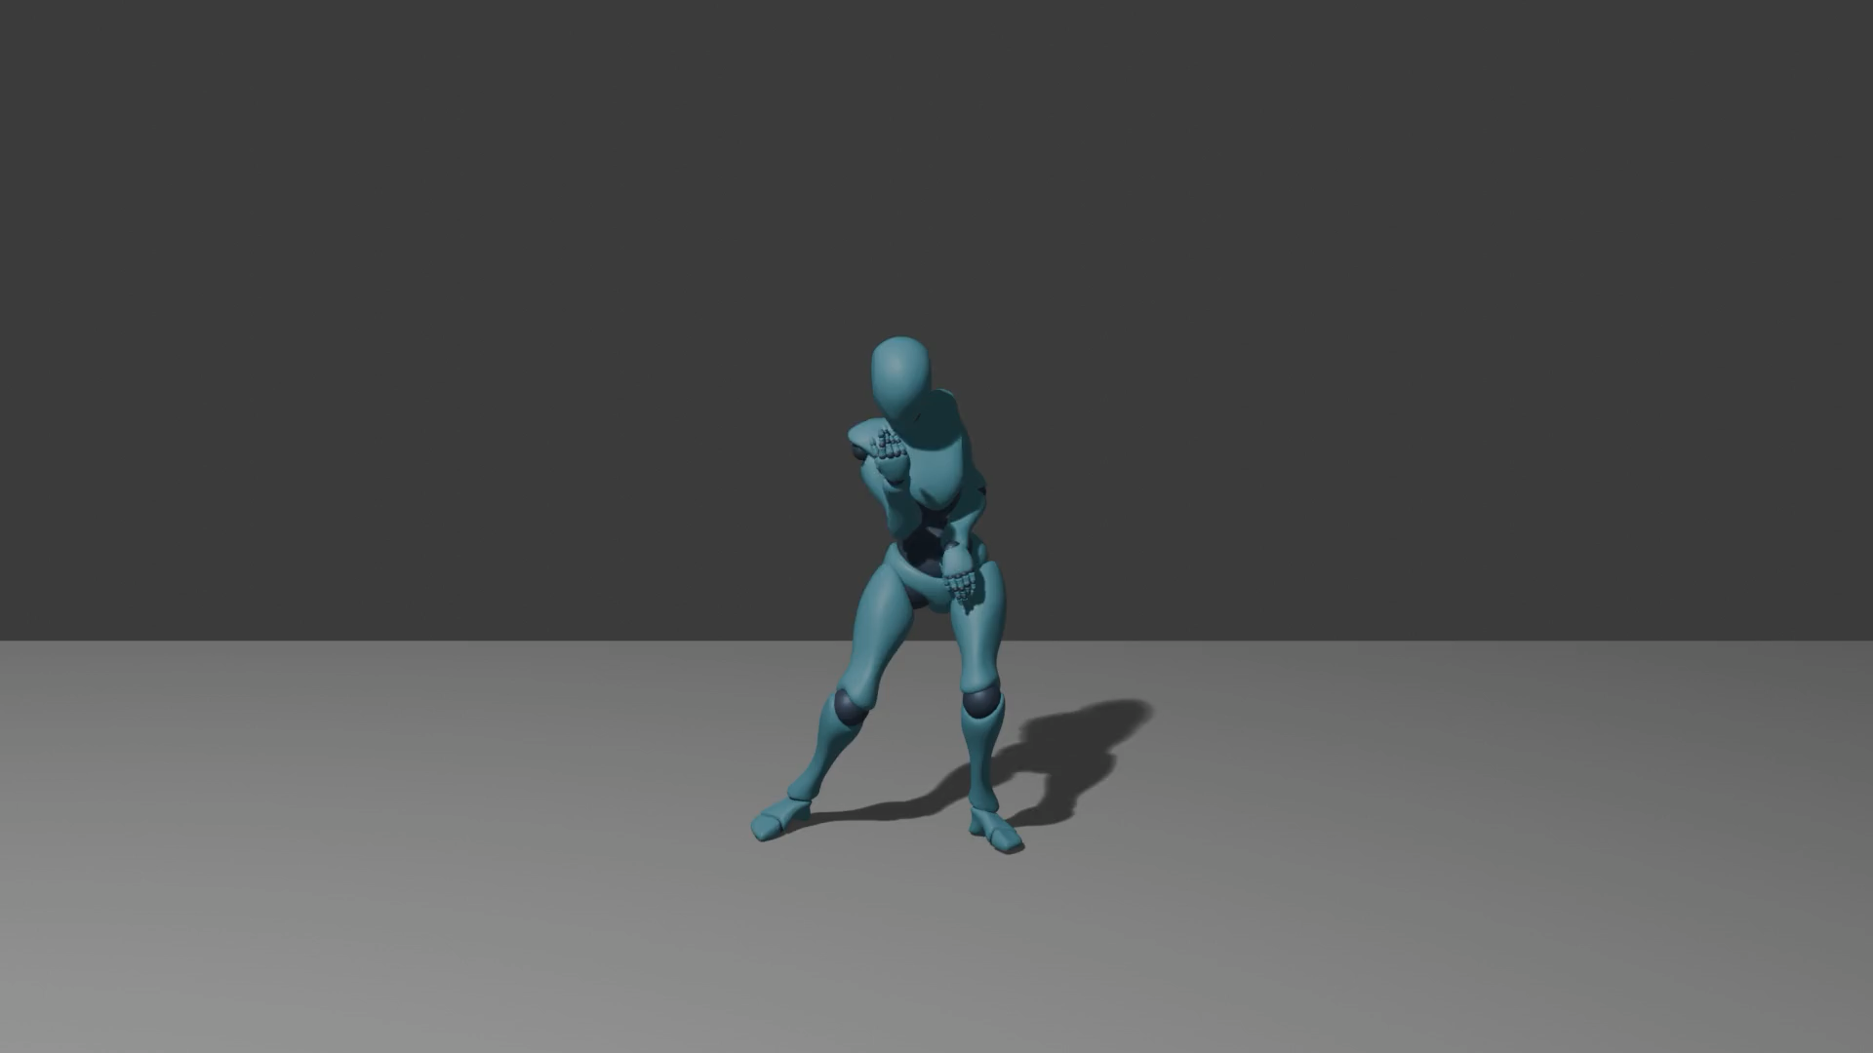
TeMuDance-Demo
Music
Music
Music + “walk in clockwise direction”
Music + “jump”
X. Liu, D. Kanojia, W. Wang, Z. Feng, "TeMuDance: Contrastive Alignment-Based Textual Control for Music-Driven Dance Generation," ACM MM, 2026.

Slide 31
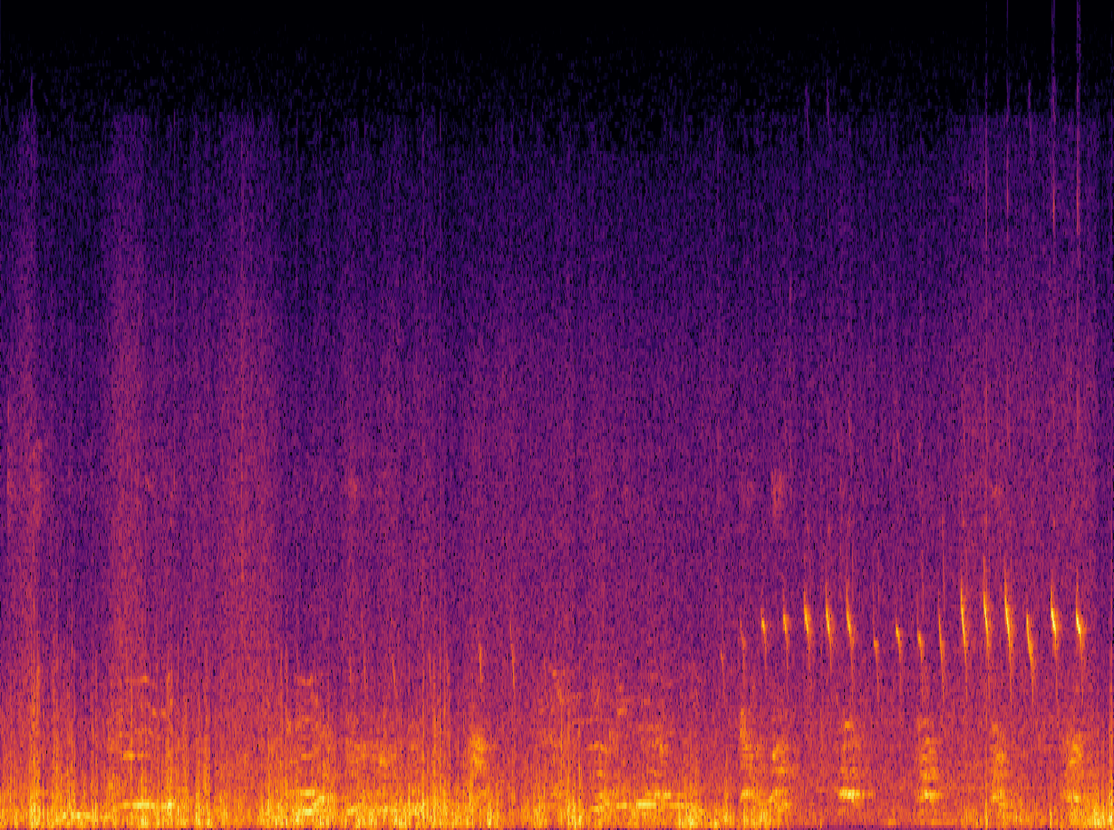
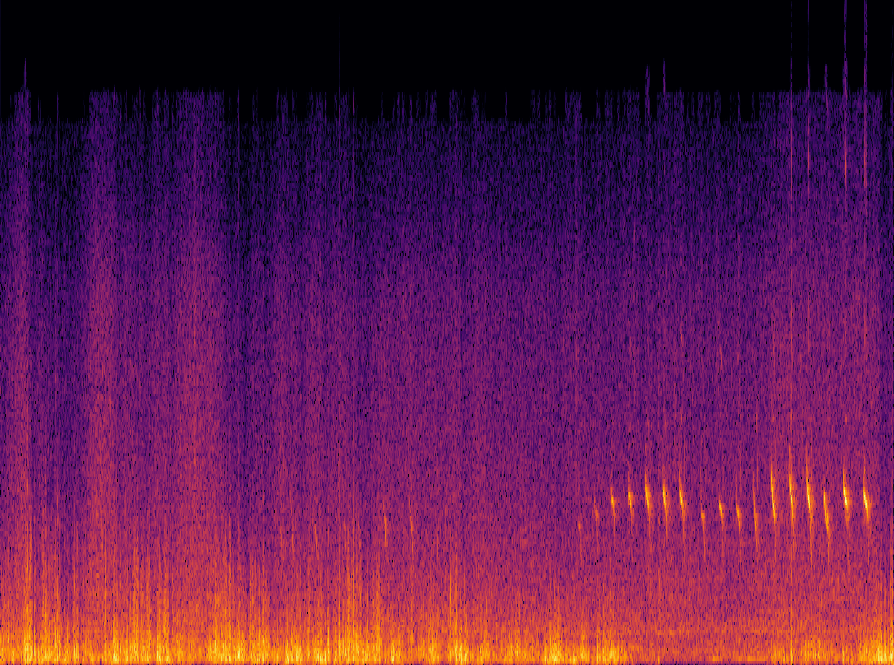
Task 4: Language-Queried Audio Source Separation
Existing methods
  LASS-Net (Liu et al 2022): first LASS model
  SoundFilter (Kilgour 2022): exploiting audio supervision
  CLIPSep (Dong et al. 2023): exploiting visual supervision
Challenges
  Small scale of data available for training
  Open-domain source separation with texts
  Overlapping sound events
  Processing artefacts and incomplete separation
LASS – Separate a target source from an audio mixture based on the natural language descriptions of the target source
First attempt bridging audio source separation and natural language processing
Support input arbitrary text to separate desired sound sources
Language Query: A bird is chirping under the thunder storm
LASS
X. Liu, H. Liu, Q. Kong, X. Mei, J. Zhao, Q. Huang, M.D. Plumbley, and W. Wang,"Separate What You Describe: Language-Queried Audio Source Separation," in Proc. 23rd Interspeech Conference (INTERSPEECH 2022), 18-22 September, 2022, Incheon, Korea.

Slide 32
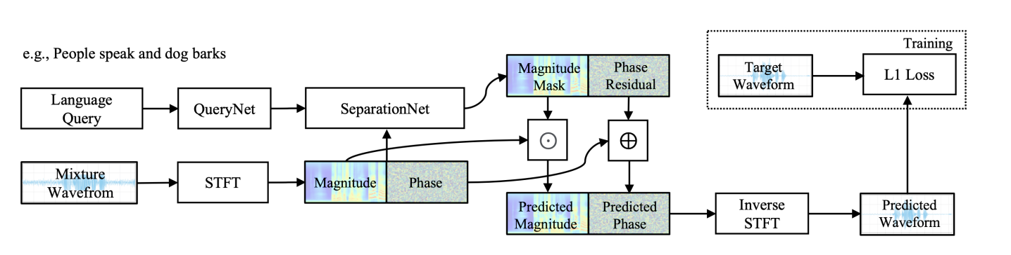
Task 4: AudioSep - Architecture
CLAP/CLIP + ResUNet, trained with 14,000 hours of multimodal data
A foundation model for open-domain sound separation with texts
Impressive zero-shot performance in separating speech, music, sounds
X. Liu, Q. Kong, Y. Zhao, H. Liu, Y. Yuan, Y. Liu, R. Xia, Y. Wang, M. D. Plumbley, and W. Wang, "Separate anything you describe," IEEE Transactions on Audio Speech and Language Processing, vol. 33, 458--471, 2025. [PDF] [code]
Demo:
https://huggingface.co/spaces/Audio-AGI/AudioSep

Slide 33
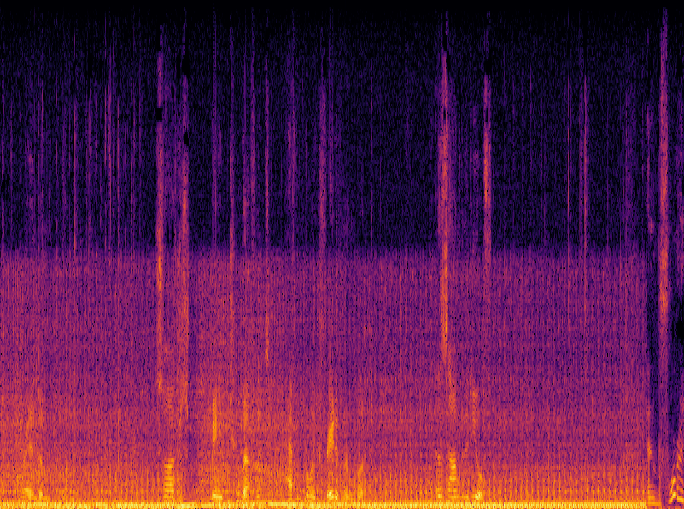
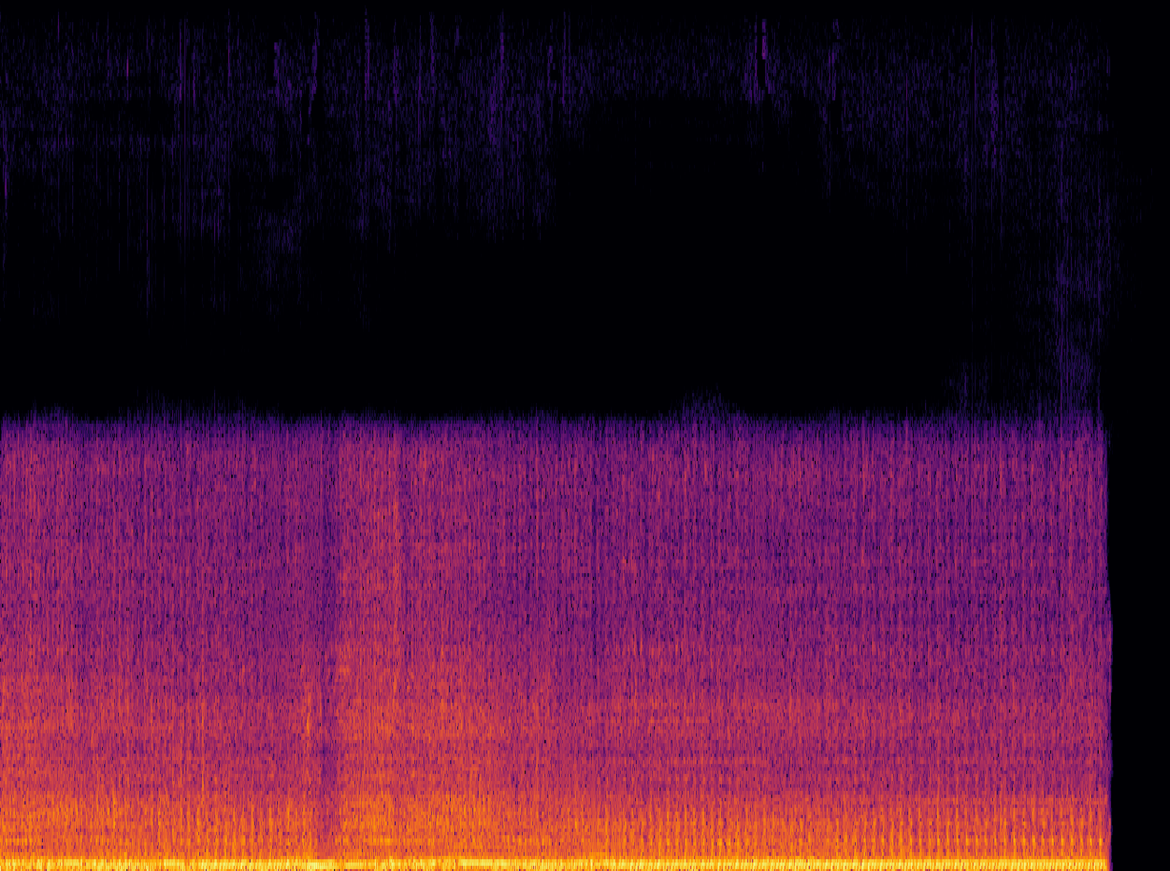
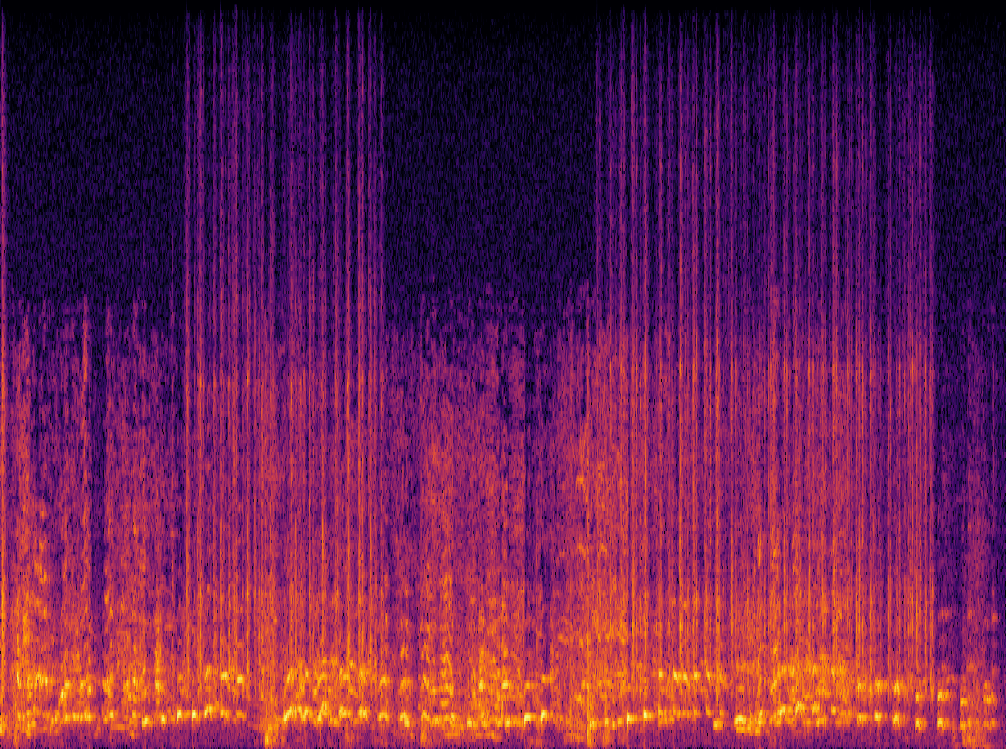
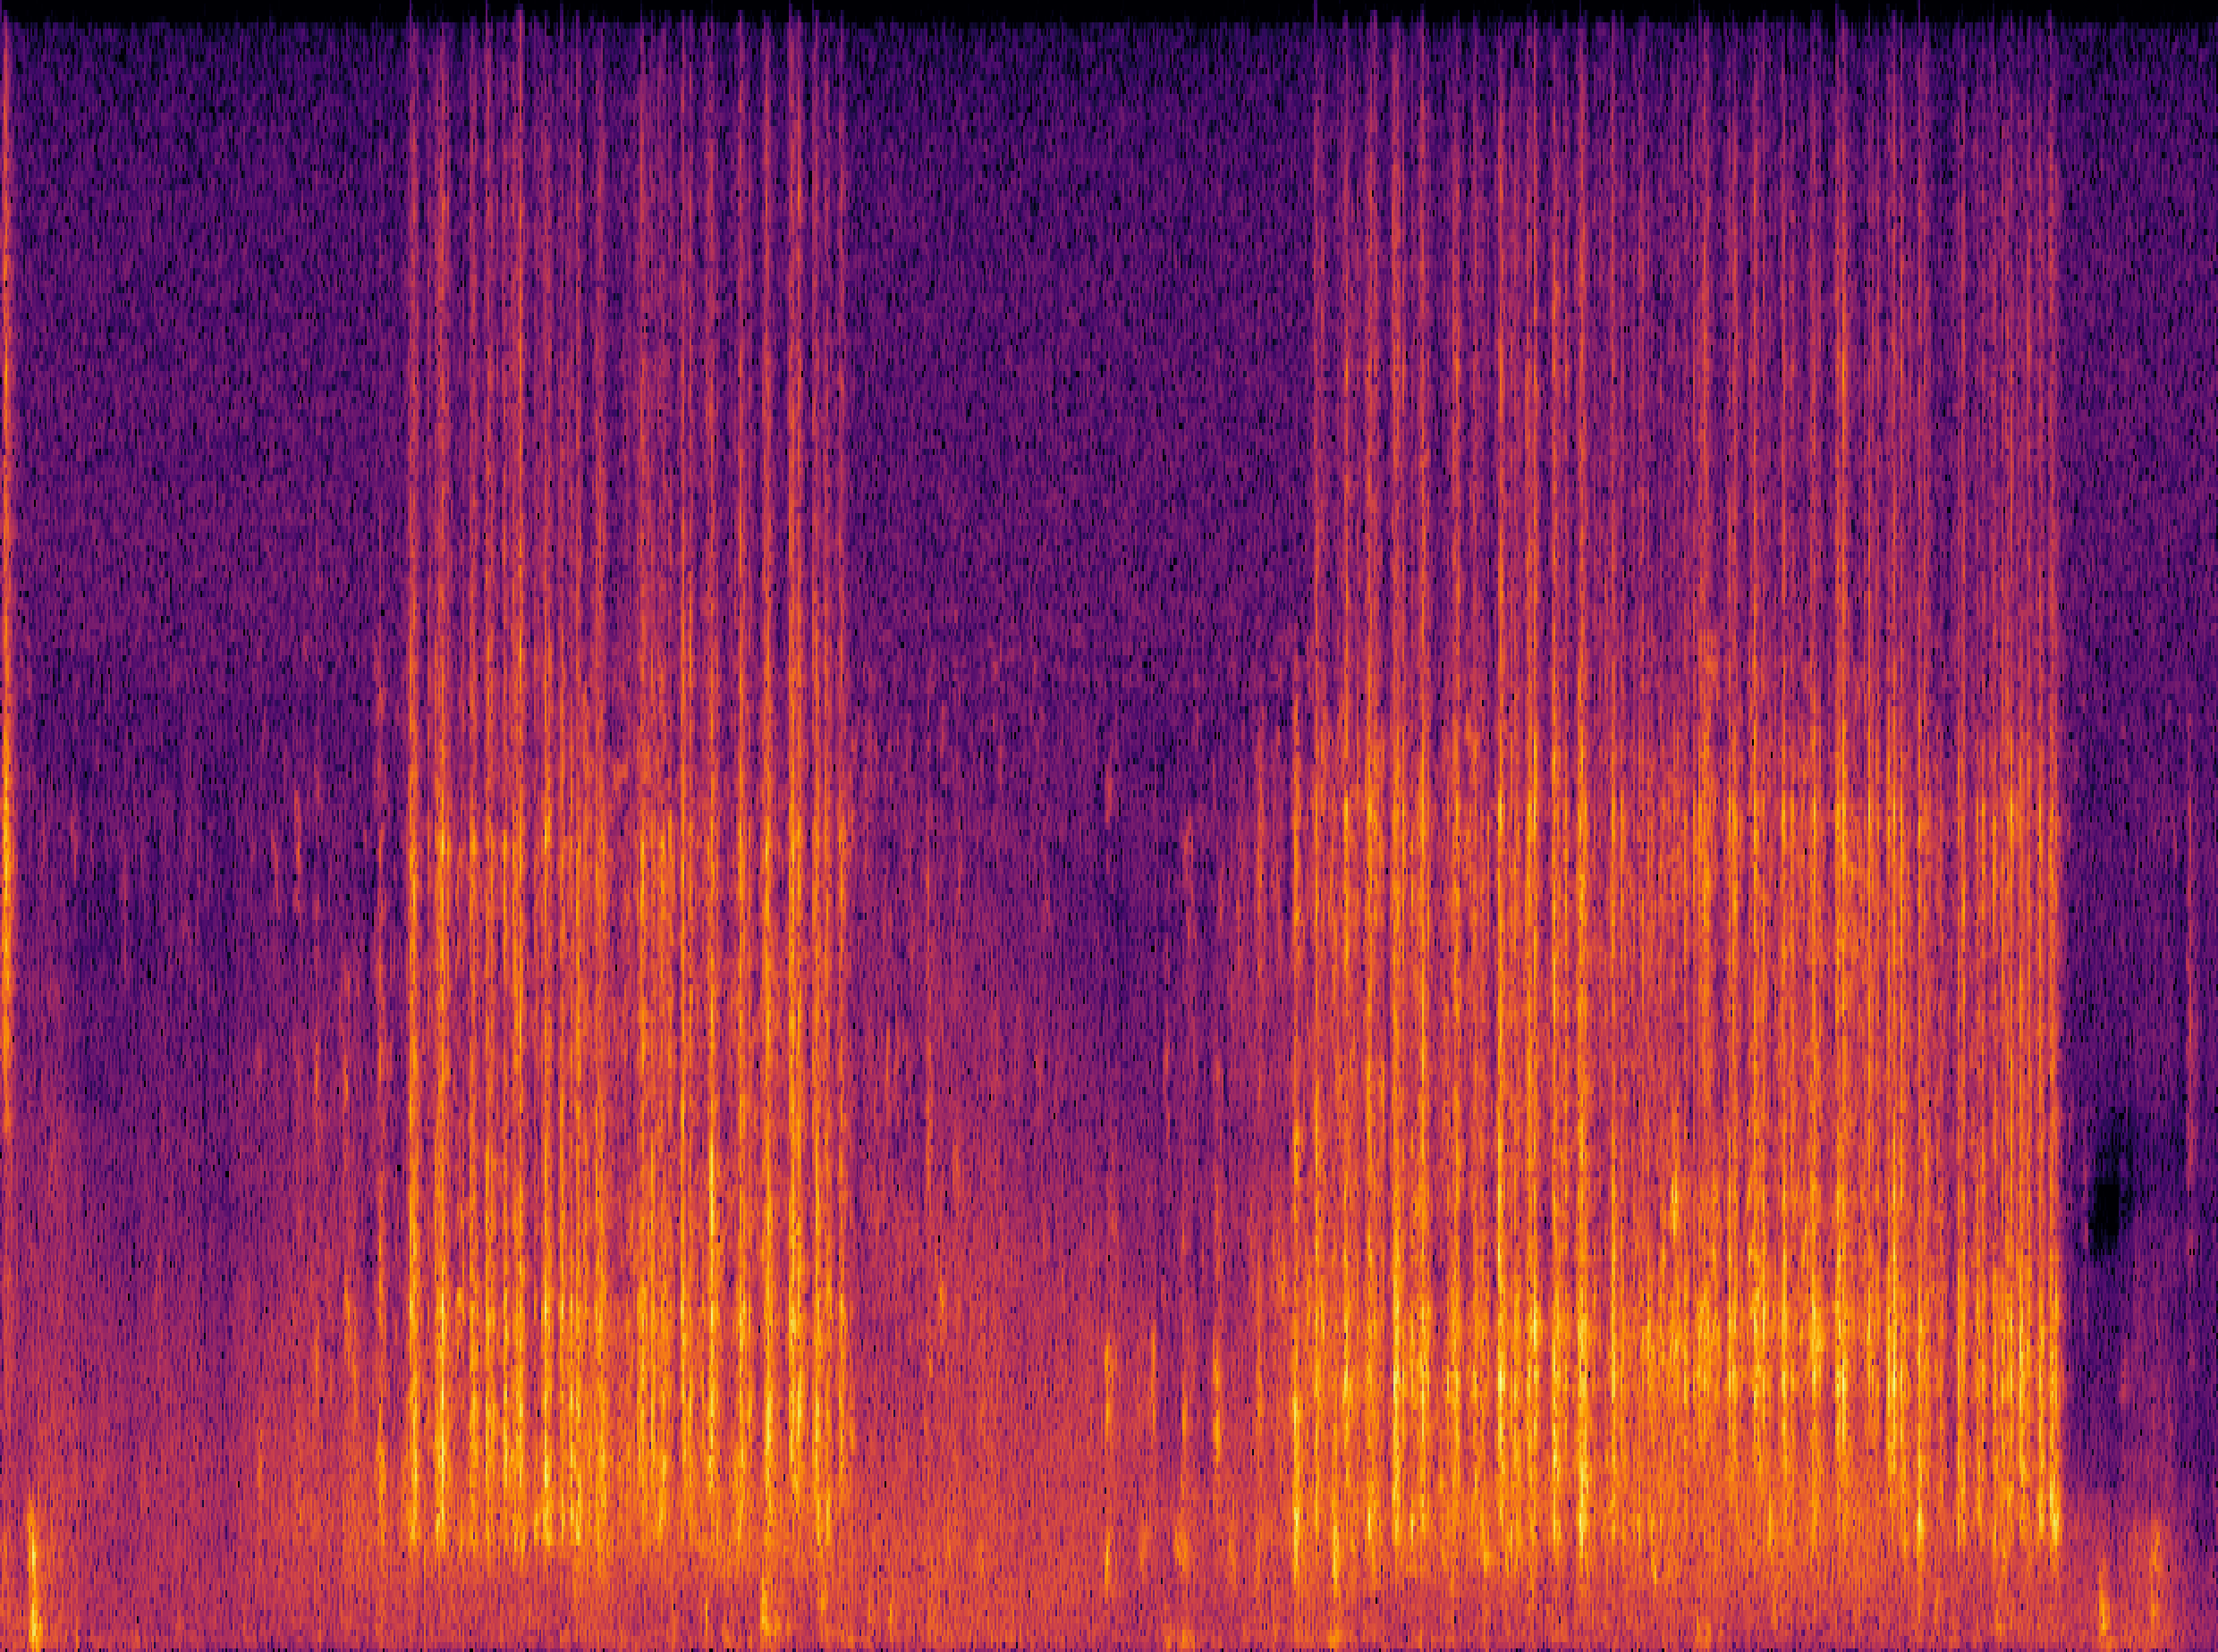
Task 4: AudioSep - Demo
Human query: “The engine sound of a vehicle”
Mix
Separated
Human query: “The sound of hitting the keyboard”
Mix
Separated

Slide 34
Task 4: FlowSep - Motivation
Existing Ideas:
A “New” Idea:
  Discriminative approaches.
  Time-frequency masking on spectrogram to remove the noise sound sources.
  Using the generative approaches.
  Diffusion-based generation framework with rectified flow matching.
  Separation system by generating new audio samples with the noisy clips and text prompts as a condition.
Challenges:
  Challenging with overlapping sound events.
  Excessive and insufficient masking leads to artifacts, including spectral holes and incomplete separation.

Slide 35
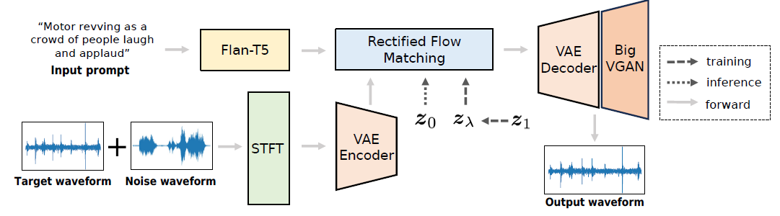
Task 4: FlowSep - Architecture
  Text-to-audio generation model as the backbone, Rectified Flow Matching for feature generation.
  Extended VAE latent space to integrate the noise audio feature.
  Flan-T5 text encoder, VAE latent decoder and BigVGAN vocoder.
Y. Yuan, X. Liu, H. Liu, M.D. Plumbley, and W. Wang,“FlowSep: Language-Quried Sound Separation with Rectified Flow Matching" in ICASSP 2025.

Slide 36
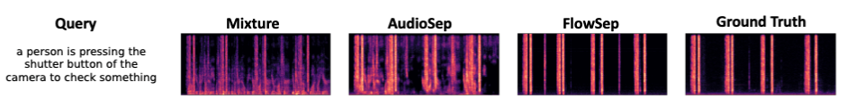
Task 4: FlowSep - Demo
  Baseline models show incomplete separation with noticeable spectral gaps.
  FlowSep demonstrates promising capabilities in such situations.
  More demos please refer to https://audio-agi.github.io/FlowSep_demo/.
Y. Yuan, X. Liu, H. Liu, M.D. Plumbley, and W. Wang, “FlowSep: Language-Quried Sound Separation with Rectified Flow Matching" in ICASSP 2025.

Slide 37
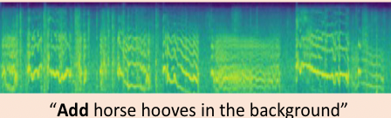
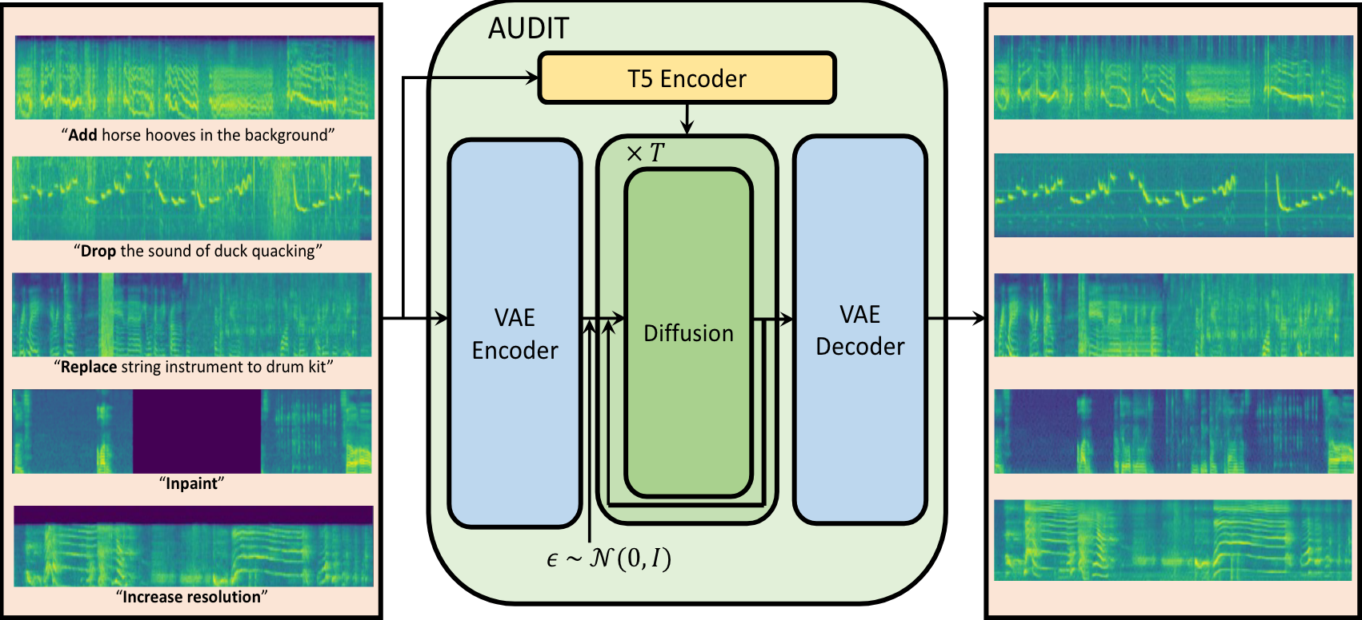
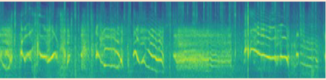
Task 5: LLMs for Controllable Audio Editing
Audio editing is to change the content of audio by following the instruction precisely.
This work introduces an audio agent that understands the user instruction, decomposes the instruction into several tasks, and allocates different tasks to the proper models.
Instruction interpreter
Expert models
An example of end-to-end audio editing system: AUDIT
J. Liang, H. Zhang, H. Liu, Y. Cao, Q. Kong, X. Liu, W. Wang, M. Plumbley, and E. Benetos, “WavCraft: Audio Editing and Generation with Large Language Models”, in ICLR 2024 Workshop on Large Language Model (LLM) Agents, 2024.

Slide 38
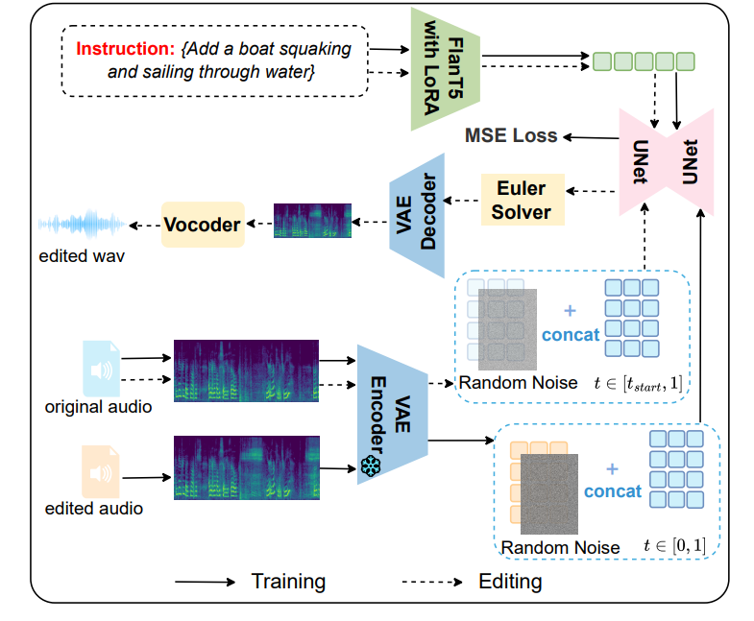
RFM-EDITING – Controllable Audio Editing
Demos here:
https://katelin-glt.github.io/RFM-Editing-Demo/
Remove continuous frying noises:
Original:
Edited:
Replace someone suddenly sneezes out loud with several pigeons cooing:
Original:
Edited:
L. Gao, Y. Yuan, Y. Chen, Y. Cheng, Z. Li, J. Wen, S. Zhang, and W. Wang, "RFM-EDITING: Rectified Flow Matching for Text-Guided Audio Editing," in Proc. IEEE International Conference on Acoustics, Speech and Signal Processing (ICASSP 2026), Barcelona, Spain, May 4-8, 2026. [PDF]

Slide 39
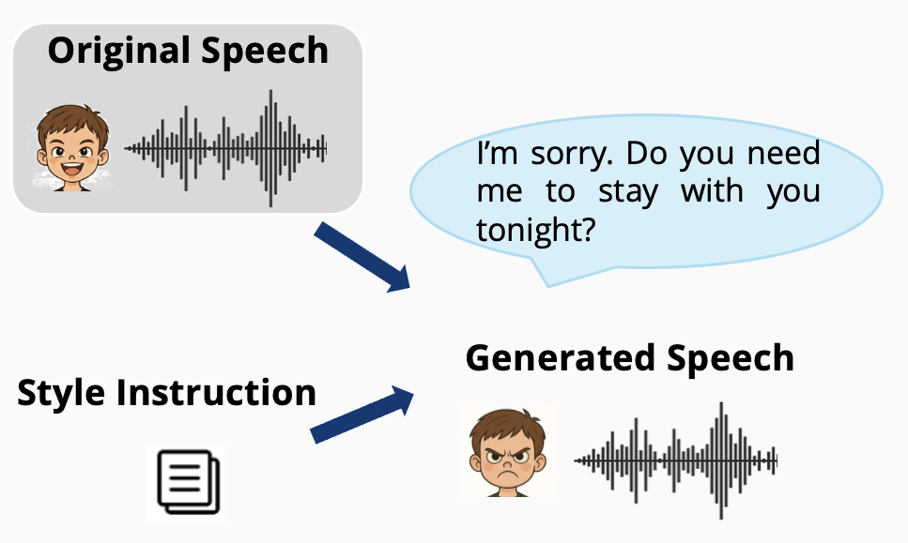

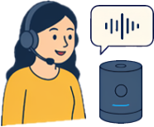
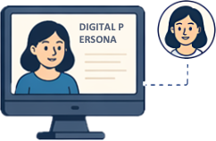
SFM-Adapter – Controllable Speech Editing
The goal of Speech Style Edit: Change How Speech Sounds, Not What It Says !
Why It Matters
Human-Computer Interaction
More natural and engaging communication.
Voice Assistants
Hands-free help in daily life.
Instruction-guided speech style editing: changes the speaking style (expressiveness and timbre) while preserving linguistic content.
Digital Personas & Avatars
Bring virtual characters to life with expressive voices.
Y. Chen, H. Liu, Q. Chen, A. Singh, J. Zhao, W. Wang, P. J. B. Jackson, M. D. Plumbley, "SFM-Adapter: Style-aware Feature Manipulation Adapter for Speech Style Editing", IEEE Transactions on Audio Speech and Language Processing, 2026. [PDF] [code, data, & demo], vol. 34, pp. 3132-3145, 2026.

Slide 40
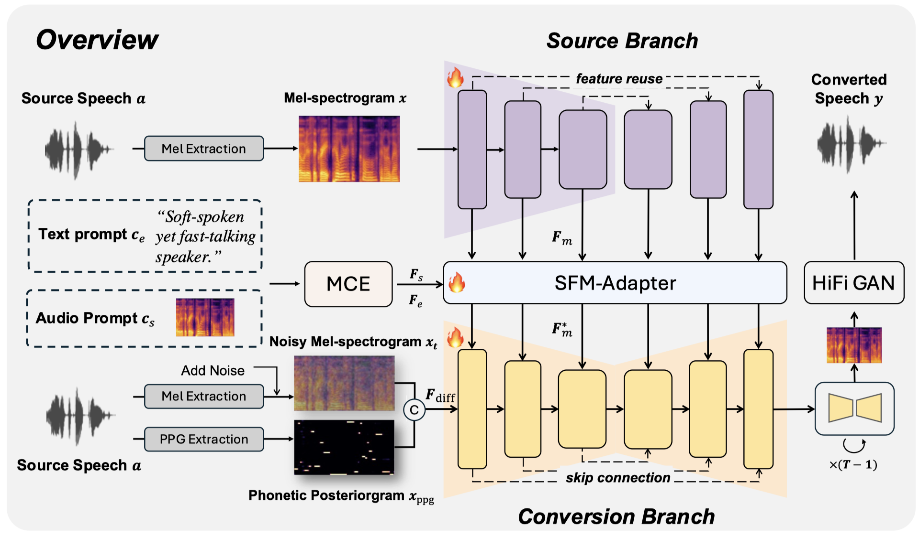

Method
Main framework: a reconstruction-based diffusion architecture that can incorporate external style conditions (e.g., natural language and audio).
Main components:
Source Branch: Extracts multi-scale features $F_{m}$from the input mel-spectrogram.
Conversion Branch: A diffusion-based U-Net model that synthesizes target speech by combining style features and PPG features.
MCE: Encodes the text and audio prompts into expressive features $F_{e}$ and timbre features $F_{s}$
SFM-Adapter: Manipulates the source features using the requested target styles at multiple U-Net layers.

Slide 41
SFM-Adapter - Demos
Source Speech
Audio Prompt
Text Prompt
Target
SFM-Adapter
Speaking with intention, her unhappy voice held a high pitch and low energy.
A fatigued disconsolate male voice, characterized by a slow speaking speed and a deep, low pitch, emits a subtle energy, resulting in a soothing audio experience that exudes tranquility.
Y. Chen, H. Liu, Q. Chen, A. Singh, J. Zhao, W. Wang, P. J. B. Jackson, M. D. Plumbley, "SFM-Adapter: Style-aware Feature Manipulation Adapter for Speech Style Editing", IEEE Transactions on Audio Speech and Language Processing, 2026. [PDF] [code, data, & demo], vol. 34, pp. 3132-3145, 2026.

Slide 42

Task 6: Neural Audio Codec
Audio Codec:
Neural Audio Codec:
A device or software that encodes or decodes digital audio data for transmission, storage, or playback.
Compressor-decompressor → “Codec”
MP3, FLAC, AAC, Vorbis, etc.
SoundStream (Zeghidour et al. 2021)
Encodec (Défossez et al. 2021)
Descript (Kumar et al. 2023)
HiFi-Codec (Yang et al. 2023)
SpeechTokenizer (Zhang et al, 2023)
Codec Superb Benchmark (Wu et al. 2024)
  https://github.com/voidful/Codec-SUPERB

Slide 43


Large scale k-means is challenging
AudioSet + Million Song Dataset + GigaSpeech
https://github.com/haoheliu/kmeans_pytorch
Task 6: SemantiCodec
Ultra-low bit rate (0.31 kbps ~1.40 kbps, token rate 25, 50, or 100 per second) & Strong semantics in the token & Variable vocabulary sizes
AudioMAE
Encoder
https://haoheliu.github.io/SemantiCodec/
CrossAtten

Slide 44
Task 6: SemantiCodec - Demos
Original
HiFi-Codec
(2.0 kbps)
Encodec
(1.5 kbps)
DAC
(1.41 kbps)
SemantiCodec
(1.43 kbps)
DAC
(0.47 kbps)
SemantiCodec
(0.35 kbps)
Music
(MUSDB18)
General Audio
(AudioSet)
Speech
(Libri)
More sound demos:
https://haoheliu.github.io/SemantiCodec/

Slide 45
Dataset: WavCaps/Sound-VECaps/AudioSetCaps
Dataset | Quantity | Ave-Length | Vocabulary | Caption Source
Clotho | 30K | 11 | 4K | H
AutoCaps | 57K | 9 | 5K | H
LAION-Audio-630K | 630K | 7 | 311K | L
WavCaps | 400K | 8 | 24K | L
Auto-ACD | 1.5M | 18 | 20K | L+A+V
Sound-VECaps | 1.6M | 40 | 50K | L+A+V
AudioSetCaps | 1.9M | 28 | 21K | L+A
X. Mei, C. Meng, H. Liu, Q. Kong, T. Ko, C. Zhao, M. D. Plumbley, Y. Zou, and W. Wang, "WavCaps: A ChatGPT-Assisted Weakly-Labelled Audio Captioning Dataset for Audio-Language Multimodal Research," IEEE/ACM Transactions on Audio Speech and Language Processing, vol. 32, pp. 3339-- 3354, 2024. [PDF] [arXiv] [code] (https://github.com/XinhaoMei/WavCaps)
Y. Yuan, D. Jia, X. Zhuang, Y. Chen, Z. Chen, Y. Wang, Y. Wang, X. Liu, X. Kang, M.D. Plumbley, and W. Wang, "Sound-VECaps: Improving Audio Generation With Visual Enhanced Captions," in ICASSP, Hyderabad, India, April 6-11, 2025. [PDF]
J. Bai, H. Liu, M. Wang, D. Shi, W. Wang, M. D. Plumbley, W.-S. Gan, and J. Chen, "AudioSetCaps: An Enriched Audio-Caption Dataset using Automated Generation Pipeline with Large Audio and Language Models," IEEE Transactions on Audio Speech and Language Processing, vol. 33, pp. 2817 - 2829, June 2025. [arXiv][code]

Slide 46

AudioSetCaps – An Example
Mean
Subjective
Score
Dataset-Caption
Label
Female speech, Woman speaking, Background noise, Generic impact sounds, Surface contact, Babbling, Tick, Human voice, Breathing, Baby laughter
4
AudioCaps
A human baby laughs and gurgles as a female sings gently
4
WavCaps
People are talking and babbling with a baby laughing and surface contact.
4.2
Auto-ACD
The sound of a laughing baby and women chatting and giggling can be heard at a busy spa.
4
AudioSetCaps
A joyful interaction between a woman and a baby, as the infant giggles and the woman responds with a happy and upbeat tone.
ID: Y0qH8FmqGI2U
4.4

Slide 47
Conclusion & Future Works
Summary
  Large language-audio models are promising - offering new opportunities to solve problems in conventional audio tasks and newly emerging audio tasks
  These models often provide SOTA performance in many downstream tasks and may offer new capabilities that were not available in previous audio models.
Future Works
  Developing unified models for multi-tasks (e.g. understanding and generation) and multi-modal data (audio, visual, language)
  Improving controllability/personalization/customisation of LALMs in various downstream tasks (e.g. generation and captioning)
  Developing LALMs for long form audio activity understanding, reasoning
  Developing LALMs for spatial audio generation and reasoning
  Leveraging physics-based model + data driven models

Slide 48
Paper, Codes, Demos, and More, …
AudioLDM2:
Project Page: https://audioldm.github.io/audioldm2/
AudioLDM:
Paper: https://arxiv.org/abs/2301.12503
Project Page: https://audioldm.github.io/
Github:
  Pretrained model: https://github.com/haoheliu/AudioLDM
  Evaluation tools: https://github.com/haoheliu/audioldm_eval
YouTube: https://www.youtube.com/watch?v=_0VTltNYhao
APT:
Code: https://github.com/JinhuaLiang/APT
WavCraft:
Code: https://github.com/JinhuaLiang/WavCraft
SemantiCodec:
WavJourney:
Paper: https://arxiv.org/abs/2307.14335
Code: https://github.com/Audio-AGI/WavJourney
Demo: https://huggingface.co/spaces/Audio-AGI/WavJourney
Paper/code/demos at project page:
https://haoheliu.github.io/SemantiCodec/
AudioSep:
Code: https://github.com/Audio-AGI/AudioSep
RFM-EDITING:
https://katelin-glt.github.io/RFM-Editing-Demo/
AudioSetCaps:
Data and code: https://github.com/JishengBai/AudioSetCaps
https://huggingface.co/datasets/baijs/AudioSetCaps
WavCaps:
Paper: https://arxiv.org/abs/2303.17395
Code: https://github.com/xinhaomei/wavcaps
SFM-Adapter: https://ychenn1.github.io/SFM-Adapter/
Sound-VECaps: paper, data & code:
https://yyua8222.github.io/Sound-VECaps-demo
More code about other works avaliable at:
https://github.com/XinhaoMei/DCASE2021_task6_v2
https://github.com/XinhaoMei/ACT
https://github.com/liuxubo717/cl4ac
GCDance: paper, data & code:
https://xinranliu7715.github.io/gcdance/

