Slide 1
Numerical Solution of the Spectral Problem
and BFKL at Next-to-Next-to-Leading Order in N=4 SYM
Fedor Levkovich-Maslyuk
King’s College London
based on
arXiv:1504.06640 [N. Gromov, FLM, G. Sizov]
arXiv:1507.04010 [N. Gromov, FLM, G. Sizov]
arXiv:1510.02098 [N. Gromov, FLM]

Slide 2
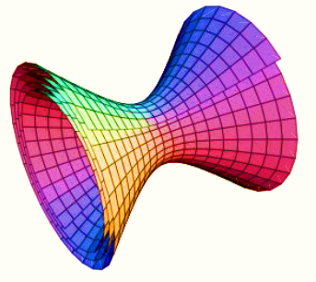
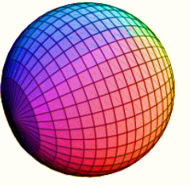
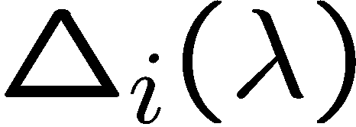
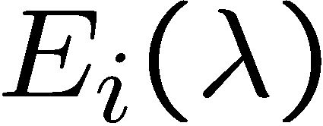
Introduction
superstring theory in
super Yang-Mills theory
in four dimensions
(planar limit)
,
Operator conformal
dimensions
spectrum of
string energies
Integrability
hope to solve both theories exactly!

Slide 3
Quantum Spectral Curve in N=4 SYM
A compact set of equations for only a few functions
giving the exact spectrum
Gromov,Kazakov,
Leurent,Volin 2013
Our motivation:
Finite set of equations very precise numerics
Quantum numbers don’t have to be integer!
Can deeply probe the BFKL regime ( )

Slide 4
QSC already gave many new results
Gromov, Kazakov, Leurent, Volin 13,14
Gromov, FLM, Sizov 14
Alfimov, Gromov, Kazakov 14
Marboe, Volin 14
…
ABJM & more:
Cavaglia, Fioravanti, Gromov, Tateo 14;
Gromov, Sizov 14;
Anselmetti, Bombardelli, Cavaglia, Tateo 15
Cavaglia, Cornagliotto, Mattelliano, Tateo 15

Slide 5
Talk outline
Quantum Spectral Curve and its origins
Numerical solution
Analytic results in BFKL limit
QSC for the quark-antiquark potential

Slide 6
Integrability and the Quantum Spectral Curve

Slide 7
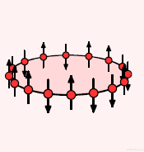
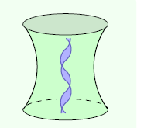
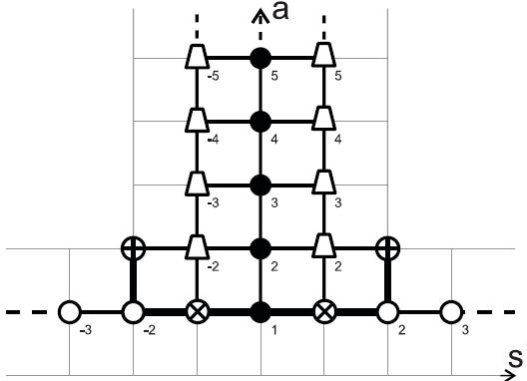
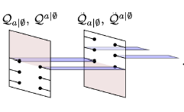
Integrability for the spectral problem
Spin chains in Regge scattering/BFKL
Lipatov, Faddeev,
Korchemsky
Perturbative integrability in N=4 SYM
Minahan, Zarembo
Classical integrability for the string sigma model
Exact S-matrix, asymptotic Bethe ansatz
Beisert, Eden, Staudacher
TBA/Y-system/Hirota equations
Arutyunov,Frolov
Gromov,Kazakov,Kozak,Vieira
Bombardelli,Fioravanti,Tateo
Quantum Spectral Curve
Gromov,Kazakov,
Leurent,Volin 2013

Slide 8
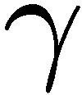
String theory on AdS₅ x S⁵
Coset sigma model
Metsaev,Tseytlin;Bena,Polchinski,Roiban;
Kazakov,Marshakov,Minahan,Zarembo
Infinitely many integrals of motion!
Encoded in monodromy matrix
on E.O.M.

Slide 9
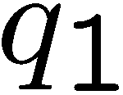
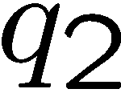
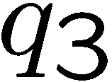
Classical spectral curve
Eigenvalues are integrals of motion

Slide 10
QSC may be viewed as a quantum version
of the classical algebraic curve
But also has clear algebraic origins

Slide 11
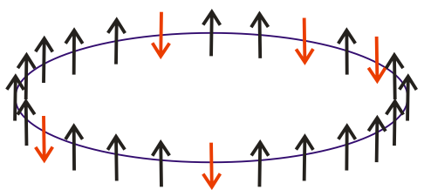
Integrability at weak coupling
in adjoint of
,
is fixed – ‘t Hooft coupling
Theory is conformal
e.g.
+ permutations
At 1 loop – eigenvalues of
integrable XXX spin chain!
Minahan, Zarembo 2002

Slide 12
Q-functions for the XXX spin chain
Two polynomial Q-functions:
QQ-relation:
Polynomiality
QQ-relation
Bethe equations!
What are the analytical properties in AdS/CFT ?

Slide 13
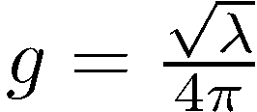
Q-functions in AdS/CFT
Gromov,Kazakov,
Leurent,Volin 2013
Basis of 4+4 functions and
Charges in S⁵ are integer
Charges in AdS₅ contain anom.dimension

Slide 14
-system
Gromov,Kazakov,
Leurent,Volin 2013
The system reduced to 4+6 functions:
Analytical continuation to the next sheet:
-system
is a closed system of equations!
in simplest cases

Slide 15
Relation to classical curve
In the classical limit

Slide 16
Numerical solution
Gromov,FLM,Sizov 2015

Slide 17
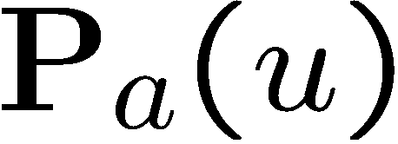
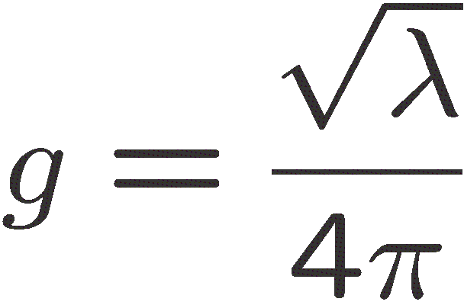
QSC and P-functions
For any state all Q-functions can be built using
charges
Marboe,Volin 2014
(and similarly for )
are the main parameters
in our numerics

Slide 18
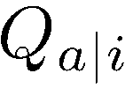
From P to Q
are analogs of related to AdS₅ instead of S⁵
Then

Slide 19
Constructing
We need for
Large u expansion:
This is a good approximation
for large Im u
Then we use the exact equation
to decrease Im u !

Slide 20
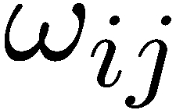
Closing the equations
Remains only to fix
Can reduce the QSC equations even further!
or are not needed
Gromov,FLM,Sizov 2015
E.g. for enough to require
Standard optimization problem – solved by an analog of Newton’s method

Slide 21
Examples

Slide 22
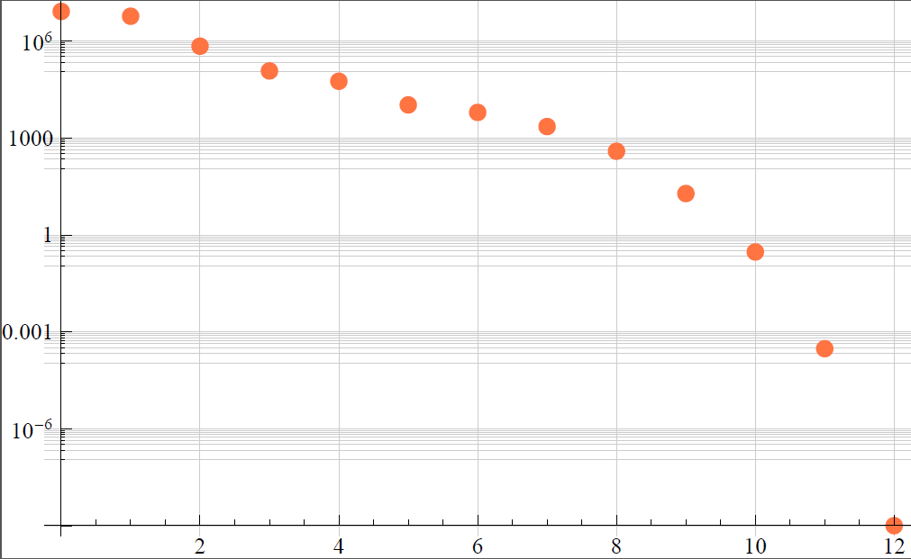
Convergence
Konishi operator, g=0.2
at n-th iteration
Took 30 sec on a 3GHz
Intel i7 processor

Slide 23
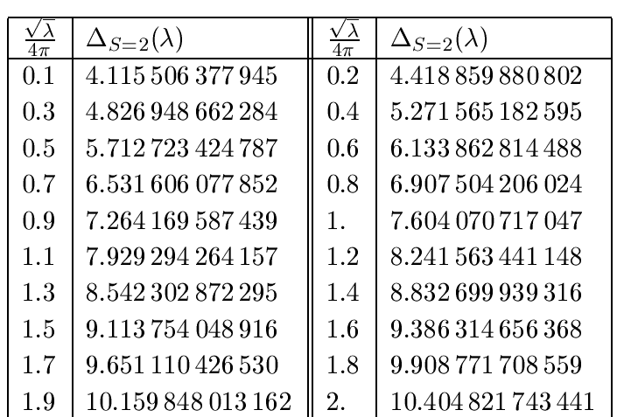
Konishi anomalous dimension
… up to g=5
Matches previous data from TBA,
much higher precision and larger g
Gromov,Kazakov,Vieira 2009
Frolov 2010
Frolov 2012

Slide 24
Examples: non-integer spin

Slide 25
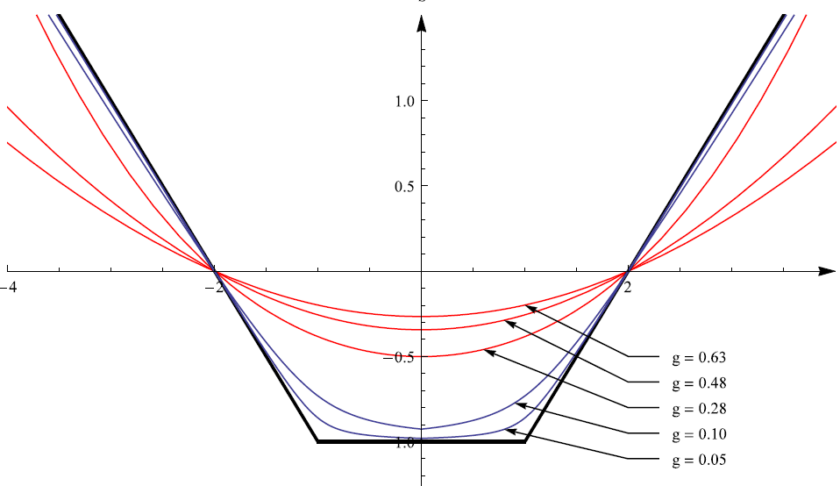
Exploring non-integer S
weak or strong
coupling expansions
BFKL regime

Slide 26
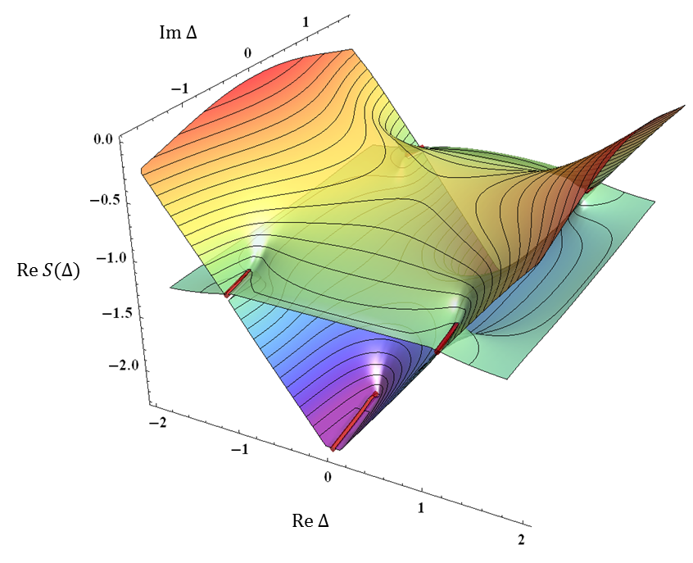
Analytic structure at finite coupling
Gromov,FLM,Sizov 2015
Can also explore e.g. analytic continuation to complexified coupling

Slide 27
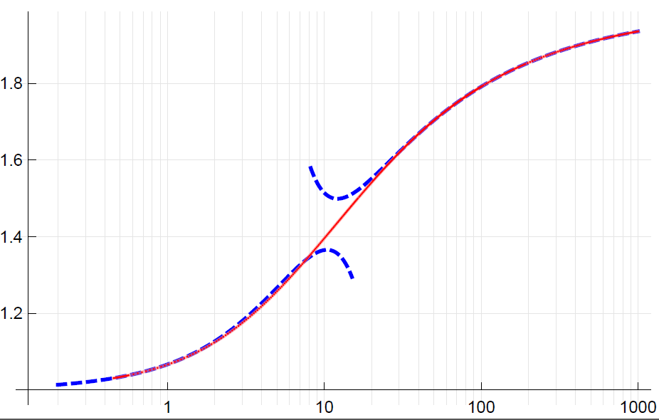
BFKL pomeron intercept
Gromov,FLM,Sizov 2015
strong coupling
Costa,Goncalves,Penedones 2012
Kotikov,Lipatov 2013
Brower,Costa,Djuric,Raben,Tan 2013
Gromov,FLM,Sizov 2014
numerics
weak coupling
Kotikov,Lipatov 2002
Brower,Polchinski,Strassler,Tan 2007

Slide 28
Gromov,FLM,Sizov 2015
BFKL at
Next-to-Next-to-Leading Order

Slide 29
BFKL regime
Resums contributions from all loop orders
N=4 SYM should give highest transcendentality part of the QCD result !
Costa,Goncalves,Penedones 2012
Leading
order
Jaroszewicz, 1982
Lipatov 1986
Kotikov,Lipatov 2002
Reproduced from QSC in
[Alfimov,Gromov,Kazakov 2014]

Slide 30
BFKL regime
Leading
order
Jaroszewicz, 1982
Lipatov 1986
Kotikov,Lipatov 2002
NLO
Kotikov,Lipatov 2002
Kotikov,Lipatov 2000
NNLO
Main assumption: only harmonic sums + max transcendentality at each order

Slide 31
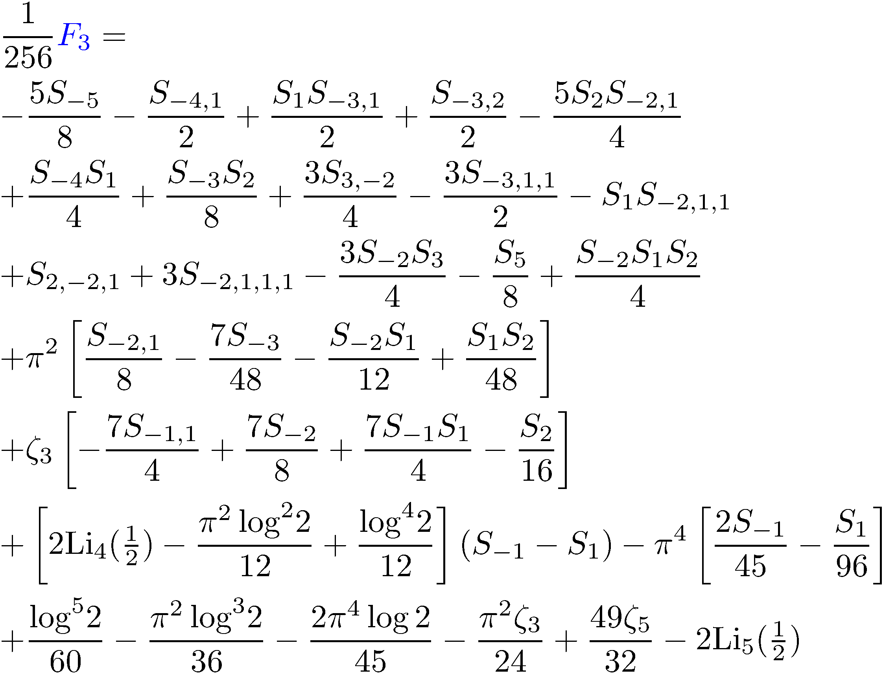
Our result: BFKL at NNLO
Gromov,FLM,Sizov 2015
Found from
iterative solution of QSC
See also later paper of
Velizhanin 2015

Slide 32
Basis for NNLO
Each term has transcendentality 5
harmonic sums with transcendentality up to 5, and constants:
In total 288 elements
We derive analytic constraints from QSC
for expansion around poles at

Slide 33
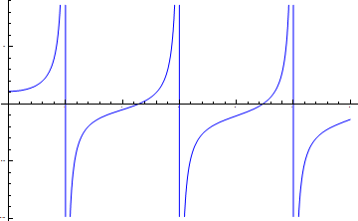
Expansion at poles
usual perturbation theory
(known to 6 loops)
50
Marboe,Velizhanin,Volin 2014; Lukowski,Rej,Velizhanin 2009;…
1
2
3
4
5
-50
P’s at LO are known,
Alfimov,Gromov
Kazakov 2014
Q’s are easy to find
-100
Then we solve
iteratively in and
Developed a very general iterative method
Key ansatz:
We get a first order FDE

Slide 34
For example around to the leading order:

Slide 35
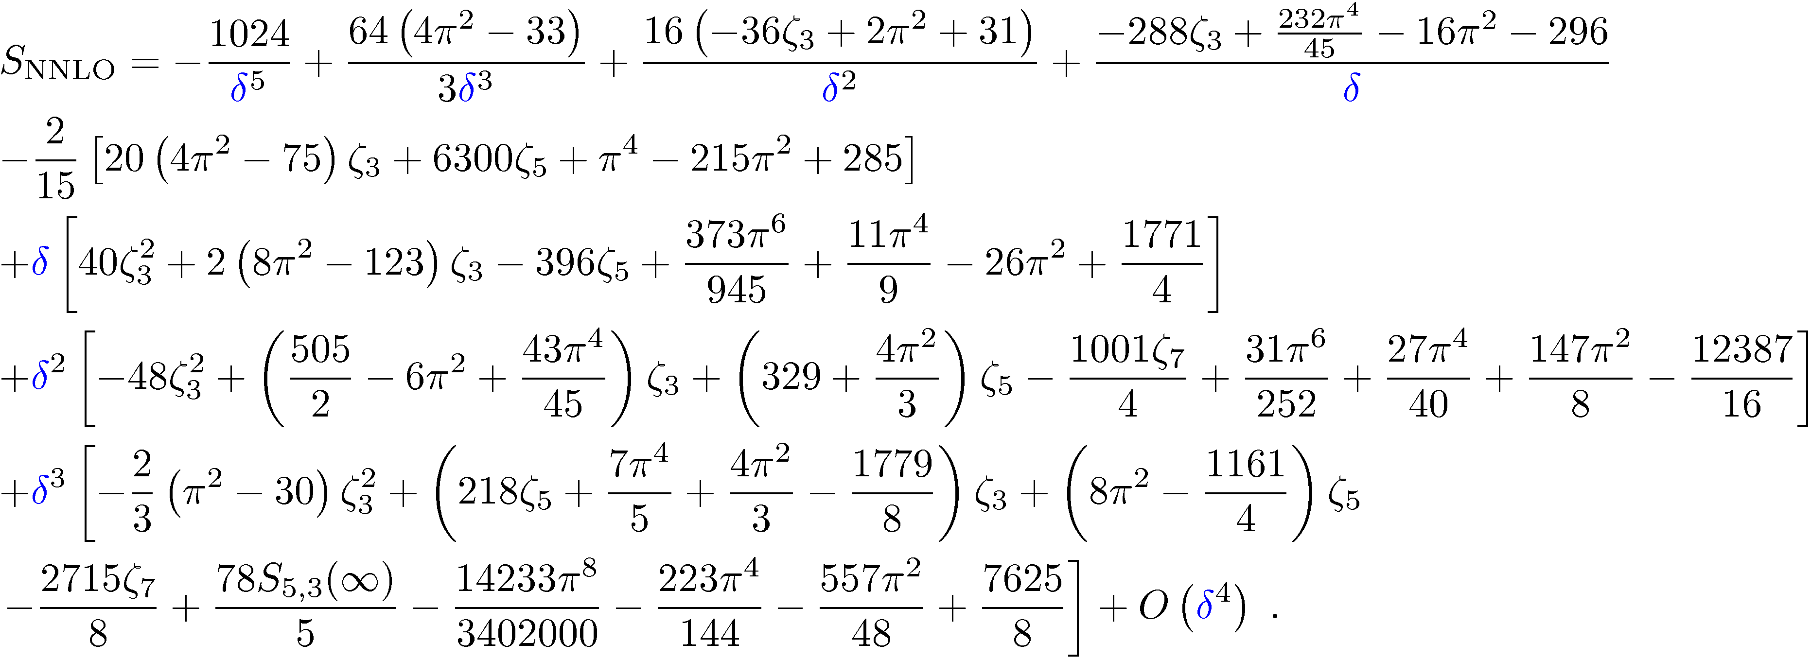
E.g. close to we get the expansion
Get an overdetermined set of equations
on coefficients of basis elements
the result
Only 37 out of 288 coefficients are nonzero!

Slide 36
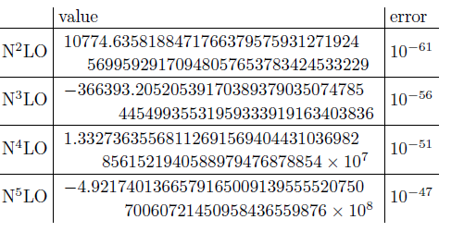
Numerical test
At and
computed NNLO by fitting
our numerical data
Reached 60 digits precision – perfect match with our analytic result !

Slide 37
Extension to
generalized quark-antiquark potential

Slide 38
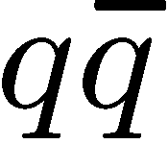
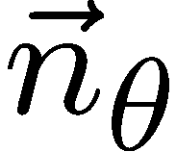
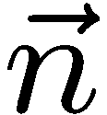
Cusped Wilson line in N=4 SYM
equivalent to generalized
potential
Parameters:
Cusp angle
Angle between the couplings to scalars on two rays
The number of scalars inserted
‘t Hooft coupling

Slide 39
QSC for the generalized cusp
TBA QSC
Correa,Maldacena,Sever 2012
Drukker 2012
Gromov,FLM
2015
encode and angles
A test: near-BPS expansion
Correa,Henn,Maldacena,Sever 12
Fiol,Garolera,Lewkowycz 12
Gromov,Sever 12;
Gromov, FLM, Sizov 13
Gromov, FLM 2015
Any coupling!
See also Kazakov, Leurent, Volin 2015

Slide 40
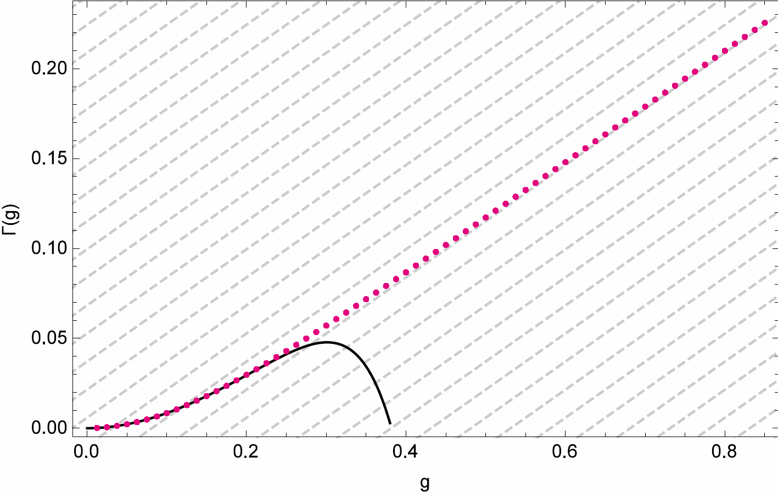
From weak to strong coupling
Gromov, FLM 2015
numerics
classical
strings
Drukker, Forini 2011
…
4-loop gauge theory
Drukker, Forini 2011
Correa, Henn, Maldacena, Sever 2012
Henn, Huber 2013
Perfect match with known results!

Slide 41
Summary
Very precise numerical method to compute the spectrum
New analytic result for NNLO BFKL
QSC for the generalized quark-antiquark potential
Future
BFKL at N³LO, structure of general term?
Systematic strong coupling expansion
3-point functions from relation with Sklyanin’s SOV
ABJM theory, q-deformation, boundary problems…

Slide 43
Extra slides

Slide 44
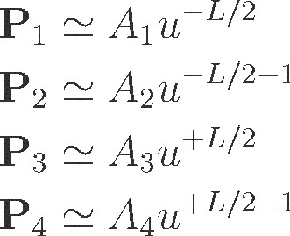
The energy from Pμ-system
E.g. for twist operators
(where )

Slide 45
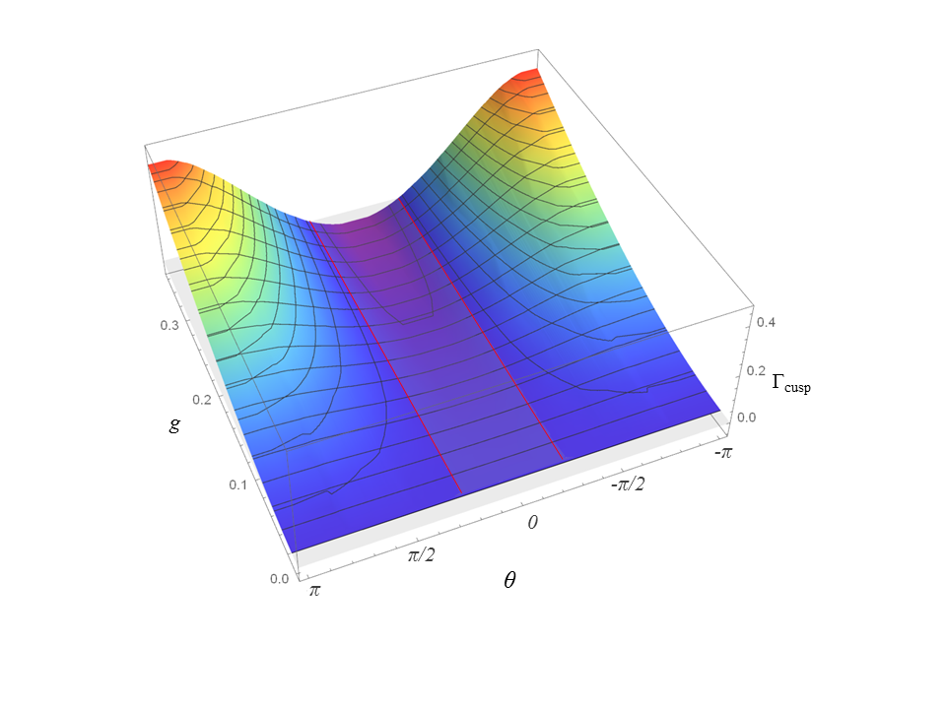
Numerics at generic angles
BPS regime
~800 data points

