Slide 1
SAND: Feature Learning via Hierarchical Context Aggregation
{jaime.spencer, r.bowden, s.hadfield}@surrey.ac.uk
Jaime Spencer | Richard Bowden | Simon Hadfield

Slide 2
Introduction
Takeaway Message
Scale-Adaptive Neural Dense Features
Learnt feature vector representation for every image pixel
Restricting negative sampling range leads to different feature properties
Scale-Adaptive
Global Mining
Local Mining
Notes:
SAND, of course, is an acronym for Scale Adaptive Neural Dense features
At it’s core, it’s a dense feature extractor, meaning that for a HxWx3 image we get a HxWxn feature map (Neural Dense)
Instead of randomly sampling, we restrict the area negatives can be sampled from
This makes the features learn different properties which might be useful for different tasks
Furthermore, these mining strategies can be combined and trained simultaneously, in what we call Hierarchical Context Aggregation
These feature are then applied to multiple computer vision tasks, where we can achieve better or comparable performance with less training
And obviously, code is available on GitHub

Slide 3
Introduction
Takeaway Message
Multiple mining strategies can be combined and trained simultaneously
Hierarchical Context Aggregation
Better or comparable performance with little-to-no additional training
Disparity estimation, semantic segmentation
Self-localisation, SLAM
Code available: https://github.com/jspenmar/SAND_features
Notes:
SAND, of course, is an acronym for Scale Adaptive Neural Dense features
At it’s core, it’s a dense feature extractor, meaning that for a HxWx3 image we get a HxWxn feature map (Neural Dense)
Instead of randomly sampling, we restrict the area negatives can be sampled from
This makes the features learn different properties which might be useful for different tasks
Furthermore, these mining strategies can be combined and trained simultaneously, in what we call Hierarchical Context Aggregation
These feature are then applied to multiple computer vision tasks, where we can achieve better or comparable performance with less training
And obviously, code is available on GitHub

Slide 4
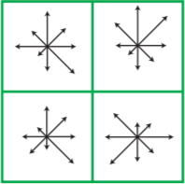
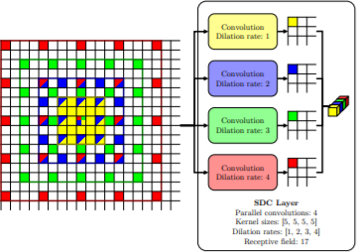
Introduction
Related Work
Hand-crafted features
SIFT, ORB, SURF
Holistic image representations
VLAD, NetVLAD
Feature detection & description
Salti et al. [1]
Georgakis et al. [2]
D2 Net (CVPR19)
Dense features representation
Schmidt et al. [3]
SDC Net (CVPR19)
Notes:
Classical hand-crafted features such as SIFT, ORB, SURF
Obviously still perform well, ORB-SLAM, but limited in representation power
Other approaches learn a single feature representation for a whole image.
Mainly used in image retrieval tasks, person re-identification, loop closure
Other deep learning tries to learn keypoint extraction and/or representation
Notable mention to D2 Net (also CVPR), which uses a describe-then-detect for localisation
More related to our work, we have other feature representations
Schmidt et al, pixel-wise version of contrastive loss
SDC Net (also CVPR), dilated convolutions. Focuses on architecture, sampling is still just random

Slide 5
Introduction
Overview
Notes:
First we train features based on the target negative mining
We show the different properties learnt
Apply to various tasks, in further end-to-end learning
Finally, direct replacement for ORB in SLAM

Slide 6
SAND Feature Extraction
Architecture
Feature extraction ➢ Mapping function
Dense ➢ Fully Convolutional Network
Multiple scales ➢ Spatial Pooling Pyramid
Notes:
As I mentioned before, SAND converts an image into a dense n-dimensional feature map
The architecture used is a standard fully convolutional encoder-decoder, where the final encoder layer has multiple pooling scales

Slide 7
Hierarchical Context Aggregation
Introduction
Training data from ground truth correspondences between pairs of images
Pixel-wise contrastive loss
Positive pairs are fixed by the ground truth
What about the negatives?
Notes:
In order to train this network, we use ground truth correspondences between pairs of images
We use a pixel-wise version of contrastive loss.
Basis of contrastive loss is matching features as close as possible, non-matching pairs separated by at least the margin
As you can imagine, the set of positive matches is limited by the ground truth
But this leaves an open question about the negatives

Slide 8
Hierarchical Context Aggregation
Targeted Negative Mining
Each correspondence has potential negatives
Base case ➢ Random sampling
Instead draw negatives within lower and higher bounds
This defines the scale, i.e. area of uniqueness for the feature
(0, 25)
Local
(0,∞)
Global
Notes:
Each match has almost a full image of potential negative matches, so how do we choose them?
In the base case, we could just randomly sample from the whole image.
Instead, we propose to restrict this to a minimum and maximum distance, which determines where the feature is required to be unique
Bottom left is the case where we restrict the max to a 25 pix radius

Slide 9
Hierarchical Context Aggregation
Hierarchical Context Aggregation
What if our task requires more complicated features?
Scales can be combined by “splitting” the feature map and providing each section with different negative mining strategies
Notes:
As

Slide 10
Results
Visualizations
Features can be projected onto the RGB cube via PCA for visualization
Global features group semantically similar objects
Local features outline the texture and edges in the image

Slide 11
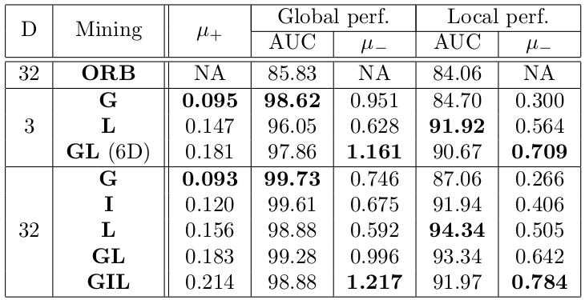
Results
Distance Distributions
Trained on a subset of Kitti Odometry 00
Global (whole image), Local (25 pix.) & Intermediate (75 pix.)
`
Average
non-matches distance
Average matches distance
`
`
Notes:
mu+: Mean distance for matching pairs (lower is better)
mu-: Mean distance for non-matching pairs (higher is better)
AUC: Expectation that a true match will have lower distance than an incorrect match

Slide 12
Applications
Introduction
Okay, but what can I actually use these features for?
Disparity Estimation ➢ Narrow baseline matching
Semantic Segmentation ➢ End-to-end learning
Self-Localisation ➢ Wide baselines
SLAM ➢ Sparse feature matching & tracking
Objective is to introduce SAND into a pre-existing system and improve performance with little-to-no additional training

Slide 13
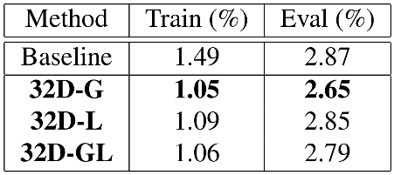
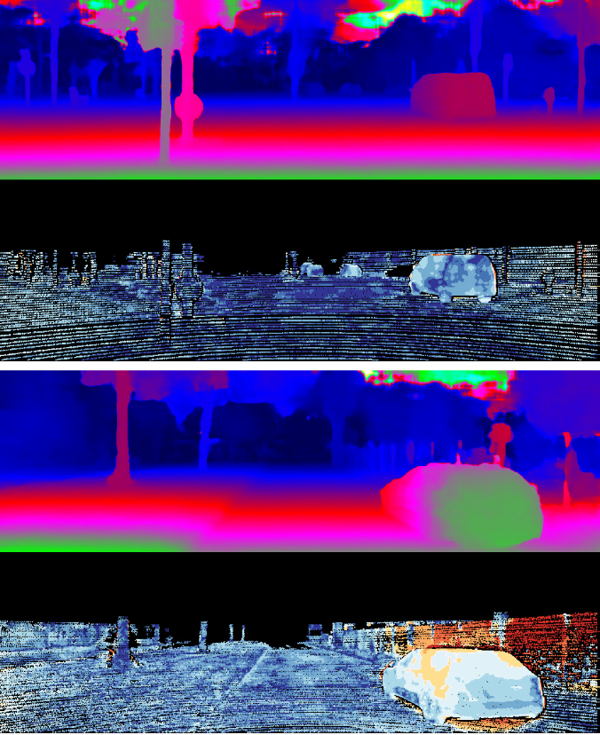
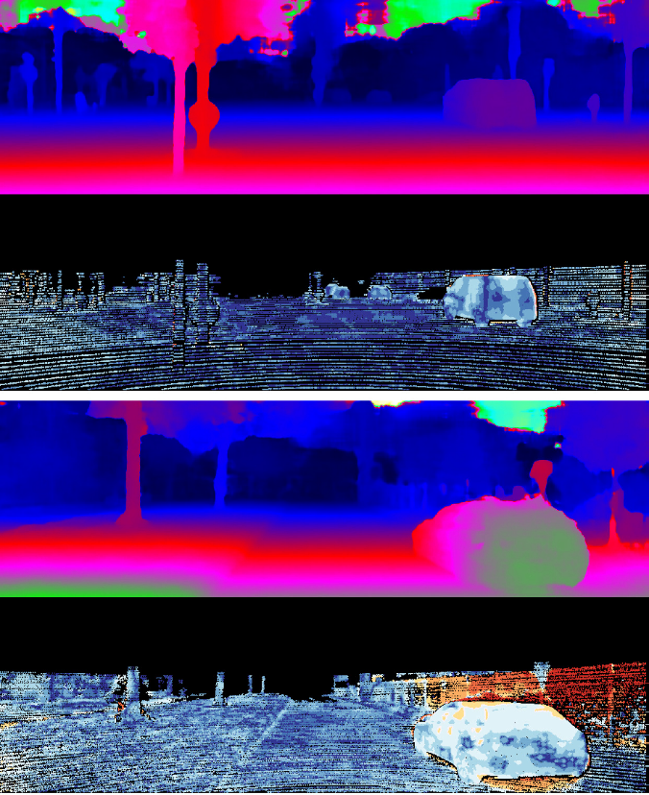
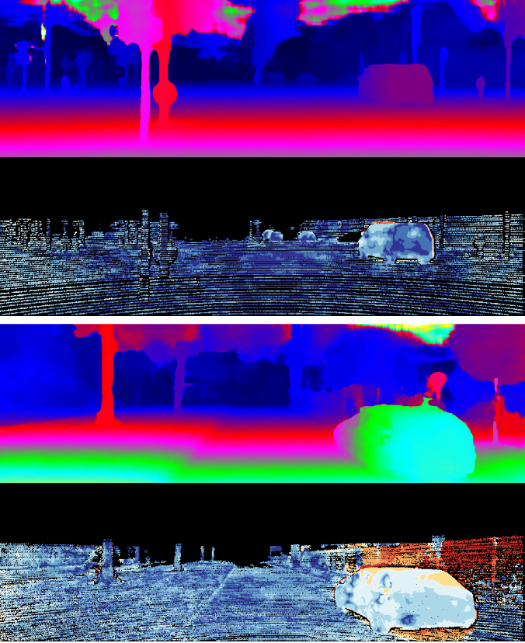
Applications
Disparity Estimation
Focus: Narrow baseline matching/end-to-end learning
Method: Replace input image in PSMNet [4]
Baseline
32D - Global
32D - Local

Slide 14
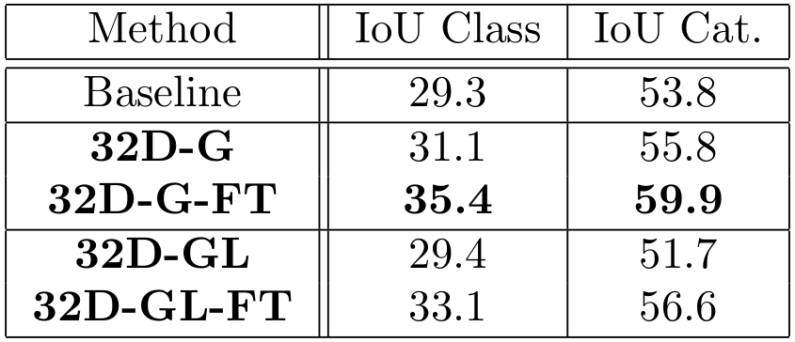
Applications
Semantic Segmentation
Focus: Implicit feature extraction/end-to-end learning
Method: Cost matching volume, as disparity
Baseline
32D - G
32D - GL

Slide 15
Applications
Self-localisation
Focus: Wide baselines and revisitations
Method: Replace input image in PoseNet [5]
Position (m)
Rotation (deg/m)

Slide 16
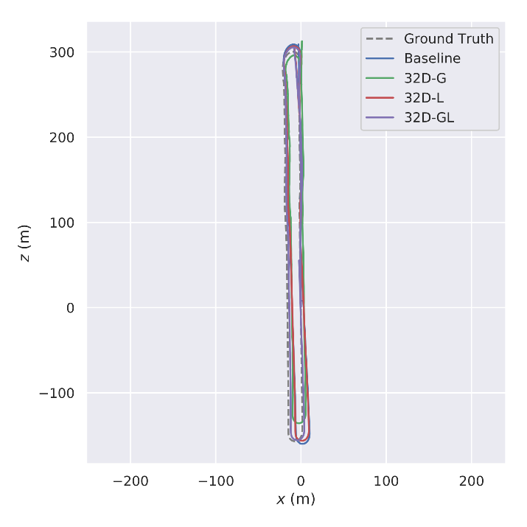
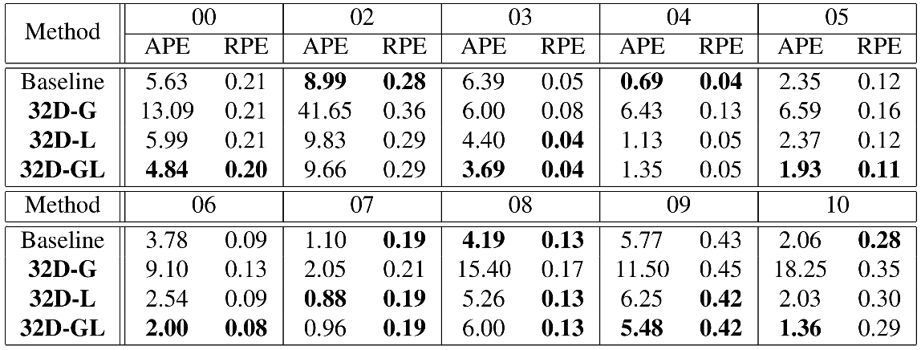
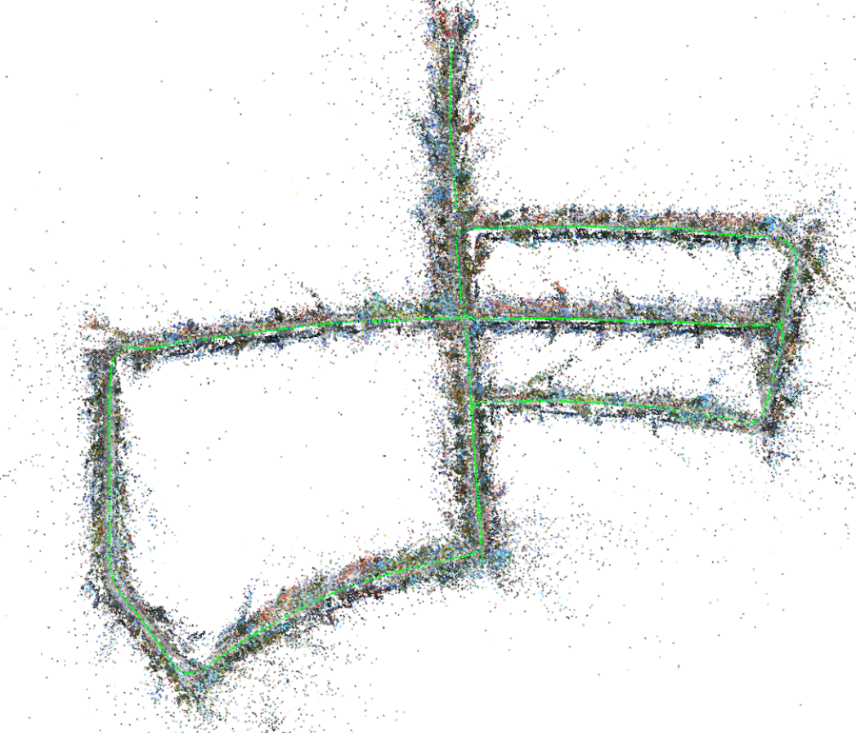
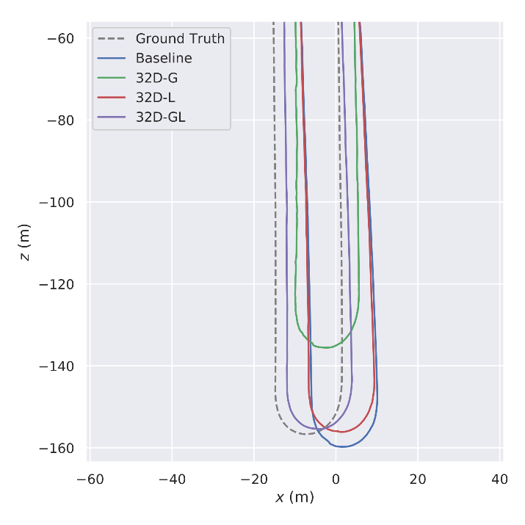
Applications
SLAM
Focus: Sparse feature matching
Method: Drop-in replacement for ORB features in S-PTAM [6]
Average Pose Error (VO + LC)
Relative Pose Error (VO)
06 - Full
05 - Map
06 - Detail

Slide 17
Conclusions & Future Work
Conclusion
We introduce SAND, a framework for generic dense feature learning
The novel targeted negative mining allows for the combination of information at multiple scales
We apply these to a wide range of problems
Wide or narrow baseline matching
End-to-end learning approaches
Sparse feature matching

Slide 18
Conclusions & Future Work
Future Work
Additional feature properties (e.g. seasonal invariance)
Learning sampling scales depending on the final tasks
Explore unsupervised approaches
Train with larger amounts of data

Slide 19
References
[1] S. Salti, F. Tombari, R. Spezialetti, and L. D. Stefano. Learning a descriptor-specific 3D keypoint detector. In Proceedings of the IEEE International Conference on Computer Vision, volume 2015 Inter, pages 2318–2326. IEEE, dec 2015.
[2] G. Georgakis, S. Karanam, Z. Wu, J. Ernst, and J. Kosecka. End-to-end learning of keypoint detector and descriptor for pose invariant 3D matching. CVPR 2018.
[3] T. Schmidt, R. Newcombe, and D. Fox. Self-Supervised Visual Descriptor Learning for Dense Correspondence. IEEE Robotics and Automation Letters, 2(2):420–427, 2017. 2, 3
[4] J.-R. Chang and Y.-S. Chen. Pyramid Stereo Matching Network. CVPR 2018.
[5] A. Kendall, M. Grimes, and R. Cipolla. PoseNet: A convolutional network for real-time 6-dof camera relocalization. In
Proceedings of the IEEE International Conference on Computer Vision, volume 2015 Inter, pages 2938–2946, 2015.
[6] T. Pire, T. Fischer, G. Castro, P. De Crist´oforis, J. Civera and J. Jacobo Berlles. S-PTAM: Stereo Parallel Tracking and Mapping. Robotics and Autonomous Systems, 93:27–42, jul 2017. 2, 7
[7] https://www.youtube.com/watch?v=4SmJP8TdWTU

Slide 20
Questions?

